Slide 1
New ECE 574 class about Embedded Systems
Marek Perkowski
October 3, 2008
Graduate Seminar of ECE PSU

Slide 2
Embedded System Design Using FPGAs and GPUs – ECE 574
Marek Perkowski
The talk presents some material that I teach in ECE 574 class as well as projects from this class.
We discuss how the typical embedded systems used especialy in robotics are designed from high level specifications.
These systems include robot vision based on Fast Fourier Transform, image matching, convolution and filtering.
Another typical image processing application is Hough Transform which we present together with some applications.
The talk will present also Embedded Systems applications in robot control and problem solving.
New specification methods and CAD software will be discussed as well as few complex FPGA systems built by my students in their projects in last few years.

Slide 3
Project based class
Graduate class - no prerequisities
C/C++ welcome, but not mandatory
Verilog/VHDL welcome, but not mandatory.
FPGA – Field Programmable Gate Arrays.
Spectral transforms
Robot Vision – tracking, face recognition.
GPU – Graphic Processing Unit
Constraint-Satisfaction programming – Orion.
Real world interface

Slide 4
Three new great platforms for projects
Graphic Processing Unit (GPU) based low cost supercomputers
Tetrix robotic kit with sensors, communication and actuators.
Quantum computer - First in the world, Orion from DWAVE, Vancouver, BC, Canada

Slide 5
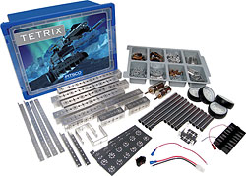
Tetrix Robot Kit from Pitsco
TETRIX™, a complete design system for students who are serious about robotics.
Used in commercial companies for robot and embedded systems prototyping.
TETRIX is also the official building system of the FIRST Tech Challenge.
Our robot team will participate for year 2008/2009.
To learn more about this competition, visit www.usfirst.org.
You are welcome to join.

Slide 6
TETRIX by PITSCO
Developed for use in high schools
TETRIX is a revolutionary new metal building system
designed by Pitsco, Inc.
sold by LEGO® Education.
A unique LEGO connector joins the metal with LEGO elements
use the LEGO NXT Intelligent Brick as the controller.

Slide 7
Tetrix Robot Kit
Featuring heavy-duty aluminum elements for construction of robotic components
Flexible and broad robot design base
All improved: hardware, interface, mechanics and software.
Build a basic square chassis robot base with a remote control
Incorporate other electronics (not included) into design – hundreds of components.
Highly specific autonomous robot.
Designed by Carnegie Mellon University Robotics Department

Slide 8
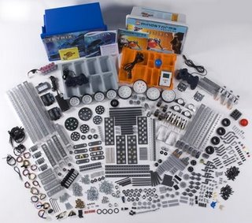
Tetrix Robot Kit
The TETRIX Base Set has 600 parts, including the following:
Brackets and mounts
Structural channel and plates
Structural tubing and hubs
Servos, motors, and accessories
Wheels, gears, and drive train
Hardware and hex keys
Battery holder and connectors
Number of Elements: 600

Slide 9
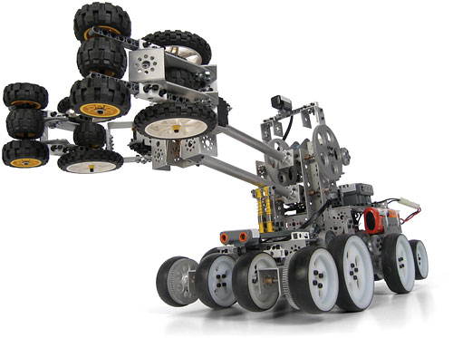
Very high quality, stability, mechanically firm designs.
No comparison in quality with Lego, Vex, Mechano or any other previous robotic kit system.
Also includes a user guide that covers building the basic robot body, wiring and using a remote control, designing gear assemblies, building arm mechanisms and end effectors, and more.

Slide 10
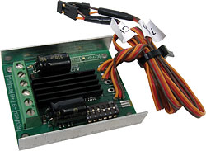
Motors
TETRIX™ DC Motor Speed Controller

Slide 11
Three Systems in one
Lego NXT motors
Servos with controllers
12-volt DC motors with controllers
With the motor controllers that allow the NXT to control the non-LEGO motors, you can have many more than three motors;
by stringing motor controllers together, you can have almost as many motors as you want, provided you have enough batteries.
And in January 2009, robot builders can use the unique TETRIX hole pattern to attach
the LEGO® MINDSTORMS® NXT Intelligent Brick,
sensors,
and any other LEGO® Technic element
to the TETRIX system via a custom connector.

Slide 12
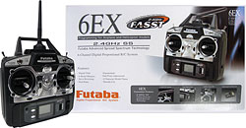
R/C Controller
Get ultimate control of your TETRIX™ robot with this six-channel remote control.
Featuring interference-free performance and a 2.4 GHz system.
This advanced system also includes servo reversing on all six channels.
Unlike the commercial version of this controller, it includes
a receiver,
transmitter with charger,
on/off switch, and battery holder.

Slide 13
Mechanical Design
structural pieces to be connected at many angles, not just 90º and 180º.
the metal gears
tough and flexible.
heavy-duty aluminum
strong drive motors and servos

Slide 14
Growing Up with FIRST
Sixteen years ago, the initial FIRST Robotics Competition took place with 28 teams in a high school gym in New Hampshire. With the unwavering support of corporate sponsors and a global community of teacher, mentor and parent volunteers, FIRST’s four robotics programs now serve more than 150,000 children around the world. Children are eligible for the program at age six, but can enter at any point afterwards and may participate all the way up to high school graduation.
The FIRST Robotics Competition (FRC) combines the excitement of sport with science and technology to create a unique varsity sport for the mind. FRC helps high school students discover the rewarding and engaging process of innovation and engineering by challenging them to work with professional mentors to design and build a robot, and compete in high-intensity events that measure the effectiveness of each robot, the power of team strategy and collaboration, and the determination of students.
The revised FIRST Tech Challenge provides an intermediate robotics competition that offers high-school-aged students the traditional challenge of FRC, but with a more accessible and affordable robotics kit.
Celebrating its tenth anniversary, the FIRST LEGO® League (FLL) asks kids, 9 to 14, to use the LEGO MINDSTORMSTM NXT robotics platform to solve real-world engineering challenges facing today’s scientists. More than 10,600 teams of ten children participated in the 2007 Power Puzzle Challenge.
Junior FIRST LEGO® League (JFLL) introduces kids, 6 to 9, to the wonders of science and technology with a challenge based on the same real-world theme as FLL. FLL and JFLL are a result of a partnership between FIRST and The LEGO Group. Junior FIRST LEGO League (JFLL) is an exciting opportunity for the youngest budding scientists. It encompasses the core concepts of all FIRST programs to inspire, excite, and introduce kids to the wonders of science, technology, and engineering.

Slide 15
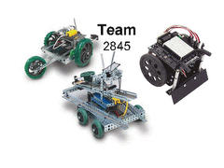
Studies show a distinct link between the use of LEGO Education robotics and the tendency of students to follow science and engineering career paths.
Of the students who participate in FIRST LEGO League, a worldwide LEGO robotics competition, 59% want to pursue careers in science or engineering (“Evaluation of FIRST LEGO League.” Brandeis University, 2004).

Slide 16
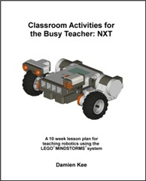
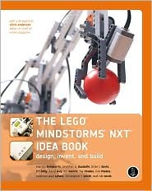
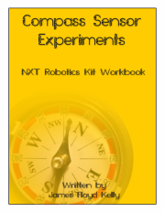
Many books and webpages available for NXT system

Slide 17
Software
LEGO MINDSTORMS Education NXT Software
LabVIEW for FTC
RobotC

Slide 18
LEGO MINDSTORMS Education NXT Base Set
LEGO Touch Sensor (in addition to NXT Base Set sensors)
LEGO Light Sensor (in addition to NXT Base Set sensor)
HiTechnic NXT Compass Sensor
8-Cell AA Battery Holder
12v NiMh 3000 mah Rechargeable Battery
Battery Charger
On/Off Battery Harness
DC gearhead motor shaft encoders
FTC Bluetooth Dongle
Logitech Gaming Controller
HiTechnic DC Motor Controller for TETRIX
HiTechnic Servo Controller for TETRIX
HiTechnic Touch Sensor Multiplexer

Slide 19
ruby-nxt description
Ruby interface for controlling the Lego Mindstorms NXT robotics kit via Bluetooth The ruby-nxt library lets you control the LEGO Mindstorms NXT robotics kit via Bluetooth using the Ruby language. At the moment, ruby-nxt provides low-level access to the protocol as well as some preliminary high-level functionality. There are three interfaces: · High-Level: The NXT class provides multi-threaded, object-oriented interface to the motors, sensors, and most other core NXT functions. · NEW High-Level: The Commands module (included with NXTComm) provides a command object-based interface very similar to the Blocks in NXT-G. (this may replace the NXT class in the future) · Low-Level: The NXTComm class provides direct access to the NXT Bluetooth bytecode protocol. There is also the UltrasonicComm class which implements the I2C communications needed to interact with the ultrasonic sensor (via NXTComm).

Slide 20
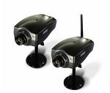
The whole proposed PSU Quantum Robot system
hands
head
PC
Personal computer
Bluetooth connection
GPU supercomputer

Slide 21
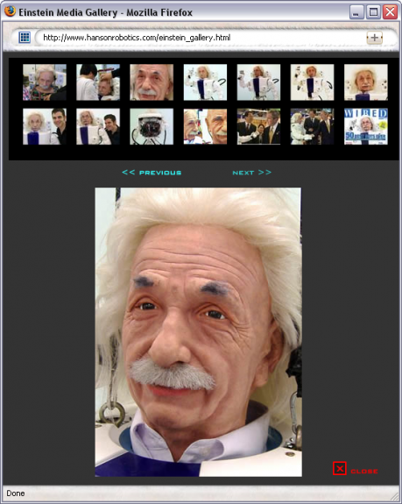
This generic situation, where the robot’s behavior is conditioned upon the input from the feature detectors connected to the camera, maps to a constraint satisfaction problem as described here.
The way this would work is that the human / camera / robot system would generate optimization and satisfiability problems, to determine how the robot’s effectors should fire, and these problems can be remotely solved using Orion.
For example, you could acquire a Hansen Robotics Einstein, sit it him on your desk, train a camera on your face, use an anger feature detector that causes the Einstein robot to laugh harder the angrier you get.

