Slide 1
Marek Perkowski
INTRODUCTION TO
MODAL AND EPISTEMIC LOGIC for beginners

Slide 2
Overview
Why we need moral robots
Review of classical Logic
The Muddy Children Logic Puzzle
The partition model of knowledge
Introduction to modal logic
The S5 axioms
Common knowledge
Applications to robotics
Knowledge and belief

Slide 3
The goals of this series of lectures
My goal is to teach you everything about modal logic, deontic logic, temporal logic, proof methods etc that can be used in the following areas of innovative research:
Robot morality (assistive robots, medical robots, military robots)
Natural language processing (robot assistant, robot-receptionist)
Mobile robot path planning (in difficult “game like” dynamically changeable environments)
General planning, scheduling and allocation (many practical problems in logistics, industrial, military and other areas)
Hardware and software verification (of Verilog or VHDL codes)
Verifying laws and sets of rules (like consistency of divorce laws in Poland)
Analytic philosophy (like proving God’ Existence, free will, the problem of evil, etc)
Many other…
At this point I should ask all students to give another examples of similar problems that they want to solve

Slide 4
Big hopes
Modal logic is a very hot topic in recent ~12 years.
In my memory I see new and new areas that are taken over by modal logic
Let us hope to find more applications
Every problem that was formulated or not previously in classical logic, Bayesian logic, Hiden Markov models, automata, etc can be now rewritten to modal logic.

Slide 5
The Tokyo University of Science: Saya
Morality for non-military robots that deal directly with humans.
At this point I should ask all students to give another examples of dialogs, that would include reasoning, to have with Saya

Slide 6
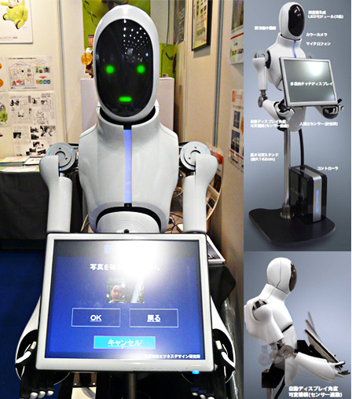
MechaDroyd Typ C3 Business Design, Japan
At this point I should ask all students to give another examples of dialogs, that would include reasoning, to have with MechaDroyd

Slide 7
My Spoon – Secom in Japan http://www.secom.co.jp/english/myspoon/index.html

Slide 8
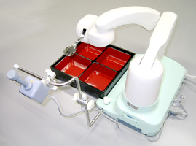
My Spoon – Secom
At this point I should ask all students to give examples of robots to help elderly, autistic children or handicapped and what kind of morality or deep knowledge this robot should have.
Example, a robot for old woman, 95 years old who cannot find anything on internet and is interested in fashion and gossip.

Slide 9
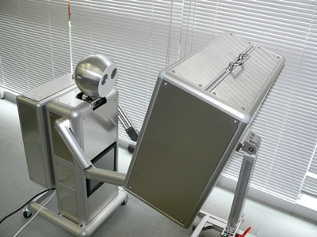
Robot IPS

Slide 10
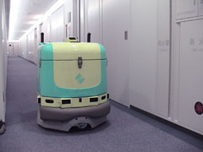
Fuji Heavy Industries/Sumitomo
Cleaning lawn-moving, and similar robots will have contact with humans and should be completely safe
What kind of deep knowledge and morality a robot should have for standard large US hospital?

Slide 11
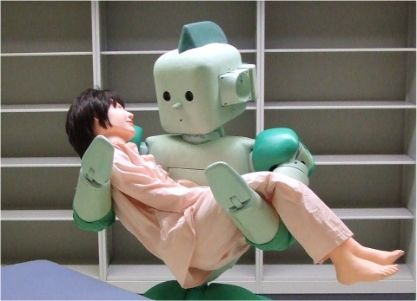
Care robot
How much trust you need to be in arms of a strong big robot like this?
How to build this trust?
What kind morality you would expect from this robot?

Slide 12
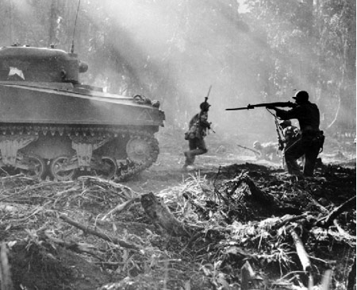
Robots and War
Congress: one-third of all combat vehicles to be robots by 2015
Future Combat System (FCS) Development cost by 2014: $130-$250 billion

Slide 13
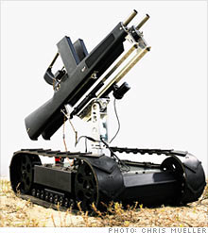
Robotex (Palo Alto, California) by Terry Izumi
We urgently need robot morality for military robots
It is expected that these robots will be more moral than contemporary US soldiers in case of accidental shootings of civilians, avoiding panic behaviors, etc

Slide 15
Review of classical logic

Slide 16
Classical logic
What is logic?
A set of techniques for
representing,
transforming,
and using information.
What is classical logic?
A particular kind of logic that has been well understood since ancient times.
(Details to follow…)

Slide 17
Classical vs non-classcial logic
I should warn you that non-classical logic is not as weird as you may think.
I’m not going to introduce “new ways of thinking” that lead to bizarre beliefs.
What I want to do is make explicit some non-classical ways of reasoning that people have always found useful.
I will be presenting well-accepted research results, not anything novel or controversial.

Slide 18
Classical logic in Ancient times
300s B.C.:
ARISTOTLE and other Greek philosophers discover that
some methods of reasoning are truth-preserving.
That is, if the premises are true, the conclusion is guaranteed true, regardless of what the premises are.

Slide 19
Example of Classical logic Syllogism
All hedgehogs are spiny.
Matilda is a hedgehog.
∴ Matilda is spiny.
You do not have to know the meanings of “hedgehog” or “spiny” or know anything about Matilda in order to know that this is a valid argument.

Slide 20
What Classical logic can really do?
VALID means TRUTH-PRESERVING.
Logic cannot tell us whether the premises are true.
The most that logic can do is tell us that IF the premises are true, THEN the conclusions must also be true.

Slide 21
Classical logic since 1854
1854:
George Boole points out that
inferences can be represented as formulas and
there is an infinite number of valid inference schemas.
(∀x) hedgehog(x) ⊃ spiny(x)
hedgehog(Matilda)
∴ spiny(Matilda)
Proving theorems (i.e., proving inferences valid)
is done by manipulating formulas.

Slide 22
What is an argument?
An argument is any set of statements one of which, the conclusion, is supposed to be epistemically supported by the remaining statements, the premises.

Slide 23
Is this an argument?
Ms. Malaprop left her house this morning.
Whenever she does this, it rains. _____________
Therefore, the moon is made of blue cheese.

Slide 24
What is a good argument?
An argument is valid if and only if the conclusion must be true, given the truth of the premises.

Slide 25
Is this argument valid?
If the moon is made of blue cheese, then pigs fly.
The moon is made of blue cheese. ______________
Therefore, pigs fly.

Slide 26
What we aim for
An argument is sound if and only if the argument is valid and, in addition, all of its premises are true.

Slide 27
Logical Negation
Consider the following sentences
“2 plus 2 is 4” is true
“2 plus 2 isn’t 4” is false
“2 plus 2 is 5” is false
“2 plus 2 isn’t 5” is true

Slide 28
Truth Table for Negation
p | not p
True (T) | False (F)
False (F) | True (T)

Slide 29
Definition of Logical Negation
A sentence of the form “not-p” is true if and only if p is false; otherwise, it is false.
So logically speaking negation has the effect of switching the truth-value of any sentence in which it occurs.

Slide 30
Other English phrases
That claim is irrelevant
Your work is unsatisfactory
It is not true that I goofed off all summer.

Slide 31
Logical Connectives
Technically, negation is a one-place logical connective, meaning that negation combines with a single sentence to produce a more complex sentence having the opposite truth-value as the original.

Slide 32
The Material Conditional
The material conditional is most naturally represented by the English phrase “if … , then ...”.
For example, “If you study hard in this class, you will do well.”

Slide 33
Truth Table for the Conditional
p | q | If p, then q
T | T | T
T | F | F
F | T | T
F | F | T

Slide 34
Definition of the Conditional
A sentence of the form “if p, then q” is true if and only if either p is false or q is true; otherwise it is false.

Slide 35
Some More Jargon
Technically, “if …, then …” is a two-place sentential connective: it takes two simpler sentences and connects them into a single, more complex sentence.
The first sentence p is called the antecedent. The second sentence q is called the consequent.

Slide 36
Conjunction
Which of the following are true?
2 + 2 = 4 and 4 + 4 = 8.
2 + 2 = 5 and 4 + 4 = 6.
2 + 2 = 4 and 4 + 4 = 7.
2 + 2 = 5 and 4 + 4 = 8.

Slide 37
Truth Table for Conjunction
p | q | p and q
T | T | T
T | F | F
F | T | F
F | F | F

Slide 38
Definition of Conjunction
A sentence of the form “p and q” is true if and only if p is true and q is true; otherwise it is false.
The two sentences p and q are known as the conjuncts.

Slide 39
Inclusive “Or” (Disjunction)
Example
Marion Jones is worried that she is not going to win a medal in the ’04 Olympic games. Her husband assures her that she will surely place in one of the two events she has qualified for: ‘It’s ok,’ he says. “Either you’ll medal in the long jump or in the 400m relay.”

Slide 40
Truth Table for Disjunction
p | q | p or q
T | T | T
T | F | T
F | T | T
F | F | F

Slide 41
Definition of Disjunction
A sentence of the form “p or q” is true if and only if either p is true or q is true or both p and q are true; otherwise, it is is false.
The two sentences p and q are knows as the disjuncts.

Slide 42
Exclusive “Or”
Suppose your waiter tells you that you can have either rice pilaf or baked potato with your dinner. In such circumstances, he plainly does not mean either rice pilaf or baked potato or both. You have to choose. So this use of “or” doesn’t fit the definition of disjunction given above.

Slide 43
Defining Exclusive “Or”
Rather than introducing exclusive “or” via a truth table, logicians usually just define it in terms of negation, conjunction and disjunction:
(p or q) and not-(p and q)

Slide 44
Material Biconditional
Sometimes we want to say that two sentences are equivalent―that is they are both true or false together.
For instance, I might tell you that John is a bachelor if and only if John is an unmarried adult male.

Slide 45
Truth Table for the Biconditional
p | q | p if and only if q
T | T | T
T | F | F
F | T | F
F | F | T

Slide 46
Defining the Biconditional
A sentence of the form “p if and only if q” is true if and only if either both p and q are true or both p and q are false; otherwise, it is false.
Alternatively:
p if and only if q = (if p, then q) and (if q, then p)

Slide 47
Logic, Knowledge Bases and Agents

Slide 48
Syntax versus semantics

Slide 49
What does it mean that there are many logics?

Slide 50
Types of Logic

Slide 51
Review of classical propositional logic
Basic concepts, methods and terminology that will be our base in modal and other logics

Slide 52
Propositional logic is the logic from ECE 171
Simple and easy to understand
Decidable, but NP complete
Very well studied; efficient SAT solvers
if you can reduce your problem to SAT …
Drawback
can only model finite domains

Slide 53
Truth Table Method and Propositional Proofs

Slide 54
Deduction
In deduction, the conclusion is true whenever the premises are true.
Premise: p
Conclusion: (p ∨ q)
Premise: p
Non-Conclusion: (p ∧ q)
Premises: p, q
Conclusion: (p ∧ q)

Slide 55
Logical Entailment

Slide 56
Logical Entailment
A set of premises Δ logically entails a conclusion ϕ (written as Δ |= ϕ) if and only if every interpretation that satisfies the premises also satisfies the conclusion.
Examples
{p} |= (p ∨ q) entails
{p} |# (p ∧ q) does not entail
{p,q} |= (p ∧ q) entails

Slide 57
Comment on defining
A set of premises Δ logically entails a conclusion ϕ (written as Δ |= ϕ) if and only if every interpretation that satisfies the premises also satisfies the conclusion.
This definition raised some doubt in class
But it is only the way how we define things in metalanguage
I can write like this
A set of premises Δ logically entails a conclusion ϕ (written as Δ |= ϕ)
=def=
every interpretation that satisfies the premises also satisfies the conclusion.

Slide 58
Comment on defining in Meta-Language
A set of premises Δ logically entails a conclusion ϕ (written as Δ |= ϕ)
if
every interpretation that satisfies the premises also satisfies the conclusion.
And
When
every interpretation that satisfies the premises also satisfies the conclusion
Then
A set of premises Δ logically entails a conclusion ϕ (written as Δ |= ϕ)
This is a way of defining

Slide 59
More on defining
A set of premises Δ logically entails a conclusion ϕ (written as Δ |= ϕ) if and only if every interpretation that satisfies the premises also satisfies the conclusion.
I am not saying
A set of premises Δ logically entails a conclusion ϕ (written as Δ |= ϕ) if and only if every interpretation that satisfies the premises also satisfies the conclusion and every interpretation that satisfies the conclusion also satisfies the premises.
If and only if is in definition, this is equality of metalanguage and equality inside the definition.
Metalanguage is a different beast!

Slide 60
Truth Table Method to check entailment
There are many ways to check entailment. In binary logic it is easy, here is one method. Another is to look to included in set X set S of minterms – ask student.
We can check for logical entailment by comparing tables of all possible interpretations.
In the first table, eliminate all rows that do not satisfy premises.
In the second table, eliminate all rows that do not satisfy the conclusion.
If the remaining rows in the first table are a subset of the remaining rows in the second table, then the premises logically entail the conclusion.

Slide 61
Example of using Truth Table method to check entailment
Does p logically entail (p ∨ q)?

Slide 62
Example of using Truth Table method. Other method
Does p logically entail (p ∨ q)?
In the first table, eliminate all rows that do not satisfy premises.
In the second table, eliminate all rows that do not satisfy the conclusion.

Slide 63
Example of using Truth Table method. Other method
Does p logically entail (p ∨ q)?
In the first table, eliminate all rows that do not satisfy premises.
In the second table, eliminate all rows that do not satisfy the conclusion.

Slide 64
One more Example: no entailment.
Does p logically entail (p ∧ q)?
Does {p,q} logically entail (p ∧ q)?
NO
Ask a student to show another examples of checking entailment

Slide 65
Example
If Mary loves Pat, then Mary loves Quincy.
If it is Monday, then Mary loves Pat or Quincy.
If it is Monday, does Mary love Quincy?
X10 eliminated
100 eliminated
Conclusion:
It is Monday and Mary loves Quincy
m | p | q
1 | 1 | 1
×1 | ×1 | ×0
1 | 0 | 1
×1 | ×0 | ×0
0 | 1 | 1
×0 | ×1 | ×0
0 | 0 | 1
0 | 0 | 0
m | p | q
1 | 1 | 1
× | × | ×
1 | 0 | 1
× | × | ×
0 | 1 | 1
0 | 1 | 0
0 | 0 | 1
0 | 0 | 0
Is this conclusion true?
First variant:
Entailment true
It is Monday and Mary does not love Quincy eliminated
Yes, Mary Loves Quincy on Monday
Not on Monday Mary does not love Pat and does not love Quincy
We can check for logical entailment by comparing tables of all possible interpretations.
In the first table, eliminate all rows that do not satisfy premises.
In the second table, eliminate all rows that do not satisfy the conclusion.
If the remaining rows in the first table are a subset of the remaining rows in the second table, then the premises logically entail the conclusion.

Slide 66
Example
If is always true that if on this day Mary loves Pat, then Mary loves Quincy.
If it is Monday, then Mary loves Pat or Quincy.
If it is Monday, does Mary love only Pat?
100 eliminated
X10 eliminated
Is it true that “It is Monday and Mary loves only Pat”
m | p | q
1 | 1 | 1
×1 | ×1 | ×0
1 | 0 | 1
×1 | ×0 | ×0
0 | 1 | 1
×0 | ×1 | ×0
0 | 0 | 1
0 | 0 | 0
m | p | q
x | x | x
1 | 1 | 0
x | x | x
x | x | x
0 | 1 | 1
0 | 1 | 0
0 | 0 | 1
0 | 0 | 0
Conclusion: It is Monday and Mary loves only Pat
Second
Variant:
Entailment not true
Mary does not love Pat
No, statement “Mary Loves only Pat on Monday” is not true
Not on Monday Mary does not love Pat and does not love Quincy
We can check for logical entailment by comparing tables of all possible interpretations.
In the first table, eliminate all rows that do not satisfy premises.
In the second table, eliminate all rows that do not satisfy the conclusion.
If the remaining rows in the first table are a subset of the remaining rows in the second table, then the premises logically entail the conclusion.

Slide 67
What did we learn from this example of entailment?
As seen in this example, we can formulate many various methods to remove “worlds” (cells of Kmaps, rows of truth tables) from consideration.
They can be not described by Boolean formulas but by some other rules of language or behavior.
But we can check the entailment by exhaustively checking the relation between minterms of two truth tables, in general by checking some relations directly in the model

Slide 68
Problem with too many interpretations
There can be many, many interpretations for a Propositional Language.
Remember that, for a language with n constants, there are 2^{n} possible interpretations.
Sometimes there are many constants among premises that are irrelevant to the conclusion. Much wasted work.
Answer: Proofs
Too many interpretations is like extreme Karnaugh maps that you even cannot create

Slide 69
Patterns
A pattern is a parameterized expression, i.e. an expression satisfying the grammatical rules of our language except for the occurrence of meta-variables (Greek letters) in place of various subparts of the expression.
Sample Pattern:
ϕ ⇒ (ψ ⇒ ϕ)
Instance:
p ⇒ (q ⇒ p)
Instance:
(p ⇒ r) ⇒ ((p⇒q) ⇒ (p ⇒ r))

Slide 70
Patterns
Questions
Is this pattern a tautology, check it using Kmaps or elimination of implication from logic class
If I know that this is a tautology, should I check the second instance?
Sample Pattern:
ϕ ⇒ (ψ ⇒ ϕ)
Instance 1:
p ⇒ (q ⇒ p)
Instance 2:
(p ⇒ r) ⇒ ((p⇒q) ⇒ (p ⇒ r))
Substitute logic variables for formulas

Slide 71
Rules of Inference

Slide 72
Rules of Inference
A rule of inference is a rule of reasoning consisting of one set of sentence patterns, called premises, and a second set of sentence patterns, called conclusions.

Slide 73
Instances of applying rules
An instance of a rule of inference is a rule in which all meta-variables have been consistently replaced by expressions in such a way that all premises and conclusions are syntactically legal sentences.

Slide 74
Four Sound Rules of Inference
A rule of inference is sound if and only if the premises in any instance of the rule logically entail the conclusions.
Modus Ponens (MP) Modus Tolens (MT)
Equivalence Elimination (EE) Double Negation (DN)

Slide 75
Proof (Version 1)
A proof of a conclusion from a set of premises is a sequence of sentences terminating in the conclusion in which each item is either:
1. a premise
2. the result of applying a rule of inference to earlier items in sequence.

Slide 76
Example of simple proof
When it is raining, the ground is wet. When the ground is wet, it is slippery. It is raining. Prove that it is slippery.
At this point I should ask a student to draw the tree of this derivation

Slide 77
Error
Note: Rules of inference apply only to top-level sentences in a proof. Sometimes works but sometimes fails.
No! No!

Slide 78
Another example of a proof
Heads you win. Tails I lose. Suppose the coin comes up tails. Show that you win.
Tails is no money

Slide 79
Entailment and Models

Slide 80
Entailment – Logical Implication
This can be found in Kmap, but in real life we cannot create such simple models.

Slide 81
Models versus Entailment
M(a) some set of ones in a Kmap
KB included in it set of cells

Slide 82
Derivation, Soundness and Completeness
We derive alpha from knowledge base
It is not so nice for more advanced logic systems

Slide 83
Soundness and Completeness in other notation
Soundness: Our proof system is sound, i.e. if the conclusion is provable from the premises, then the premises propositionally entail the conclusion.
(Δ |- ϕ) ⇒ (Δ |= ϕ)
Completeness: Our proof system is complete, i.e. if the premises propositionally entail the conclusion, then the conclusion is provable from the premises.
(Δ |= ϕ) ⇒ (Δ |- ϕ)
Observe that here we have only if and not iff in metalanguage

Slide 85
Syntax of Propositional Logic

Slide 87
Semantics of Propositional Logic

Slide 88
Intuitive explanation what is semantics

Slide 89
Formal definition of semantics of propositional logic

Slide 91
Exercise to understand the concept of interpretation
Find an interpretation and a formula such that the formula is true in that interpretation
(or: the interpretation satisfies the formula).
Find an interpretation and a formula such that the formula is not true in that interpretation
(or: the interpretation does not satisfy the formula).
Find a formula which can't be true in any interpretation (or: no interpretation can satisfy the formula).

Slide 92
Satisfiability and Validity

Slide 93
Definitions of Satisfiability and Validity
Ask students to do several exercises

Slide 94
Exercises for Satisfiability, Tautology and Equivalency
Ask students to do all these exercises with various Kmaps.

Slide 95
Consequences of definitions of satisfiability and tautology
Important – equivalent formulas can be replaced forward and backward

Slide 97
Enumeration Method – check all possible models

Slide 103
Deduction, Contraposition and Contradiction theorems of propositional logic
Can be used in automated theorem proving and reasoning

Slide 104
Equivalences of propositional logic

Slide 107
Normal Forms for propositional logic

Slide 108
Conjunctive Normal Form and Disjunctive Normal Form
POS
SOP

Slide 109
Conjunction of Horn Clauses Normal Form

Slide 111
Axiom Schemata

Slide 112
Axiom Schemata
Fact: If a sentence is valid, then it is true under all interpretations.
Consequently, there should be a proof without making any assumptions at all.
Fact: (p ⇒ (q ⇒ p)) is a valid sentence.
Problem: Prove (p ⇒ (q ⇒ p)).
Solution: We need some rules of inference without premises to get started.
An axiom schema is sentence pattern construed as a rule of inference without premises.

Slide 113
Rules and Axiom Schemata
Axiom Schemata as Rules of Inference
ϕ ⇒ (ψ ⇒ ϕ)
Rules of Inference as Axiom Schemata
(ϕ ⇒ ψ) ⇒ (¬ψ ⇒ ¬ϕ)
Note:
Of course, we must keep at least one rule of inference to use the schemata.
By convention, we retain Modus Ponens.

Slide 114
Valid Axiom Schemata
A valid axiom schema is a sentence pattern denoting an infinite set of sentences, all of which are valid.
ϕ ⇒ (ψ ⇒ ϕ)

Slide 115
Standard Axiom Schemata
II: ϕ ⇒ (ψ ⇒ ϕ)
ID: (ϕ ⇒ (ψ ⇒ χ)) ⇒ ((ϕ ⇒ ψ) ⇒ (ϕ ⇒ χ))
CR: (¬ψ ⇒ ϕ) ⇒ ((¬ψ ⇒ ¬ϕ) ⇒ ψ)
(ψ ⇒ ϕ) ⇒ ((ψ ⇒ ¬ϕ) ⇒ ¬ψ)
EQ: (ϕ ⇔ ψ) ⇒ (ϕ ⇒ ψ)
(ϕ ⇔ ψ) ⇒ (ψ ⇒ ϕ)
(ϕ ⇒ ψ) ⇒ ((ψ ⇒ ϕ) ⇒ (ϕ ⇔ ψ))
OQ: (ϕ ⇐ ψ) ⇔ (ψ ⇒ ϕ)
(ϕ ∨ ψ) ⇔ (¬ϕ ⇒ ψ)
(ϕ ∧ ψ) ⇔ ¬(¬ϕ ∨ ¬ψ)

Slide 116
Sample Proof using Axiom Schemata
Whenever p is true, q is true.
Whenever q is true, r is true.
Prove that, whenever p is true, r is true.

Slide 117
Proof (Official Version)
A proof of a conclusion from a set of premises is a sequence of sentences terminating in the conclusion in which each item is either:
A premise
An instance of an axiom schema
The result of applying a rule of inference to earlier items in sequence.

Slide 118
Provability
Definition of provable
A conclusion is said to be provable from a set of premises (written Δ |- ϕ)
if and only if
there is a finite proof of the conclusion from the premises using only Modus Ponens and the Standard Axiom Schemata.

Slide 119
Truth tables versus proofs

Slide 120
Truth Tables versus Proofs
The truth table method and the proof method succeed in exactly the same cases.
On large problems, the proof method often takes fewer steps than the truth table method.
However, in the worst case, the proof method may take just as many or more steps to find an answer as the truth table method.
Usually, proofs are much smaller than the corresponding truth tables.
So writing an argument to convince others does not take as much space.

Slide 121
Metatheorems of propositional logic
Deduction Theorem:
Δ |- (ϕ ⇒ ψ) if and only if Δ∪{ϕ} |- ψ.
Equivalence Theorem:
Δ |- (ϕ ⇔ ψ) and Δ |- χ, then it is the case that Δ |- χ_{ϕ←ψ} .
If some implication is entailed from set delta than the precedence of this formula added to delta entails the consequence of this implication
We will show with examples that these theorems are truly useful in proofs

Slide 122
Proof Without Deduction Theorem
Problem: {p ⇒ q, q ⇒ r} |- (p ⇒ r)?

Slide 123
Proof Using Deduction Theorem
Problem: {p ⇒ q, q ⇒ r} |- (p ⇒ r)?

Slide 124
TA Appeasement Rules ;-)
When we ask you to show that something is true, you may use metatheorems.
When we ask you to give a formal proof, it means you should write out the entire proof.
When we ask you to give a formal proof using certain rules of inference or axiom schemata, it means you should do so using only those rules of inference and axiom schemata and no others.

Slide 125
Summary on Propositional
Syntax: formula, atomic formula, literal, clause
Semantics: truth value, assignment, interpretation
Formula satisfied by an interpretation
Logical implication, entailment
Satisfiability, validity, tautology, logical equivalence
Deduction theorem, Contraposition Theorem
Conjunctive normal form, Disjunctive Normal form, Horn form

