Slide 1
Now, knowing classical logic we move to model checking and modal logic
Muddy Children Problem

Slide 2
The Muddy Children Puzzle
n children meet their father after playing in the mud. The father notices that k of the children have mud dots on their foreheads.
Each child sees everybody else’s foreheads, but not his own.
The father says: “At least one of you has mud on his forehead.”
The father then says: “Do any of you know that you have mud on your forehead? If you do, raise your hand now.”
No one raises his hand.
The father repeats the question, and again no one moves.
After exactly k repetitions, all children with muddy foreheads raise their hands simultaneously.

Slide 3
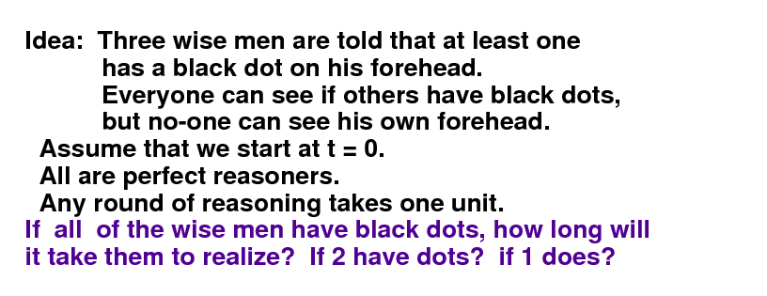
Muddy Children, Dirty Kids, Wise men, Cheating Husbands, etc.

Slide 4

Muddy Children (cont.)
Suppose k = 1
The muddy child knows the others are clean
When the father says at least one is muddy, he concludes that it’s him

Slide 5
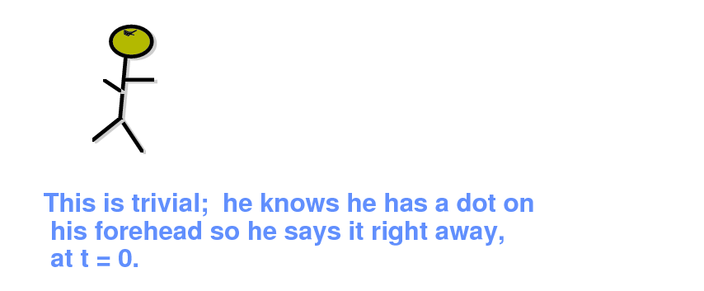
Muddy Children.
Concluding – recursion starter
BEST CASE: One child

Slide 6
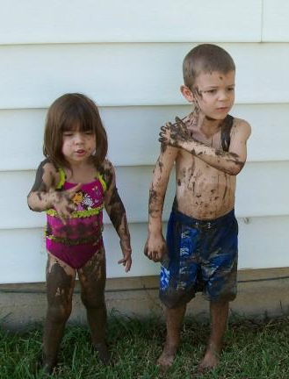
Muddy Children (cont.)
Suppose k = 2
Suppose you are muddy
After the first announcement, you see another muddy child, so you think perhaps he’s the only muddy one.
But you note that this child did not raise his hand, and you realise you are also muddy.
So you raise your hand in the next round, and so does the other muddy child

Slide 7
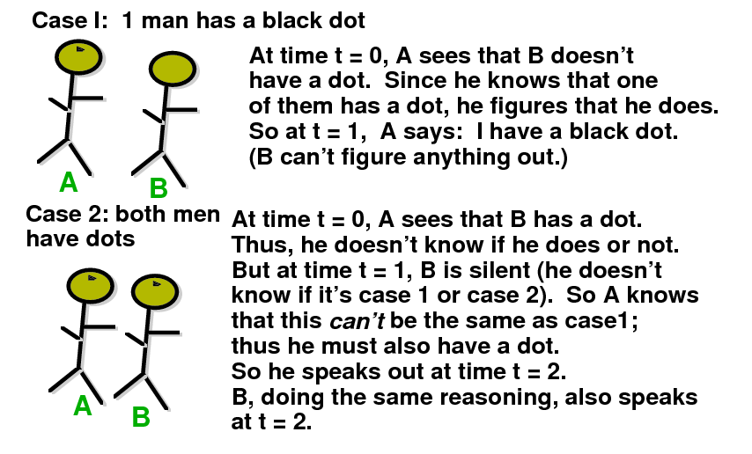
Muddy Children.
Detailed analysis of two children
CASE 1: 1 child has mud dot on his head
CASE 2: Both children have mud dots on their heads

Slide 8
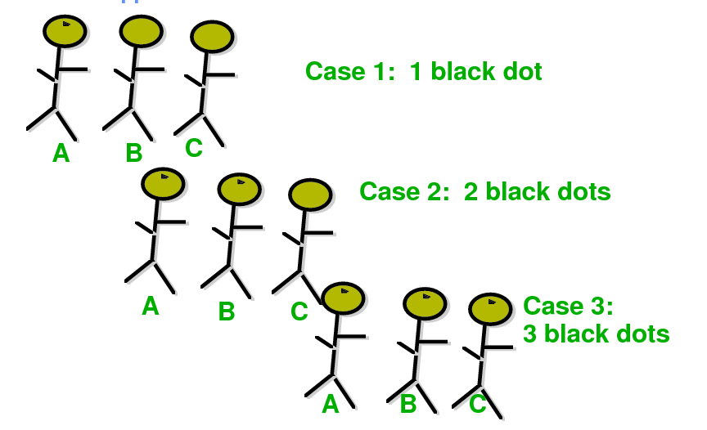
Muddy Children.
Now suppose there are 3 children

Slide 9
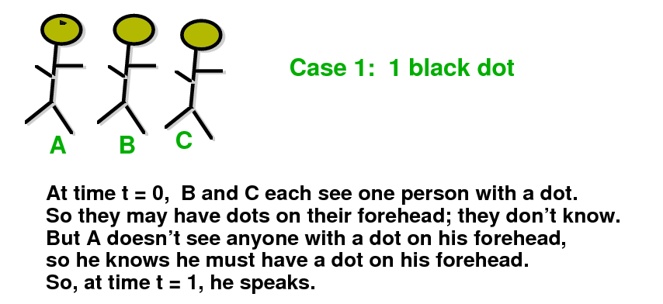
Muddy Children.
Case of three children

Slide 10
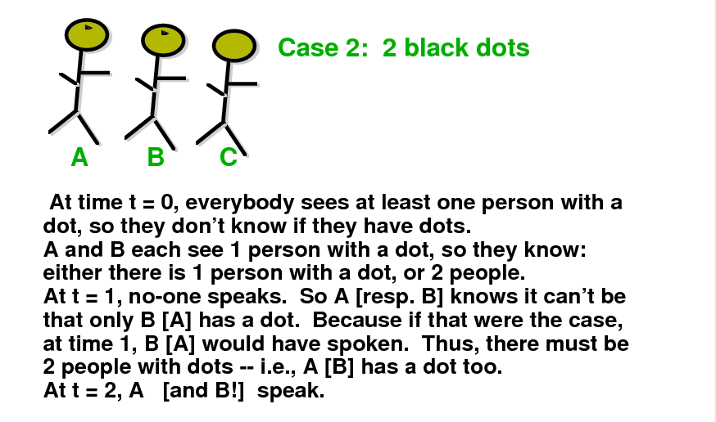
Muddy Children.
Case of three children

Slide 11
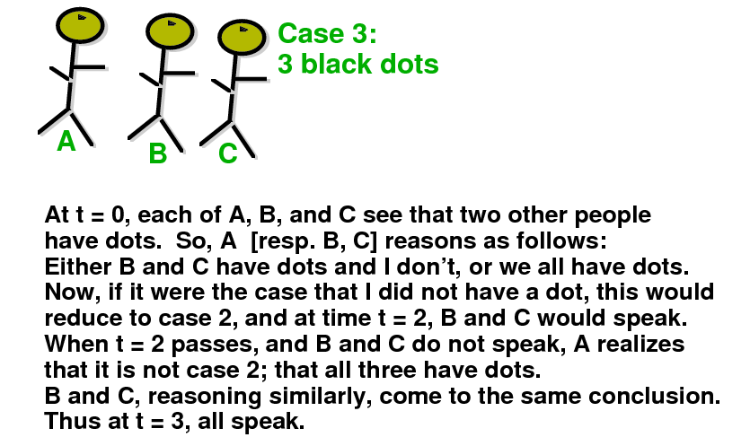
Muddy Children.
Case of three children

Slide 12
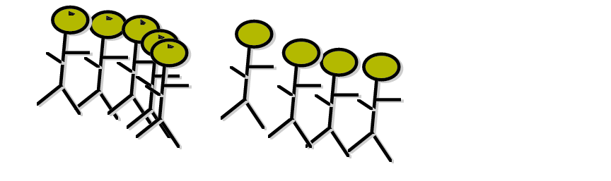
Muddy Children.
Case of N children
Assume N children
Assume K have mud on heads.
Assuming – common knowledge of at least one dot ,
all perfect reasoners
each round of reasoning takes one unit
This is the simplest problem that can be solved using modal logic and its variants
Theorem
K children will speak at time t=K
The crucial concepts:
Common knkowledge
Consequential closure

Slide 13
The Partition Model of Knowledge

Slide 14
Concepts to remind from classical logic
Agent
Group of agents
Language
Ordered tuple for definition
Possible worlds
Interpretation function
Partitions of set

Slide 15
Worlds and non-distinguishability of worlds
Example of worlds
Suppose there are two propositions p and q
There are 4 possible worlds:
  w₁: p ∧ q
  w₂: p ∧ ¬ q
  w₃: ¬ p ∧ q
  w₄: ¬ p ∧ ¬ q
Suppose the real world is w₁, and that in w₁ agent i cannot distinguish between w₁ and w₂
We say that I_{i}(w₁) = {w₁, w₂}
  This means, in world w₁ agent i cannot distinguish between world w₁ and world w₂
W = {w₁ , w₂ , w₃ , w₄ } is the set of all worlds
Function I describes non-distinguishability of worlds

Slide 16
Partition Model of knowledge, partition of worlds in the set of all worlds W
What is partition of worlds?
  Each I_{i} is a partition of W for agent i
    Remember: a partition chops a set into disjoint sets
    I_{i}(w) includes all the worlds in the partition of world w
Intuition:
  if the actual world is w, then I_{i}(w) is the set of worlds that agent i cannot distinguish from w
  i.e. all worlds in I_{i}(w), all possible as far as i knows

Slide 17
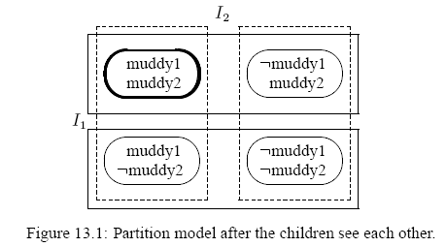
W = set of all worlds for Muddy Children with two children
This is knowledge of child 2
  w₂
  w₁
  w₄
  w₃
Partition model when children see one another but before father speaks

Slide 18
The Partition Model of Knowledge
Now we can define the partition model of Knowledge
An n-agent partition model over language Σ is A = (W, π, I₁, …, I_{n}) where
  W is a set of possible worlds
  π : Σ → 2^{W} is an interpretation function that determines which sentences are true in which worlds
  Each I_{i} is a partition of W for agent i
    Remember: a partition chops a set into disjoint sets
    I_{i}(w) includes all the worlds in the partition of world w

Slide 19
The Knowledge Operator
By K_{i}ϕ we will denote that:
  “agent i knows that ϕ”
It describes the knowledge of an agent

Slide 20
Logical Entailment
What is logical entailment?
Let us recall definition:
  We say A,w |= K_{i}ϕ if and only if ∀w’,
  if w’∈I_{i}(w), then A,w |= ϕ
Intuition: in partition model A, if the actual world is w, agent i knows ϕ if and only if ϕ is true in all worlds he cannot distinguish from w

Slide 21
The Knowledge Operator
By K_{i}ϕ we will denote that:
  “agent i knows that ϕ”
Let A = (W, π, I₁, …, I_{n}) be a partition model over language Σ and let w ∈ W
We define logical entailment |= as follows:
  For ϕ ∈ Σ we say (A,w |= ϕ) if and only if w ∈ π(ϕ)
  We say A,w |= K_{i}ϕ if and only if ∀w’,
  if w’∈I_{i}(w), then A,w |= ϕ
π : Σ → 2^{W} is an interpretation function

Slide 22
Example of Knowledge Operator for Muddy Children
Partitioning all possible worlds for agents in case of Two Muddy Children
Partition for agent 2 (what child 2 knows)
Note: in w₁ we have:
K₁ muddy2
K₂ muddy1
K₁ ¬ K₂ muddy2
…
But we don’t have:
K₁ muddy1
Child 1 but not child 2 knows that child 2 is muddy
Partition for agent 1
Knowledge operators
Bold oval = actual world
Solid boxes = equivalence classes in I₁
Dotted boxes = equivalence classes in I₂
  w₁: muddy1 ∧ muddy2 (actual world)
  w₂: muddy1 ∧ ¬ muddy2
  w₃: ¬ muddy1 ∧ muddy2
  w₄: ¬ muddy1 ∧ ¬ muddy2

Slide 23
Muddy Children Revisited
Now we have all background to illustrate solution to Muddy Children

Slide 24
Muddy Children Revisited
n children meet their father after playing in the mud.
The father notices that k of the children have mud on their foreheads.
Each child sees everybody else’s foreheads, but not his own.

Slide 25
Muddy Children Revisited (cont.).
The Case of two muddy children
Formulation of logic variables and possible worlds
Suppose n = k = 2 (two children, both muddy)
As the first step we have to formalize the worlds.
To formalize worlds, we need logic variables
Logic variables are muddy₁ for child 1 being muddy, muddy₂ for child 2 being muddy, etc.
With this all Possible Worlds w are the following:
  w₁: muddy1 ∧ muddy2 (actual world)
  w₂: muddy1 ∧ ¬ muddy2
  w₃: ¬ muddy1 ∧ muddy2
  w₄: ¬ muddy1 ∧ ¬ muddy2
These are all combinations of values of variables muddy1 ∧ muddy2 , no more are possible
At the start, no one sees or hears anything, so all worlds are possible for each child
After seeing each other, each child can tell apart worlds in which the other child’s state is different

Slide 26
Partitioning all possible worlds for agents in case of Two Muddy Children
Partition for agent 2 (what child 2 knows)
Note: in w₁ we have:
K₁ muddy2
K₂ muddy1
K₁ ¬ K₂ muddy2
…
But we don’t have:
K₁ muddy1
Child 1 but not child 2 knows that child 2 is muddy
Partition for agent 1
Bold oval = actual world
Solid boxes = equivalence classes in I₁
Dotted boxes = equivalence classes in I₂
  w₁: muddy1 ∧ muddy2 (actual world)
  w₂: muddy1 ∧ ¬ muddy2
  w₃: ¬ muddy1 ∧ muddy2
  w₄: ¬ muddy1 ∧ ¬ muddy2

Slide 27
Now we will consider stages of Muddy Children after each statement from father
Modification to knowledge and partitions done by the announcement of the father
The father says: “At least one of you has mud on his forehead.”
  This eliminates the world:
  w₄: ¬ muddy1 ∧ ¬ muddy2
  w₁: muddy1 ∧ muddy2 (actual world)
  w₂: muddy1 ∧ ¬ muddy2
  w₃: ¬ muddy1 ∧ muddy2
  w₄: ¬ muddy1 ∧ ¬ muddy2

Slide 28
Muddy Children Revisited (cont.)
Now, after father’s announcement, the children have only three options:
Other child is muddy
I am muddy
We are both muddy
For instance in I₂ we see that child 2 thinks as follows:
Either we are both muddy
Or he (child1) is muddy and I (child 2) am not muddy
The same for Child 1
So each partition has more than one world and none of children can communicate any decision
Bold oval = actual world
Solid boxes = equivalence classes in I₁
Dotted boxes = equivalence classes in I₂
  w₁: muddy1 ∧ muddy2 (actual world)
  w₂: muddy1 ∧ ¬ muddy2
  w₃: ¬ muddy1 ∧ muddy2
  w₄: ¬ muddy1 ∧ ¬ muddy2

Slide 29
Muddy Children Revisited (cont.)
Modification to knowledge and partitions done by the SECOND announcement of the father
The father then says: “Do any of you know that you have mud on your forehead? If you do, raise your hand now.”
  Here, no child raises his hand.
  But by observing that the other child did not raise his hand (i.e. does not know whether he’s muddy), each child concludes the true world state.
  So, at the second announcement from father, they both raise their hands.

Slide 30
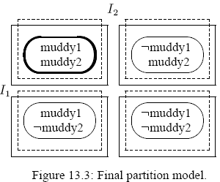
Muddy Children Revisited (cont.)
Note: in w₁ we have:
K₁ muddy1
K₂ muddy2
K₁ K₂ muddy2
…
Child 1 knows he is muddy
Child 2 knows he is muddy
Both children know they are muddy
Bold oval = actual world
Solid boxes = equivalence classes in I₁
Dotted boxes = equivalence classes in I₂
  w₁: muddy1 ∧ muddy2 (actual world)
  w₂: muddy1 ∧ ¬ muddy2
  w₃: ¬ muddy1 ∧ muddy2
  w₄: ¬ muddy1 ∧ ¬ muddy2

Slide 31
“Non-Modal” Muddy Children Homework
The problem is like Muddy Children with three children but the children can give non-unique answers, like k or k+1 children are muddy.
But this is only when not enough information immediately available.
We have to introduce time. When the output stabilizes, the information given by the output is correct.
The role of delays in logic gates here is important, serves as a modality.
Design a combinational logic circuit
Child 1 is muddy
Child 1 muddy
Child 1 answers
Child 2 is muddy
It must be a combinational logic circuit
No memory
No MV logic
Child 3 is muddy
Child 2 muddy
Child 2 answers
Child 3 answers
Child 3 muddy
Various versions possible

Slide 32
Muddy 1
Child 1 shouts “I am muddy”
Muddy 2
Child 2 shouts “I am muddy”
Muddy 3
Child 3 shouts “I am muddy”
No Child shouted
exor
Child 1 shouts “I am muddy”
exor
Child 2 shouts “I am muddy”
exor
Child 3 shouts “I am muddy”
No Child shouted
1
3
Homework 1: Complete this diagram for Muddy Children
2
Homework 2: Draw State Machine Diagram for a Model for Muddy Children

Slide 33
Muddy Children Revisited
Again with 3 children

Slide 34
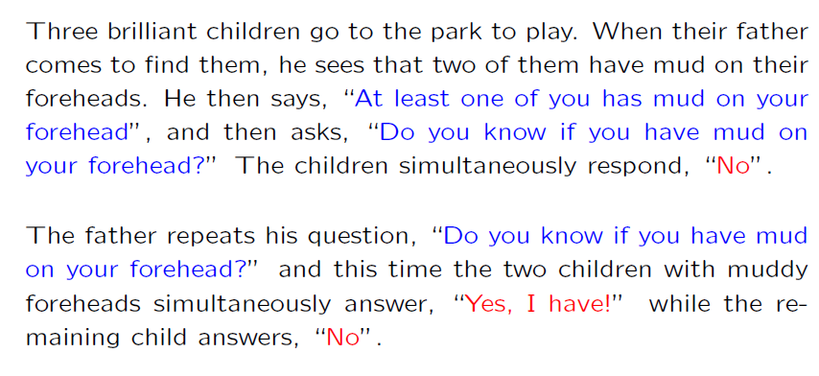
Reminder of formulation for 3 children

Slide 35
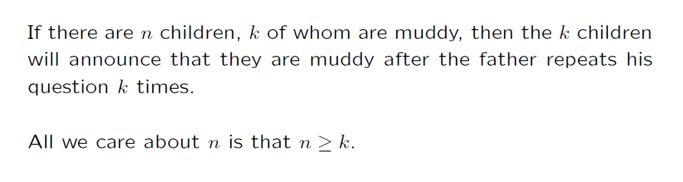
General claim for n, k

Slide 36
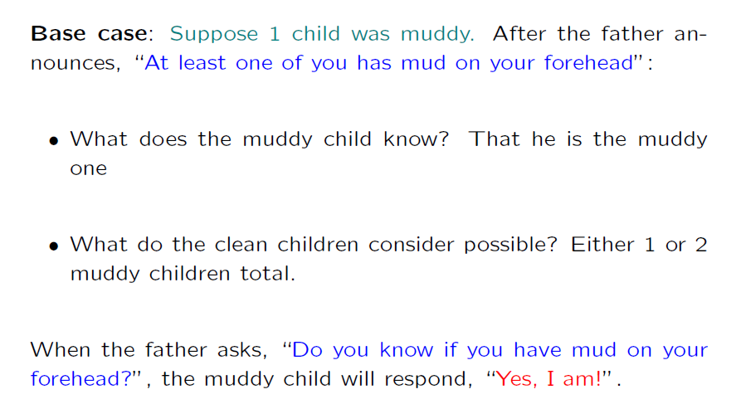
Induction

Slide 37
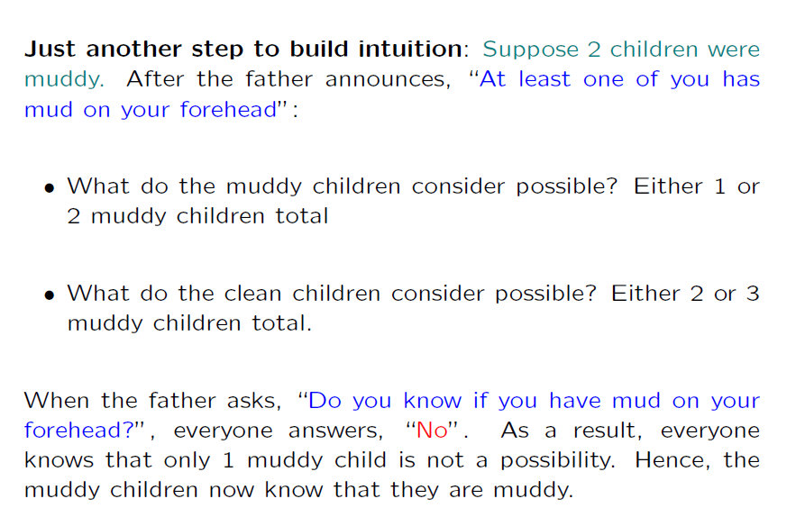
We want to build our intuition about creating models

Slide 38
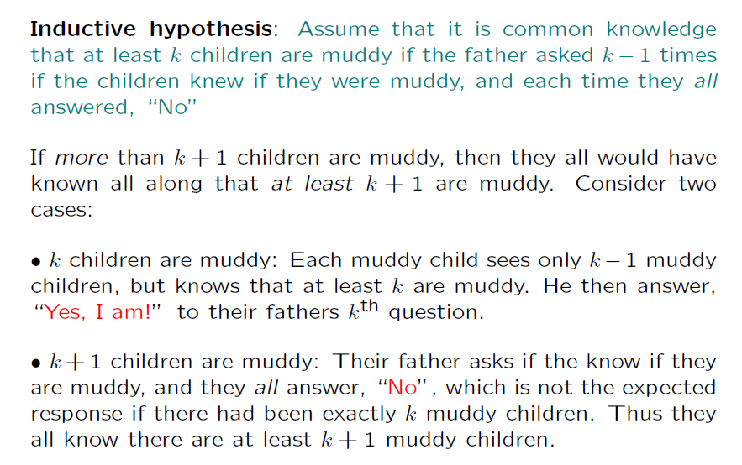
How to formulate inductive hypothesis

Slide 39
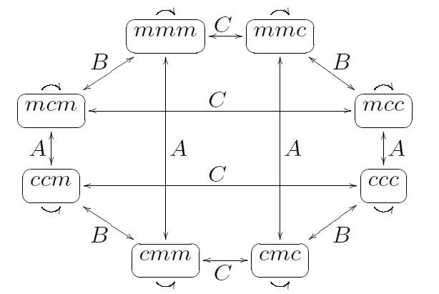
Back to initial example: n = 3, k = 2
In our model, we will not only draw states of logic variables in each world,
but also some relations between the worlds, as related to knowledge of each agent (child). These are non-distinguishability relations for each agent A, B, C
An arrow labeled A (B, C resp.) linking two states indicates that A (B, C resp.) cannot distinguish between the states (reflexive arrows indicate that every agent considers the actual state possible).
Initial situation:
State of C
State of B
State of A
This is a situation before any announcement of father
An arrow labeled A linking two states indicates that A cannot distinguish between the states
Note that at every state, each agent cannot distinguish between two states

Slide 40
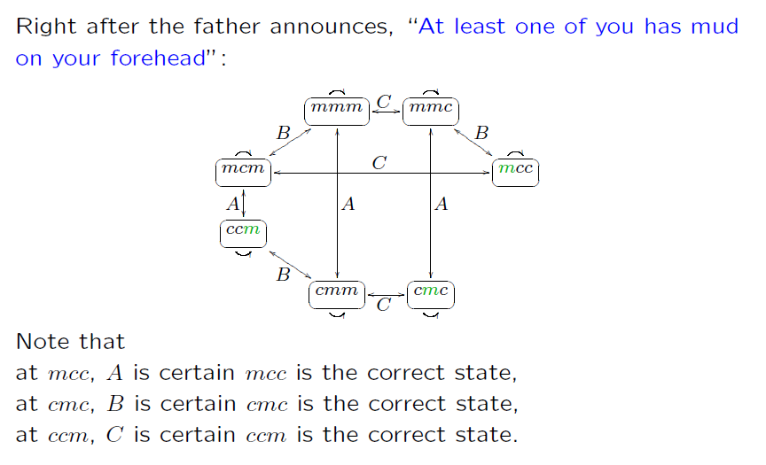
New information (father talks) removes some worlds with their labels on arrows
This is a situation after first announcement of father
ccc eliminated
Green color means that the agent is certain
States mmc, ccm and cmc are removed from set of worlds

Slide 41
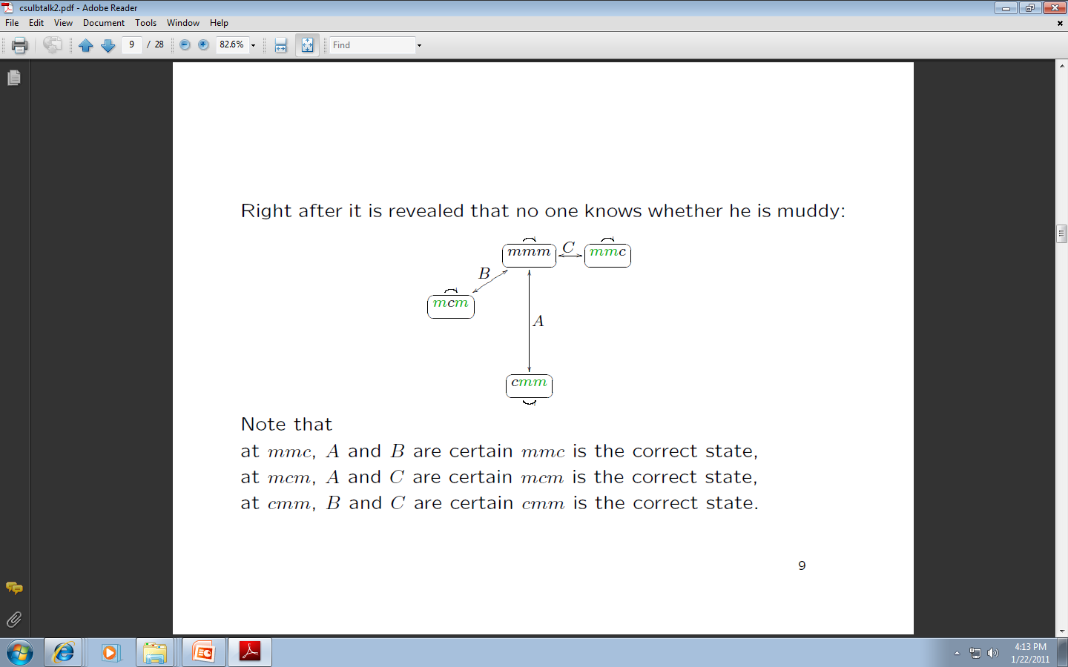
Reduction of the set of worlds
This is a situation after second announcement of father

Slide 42
Reduction of the set of worlds
This is a situation after second announcement of father
After third announcement of father, states mmc , cmm and mcm are eliminated and only state mmm becomes possible

Slide 43
Final Reduction of the set of worlds after third announcement of father
This is a situation after third announcement of father
only state mmm becomes possible

Slide 44
Where we are?
We were using models, as they are used in modal logic
One method used partitions, other method used relations of non-distinquishability
  The deep concept is the same
But we did not know what is the name of the formalism that we used.
Now we will introduce modal logic formally as we have a good intuition about logic variables in different worlds.
We understand also agents and their knowledge.
Models and model checking is the fundament of modal and similar logics

Slide 45
Where we are?
Homework 3.
Using Karnaugh Maps, solve the Muddy Children problem removing step by step the cells of the map that cannot be a solution.
How do you know how to go from step to next step?
What knowledge can be used?
Can you modify your circuits from Homework 1 and Homework 2?

Slide 46
Modal Logic

Slide 47
Modal Logic: basic operators
Can be built on top of any language
Has several special variants related to sub-domains
Two modal operators:
  ϕ reads “ϕ is necessarily true”
  ◊ϕ reads “ϕ is possibly true”
Equivalence:
  ◊ϕ ≡ ¬¬ϕ
  ϕ ≡ ¬◊¬ϕ
So we can use only one of the two operators, for instance “necessary”
But it is more convenient to use two operators.
Next we will be using even more than two, but the understanding of these two is crucial.

Slide 48
Modal Logic: Syntax
Let P be a set of propositional symbols
We define modal language L as follows:
If p ∈ P and ϕ, ψ ∈ L then:
  p ∈ L
  ¬ϕ ∈ L
  ϕ ∧ ψ ∈ L
  ϕ ∈ L
Remember that ◊ϕ ≡ ¬¬ϕ, and ϕ ∨ψ ≡ ¬ (¬ϕ ∧¬ψ) and ϕ →ψ ≡ ¬ϕ ∨ ψ
We can extend the language defining new symbols of operators

Slide 49
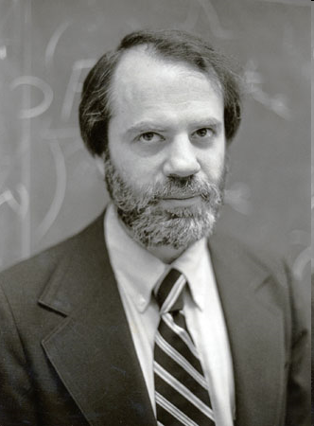
Modal Logic: Semantics
Semantics is given in terms of Kripke Structures (also known as possible worlds structures)
Due to American logician Saul Kripke, City University of NY
A Kripke Structure is (W, R)
  W is a set of possible worlds
  R : W × W is an binary accessibility relation over W
  This relation tells us how worlds are accessed from other worlds
Saul Kripke
We already introduced two close to one another ways of representing such set of possible worlds.
There will be many more.
He was called “the greatest philosopher of the 20st century

Slide 50
Meaning of Entailment
Entailment says what we can deduce about state of world, what is true in them.
Part of the Definition of entailment relation :
  M,w |= ϕ if ϕ is true in w
  M,w |= ϕ ∧ ψ if M,w |= ϕ and M,w |= ψ
Given Kripke model with state w
formula
If there are two formulas that are true in some world w than a logic AND of these formulas is also true in this world.
state w

Slide 51
Semantics of Modal Logic: Definition of Entailment
Kripke Structure
A world
Definition of Kripke Model
A Kripke model is a pair M,w where
  M = (W, R) is a Kripke structure and
  w ∈ W is a world
The entailment relation is defined as follows:
  M,w |= ϕ if ϕ is true in w
  M,w |= ϕ ∧ ψ if M,w |= ϕ and M,w |= ψ
  M,w |= ¬ϕ if and only if we do not have M,w |= ϕ
  M,w |= ϕ if and only if ∀w’ ∈ W such that R(w,w’) we have M,w’ |= ϕ
Definition of Entailment Relation in Kripke Model
It is true in every word that is accessible from world w
accessibility relation over W

Slide 52
Satisfiable formulas in Kripke models for modal logic
In classical logic we have the concept of valid formulas and satisfiable formulas.
In modal logic it is as in classical logic:
  Any formula ϕ is valid (written |= ϕ) if and only if ϕ is true in all Kripke models
  E.g. ϕ ∨ ¬ϕ is valid
  Any formula ϕ is satisfiable if and only if ϕ is true in some Kripke models
We write M, |= ϕ if ϕ is true in all worlds of M
All Kripke models or all worlds from Kripke Model???

Slide 53
Relation to classical satisfiability and entailment
For a particular set of propositional constants P, a Kripke model is a three-tuple <W,R, V> .
W is the set of worlds.
R is a subset of W × W, which defines a directed graph over W.
V maps each propositional constant to the set of worlds in which it is true.
Conceptually, a Kripke model is a directed graph where each node is a propositional model.
Given a Kripke model M = <W,R, V> , each world w ∈ W corresponds to a propositional model: it says which propositions are true in that world. In each such world, satisfaction for propositional logic is defined as usual.
Satisfaction is also defined at each world for <> , and this is where R is important.
A sentence is possibly true at a particular world whenever the sentence is true in one of the worlds adjacent to that world in the graph defined by R.

Slide 54
Relation to classical satisfiability and entailment
Satisfiability can also be defined without reference to a particular world and is often called global satisfiability.
A sentence is globally satisfied by model M = <W,R, V> exactly when for every world w ∈ W it is the case that |=_{M,w} ϕ.
Entailment in modal logic is defined as usual:
  “ the premises Δ logically entail the conclusion ϕ whenever every Kripke model that satisfies Δ also satisfies ϕ.”
Please observe that I talk about every Kripke model and not every world of one Kripke Model

Slide 55
Modal Logic: Semantics concepts
Intuitions for classical logic:
World = cell of Kmap.
Valid = Kmap of all symbols “1” (ones).
Satisfiable = Kmap with at least one symbol “1”.
Non-satisfiable = Kmap with all zeros.
Contingent = Kmap with some ones some zeros.
Necessary = Kmap with all ones.
False = Kmap with all zeros.
Intuitions for Kripke Model:
World = cell of Kmaps accessible by some accessability relation.
Valid = Kmap of all symbols “1” (ones) in accessible cells.
Satisfiable = Kmap with at least one symbol “1”, in accessible cells.
Non-satisfiable = Kmap with all zeros in accessible cells..
Contingent = Kmap with all zeros in accessible cells..
Necessary = Kmap with all ones in accessible cells..
False = Kmap with all zeros in accessible cells..

Slide 56
Modal Logic: Axiomatics
Is there a set of minimal axioms that allows us to derive precisely all the valid sentences?
Some well-known axioms:
  Axiom(Classical) All propositional tautologies are valid
  Axiom (K) (ϕ ∧ (ϕ →ψ)) → ψ is valid
  Rule (Modus Ponens) if ϕ and ϕ →ψ are valid, infer that ψ is valid
  Rule (Necessitation) if ϕ is valid, infer that ϕ is valid
These are enough, but many other can be added for convenience

Slide 57
Sound and complete sets of inference rules in Modal Logic Axiomatics
Refresher:
remember that
  A set of inference rules (i.e. an inference procedure) is sound if everything it concludes is true
  A set of inference rules (i.e. an inference procedure) is complete if it can find all true sentences
Theorem:
System K is sound and complete for the class of all Kripke models.
What is system K?

Slide 58
Multiple Modal Operators
We can define a modal logic with n modal operators ₁, …, _{n} as follows:
  We would have a single set of worlds W
  n accessibility relations R₁, …, R_{n}
  Semantics of each _{i} is defined in terms of R_{i}
Powerful concept – many accessibility relations

Slide 59
Axiomatic theory of the partition model

Slide 60
Axiomatic theory of the partition model
Objective: Come up with a sound and complete axiom system for the partition model of knowledge.
Note: This corresponds to a more restricted set of models than the set of all Kripke models.
In other words, we will need more axioms.

Slide 61
Axiomatic theory of the partition model
K_{i} means “agent i knows that”
The modal operator _{i} becomes K_{i}
Worlds accessible from w according to R_{i} are those indistinguishable to agent i from world w
K_{i} means “agent i knows that”
Start with the simple axioms:
  (Classical) All propositional tautologies are valid
  (Modus Ponens) if ϕ and ϕ →ψ are valid, infer that ψ is valid
Now we are defining a logic of knowledge on top of standard modal logic.

Slide 62
Axiomatic theory of the partition model
(More Axioms)
(K) From (K_{i}ϕ ∧ K_{i}(ϕ →ψ)) infer K_{i}ψ
  Means that the agent knows all the consequences of his knowledge
  This is also known as logical omniscience
(Necessitation) From ϕ, infer that K_{i}ϕ
  Means that the agent knows all propositional tautologies
Remember, we introduced the rule K
This defines some logic
In a sense, these agents are inhuman, they are more like God, which started this whole area of research

Slide 63
Axiomatic theory of the partition model (More Axioms)
Axiom (D) ¬ K_{i} (ϕ ∧ ¬ϕ)
  This is called the axiom of consistency
Axiom (T) (K_{i} ϕ) → ϕ
  This is called the veridity axiom
  Means that if an agent knows something than is true.
  Corresponds to assuming that accessability relation R_{i} is reflexive
Axiom D means that nobody can know nonsense, inconsistency
Remember symbols D and T of axioms, each of them will be used to create some type of logic

Slide 64
Refresher: what is Euclidean relation?
Binary relation R over domain Y is Euclidian
  if and only if
  ∀y, y’, y’’ ∈ Y, if (y,y’) ∈ R and (y,y’’) ∈ R then (y’,y’’) ∈ R
(y,y’) ∈ R and (y,y’’) ∈ R then (y’,y’’) ∈ R
y
R
y’
y
R
y’
R
R
R
y’’
y’’

Slide 65
Axiomatic theory of the partition model (More Axioms)
Axiom (4) K_{i} ϕ → K_{i} K_{i} ϕ
  Called the positive introspection axiom
  Corresponds to assuming that R_{i} is transitive
Axiom (5) ¬K_{i} ϕ → K_{i} ¬K_{i} ϕ
  Called the negative introspection axiom
  Corresponds to assuming that R_{i} is Euclidian
Remember symbols 4 and 5 of axioms, each of them will be used to create some type of logic

Slide 66
Axiomatic theory of the partition model (Overview of Axioms)
Table. Axioms and corresponding constraints on the accessibility relation.
Proposition: a binary relation is an equivalence relation if and only if it is reflexive, transitive and Euclidean
Proposition: a binary relation is an equivalence relation if and only if it is reflexive, transitive and symmetric
Some modal logic systems take only a subset of this set. All general , problem independent theorems can be derived from only these axioms and some additional, problem specific axioms describing the given puzzle, game or research problem.

Slide 67
What to do with these axioms?
Now that we have these axioms, we can take some of their sets , add them to classical logic axioms and create new modal logics.
The most used is system K45
Homework 4.
Try to derive some new theorems from the axioms above. Is any of these theorems useful?
Is any of these theorems counter-intuitive?

Slide 68
Axiomatic theory of the partition model (back to the partition model)
System KT45 exactly captures the properties of knowledge defined in the partition model
System KT45 is also known as system S5
S5 is sound and complete for the class of all partition models

Slide 69
And now a test…
Next slide has a problem formulation of a relatively not difficult but not trivial problem in modal logic.
Please try to solve it by yourself, not looking to my solution.
If you want, you can look to internet for examples of theorems in modal logic that you can use in addition to those that are in my slides. I do not know if this would help to find a better solution but I would be interested in all what you get.
Good luck. You can use system BK, or any other system of modal logic from these slides.

Slide 70
Example of proving in Modal Logic
Given is system BK of modal logic with all its axioms, theorems, and proof methods
Given are two axioms:
  A axiom
  L axiom
Prove that Ge
A Axiom: Ge → Necessarily (Ge)
L Axiom: Possible (Ge)
Ge
Do not look to the next slide with the solution!!!

Slide 71
A Axiom: Ge → Necessarily (G)
X→ Necessarily(X)
Modal Logic thesis: Necessarily(p → q) → (Possible(p) → Possible(q)),
1
X = Ge → Necessarily (Ge)
Necessarily (Ge → Necessarily(Ge) )
q= Necessarily(Ge)
2
p=Ge
Possible(Ge) → Possible (Necessarily(Ge))
Thesis specific to BK system of modal logic:
Possible( Necessarily (p) )→ p
3
p = Ge
4
Possible( Necessarily (Ge) )→ Ge
Possible(Ge) → Ge
L Axiom: Possible (Ge)
5
Here is the solution.
Do you know that you proved that God exists?
This is a famous proof of Hartshorne, which resurrected interest among analytic philosophers in proofs of God’s Existence. See next slide.
Ge
System BK of modal logic is used

Slide 72
Ge or “God Exists”?
Amazingly, when I showed the proof from last slide to some people, they told me “OK”.
When I showed them the next slide, and I claimed that the proof proves God’s existence, they protested.
Can you explain me why?

Slide 73
Anselm Axiom: God_exists → Necessarily (God_exists)
X→ Necessarily(X)
AA
Modal Logic thesis: Necessarily(p → q) → (Possible(p) → Possible(q)),
1
X = God_exists → Necessarily (God_exists)
Necessarily (God_exists → Necessarily(God_exists) )
q= Necessarily(God_exists)
2
p=God_exists
Possible(God_exists) → Possible (Necessarily(God_exists))
Thesis specific to BK system of modal logic:
Possible( Necessarily (p) )→ p
3
p = God_exists
4
Possible( Necessarily (God_exists) )→ God_exists
Possible(God_exists) → God_exists
Leibnitz Axiom: Possible (God_Exists)
5
This is the same proof, the same axioms. We only give the historical assumptions. Axiom A is from Saint Anselm – it is like if Pythagoras invents his theorem in his head – then the theorem is true in any World. Axiom L comes from Leibniz – “we can create a consistent model of God in our head”.
God _exists
Can we invent a puzzle like Muddy Children with these axioms?
System BK of modal logic is used

Slide 74
We are back to Muddy Children…
We will formulate now a completely formal modal (knowledge) logic, language based formulation of Muddy Children
Before you read, try to do this by yourself.
Invent another puzzle similar to Muddy Children and formulate it in Modal Logic.

Slide 75
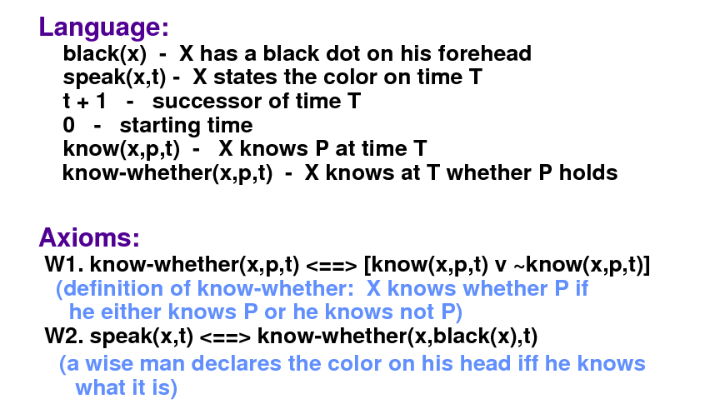
Muddy Children – Formulation in Logic
(a child declares the color on its head if and only if it knows what it is)

Slide 76
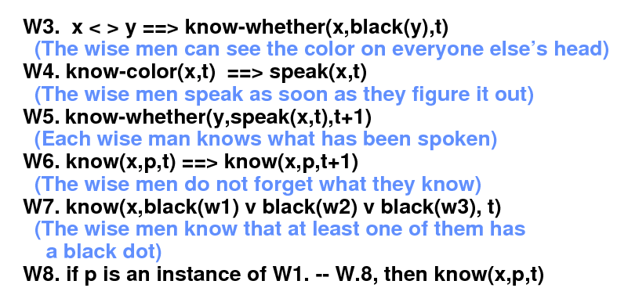
Muddy Children – Formulation in Logic (cont)
The children are now so smart that we call them wise men and not children any more.

Slide 77
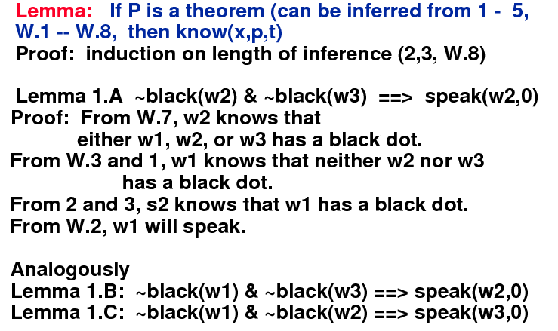
Muddy Children – Inference in Logic
Lemma 1.A
Lemma 1.B
Lemma 1.C

Slide 78
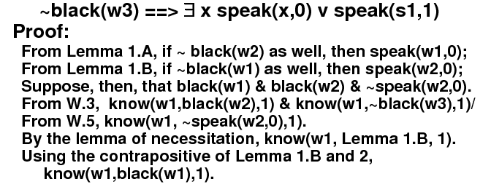
Muddy Children – Inference in Logic
Lemma 2.A:
.. And so on….
Solving problems is
like proving theorem
in modal logic

Slide 79
We will give more examples to motivate you to modal logic using puzzles and games
More examples to motivate thinking about models and modal logic.

