Slide 1
Modal Logic and Its Applications, explained using
Puzzles and Examples

Slide 2
From Boolean Logic to high order predicate modal logic
High-Order Modal logic
Modal Predicate logic
Modal Propositional logic
First-Order Logic = Predicate logic
Boolean Logic
= Propositional logic

Slide 3
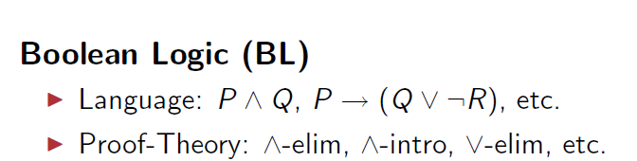
From Boolean Logic to high order predicate modal logic

Slide 4
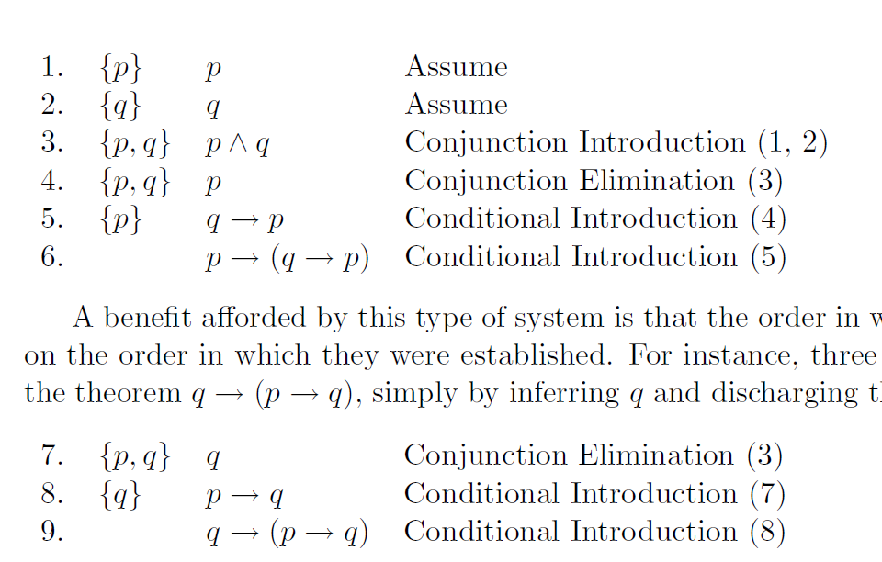
As an illustration, consider the following proof which establishes the theorem p → (q → p):
1. p
3. p/\q
4. p
5. q→ p
6. p→ (q→ p)
2. q
7. q
8. p→ q
9. q→(p→ q)

Slide 5
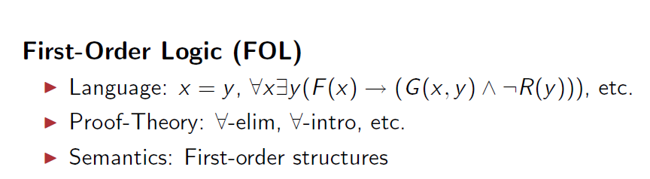

Slide 6
We shall be concerned with alethic modal logic, or modal logic tout court.
The starting point, once again, is Aristotle, who was the first to study the relationship between modal statements and their validity.
However, the great discussion it enjoyed in the Middle Ages.
The official birth date of modal logic is 1921, when Clarence Irving Lewis wrote a famous essay on implication.

Slide 7
Modal logics has Roots in C. I. Lewis
Aristotle
As is widely known and much celebrated, C. I. Lewis invented modal logic.
Modal logic sprang in no small part from his disenchantment with material implication
  Material implication was accepted and indeed taken as central in Principia by Russell and Whitehead.
In the modern propositional calculus (PC), implication is of this sort;
hence a statement like
  “ If the moon is composed of Jarlsberg cheese, then Selmer is Norwegian" is symbolized by
m → s;
where of course the propositional variables can vary with personal choice.
St. Anselm
C.I. Lewis
Saul Kripke
Modern Engineering Temporal Logic and Model Checking

Slide 8
Proof Rules for Modal Logic

Slide 9
Proof Rules for Modal Logic
Modal Generalization
  A
  A
Monotonicity of ◊
  A → B
  ◊ A → ◊ B
Monotonicity of
  A → B
  A → B

Slide 10
An Axiom System for Prepositional Logic
(A → (B → C)) → (A → B) → (A → C)
A → (B → A)
(( A → false ) → false ) → A
Modus Ponens
  A, A -> B
  B

Slide 11
An Axiom System for
Predicate Logic
∀x (A(x) → B(x)) → (∀xA(x) → ∀xB(x))
∀x A(x) → A[t/x] provided t is free for x in A
A → ∀x A(x) provided x is not free in A
Modus Ponens
  A, A → B
  B
Generalization
  A
  ∀x A(x)

Slide 12
Some Facts About Modal Logic
A couple of Valid Modal Formulas:
  ◊ (A ∨ B ) ←→ (◊ A) ∨ (◊ B)
  (A ∧ B ) ←→ ( A) ∨ ( B)
    [](A ∧ B ) ←→ ([] A) ∨ ([] B)
    [K](A ∧ B ) ←→ ([K] A) ∨ ([K] B)
  ◊ (false) →(false)
  (◊ A) ∧ ([]B) → ◊ (A ∧ B )
Counter-examples to invalid modal formulas
  (◊ A) → ( [] A )

Slide 13
X's proof system as an example of modal software
There are several computer tools for proving, verifying, and creating theorems.
nuSMV, Molog, X.
X's proof system ( a set of programs) for the propositional calculus includes :
  the Gentzen-style → introduction
  and elimination rules,
    as well as some rules,
    such as ”De Morgan's Laws,"
    that are formally redundant,
    but quite useful to have on hand.

Slide 14
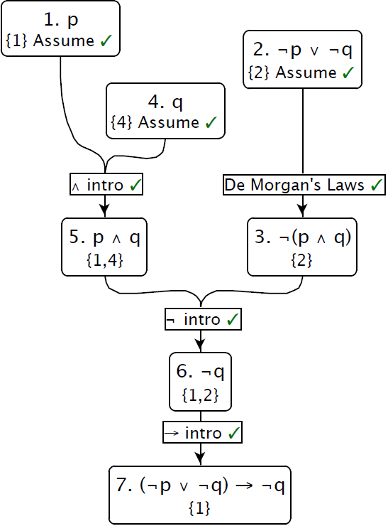
A proof in the propositional calculus (¬p \/ ¬ q) → ¬ q from p.
Assumption 4 is
discharged by ¬ elimination in step 6;
assumption 7 by → introduction in step 7.
Figure demonstrates
p |-_{PC} (¬p \/ ¬ q) → ¬ q,
that is, it illustrates a proof of (¬ p \/ ¬ q) → ¬ q from the premise p.
Gentzen-style
→ introduction
Example of formalized computer proof in propositional logic

Slide 15
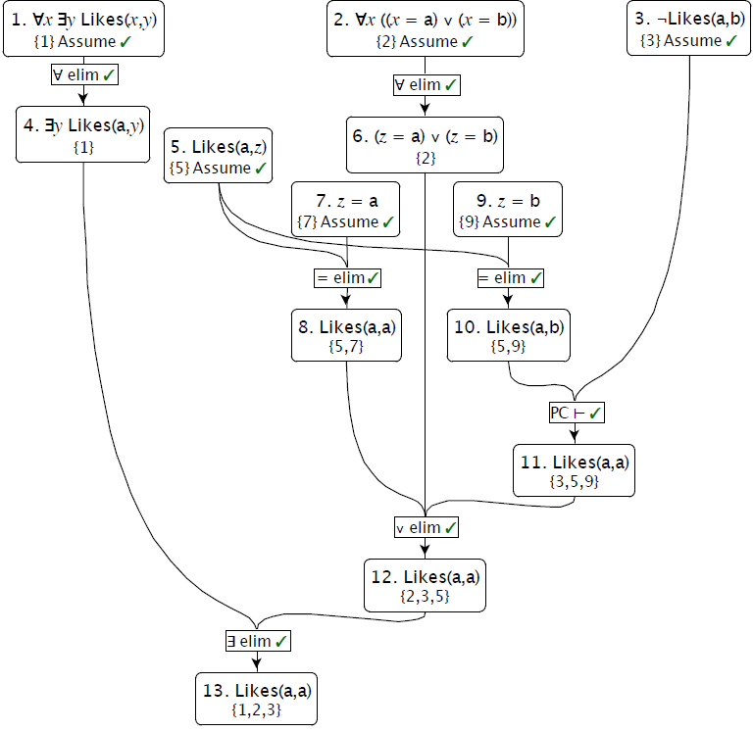
everyone likes someone
A proof in first order logic showing that if everyone likes someone, the domain is {a; b}, and a does not like b, then a likes himself.
In step 5, z is used as an arbitrary name.
Step 13 discharges 5 since 12 depends on 5, but on no assumption in which z is free.
In step 12, assumptions 7 and 9, corresponding to the disjuncts of 6, are discharged by \/ elimination.
Step 11 the principle that, in classical logic, everything follows from a contradiction.
the domain is {a; b}
a does not like b
a likes himself
Example of proof in predicate logic

Slide 16
TYPES OF MODAL LOGIC

Slide 17
TYPES OF MODAL LOGIC
Modal logic is extremely important both for its philosophical applications and in order to clarify the terms and conditions of arguments.
The label “modal logic” refers to a variety of logics:
  alethic modal logic, dealing with statements such as
    “It is necessary that p”,
    “It is possible that p”,
    etc.
  epistemic modal logic, that deals with statements such as
    “I know that p”,
    “I believe that p”,
    etc.

Slide 18
TYPES OF MODAL LOGIC (cont)
deontic modal logic, dealing with statements such as
  “It is compulsory that p”,
  “It is forbidden that p”, etc
temporal modal logic, dealing with statements such as
  “It is always true that p”,
  “It is sometimes true that p”, etc.
ethical modal logic, dealing with statements such as
  “It is good that p”,
  “It is bad that p”

Slide 19
Main Concepts of
MODAL LOGIC

Slide 20
Reminder on Modal Strict Implication
We introduced two modal terms such as impossible and necessary.
In order to define strict implication, that is, we need two new symbols, ◻ and .
Given a statement p,
by “◻p” we mean “It is necessary that p”
and
by “p” we mean “It is possible that p”
Now we can define strict implication:
p ⇨ q := ¬(p Λ ¬q)
that is
it is not possible that both p and ¬q are true

Slide 21
Reciprocal definitions
Both operators, that of necessity ◻ and that of possibility , can be reciprocally defined.
If we take  as primitive, we have:
◻p := ¬¬p
that is
“it is necessary that p” means
“it is not possible that non-p”
Therefore, we can define strict implication as:
p ⇨ q := ◻(¬p Λ q)
but since p → q is logically equivalent to ¬(p Λ ¬q), or (¬p Λ q), we have
p ⇨ q := ◻(p → q)

Slide 22
Taking ◻ as primitive
Analogously, if we take ◻ as primitive, we have:
p := ¬◻¬p
that is
“it is possible that p” means
“it is not necessary that non-p”
And again, from the definition of strict implication and the above definition, we can conclude that
p ⇨ q := ◻(p → q)

Slide 23
Square of opposition
Following Theophrastus (IV century BC), but with modern logic operators, we can think of a square of opposition in modal terms:
necessary
◻p
¬¬p
impossible
◻¬p
¬p
contradictory statements
possible
¬◻¬p
p
contingent
¬◻p
¬p

Slide 24
What is logical Necessity?
By logical necessity we do not refer
  either to physical necessity (such as “bodies attract according to Newton’s formula”, or “heated metals dilate”)
  nor philosophical necessity (such as an a priori reason, independent from experience, or “cogito ergo sum”).
What we have in mind, by contrast, the kind of relationship linking premises and conclusion in a mathematical proof, or formal deduction:
  if the deduction is correct and the premises are true, the conclusion is true.

Slide 25
Necessary is true in every possible world
In this sense we say that “true mathematical and logical statements are necessary”.
In Leibniz’s terms,
  a necessary statement is true in every possible world;
  a possible statement is true in at least one of the possible worlds.

Slide 26
Tautology, non-satisfiability and contingence
ab\cd | 00 | 01 | 11 | 10
00 | 1 | 1 | 1 | 1
01 | 1 | 1 | 1 | 1
11 | 1 | 1 | 1 | 1
10 | 1 | 1 | 1 | 1
ab\cd | 00 | 01 | 11 | 10
00 | 0 | 0 | 0 | 0
01 | 0 | 0 | 0 | 0
11 | 0 | 0 | 0 | 0
10 | 0 | 0 | 0 | 0
Not satisfied is false in every world
Tautology is true in every world
ab\cd | 00 | 01 | 11 | 10
00 | 0 | 0 | 0 | 0
01 | 0 | 1 | 0 | 0
11 | 0 | 0 | 0 | 0
10 | 0 | 0 | 0 | 0
ab\cd | 00 | 01 | 11 | 10
00 | 1 | 1 | 1 | 1
01 | 1 | 0 | 1 | 1
11 | 1 | 1 | 1 | 1
10 | 1 | 1 | 1 | 1
not
Contingent is not always false and not always true

Slide 27
CONTINGENT and POSSIBLE
According to Aristotle, “p is contingent” is to be understood as p Λ ¬p.
Looking at the square of opposition, we can interpret “possible” and “contingent”, on the basis of their contradictory elements, as purely possible and purely contingent:
purely possible
the contradictory of impossible: ¬◻¬p
purely contingent
the contradictory of necessary: ¬◻p

Slide 28
necessary
◻p
¬¬p
impossible
◻¬p
¬p
contradictory statements
possible
¬◻¬p
p
contingent
¬◻p
¬p
Looking at the square of opposition, we can interpret “possible” and “contingent”, on the basis of their contradictory elements, as purely possible and purely contingent:
purely possible
the contradictory of impossible: ¬◻¬p
purely contingent
the contradictory of necessary: ¬◻p

Slide 29
CONTINGENT and POSSIBLE
By contrast, “possible” and “contingent” may be both interpreted as
  “what can either be or not be”,
  or else,
  “what is possible but not necessary”:
bilateral contingent,
or bilateral possible:
p Λ ¬p
or p Λ ¬◻p
necessary
◻p
¬¬p
impossible
◻¬p
¬p
possible
¬◻¬p
p
contingent
¬◻p
¬p

Slide 30
NECESSITY OF THE CONSEQUENCE and
NECESSITY OF THE CONSEQUENT
The strict implication, defined as ◻(p → q), is to be understood as the necessity to obtain the consequence given that antecedent:
necessitas consequentiae
where the consequentia is (p → q)
This must not be confused with the fact that the consequent might be necessary:
necessitas consequentis (fallacy: p → ◻q)
where the consequens is q

Slide 31
NECESSITY OF THE CONSEQUENCE and
NECESSITY OF THE CONSEQUENT
Whereas by ◻(p → q)
we mean that it is logically impossible
that the antecedent is true
and the consequent false (by definition of strict implication),
by p → ◻q
we mean that the antecedent implies the necessity of the consequent.

Slide 32
Modality DE DICTO
Whenever we wish to modally characterize the quality of a statement (dictum), we speak of modality de dicto.
EXAMPLE: “It is necessary that Socrates is rational”
“It is possible that Socrates is bald”
◻ Rational (Socrates)
Statement
✵ Bald (Socrates)
Statement

Slide 33
Modality DE RE
By contrast, when we wish to modally characterize the way in which a property belongs to something (res), we speak of modality de re.
EXAMPLE: “Socrates is necessarily rational”
“Socrates is possibly bald”
Has_Property (Socrates, ◻ Rational )
How rationality belongs to Socrates
Has_Property (Socrates,  Bald )
How baldness belongs to Socrates

Slide 34
Typical Logical Fallacy is to confuse modality DE DICTO and modality DE RE
The confusion between de dicto and de re modalities is deceitful, for it leads to a logical fallacy.
what is true de dicto is NOT always true de re,
and vice versa

Slide 35
Modality SENSU COMPOSITO versus Modality SENSU DIVISO
Let us consider an example by Aristotle himself:
“It is possible that he who sits walks”
If f = “sits”, we may read it either as
(∃ x) (f(x) Λ ¬f(x)) [sensu composito]
or as
(∃ x) (f(x) Λ (¬f(x))) [sensu diviso]
In the former case, the statement is false.
In the latter, the statement is true:

Slide 36
Modality SENSU COMPOSITO versus Modality SENSU DIVISO
Let us consider an example by Aristotle himself:
“It is possible that Socrates is bald and not bald”
If f = “sits”, we may read it either as
(∃ S) (bald(S) Λ ¬bald(S)) [sensu composito]
or as
(∃ S) (f(S) Λ (¬f(S))) [sensu diviso]
“Socrates is (possibly) bald and non-bald”,
In the former case, the statement is false.
In the latter, the statement is true:

Slide 37
Modality SENSU COMPOSITO / Modality SENSU DIVISO
“It is possible that Socrates is (bald and non-bald)”, which is false.
“Socrates is (possibly) bald and non-bald”, which is true.
Sometimes the distinction de re/de dicto coincides with sensu composito / sensu diviso.

Slide 38
Kripke and Semantics of Modal Logic

Slide 39
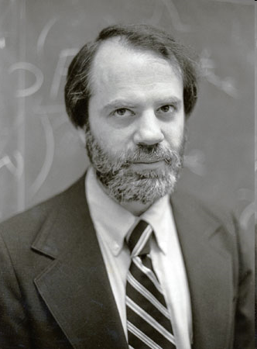
Modal Logic: Semantics
Semantics is given in terms of Kripke Structures (also known as possible worlds structures)
Due to American logician Saul Kripke, City University of NY
A Kripke Structure is (W, R)
  W is a set of possible worlds
  R : W × W is an binary accessibility relation over W
  This relation tells us how worlds are accessed from other worlds
Saul Kripke
We already introduced two close to one another ways of representing such set of possible worlds.
There will be many more.
He was called “the greatest philosopher of the 20st century

Slide 40
Kripke Semantics of Modal Logic
The “universe” seen as a collection of worlds.
Truth defined “in each world”.
Say U is the universe.
I.e. each w ∈ U is a prepositional or predicate model.
W₁
W4
W2
W3

Slide 41
Kripke Semantics of Modal Logic
W₁ satisfies X if X is satisfied in each world accessible from W₁.
  If W₃ and W₄ satisfy X.
  Notation:
    W₁ |= X if and only if
      W₃ |= X and W₄ |= X
W₁ satisfies ◊ X if X is satisfied in at least one world accessible from W₁.
W4
W₁
W2
W3
Notation:
  W₁ |= ◊ X if and only if
    W₃ |= X or W₄ |= X

Slide 42
Meaning of Entailment
Entailment says what we can deduce about state of world, what is true in them.
Part of the Definition of entailment relation :
  M,w |= ϕ if ϕ is true in w
  M,w |= ϕ ∧ ψ if M,w |= ϕ and M,w |= ψ
Given Kripke model with state w
formula
If there are two formulas that are true in some world w than a logic AND of these formulas is also true in this world.
state w

Slide 43
Semantics of Modal Logic: Definition of Entailment
Kripke Structure
A world
Definition of Kripke Model
A Kripke model is a pair M,w where
  M = (W, R) is a Kripke structure and
  w ∈ W is a world
The entailment relation is defined as follows:
  M,w |= ϕ if ϕ is true in w
  M,w |= ϕ ∧ ψ if M,w |= ϕ and M,w |= ψ
  M,w |= ¬ϕ if and only if we do not have M,w |= ϕ
  M,w |= ϕ if and only if ∀w’ ∈ W such that R(w,w’) we have M,w’ |= ϕ
Definition of Entailment Relation in Kripke Model
It is true in every word that is accessible from world w
accessibility relation over W

Slide 44
Satisfiable formulas in Kripke models for modal logic
In classical logic we have the concept of valid formulas and satisfiable formulas.
In modal logic it is as in classical logic:
  Any formula ϕ is valid (written |= ϕ) if and only if ϕ is true in all Kripke models
  E.g. ϕ ∨ ¬ϕ is valid
  Any formula ϕ is satisfiable if and only if ϕ is true in some Kripke models
We write M, |= ϕ if ϕ is true in all worlds of M

Slide 45
Relation to classical satisfiability and entailment
For a particular set of propositional constants P, a Kripke model is a three-tuple <W, R, V> .
  W is the set of worlds.
  R is a subset of W × W, which defines a directed graph over W.
  V maps each propositional constant to the set of worlds in which it is true.
Conceptually, a Kripke model is a directed graph where each node is a propositional model.
Given a Kripke model M = <W,R, V> , each world w ∈ W corresponds to a propositional model:
  it says which propositions are true in that world.
  In each such world, satisfaction for propositional logic is defined as usual.
Satisfaction is also defined at each world for and ◊ , and this is where R is important.
A sentence is possibly true at a particular world whenever the sentence is true in one of the worlds adjacent to that world in the graph defined by R.
P,s
¬P,s
W4
W₁
¬r
W2
W3
¬s, r

Slide 46
Relation to classical satisfiability and entailment
Satisfiability can also be defined without reference to a particular world and is often called global satisfiability.
A sentence is globally satisfied by model M = <W,R, V> exactly when for every world w ∈ W it is the case that |=_{M,w} ϕ.
Entailment in modal logic is defined as usual:
  “ the premises Δ logically entail the conclusion ϕ whenever every Kripke model that satisfies Δ also satisfies ϕ.”
Please observe that I talk about every Kripke model and not every world of one Kripke Model

Slide 47
Modal Logic: Axiomatics of system K
Is there a set of minimal axioms that allows us to derive precisely all the valid sentences?
Some well-known axioms of basic modal logic are:
  Axiom(Classical) All propositional tautologies are valid
  Axiom (K) (ϕ ∧ (ϕ →ψ)) → ψ is valid
  Rule (Modus Ponens) if ϕ and ϕ →ψ are valid, infer that ψ is valid
  Rule (Necessitation) if ϕ is valid, infer that ϕ is valid
These are enough, but many other can be added for convenience

Slide 48
Sound and complete sets of inference rules in Modal Logic Axiomatics
Refresher:
remember that
  A set of inference rules (i.e. an inference procedure) is sound if everything it concludes is true
  A set of inference rules (i.e. an inference procedure) is complete if it can find all true sentences
Theorem:
System K is sound and complete for the class of all Kripke models.

Slide 49
Multiple Modal Operators
We can define a modal logic with n modal operators ₁, …, _{n} as follows:
  We would have a single set of worlds W
  n accessibility relations R₁, …, R_{n}
  Semantics of each _{i} is defined in terms of R_{i}
Powerful concept – many accessibility relations

Slide 50
Axiomatic theory of the knowledge logic

Slide 51
Axiomatic theory of the knowledge logic
Objective: Come up with a sound and complete axiom system for the partition model of knowledge.
Note: This corresponds to a more restricted set of models than the set of all Kripke models.
In other words, we will need more axioms.

Slide 52
Axiomatic theory of the knowledge logic
K_{i} means “agent i knows that”
The modal operator _{i} becomes K_{i}
Worlds accessible from w according to R_{i} are those indistinguishable to agent i from world w
K_{i} means “agent i knows that”
Start with the simple axioms:
  (Classical) All propositional tautologies are valid
  (Modus Ponens) if ϕ and ϕ →ψ are valid, infer that ψ is valid
Now we are defining a logic of knowledge on top of standard modal logic.

Slide 53
Axiomatic theory of the knowledge logic
(More Axioms)
(K) From (K_{i}ϕ ∧ K_{i}(ϕ →ψ)) infer K_{i}ψ
  Means that the agent knows all the consequences of his knowledge
  This is also known as logical omniscience
(Necessitation) From ϕ, infer that K_{i}ϕ
  Means that the agent knows all propositional tautologies
Remember, we introduced the rule K
This defines some logic
In a sense, these agents are inhuman, they are more like God, which started this whole area of research
So far, axioms were like in alethic modal logic

Slide 54
Axiomatic theory of the knowledge logic
(Now we add More Axioms)
Axiom (D) ¬ K_{i} (ϕ ∧ ¬ϕ)
  This is called the axiom of consistency
Axiom (T) (K_{i} ϕ) → ϕ
  This is called the veridity axiom
  Means that if an agent knows something than is true.
  Corresponds to assuming that accessability relation R_{i} is reflexive
Axiom D means that nobody can know nonsense, inconsistency
Remember symbols D and T of axioms, each of them will be used to create some type of logic

Slide 55
Refresher: what is Euclidean relation?
Binary relation R over domain Y is Euclidian
  if and only if
  ∀y, y’, y’’ ∈ Y, if (y,y’) ∈ R and (y,y’’) ∈ R then (y’,y’’) ∈ R
(y,y’) ∈ R and (y,y’’) ∈ R then (y’,y’’) ∈ R
y
R
y’
y
R
y’
R
R
R
y’’
y’’

Slide 56
Axiomatic theory of the knowledge logic
(Now we add More Axioms)
Axiom (4) K_{i} ϕ → K_{i} K_{i} ϕ
  Called the positive introspection axiom
  Corresponds to assuming that R_{i} is transitive
Axiom (5) ¬K_{i} ϕ → K_{i} ¬K_{i} ϕ
  Called the negative introspection axiom
  Corresponds to assuming that R_{i} is Euclidian
Remember symbols 4 and 5 of axioms, each of them will be used to create some type of logic

Slide 57
Overview of Axioms
Table. Axioms and corresponding constraints on the accessibility relation.
Proposition: a binary relation is an equivalence relation if and only if it is reflexive, transitive and Euclidean
Proposition: a binary relation is an equivalence relation if and only if it is reflexive, transitive and symmetric
Some modal logic systems take only a subset of this set. All general , problem independent theorems can be derived from only these axioms and some additional, problem specific axioms describing the given puzzle, game or research problem.

Slide 58
What to do with these axioms?
Now that we have these axioms, we can take some of their sets , add them to classical logic axioms and create new modal logics.
The most used is system K45

Slide 59
Axiomatic theory of the partition model (back to the partition model)
System KT45 exactly captures the properties of knowledge defined in the partition model
System KT45 is also known as system S5
S5 is sound and complete for the class of all partition models

Slide 60
modern version of S5 invented by Bjorssberg
This logic is used for automated and semi-automated:
  proof design,
  discovery,
  and verification.
This logic was formalized and implemented in system X.
This tool comes from Computational Logic Technologies.
We now review this version of S5.
Since S5 subsumes the propositional calculus, we review this primitive system as well.
And in addition, since in LRT* quantification over propositional variables is allowed, we review the predicate calculus (= first-order logic) as well.

Slide 61
Modern Versions of the Propositional and Predicate Calculi, and Lewis' S5
Presented version of S5, as well as the other proof systems available in X, use an ”accounting system“ related to the system described by Suppes (1957).
In such systems, each line in a proof is established with respect to some set of assumptions.
  an “Assume" inference rule, which cites no premises, is used to justify a formulae ' with respect to the set of assumptions {ϕ}.
Unless otherwise specified, the formulae justified by other inference rules have as their set of assumptions the union of the sets of assumptions of their premises.
Some inference rules, e.g., conditional introduction, justify formulae while discharging assumptions.

Slide 62
necessity count in modal logics T, S4 and S5
The accounting approach can be applied to keep track of other properties or attributes in a proof.
Proof steps in X for modal systems keep a “necessity count" which indicates how many times necessity introduction may be applied.
While assumption tracking remains the same through various proof systems, and a formula's assumptions are determined just by its supporting inference rule, necessity counting varies between different modal systems (e.g., T, S4, and S5).
In fact, in X, the differences between T, S4, and S5, are determined entirely by variations in necessity counting.
In X, a formula's necessity count is a non-negative integer, or inf, and the default propagation scheme is that a formula's necessity count is the minimum of its premises' necessity counts.

Slide 63
The exceptional rules for systems T, S4, and S5
The exceptional rules are as follows:
  (i) a formula justified by necessity elimination has a necessity count one greater than its premise;
  (ii) a formula justified by necessity introduction has a necessity count is one less than its premise;
  (iii) any theorem (i.e., a formula derived with no assumptions) has an infinite necessity count.
The variations in necessity counting that produce T, S4, and S5, are as follows:
  in T, a formula has a necessity count of 0, unless any of the conditions (i{iii) above apply;
  S4 is as T, except that every necessity has an infinite necessity count;
  S5 is as S4, except that every modal formula (i.e., every necessity and possibility) has an infinite necessity count.

Slide 64
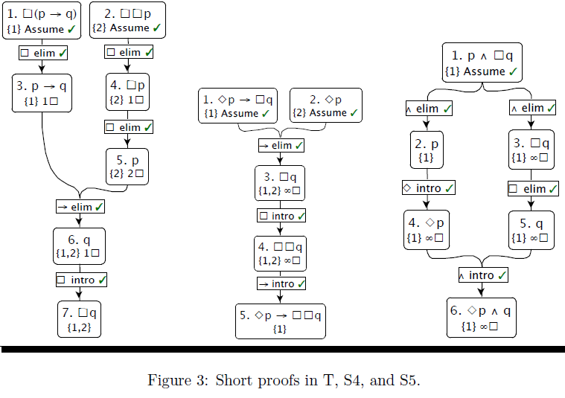
Examples of proofs in modal logic

Slide 65
We add introduction rules and elimination rules for the modal operators
The modal proof systems add
  introduction rules and
  elimination rules
  for the modal operators
Since LRT* is based on S5, a more involved S5 proof is given in next slide
The proof shown therein also demonstrates the use of rules based on machine reasoning systems that act as oracles for certain proof systems.
For instance,
  the rule “PC " uses an automated theorem prover
  to search for a proof in the propositional calculus
  of its conclusion from its premises.

Slide 66
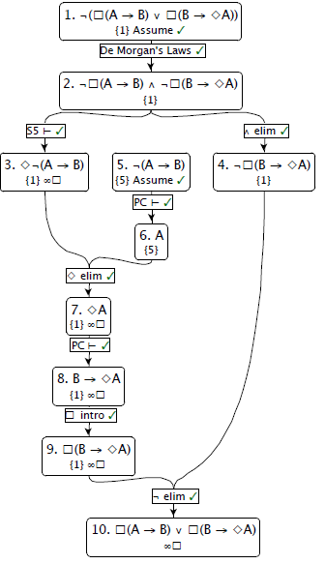
We assume the negation of what we want to prove
A modal proof in S5 demonstrating that (A → B) \/ (B → ◊ A).
Note the use of “PC |- " and
“S5 |- " which check inferences by using machine reasoning systems integrated with X.
“PC |- " serves as an oracle for the propositional calculus,
“S5 |- " for S5.

Slide 67
And now a test…
Next slide has a problem formulation of a relatively not difficult but not trivial problem in modal logic.
Please try to solve it by yourself, not looking to my solution.
If you want, you can look to internet for examples of theorems in modal logic that you can use in addition to those that are in my slides. I do not know if this would help to find a better solution but I would be interested in all what you get.
Good luck. You can use system BK, or any other system of modal logic from these slides.

Slide 68
We will give more examples to motivate you to modal logic using puzzles and games
More examples to motivate thinking about models and modal logic.

Slide 69
formalism of X system
A formula ϕ derived with respect to the set of assumptions Φ using a proof calculus C serves as a demonstration that Φ |- _{C} ϕ .
When Φ is the empty set, then ϕ is a theorem of C, in symbols, |- _{C} ϕ.
The line-by-line presentation of proofs is not strictly necessary, and there are often “equivalent“ proofs which differ only by ordering of certain lines.
Interchanging lines 1 and 2 above, for instance, does not essentially change the proof.
In X, proofs are presented graphically, in tree form, which makes the essential structure of the proof more apparent.
When a formula's set of assumption is non-empty, it is displayed with the formula.

Slide 70
The logic of requirement LRT

Slide 71
The logic of requirement LRT
Lewis was an advisor of Chisholm
Chrisholm introduced the ”logic of requirement"
The ”logic of requirement" is based on a tricky ethical conditional that has the flavor, in part, of a subjunctive conditional in English (Chisholm 1974).
In this language, a conditional like “If it were the case that Greece had the oil reserves of Norway, its economy would be smooth and stable" is in the subjunctive mood.
Chisholm's ethical conditional is abbreviated as `pRq,' and is to be read:
  “The (ethical) requirement that q would be imposed if it were the case that p.‘”
It should be clear that this is a subjunctive conditional.

Slide 72
The logic of requirement LRT
Quinn (1978) bases LRT on Chisholm's logic.
Quinn uses `M' for an informal logical possibility operator.
Quinn writes that LRT subsumes the propositional and predicate calculi.
The machinery of the predicate calculus is needed because quantification over propositional variables is part of the approach.
Quinn's approach is axiomatic.

Slide 73
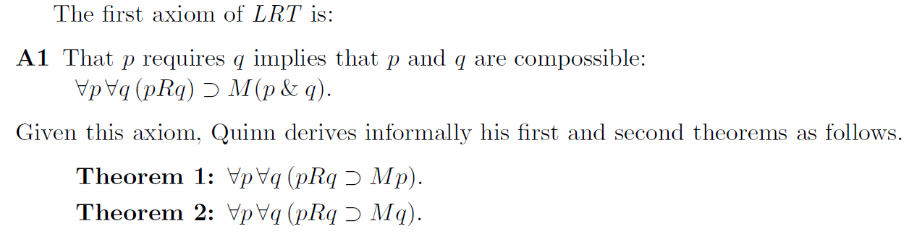
Axioms of LRT system of Quinn

Slide 74
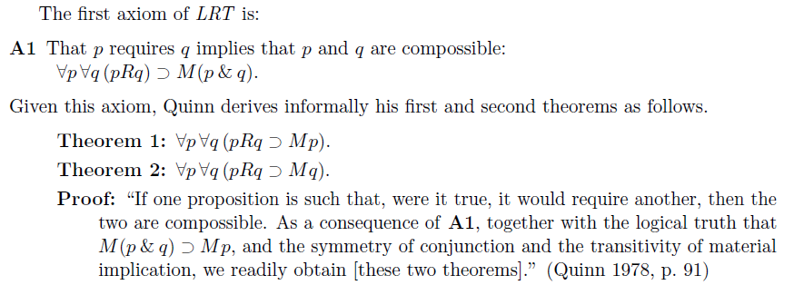

Slide 75
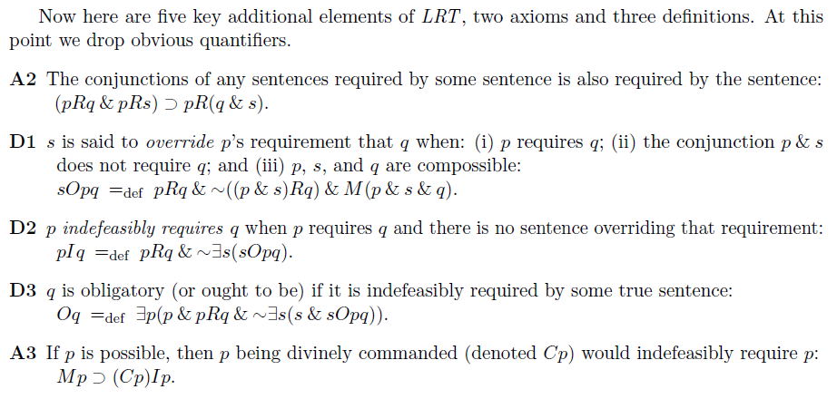

Slide 76
The Logic LRT *

Slide 77
The Logic LRT *
Proof-theoretically speaking, we take LRT* to subsume our version of Lewis' S5, PC, and FOL.
We shall write Chisholm's conditional, which as we have seen operates on pairs of propositions, as pBq;
  this notation pays homage to modern conditional logic (an overview is presented in Nute 1984).
As LRT* in X is a natural-deduction style proof calculus, we introduce rules corresponding to the axioms A1-A3;
  The rules, A1 and A3 license inferring an instance of the consequent of the corresponding axiom from an instance of its antecedent.

Slide 78
The Logic LRT *
The A2 inference rule generalizes the axiomatic form slightly.
The A2 inference rule allows two or more premises to be cited which correspond to the conjuncts appearing in the A2 axiom
The A2 inference rule justifies the similarly formed conclusion.
Chisholm built the logic not on propositional variables, but rather on variables for states-of-affairs
But, following Quinn (1978), we shall simply quantify over propositional variables.

Slide 79
Examples of LRT*,
To begin our presentation of LRT*, we first present some formal proofs (including Theorems 1 and 2 from above) in X (see next slide)

Slide 80
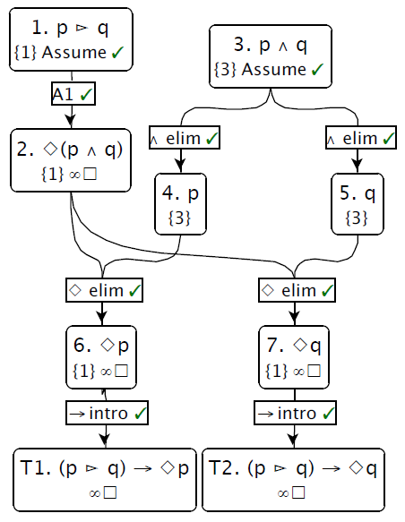
Proofs of modal theorems T1 and T2 in LRT*
An X proof of Theorems T1 and T2.
Note that:
  each Theorem is in the scope of no assumptions
  each Theorem has an infinite necessity reserve
These are the characteristics of theorems in a modal system.

Slide 81
To begin our presentation of LRT*, we first present some formal proofs (including Theorems 1 and 2 from above) in X (see Figure 5).
In addition to the proofs of Theorems 1 and 2, Figure 5 gives proofs of two interesting properties of the alethic modalities in LRT ?:
  (i) impossible sentences impose no requirements and are never imposed as requirements; and
  (ii) any necessitation that imposes any requirement, or which is imposed as a requirement, in fact, obtains.
The latter, perhaps surprising, result follows immediately from Theorems 1 and 2 and the fact that in S5, which LRT* subsumes, iterated modalities are reduced to their rightmost modality, and, specifically, ◊ p → p.

Slide 82
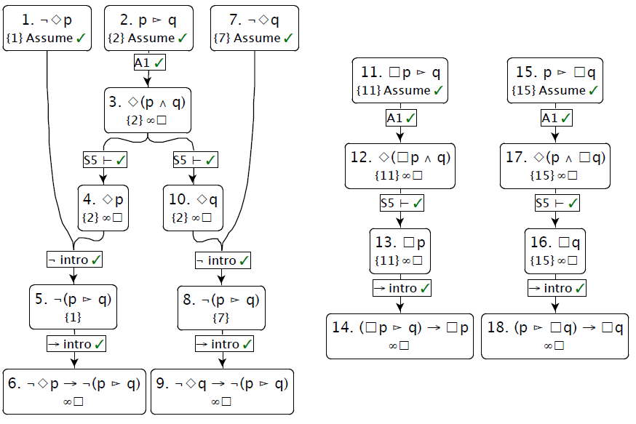
Fig 5
(Right) More LRT* theorems using A1. 7 and 10 express the truth that impossible sentences impose no requirements, and are not imposed by any sentences. 16 and 17 express, perhaps surprising, truths that if any necessitation were to impose a requirement, or were a necessitation a requirement, then the necessitation would, in fact, obtain.

Slide 83
d
In Figure 6 we recreate proofs of Quinn's third and fourth theorems.
Theorem 3 expresses the fact that in LRT* ? the requirements imposed by any sentence are consistent; that is, no sentence imposes both another and its negation.
Theorem 4, a somewhat more complicated formula, shows that, in LRT*, if two sentences p and q impose contradictory requirements, then their conjunction p ^ q must fail to impose at least one of the contradictory requirements.
Note that Theorem 4 does not state that their conjunction p ^ q is impossible, or even simply false, but rather makes a more nuanced statement about the interaction between requirements imposed by conjunctions and the requirements imposed by their conjuncts.
Theorems 3 and 4 also use the A2 in addition to the A1 rule used earlier.

Slide 84
(Right) More LRT* theorems using A1.
7 and 10 express the truth that impossible sentences impose no requirements, and are not imposed by any sentences.
16 and 17 express, perhaps surprising, truths that if any necessitation were to impose a requirement, or were a necessitation a requirement, then the necessitation would, in fact, obtain.
Figure 6:

Slide 85
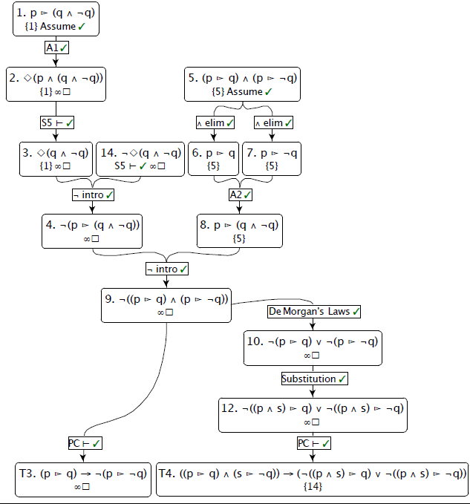
Figure 6:
Theorems 3 and 4 require the use of A2.
Theorem 3 expresses the proposition that no sentence requires another and its negation.
Theorem 4 expresses the proposition that if any sentences p and s were to impose contradictory requirements, then at least one of the contradictory requirements would not be imposed by the conjunction of p and s.

Slide 86
Semantics of Modal Logic

Slide 87
Semantics of Modal Logic
Frame A frame is a structure F = (W,R), where W is a set of possible worlds and R ⊆ W X W is the accessibility relation.
Model A model is a pair M = (F,V) where F = (W,R) is a frame and
V:W pow(P) is a valuation.
Satisfaction
M,w |= p iff p Є V(w) for p Є P
M,w |= ¬α  iff M,w |≠ α
M,w |= (α∨β) iff M,w |= α or M,w |= β
M,w |= ❏α iff for each w' Є W, if wRw' then M,w' |= α

Slide 88
Semantics contd...
Satisfiability and validity
A formula α is satisfiable if there exists a frame F = (W,R) and a model M = (F,V) such that M,w |= α for some w Є W.
A formula α is valid ,written |= α, if for every frame F = (W,R), for every model M = (F,V) and for every w Є W, M,w |=α.
Some examples of valid formulas :
(i) Every tautology of propositional logic is valid.
(ii) ❏(α ⊃ β) ⊃ (❏α ⊃ ❏β)
(iii) Suppose that α is valid. Then, ❏α must also be valid.

Slide 89
Correspondence Theory
Let α be a formula of modal logic. With α, we identify a class of frames Cα as follows :
F = (W,R) Є Cα iff for every valuation V over W, for every world w Є W and for every substitution instance β of α ((W,R),V),w |= β.
Characterising classes of frames
  We say a class of frames C is characterised by the formula α if C=Cα.
  Some examples of frame conditions which can be characterised by formulas of modal logic.
  (i) The class of reflexive frames is characterised by the formula
  ❏α⊃α.

Slide 90
Characterizing classes of frames contd..
(ii) The class of transitive frames is characterised by the formula
❏α⊃❏❏α.
(iii)The class of symmetric frames is characterised by the formula
α⊃❏◊α.
(iv)The class of Euclidean frames is characterised by the formula ◊α⊃❏◊α.
An accessibility relation R over W is Euclidean if for all w,w',w'' W, ifwRw'and wRw'' , then w'Rw'' and w'' R w'.

Slide 91
Bisimulations
Let M1 = ((W1,R1),V1) and M2 = ((W2,R2),V2) be a pair of models.
A bisimulation is a relation ~ ⊆ W1 X W2 satisfying the following conditions.
  If w1 ~ w2 and w1 R1 w1', then there exists w2' such that w2 R2 w2' and w1' ~ w2'.
  If w1 ~ w2 and w2 R1 w2', then there exists w1' such that w1 R2 w1' and w1' ~ w2'.
  If w1 ~ w2, then V1(w1) = V2(w2).

Slide 92
Bisimulations
Lemma
Let ~ be a bisimulation between
M1 = ((W1,R1),V1)
and
M2 = ((W2,R2),V2).
For all w1 Є W1 and w2 Є W2,
if w1 ~ w2,
then for all formulas ,
M1,w1 |= α iff M2,w2 |=α .

Slide 93
Bisimulations contd ...
Lemma
The class of irreflexive frames cannot be characterised in modal logic.
Lemma
Let α be a formula which is satisfiable over the class of reflexive and transitive frames.
Then, α is satisfiable in a model based on reflexive, transitive and antisymmetric frame.
M = ((W,R),V) R is reflexive and transitive.
M^ = ((W^,R^),V^) R^ is reflexive, transitive and antisymmetric.
X ⊆ W is a cluster if X x X ⊆ R.
Cl be the class of maximal clusters.
X ∈ Cl if X is a cluster and for each w ∉X, (X∪ {w}) x (X∪ {w}) ⊄ R

Slide 94
For each X ∈Cl , define Wx = X x N
We define an accessibility relation within Wx.
Fix an arbitrary total order ≤x on X.
Rx = {((w,i),(w,i)) | w∈X and i ∈N}
 ∪ {((w,i),(w',i))| w,w' ∈ X and w ≤x w'}
 ∪ {((w,i),(w',j))| w,w' ∈ X and i < j}
We define a relation across maximal clusters based on the original accessibility relation R:
R' = ∪ {(Wx X Wy) | X ≠ Y
and for some w ∈ X and w' ∈ Y, wRw'}

Slide 95
We define the new frame (W^,R^) corresponding to (W,R) as
W^ = ∪ x∈cl Wx
R^ = R' ∪ (∪ x∈cl Rx)
We extend (W^,R^) to a model by defining V^((w,i)) = V(w) for all w ∈ W and i ∈N.
We define a relation ~ ⊆ W^ x W as follows:
~ = {((w,i),w)|w ∈ W,i ∈ N}

Slide 96
Axiomatizing valid formulas
Axiom System K
Axioms
(A0) All tautologies of propositional logic.
(K) ❏(α⊃β) ⊃ (❏α⊃❏β)
Inference Rules
(MP) α,α⊃β | β
(G) α | ❏α

Slide 97
Proof of completeness
Consistency
A formula α is consistent with respect to System K if there is no proof for ¬α.
A finite set of formulas is consistent if their conjunction is consistent.
An arbitrary set of formulas X is consistent if every finite subset of X is consistent.
Lemma
Let α be a formula which is consistent with respect to System K.
Then, α is satisfiable.
Corollary
Let α be a formula which is valid.
Then α has a proof in System K.

Slide 98
Maximal Consistent Sets
A set of formulas X is a maximal consistent set or MCS if X is consistent and for all α ∉ X, X ∪ {α} is inconsistent.
By Lindenbaum's Lemma, every consistent set of formulas can be extended to an MCS.
Let X be a maximal consistent set
  (i) For all formulas α, α ∈X iff α ∉ X.
  (ii) For all formulas α,β, α∨β ∈X iff α ∈X or β ∈X.
  (iii) If β is a substitution instance of an axiom, then β ∈X.
  (iv) If α⊃β ∈X and α ∈X, then β ∈X.

Slide 99
Canonical Model
The canonical frame for System K is the pair Fk = (Wk,Rk) where
  (1) Wk = {X | X is an MCS }
  (2) If X and Y are MCSs, then X Rk Y iff {α | ❏α ∈ X} ⊆ Y.
The canonical model for System K is given by Mk = (Fk,Vk) where for each X ∈Wk, Vk(X) = X ∩ P.
Lemma
For each MCS X ∈Wk and for each formula α ∈ Φ,Mk,X |= α iff α ∈ X.
Proof by induction on the structure of α.
Let α be a formula which is consistent with respect to System K. By Lindenbaum's Lemma, α can be extended to a maximal consistent set Xα. By preceding result M,Xα |= α , so α is satisfiable.

Slide 100
Semantics of Modal Logic
(□ and ◊)
The semantics of a modal logic ML is defined through:
a set of worlds W = {w₁, w₂, ..., w_{n}},
an accessibility relation R⊆W×W, and
an interpretation function υ: α→{0,1}

Slide 101
Semantics of Modal Logic (◻ and ◊)
The interpretation in ML of a formula P, Q, ... of the propositional language of ML corresponds to its truth value in the "current world":
  υ_{w} (P)=1 iff I(P) is true in w.
  υ_{w} (P∧Q)=1 iff I(P∧Q) is true in w.
  ...

Slide 102
Semantics of Modal Logic (□ and ◊)
We extend the semantics with an interpretation of the operators □ and ◊, specified relative to a "current world" w.
  For all w∈W:
  υ_{w} (□α)=1 iff ∀w': (w,w')∈R ⇒ υ_{w'} (α)=1 ;
  0 otherwise.
  υ_{w} (◊α)=1 iff ∃w': (w,w')∈R ∧ υ_{w'} (α)=1 ;
  0 otherwise.
Note: Often, the operator ◊ is defined in terms of □:
  ◊α ≡ ¬□¬α

Slide 103
Semantics of Modal Logic (□ and ◊)
We can also prove the equivalence of □ and ◊ for our definitions above:
υ_{w} (¬□α)=1 iff ¬(υ_{w} (□α)=1) (or υ_{w} (□α)=0)
iff ¬∀w': (w,w')∈R ⇒ υ_{w'} (α)=1
iff ∃w': (w,w')∈R ∧ υ_{w'} (α)=0
iff ∃w': (w,w')∈R ∧ υ_{w'} (¬α)=1
iff υ_{w} (◊¬α)=1
This means: ¬□α ⇔ ◊¬α
Exercise: Proof ◊α ≡ ¬□¬α !

Slide 104
Semantics of Modal Logic (□ and ◊)
Other logical operators are interpreted as usual, e.g.
υ_{w} (¬□α)=1 iff υ_{w} (□α)=0

Slide 105
Semantics of ML - Complex Formulas
The interpretation of a complex formula of ML is based on the interpretation of the atomic propositional symbols, and then composed using the interpretation function υ defined above, e.g.
  υ_{w} (¬□α)=1 iff ¬(∀w': (w,w')∈R ⇒ υ_{w'} (α)=1)
  iff ∃w': (w,w')∈R ∧ υ_{w'} (α)=0
Let's say α ≡ (P∨Q).
  ∃w': (w,w')∈R ∧ υ_{w'} (P∨Q)=0
  ∃w': (w,w')∈R ∧ (υ_{w'} (P)=0 ∨ υ_{w'} (Q)=0)
"P or Q" is not necessarily true in world w, if there is a world w', accessible from w, in which P is false or Q is false.

Slide 106
Semantics of Modal Logic - Grounding
The interpretation in ML of a formula P, Q, ... of the propositional language of ML corresponds to its truth value in the "current world":
  υ_{w} (P)=1 iff I(P) is true in w.
  υ_{w} (P∧Q)=1 iff I(P∧Q) is true in w.
  ...

Slide 107
Semantics of Modal Logic
A formula α is satisfied in a world w of a Model M=<W,R,υ>, if it is true in this world w∈W under the given interpretation υ, i.e. υ_{w} (α)=1.
M, w |= α
A formula α is true in a Model M=<W,R,υ>, if it is satisfied in all worlds w∈W of M.
M |= α
A formula α is valid, if it is true in all Models.
∅|= α
A formula α is satisfiable, if it is satisfied in at least one world w∈W of one Model M=<W,R,υ>. (or: If its negation is not valid.)

Slide 108
Semantics of Modal Logic
A formula α is satisfied in a world w of a Model M=<W,R,υ>, if it is true in this world under the given interpretation υ, i.e. υ_{w} (α)=1.
M, w |= α
A formula α is true in a Model M=<W,R,υ>, if it is satisfied in all worlds w∈W of M.
M |= α
A formula α is valid, if it is true in all Models.
∅ |= α
A formula α is satisfiable, if it is satisfied in at least one world w∈W of one Model M=<W,R,υ>. (or: If its negation is not valid.)
A formula α is a consequence of a set of formulas Φ in M=<W,r,υ>, if in all worlds w∈W, in which Φ is satisfied, α is also satisfied.
Φ |= α

Slide 109
Semantics of Modal Logic: Terminology
Sometimes the term "frame" is used to refer to worlds and their connection through the accessibility relation:
A frame <W, R> is a pair consisting of a non-empty set W (of worlds) and a binary relation R on W.
A model <F, υ> consists of a frame F, and a valuation υ that assigns truth values to each atomic sentence at each world in W.

