Slide 1
Quantum Phase Estimation using Multivalued Logic

Slide 2
Agenda
Importance of Quantum Phase Estimation (QPE)
QPE using binary logic
QPE using MVL
Performance Requirements
Salient features
Conclusion

Slide 3
Introduction
QPE – one of the most important quantum subroutines, used in :
1) Shor’s Algorithm
2) Abrams and Lloyd Algorithm
(Simulating quantum systems)
Calculation of Molecular Ground State Energies
3) Quantum Counting (for Grover Search)
4) Fourier Transform on arbitrary Z_{p}

Slide 4
Abstract
We generalize the Quantum Phase Estimation algorithm to MVL logic.
We show the quantum circuits for QPE using qudits.
We derive the performance requirements of the QPE to achieve high probability of success.
We show how this leads to logarithmic decrease in the number of qudits and exponential decrease in error probability of the QPE algorithm as the value of the radix d increases.

Slide 5
General Controlled Gates

Slide 6
This is nothing new, CNOT, CV, CV+
This is a new concept, but essentially the same concept and mathematics

Slide 7
Another new concept – we use controlled powers of some Unitary Matrix U

Slide 8
REMINDER OF EIGENVALUES AND EIGENVECTORS

Slide 9
What is eigenvalue?
MATRIX * VECTOR = Constant * VECTOR
Eigenvector of this Matrix
Eigenvalue of this Matrix

Slide 10
Basic Math for Binary Phase Estimation

Slide 11
Finding the eigenvalue is the same as finding its phase φ

Slide 13
We initialize to all states
we measure the phase
Index register to store the eigenvalue
Target register
Unitary operator for which we calculate phase of eigenvalue using phase kickback

Slide 14
Formulas for the phase estimation algorithm
(
)
This is the input to QFT

Slide 15
Because e ^{jφ} is an eigenvallue of U

Slide 16
Assume k an integer
Number of bits
We found phase

Slide 17
Concluding, we can calculate phase

Slide 18
Towards Generalization of Phase Estimation

Slide 19
Agenda
Importance of Quantum Phase Estimation (QPE)
QPE using binary logic
QPE using MVL
Performance Requirements
Salient features
Conclusion
ISMVL 2011, 23-25 May 2011, Tuusula, Finland

Slide 20
Abstract
We generalize the Quantum Phase Estimation algorithm to MVL logic.
We show the quantum circuits for QPE using qudits.
We derive the performance requirements of the QPE to achieve high probability of success.
We show how this leads to logarithmic decrease in the number of qudits and exponential decrease in error probability of the QPE algorithm as the value of the radix d increases.
ISMVL 2011, 23-25 May 2011, Tuusula, Finland

Slide 21
Introduction
QPE – one of the most important quantum subroutines, used in :
1) Shor’s Algorithm
2) Abrams and Lloyd Algorithm
(Simulating quantum systems)
Calculation of Molecular Ground State Energies
3) Quantum Counting (for Grover Search)
4) Fourier Transform on arbitrary Z_{p}
ISMVL 2011, 23-25 May 2011, Tuusula, Finland

Slide 22
Quantum phase estimation (QPE)
ISMVL 2011, 23-25 May 2011, Tuusula, Finland

Slide 23
QPE – Formal Definition
phase
ISMVL 2011, 23-25 May 2011, Tuusula, Finland

Slide 24
QPE Algorithm– Binary logic case
We first review the binary case:
Schematic for the QPE Algorithm
Measure phase in t qubits
Eigenvector of U

Slide 25
QPE : step 1 – Initialization, Binary logic case
ISMVL 2011, 23-25 May 2011, Tuusula, Finland

Slide 26
QPE : step 2 – Apply the operator U
Binary logic case

Slide 27
QPE : step 3 – Apply Inverse QFT
Binary logic case

Slide 28
QPE : step 4 - Measurement
Binary logic case
If the phase _{u} is an exact binary fraction, we measure the estimate of the phase _{u} with probability of 1.
If not, then we measure the estimate of the phase with a very high probability close to 1.
ISMVL 2011, 23-25 May 2011, Tuusula, Finland

Slide 29
Quantum circuit for u^{j}
Binary logic case
The circuit for QFT is well known and hence not discussed.

Slide 30
Multiple-Valued Phase Estimation

Slide 31
MV logic case
Now we have qudits not qubits
We have t qudits for phase
Now we have arbitrary Chrestenson instead Hadamard
Now we Inverse QFT on base d, not base 2

Slide 32
QFT and Chrestenson
MV logic case

Slide 33
MV logic case

Slide 34
MV logic case
ISMVL 2011, 23-25 May 2011, Tuusula, Finland

Slide 35
MV logic case
We apply inverse Quantum Fourier Transform
ISMVL 2011, 23-25 May, Tuusula, Finland

Slide 36
MV logic case
ISMVL 2011, 23-25 May, Tuusula, Finland

Slide 37
MV logic case
These are d-valued quantum multiplexers

Slide 38
D-valued quantum multiplexers
Case d=3
control
0
1
2
Target (date)

Slide 39
MV logic case
ISMVL 2011, 23-25 May, Tuusula, Finland

Slide 40
Performance of Quantum Phase Estimation

Slide 41
MV logic case
ISMVL 2011, 23-25 May, Tuusula, Finland

Slide 42
binary
ISMVL 2011, 23-25 May, Tuusula, Finland

Slide 43
MV logic case

Slide 44
MV logic case
ISMVL 2011, 23-25 May, Tuusula, Finland

Slide 45
MV logic case
ISMVL 2011, 23-25 May, Tuusula, Finland

Slide 46
MV logic case

Slide 47
ISMVL 2011, 23-25 May, Tuusula, Finland

Slide 48
ISMVL 2011, 23-25 May, Tuusula, Finland

Slide 49
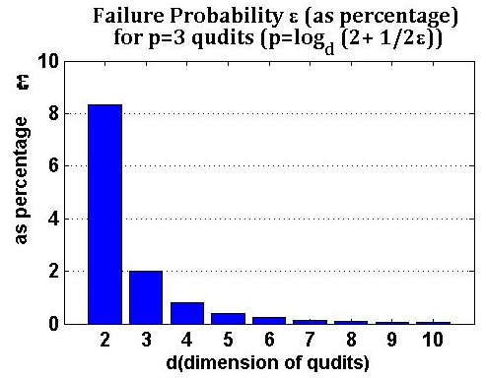
How MVL HELPS
Failure probability decreases exponentially with increase in radix d of the logic used

Slide 50
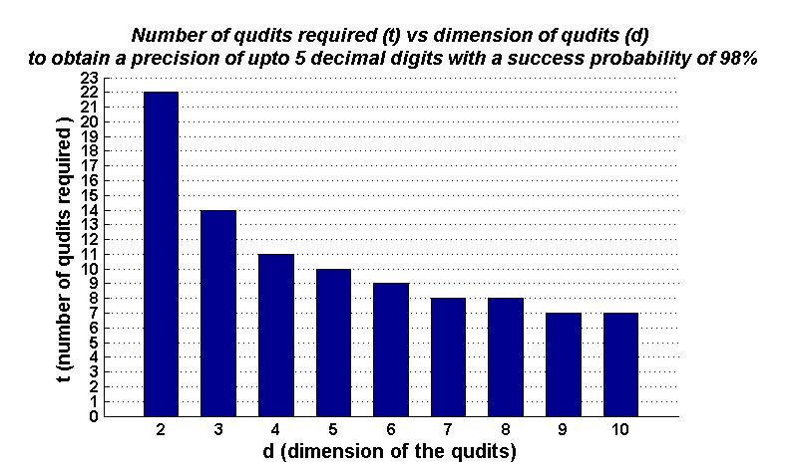
Less number of qudits for a given precision
These are the requirements for a real world problem of calculating molecular energies

Slide 51
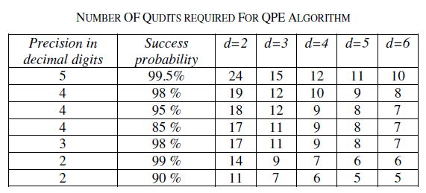
More RESULTS
ISMVL 2011, 23-25 May 2011, Tuusula, Finland
ISMVL 2011, 23-25 May, Tuusula, Finland

Slide 52
Conclusions
Quantum Phase Estimation has many applications in Quantum Computing
MVL is very helpful for Quantum Phase Estimation
Using MVL causes exponential decrease in the failure probability for a given precision of phase required.
Using MVL results in signification reduction in the number of qudits required as radix d increases
ISMVL 2011, 23-25 May 2011, Tuusula, Finland

Slide 53
Conclusions 2
The method creates high power unitary matrices U^{k} of the original Matrix U for which eigenvector |u> we want to find phase.
We cannot design these matrices as powers. This would be extremely wasteful
We have to calculate these matrices and decompose them to gates
New type of quantum logic synthesis problem: not permutative U, not arbitrary U, there are other problems like that, we found
This research problem has been not solved in literature even in case of binary unitary matrices U
ISMVL 2011, 23-25 May 2011, Tuusula, Finland

