Slide 1
SYNTHESIS OF REVERSIBLE CIRCUITS WITH NO ANCILLA BITS FOR LARGE REVERSIBLE FUNCTIONS SPECIFIED WITH BIT EQUATIONS
Nouraddin Alhagi, Maher Hawash, Marek Perkowski,
Portland Quantum Logic Group
2010

Slide 2
Outline
WHAT
Reversible Circuits
Logic Synthesis:
Synthesis with no ancilla bits (MMD - n*n)
Synthesis with small number of ancilla bits (Perkowski/Mishchenko, Khlopotine – (n+m)*(n+m))
Synthesis with very many ancilla bits (Dreschler, Wille)
HOW
MMD^{{0,1}} & company
New ideas – Multiple Pass (MP) algorithm
Generalized Ordering for MMD Algorithm
No truth tables are needed.
Truth tables reduce the size of functions that can be handled

Slide 3
What is reversible logic ?
a
a
b
f = a © b
A | B | Q
0 | 0 | 0
0 | 1 | 0
1 | 0 | 1
1 | 1 | 0
a | b | a | f
0 | 0 | 0 | 0
0 | 1 | 0 | 1
1 | 0 | 1 | 1
1 | 1 | 1 | 0
Equal # bits
onto Relation: 1-to-1

Slide 4
Reversible Gates
Plain Ole NOT
a
a
a
a
Feynman Gate
b
f =a © b
a
a
b
b
Toffoli Gate
c
f =a²b © c
a
b
Fredkin Gate = controlled SWAP
b
a

Slide 5
Graph on how over time energy wasted by physics of device will be less than wasted by loss of information
Every future technology must be reversible – IBM and Sandia study
Energy lost for physical design reasons when one bit of information is lost (switching)
Energy lost for information theory reasons when one bit of information is lost
Here reversible logic
will become
critical
Year 2012 - 2020

Slide 6
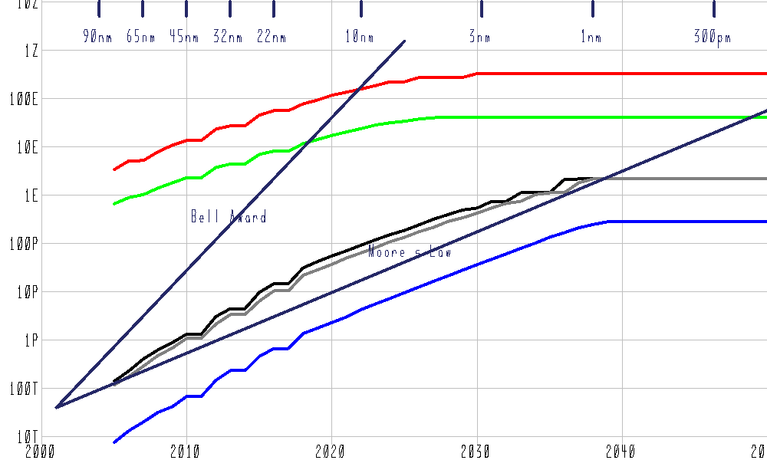
Quantum dot CA with reversible logic
Irreversible CMOS
Quantum dot CA without reversible logic
Picture from Reversible Logic for Supercomputing
Erik P. DeBenedictis, Sandia National Laboratories
P. O. Box 5800 MS 1110, Albuquerque, NM USA 87185-1110 +1 (505) 284-4017, epdeben@sandia.gov
Figure 7: Time Trend of various technologies for performing global climate modeling per [15].
Red=Quantum Dot Cellular Automata [22] with reversible logic and special purpose (non-μP architecture);
Green=Quantum Dot Cellular Automata [22] with reversible logic and μP parameters; Black=irreversible
CMOS with special purpose (non μP) architecture, Blue= irreversible CMOS μP.

Slide 7
Real-world Applications of Reversible Logic
Technologies:
Low Power design – adiabatic CMOS
Y gates and ballistic circuits
Quantum Dots and Quantum Cellular Automata
Quantum Computing (truly quantum phenomena)
Optical computing
DNA
System Ideas:
Digital signal processing
Cryptography
Computer graphics
Network congestion

Slide 8
Logic Synthesis & Minimization
Transform the in/out relation into logic gates,
Where:
Every Input generates corresponding Output
While Optimizing for:
Minimum number of gates
Minimum number of control lines.
Minimum quantum cost (various definitions)
a | b | a | f
0 | 0 | 0 | 0
0 | 1 | 0 | 1
1 | 0 | 1 | 1
1 | 1 | 1 | 0
a
a
b
f =a © b
Presented results use quantum cost but they can be extended for other reversible technology

Slide 9
Previous work on reversible synthesis with no ancilla bits
Binary Logic Synthesis
M²D – Miller, Maslov, Dueck
Single Input Sequence
Single direction and Bidirectional Variants
Template Matching
M²DS- + Stedman
MMD + All Valid Input Sequences
M²DSN- + Nouraddin
MMDS + Select Stedman Sequences
MP – select sequences and simulation of minterms
MV Logic Synthesis
Miller’s work again
Single Input Sequence
All examples only Two Trits
Our new approach, Use the ideas of MP. bigger circuits

Slide 10
Previous work on reversible synthesis with no ancilla bits - MMD
Reversible logic for quantum computing is recently flourishing research area, not for others (optical, ballistic, quantum dots).
The MMD algorithm (Miller, Maslov and Dueck) is currently the leading reversible logic synthesizer
MMD assumes a reversible function specification as data and it uses no ancilla bits.
MMD software is reasonably fast and it distinguishes itself among other programs of this type because it achieves (theoretical) 100% convergence regardless the problem size.
This program is therefore the current benchmark for the evaluation of programs for reversible circuit synthesis.

Slide 11
Previous work on reversible synthesis (methods that assume no ancilla bits)
2002-present Perkowski et al use of complexities of ESOPs, FPRMs and Maitra cascades in the cost functions that evaluate the search results.
2004 Agrawal and Jha’s algorithm uses the number of terms in the Positive Polarity Reed-Muller (PPRM) expansion of synthesized functions as its cost function.
2004 Kerntopf’s algorithm uses complexity of SBDD’s as its cost function.

Slide 12
Since the gate choice heuristic is currently being pursued elsewhere, the goal of this work is to explore whether or not other input orders can be used with 100% convergence.

Slide 13
MMD Background
The MMD algorithm transforms step-by-step a reversible function to its identity function.
The function is arranged in a natural binary code order by inputs assignments.
Each iteration adds a gate in order to correctly transform the outputs to equal the inputs without changing any of the previously assigned output patterns (minterms).
Gates are chosen to reduce the cost function such as a Hamming distance of the gate choice function to the original function or to identity function.
In some variants the gates can be added bi‑directionally, at the beginning and the end of the cascade.
Once a complete circuit is generated, the original template matching approach is applied to reduce the gate cost, which is a variant of local optimization method.

Slide 14
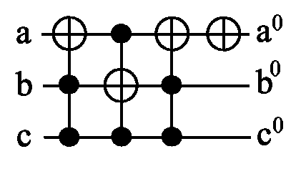
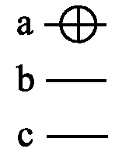
The Basic Algorithm
c b a
in
000
001
010
011
100
101
110
111
out
001
000
011
010
101
111
100
110
S1
000
001
010
011
100
110
101
111
S1
000
001
010
011
100
110
101
111
S1
000
001
010
011
100
110
101
111
S2
000
001
010
011
100
111
101
110
S3
000
001
010
011
100
101
111
110
S3
000
001
010
011
100
101
111
110
S3
000
001
010
011
100
101
110
111
Final circuit
From Miller, Maslov and Dueck

Slide 15
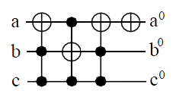
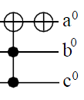
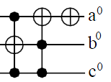
MMD “Transformation Based Algorithm for Reversible Logic Synthesis”
Round 1
Cardinal Rule: No Completed Output can be changed

Slide 16
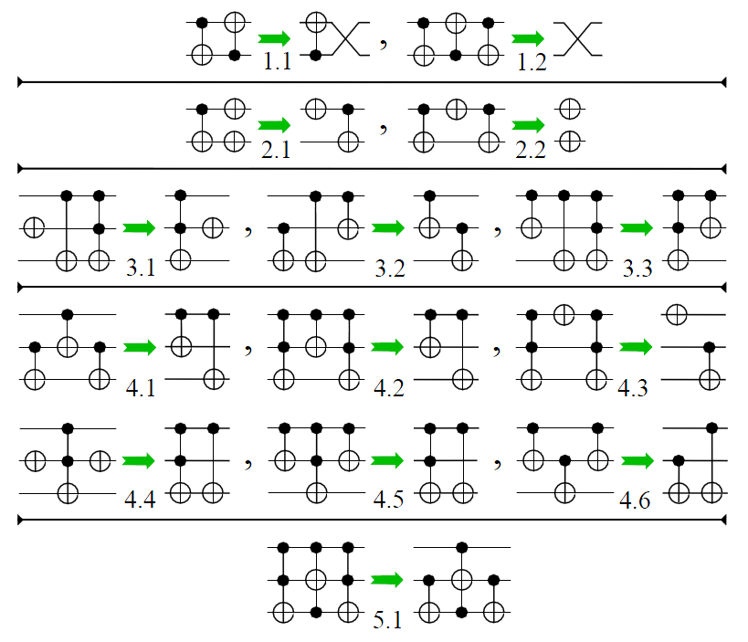
MMD “Transformation Based Algorithm for Reversible Logic Synthesis”
Round 1
Single Input Sequence
Bidirectional Application
Post Template Matching

Slide 17
The weaknesses of MMD include:
For n-variable functions it uses a permutation vector of length 2^{n} as its input data which precludes from using it for large circuits.
It works only with completely specified functions, thus excluding initial specifications being relations or incompletely specified functions.
It does not allow to create arbitrary orders of output functions, which would be one more degree of freedom and is useful in some problems of quantum layout-level optimization.
It needs template matching method to optimize its results because only one order of realizing minterms is used in it and the initial result may be far from minimum.
It does not allow to investigate the trade-off between the number of ancilla bits and the cost (length of quantum cost or a gate cost) of the cascade.
Below we present our research on improving the MMD’s weaknesses.

Slide 18
MMDS Ordering
Ordering
In this section, MMD’s natural binary order is challenged as the only 100% convergent order.
It is found that MMD’s order falls into a subset of orders that do not exhibit certain important property that we call “control line blocking”.
This observation leads to the creation of what we call the “MMDS ordering”.

Slide 19
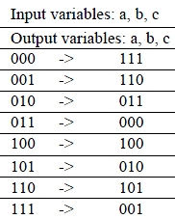
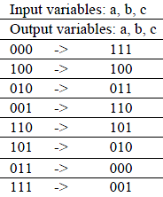
The idea to extend from Natural Ordering of Minterms to more general orderings.
MMDS = Stedman: “Synthesis of reversible circuits with small ancilla bits for large irreversible incompletely specified multi-output Boolean functions”
Why should “I” Limit my Input order ?
MMD has natural order
MMDS has many other orders

Slide 20
MMDS Ordering
Without any backtracking, bi-directional search or template matching the MMD algorithm with the new ordering uses multiple MMDS input orders to produce better results than the original MMD ordering.
It can be used with any number of inputs and has larger gains compared to MMD when the number of inputs increases.
Our interest is in what orders converge always?

Slide 21
MMDS = Stedman: “Synthesis of reversible circuits with small ancilla bits for large irreversible incompletely specified multi-output Boolean functions”
Round 2
Why should “I” Limit my Input ?
Stedman Order:
for terms i=1..n-1
for terms j=0..i-1
if t[i] = (t[i] & t[j])
reject;
3 bits:
6! = 720 Permutations
MMDS = 48 Non blocking Sequences
4 bits:
14! = 87,178,291,200
MMDS = 78,880 (1,680,382)

Slide 22
MMDSN = Nouraddin: “SYNTHESIS OF REVERSIBLE CIRCUITS With No Ancilla Bits for Large Reversible Functions Specified with Bit Equations”
Round 3
Does the ONE has the Power?
Why should I “Not” Limit myInput?
Nouraddin Order: Rule: Never to take a dominating node before a dominated node
for bits i=0..n-1
Randomize (i) {
All orders with ‘i’ ones.
}
Hasse Diagram
Processes Input Equations
Less Memory footprint
Slower
3 bits:
3!x3! = 36 Permutations
4 bits:
4!x6!x4! = 414,720 Permutations

Slide 23
Variants of minterm ordering for search algorithms
Ordering of nodes that violates the MMD order, illustrated on the Hasse Diagram.
This is however a valid MMDS ordering.
This is MMDSN ordering
Hasse diagram with binary vectors,
Hasse diagram with natural numbers

Slide 24
MMD Order
New ordering 02134657 for MMD-like binary synthesis, a valid MMDS order which is consistent with the Hasse diagram relations of order.
This is MMDS ordering which is not MMDSN ordering.
MMDSN Orders
MMDS Orders

Slide 25
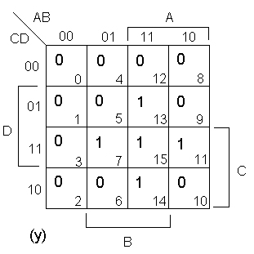
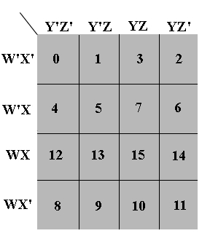
MMDS orders using KMaps
You cannot select 7, 13 or 15 before selecting 5
0101 → 0000, 0100, 0001 are blocked

Slide 26
Allowed order for MMD

Slide 27
Allowed order for MMDS
first
Arbitrary order within the color
Any of these is second
Arbitrary order within the color
Any of these is third
But 3 can be before 4, etc as in no-blocking rule

Slide 28
MMDS orderings with MMD as a special case
0
1
2
4
4
3
2
3
4
5
2
48 orderings for 3 variables
4
5
3
5
6
6
3
5
6
5
3
6
6
6
5
7
7
7
7
7
7
MMD
MMDS
MMDS
MMDS
MMDS
MMDS

Slide 29
Program MP
Using Stedman, Stedman-Nouraddin or other orders
Using simulation and not explicit truth table to allow big functions

Slide 30
Idea of Simulation as implicit truth table in MMD
Circuit C2 = the outcome of synthesis (in reverse order of gates).
outputs
Add gates one by one until identity
Generator of minterms in Stedman Order
Circuit C1 Specification of reversible circuit by equations
Circuit C2
Identity when whole circuit C2 is built
minterm
DIFFERENCE between current output and desired output
Design the gate based on this difference

Slide 31
Idea of Simulation as implicit truth table in MMD
Circuit C1
Circuit C2
Generator of minterms in Stedman Order
minterm
DIFFERENCE between current output and desired output
Design the gate based on this difference

Slide 32
Idea of Simulation as implicit truth table in MMD
Circuit C1
Circuit C2
Generator of minterms in Stedman Order
minterm
DIFFERENCE between current output and desired output
Design the gate based on this difference

Slide 33
Idea of Simulation as implicit truth table in MMD
Circuit C1
Circuit C2
Generator of minterms in Stedman Order
minterm
DIFFERENCE between current output and desired output
Design the gate based on this difference

Slide 34
Idea of Simulation as implicit truth table in MMD
Circuit C1
Circuit C2
Generator of minterms in Stedman Order
minterm
NO DIFFERENCE between current output and desired output
No gate added as we have identity

Slide 35
Identity on every input minterm
Circuit 1 = MIRROR (Circuit 2)
Circuit C1
Circuit C2
Generator of minterms in Stedman Order
minterm
Specification circuit from inputs to outputs
Designed circuit from outputs to inputs

Slide 36
The rise and fall of ONE
{0,1} have Symbolic presence
No energy level preference
Algorithmic Prejudice
Stedman: Control ONLY on ONEs
if t[i] = (t[i] & t[j])
reject;
Nouraddin: Never take a dominating node before a dominated node
ZERO got Power!
Maybe an OR operator
Control On Zero
Could reduce # control lines
1
0

Slide 37
Results for functions with 4 to 11 qubits
# bits | Function | MMD |  |  | MP
 |  | Gates | Q-Cost | Time(ms) | Gates | Q-Cost | Time(ms)
4 | hwb4 | 24 | 120 | 0.577 | 19 | 91 | 339
5 | hwb5 | 62 | 498 | 0.033 | 53 | 389 | 392
6 | hwb6 | 164 | 1,800 | 0.075 | 140 | 1,276 | 613
7 | hwb7 | 382 | 5,614 | 0.247 | 353 | 4,961 | 1503
8 | hwb8 | 883 | 17,927 | 1.312 | 837 | 15,873 | 987
9 | hwb9 | 2050 | 52,318 | 4.171 | 1993 | 48,817 | 4,170
10 | urf3 | 3426 | 119,986 | 12.595 | 3334 | 110,910 | 58,306
11 | urf4 | 10527 | 456,139 | 75.780 | 10336 | 403,184 | 384,589
Comparison of numbers of gates and quantum costs of MMD and MP algorithms for reversible functions with various numbers of bits.
This is “large circuits” variant with k=5000. No ancilla bits.

Slide 38
Table 1 Comparison of MMD, MMDS and MMDSN orders on 50 random functions of 4 variables.
Previous Figure shows the results with k=5000 produced with a single threaded application on a Windows 7 operating system running on a Intel® Core™2 Duo 2.93 GHz processor.
The application allows the user to k to any value to get the trade-off between synthesis time and quantum cost improvement.
Functions of 4 variables.
Next two pages

Slide 39
Function |  | MMDSN |  |  | MMD |  |  | MMDS
 |  | # Gates | Q-Cost | Time (ms) | # Gates | Q-Cost | Time (ms) | # Gates | Q-Cost | Time (ms)
AHP- | 0 | 18 | 102 | 8.393 | 20 | 144 | 1.074 | 15 | 55 | 178,097
AHP- | 10 | 16 | 68 | 6.991 | 29 | 209 | 0.022 | 14 | 42 | 182,428
AHP- | 100 | 22 | 150 | 8.040 | 25 | 149 | 0.018 | 18 | 98 | 205,910
AHP- | 102 | 21 | 109 | 7.653 | 28 | 192 | 0.019 | 19 | 103 | 362,359
AHP- | 104 | 19 | 99 | 7.408 | 28 | 192 | 0.020 | 17 | 73 | 392,670
AHP- | 106 | 21 | 129 | 7.567 | 24 | 116 | 0.016 | 17 | 77 | 438,121
AHP- | 108 | 20 | 108 | 8.078 | 21 | 129 | 0.015 | 17 | 77 | 464,066
AHP- | 1000 | 16 | 80 | 7.497 | 19 | 111 | 0.014 | 14 | 54 | 468,883
AHP- | 1002 | 21 | 113 | 7.513 | 31 | 223 | 0.014 | 18 | 78 | 526,966
AHP- | 1004 | 20 | 136 | 7.056 | 23 | 167 | 0.029 | 15 | 79 | 539,691
AHP- | 1006 | 17 | 93 | 7.495 | 24 | 172 | 0.030 | 17 | 109 | 575,764
AHP- | 1008 | 19 | 95 | 6.682 | 31 | 215 | 0.024 | 18 | 90 | 593,118
AHP- | 1010 | 18 | 74 | 6.953 | 30 | 230 | 0.028 | 17 | 85 | 621,180
AHP- | 1012 | 23 | 131 | 7.146 | 28 | 168 | 0.031 | 18 | 70 | 626,634
AHP- | 1014 | 23 | 139 | 8.069 | 27 | 179 | 0.031 | 19 | 75 | 639,966
AHP- | 1016 | 18 | 126 | 6.748 | 23 | 167 | 0.030 | 15 | 79 | 646,605
AHP- | 1018 | 17 | 105 | 6.939 | 25 | 197 | 0.030 | 15 | 63 | 408,780
AHP- | 1020 | 18 | 106 | 7.317 | 25 | 193 | 1.803 | 16 | 96 | 284,467
AHP- | 1022 | 19 | 111 | 7.697 | 24 | 156 | 0.153 | 14 | 54 | 268,481
AHP- | 1024 | 22 | 138 | 6.622 | 30 | 218 | 0.148 | 16 | 76 | 253,849
AHP- | 1026 | 14 | 66 | 7.252 | 17 | 113 | 0.154 | 14 | 66 | 229,625
AHP- | 1028 | 14 | 86 | 7.343 | 20 | 148 | 0.157 | 13 | 81 | 222,084
AHP- | 1030 | 21 | 137 | 7.776 | 27 | 167 | 0.124 | 16 | 80 | 211,866
AHP- | 1032 | 20 | 108 | 6.726 | 27 | 187 | 0.106 | 17 | 93 | 214,853
AHP- | 1034 | 19 | 123 | 7.132 | 22 | 138 | 0.102 | 15 | 71 | 220,812
AHP- | 1036 | 19 | 107 | 7.257 | 26 | 186 | 0.093 | 17 | 81 | 206,786
AHP- | 1038 | 18 | 106 | 7.927 | 18 | 106 | 0.083 | 13 | 65 | 210,267
AHP- | 1040 | 16 | 96 | 6.478 | 22 | 174 | 0.078 | 11 | 39 | 217,464
AHP- | 1042 | 22 | 146 | 7.263 | 25 | 173 | 0.080 | 19 | 99 | 204,661
AHP- | 1044 | 19 | 107 | 7.325 | 23 | 159 | 0.096 | 16 | 92 | 196,889
AHP- | 1046 | 19 | 107 | 7.739 | 23 | 147 | 0.092 | 15 | 71 | 210,829
AHP- | 1048 | 18 | 94 | 6.484 | 20 | 120 | 0.096 | 17 | 89 | 201,351
AHP- | 1050 | 23 | 123 | 7.325 | 34 | 230 | 0.083 | 19 | 83 | 219,222
AHP- | 1052 | 18 | 110 | 7.557 | 26 | 166 | 0.080 | 16 | 84 | 241,366
AHP- | 1054 | 17 | 81 | 7.226 | 24 | 164 | 0.047 | 16 | 76 | 215,861
AHP- | 1056 | 17 | 93 | 7.757 | 28 | 196 | 0.813 | 15 | 67 | 228,621
AHP- | 1058 | 18 | 118 | 6.991 | 23 | 155 | 0.015 | 15 | 55 | 200,601
AHP- | 1060 | 19 | 151 | 8.110 | 21 | 161 | 0.019 | 15 | 83 | 252,009
AHP- | 1062 | 19 | 107 | 7.268 | 31 | 247 | 0.020 | 16 | 76 | 236,668
AHP- | 1064 | 23 | 131 | 7.357 | 29 | 189 | 0.017 | 20 | 84 | 237,049
AHP- | 1066 | 18 | 122 | 7.055 | 31 | 235 | 0.017 | 15 | 75 | 240,952
AHP- | 1068 | 22 | 134 | 8.606 | 21 | 97 | 0.017 | 19 | 99 | 272,891
AHP- | 1070 | 18 | 106 | 7.707 | 22 | 158 | 0.018 | 16 | 80 | 386,639
AHP- | 1072 | 20 | 112 | 7.611 | 23 | 159 | 0.019 | 16 | 72 | 313,911
AHP- | 1074 | 22 | 126 | 8.236 | 26 | 194 | 0.017 | 18 | 106 | 263,204
AHP- | 1076 | 21 | 121 | 8.644 | 28 | 184 | 0.020 | 18 | 74 | 264,143
AHP- | 1078 | 21 | 105 | 7.690 | 30 | 222 | 0.021 | 18 | 78 | 277,411
AHP- | 1080 | 21 | 145 | 7.879 | 21 | 109 | 0.016 | 17 | 93 | 289,429
AHP- | 1082 | 21 | 133 | 8.109 | 29 | 233 | 0.016 | 16 | 92 | 230,252
AHP- | 1084 | 23 | 119 | 8.797 | 31 | 187 | 0.014 | 20 | 104 | 263,490
AHP- | 1086 | 20 | 116 | 7.367 | 27 | 195 | 0.014 | 17 | 85 | 232,918

Slide 40
Function |  | MMDSN |  |  | MMD |  |  | MMDS
 |  | # Gates | Q-Cost | Time (ms) | # Gates | Q-Cost | Time (ms) | # Gates | Q-Cost | Time (ms)
AHP- | 0 | 18 | 102 | 8.393 | 20 | 144 | 1.074 | 15 | 55 | 178,097
AHP- | 1038 | 18 | 106 | 7.927 | 18 | 106 | 0.083 | 13 | 65 | 210,267
AHP- | 1040 | 16 | 96 | 6.478 | 22 | 174 | 0.078 | 11 | 39 | 217,464
AHP- | 1042 | 22 | 146 | 7.263 | 25 | 173 | 0.080 | 19 | 99 | 204,661
AHP- | 1044 | 19 | 107 | 7.325 | 23 | 159 | 0.096 | 16 | 92 | 196,889
AHP- | 1046 | 19 | 107 | 7.739 | 23 | 147 | 0.092 | 15 | 71 | 210,829
AHP- | 1048 | 18 | 94 | 6.484 | 20 | 120 | 0.096 | 17 | 89 | 201,351
AHP- | 1050 | 23 | 123 | 7.325 | 34 | 230 | 0.083 | 19 | 83 | 219,222
AHP- | 1052 | 18 | 110 | 7.557 | 26 | 166 | 0.080 | 16 | 84 | 241,366
AHP- | 1054 | 17 | 81 | 7.226 | 24 | 164 | 0.047 | 16 | 76 | 215,861
AHP- | 1056 | 17 | 93 | 7.757 | 28 | 196 | 0.813 | 15 | 67 | 228,621
AHP- | 1058 | 18 | 118 | 6.991 | 23 | 155 | 0.015 | 15 | 55 | 200,601
AHP- | 1060 | 19 | 151 | 8.110 | 21 | 161 | 0.019 | 15 | 83 | 252,009
AHP- | 1062 | 19 | 107 | 7.268 | 31 | 247 | 0.020 | 16 | 76 | 236,668
AHP- | 1064 | 23 | 131 | 7.357 | 29 | 189 | 0.017 | 20 | 84 | 237,049
AHP- | 1066 | 18 | 122 | 7.055 | 31 | 235 | 0.017 | 15 | 75 | 240,952
AHP- | 1068 | 22 | 134 | 8.606 | 21 | 97 | 0.017 | 19 | 99 | 272,891
AHP- | 1070 | 18 | 106 | 7.707 | 22 | 158 | 0.018 | 16 | 80 | 386,639
AHP- | 1072 | 20 | 112 | 7.611 | 23 | 159 | 0.019 | 16 | 72 | 313,911
AHP- | 1074 | 22 | 126 | 8.236 | 26 | 194 | 0.017 | 18 | 106 | 263,204
AHP- | 1076 | 21 | 121 | 8.644 | 28 | 184 | 0.020 | 18 | 74 | 264,143
AHP- | 1078 | 21 | 105 | 7.690 | 30 | 222 | 0.021 | 18 | 78 | 277,411
AHP- | 1080 | 21 | 145 | 7.879 | 21 | 109 | 0.016 | 17 | 93 | 289,429
AHP- | 1082 | 21 | 133 | 8.109 | 29 | 233 | 0.016 | 16 | 92 | 230,252
AHP- | 1084 | 23 | 119 | 8.797 | 31 | 187 | 0.014 | 20 | 104 | 263,490
AHP- | 1086 | 20 | 116 | 7.367 | 27 | 195 | 0.014 | 17 | 85 | 232,918

Slide 41
Functions of 30 variables
Not possible for other reversible systems with no ancilla bits.
10 benchmarks – netlists – expressions, 30 variables.
Not format compatible with MMD:
Chal30, 430296 gates generated, 20 orderings, 1 hour and 9 minutes to run.
AHP30_1, 4496 gates, 2 hours and 45 minutes.
Results cited in this paper are currently available on http://www.quantumlib.org:21012.

Slide 42
Conclusions
New version of MMD. More efficient, functions up to 30 variables.
The concept of ordering of minterms, variants of ordering tuned to size of the problem.
The concept of implicit and not explicit calculation of output values – simulation. Input specification can be in any form (equations, reversible circuits with ancilla, BDDs, etc). No truth table or PPRM table.
Trade-off between cost of solution and time of run.
Extended to ternary logic
Extended to hybrid logic

Slide 43
Other ideas and future work:
Importance of linear circuits as pre- and post-processors
Importance of inverters to control gates (not only ones used to control as in MMD).
New Synthesis Approach for large incomplete irreversible functions realized in reversible cascades
Variant of the method is applied to incompletely specified multi-output Boolean functions.
Rules for Selection of gates for given orders, backtracking
Can be applied to large functions that are originally irreversible;
Conversion to reversible is thus a part of the method.
Internally use two programs: MP and the ESOP minimizer Exorcism
Use of Fredkin and Distance Gates (Miller and others)

Slide 44
Other ideas and future work:
Specifications as boolean and MV relations (generalization of don’t cares)
MMD^{{0,1,2}}
Ternary Algebra of controlled gates
Ternary Hasse Diagrams
Counting theorems for various binary and MV orderings

Slide 45
What to remember?
Why future computers must be reversible?
How the MMD algorithm works?
Hasse diagrams and their use.
Various orderings in MP
Why MP decreases dramatically the necessary memory?
The importance of Template Matching. Give examples. How it can be used?

