Slide 1
ECE 171 Digital Circuits
Prof. Marek Perkowski
Maseeh College of Engineering
and Computer Science

Slide 2
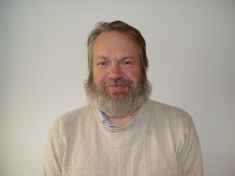
Who is this old guy?
Marek Perkowski obtained his M.S. degree in Electronics and Ph.D. Degree in automatic control from Institute of Automatic Control, Department of Electronics, Technical University of Warsaw, Warsaw, Poland. He studied also pure mathematics at University of Warsaw. In years 1981-1983 he was a Visiting Assistant Professor at University of Minnesota in Minneapolis.
Since 1983 Dr. Perkowski works for Department of Electrical and Computer Engineering at Portland State University where he is a full professor and director of Intelligent Robotics Laboratory.
He worked for Cypress Semiconductor (co-author of WARP, the first FPGA compiler of VHDL), Intel Supercomputer, Sharp Microelectronics, GTE and other companies in areas of computer architecture, CAD tools for logic synthesis and image processing.
Dr. Perkowski invented Kronecker Decision Diagrams and lattices and contributed to logic synthesis software that is used in US industry. In 1994 he worked for Machine Learning group in Wright Laboratories of U.S. Air Force applying logic decomposition as a machine learning approach to pattern recognition and continued this work on several grants.
He is an author of more than 340 papers in CAD, logic synthesis, multiple-valued logic, machine learning, robotics and quantum computing and his research is highly cited. His h-index is 41 and there are more than 6300 citations to his work on Google Scholar. His “ErdÖs Number” is 4 and his ”Publication Distance” to Einstein and many famous researchers is also 4 or 3. He had visiting professor and visiting scientist positions in the Netherlands, France, Japan and Korea. In years 2002-2004 he was professor in KAIST – Korean Advanced Institute of Science and Technology where he participated in research on humanoid robotics and quantum computing.
He chaired the IEEE Technical Committee on Multiple-Valued Logic in years 2003-2005 and was a chair of IEEE Computational Intelligence Society Task Force on Quantum Computing 2006 - 2007. His main current interests are in quantum circuits and algorithms, humanoid bipeds, emotional quantum robots, robotics for teenagers, Grover algorithm, memristor logic and system design and logic synthesis for other nano-technologies such as QCA and STO. He collaborates with many groups worldwide.
Dr. Perkowski works with very talented middle-school and high-school students on projects related to quantum computing, intelligent robotics and image processing. Since 2001, the students that he supervised obtained more than 40 awards in US national and international science fairs and competitions.
His main research area is quantum computing – how to build a new generations of computers based on principles of quantum mechanics. These computers will be significantly more powerful than all contemporary standard computers.

Slide 3
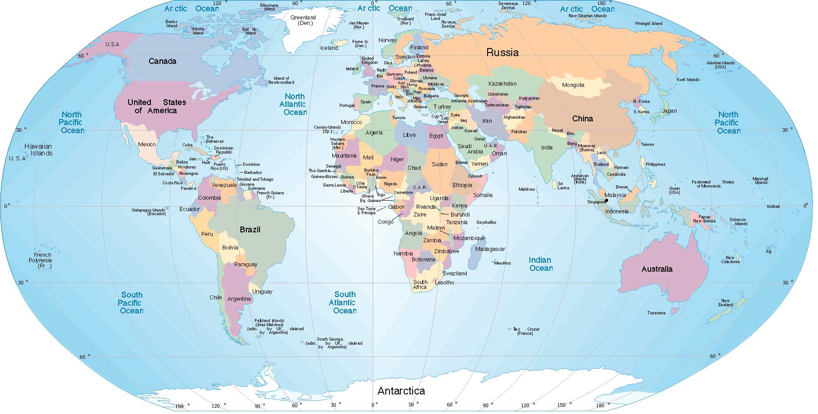
I teach this class since 1970
1970-1981
1981-1983
1996
2010
1996
2002-2005
1983-2017
2002
And it has been exciting

Slide 4
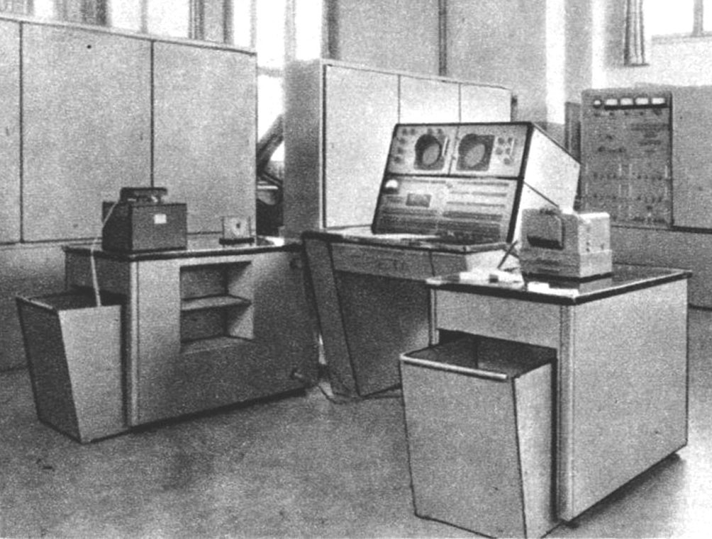
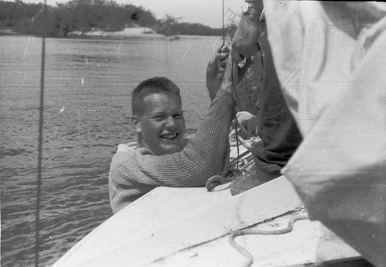
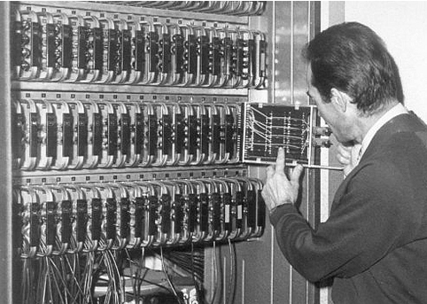
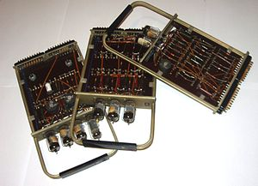
Year 1967
Polish Computer UMC-1
Me in your age
Flip-flops and logic gates

Slide 5
Why Study Digital Systems
Because you’ll probably
Design them
Use them
Interface with them
Program them
They’re ubiquitous
Obvious: PCs, Consumer Electronics
Audio, Video, Cameras, Phones, Cable Set-top Boxes, Games
Also: Appliances, Automobiles, Medical Devices

Slide 6
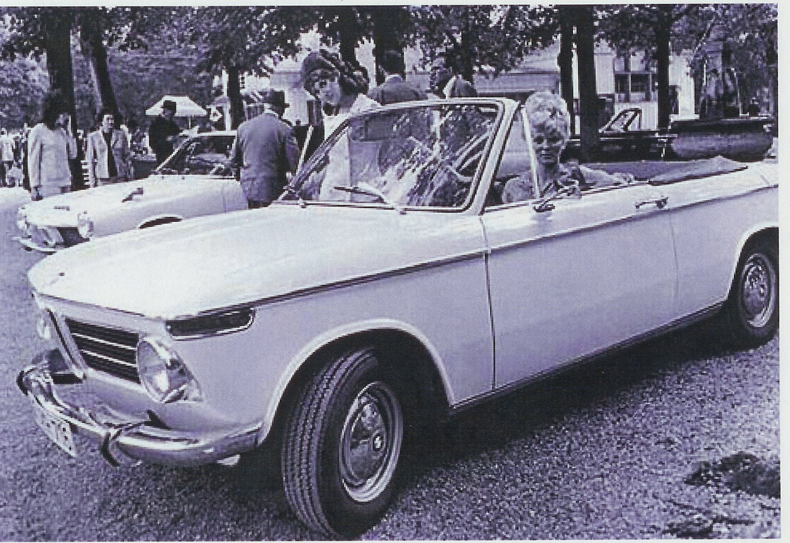
The old days…
Only electronics – car radio (analog)

Slide 7
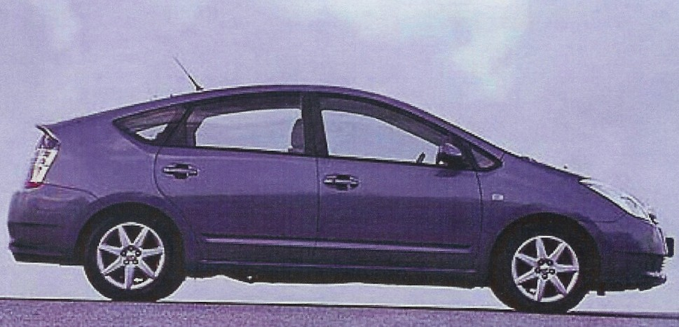
Now…
Hybrid vehicle
>150 motors, solenoids to control
>15 microcontrollers (MCUs)
>100 sensors to be checked
Airbags and belt pretensioners to be fired/pre-fired
60kW of electrical power to control

Slide 8
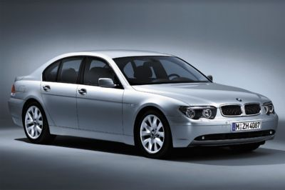
Features
Digital satellite radio
GPS guidance systems
ABS brakes
Fuel injection
Anti-collision systems
Video camera
Cell phone
Entertainment systems (DVD, CD, MP3)
Anti-theft system

Slide 9
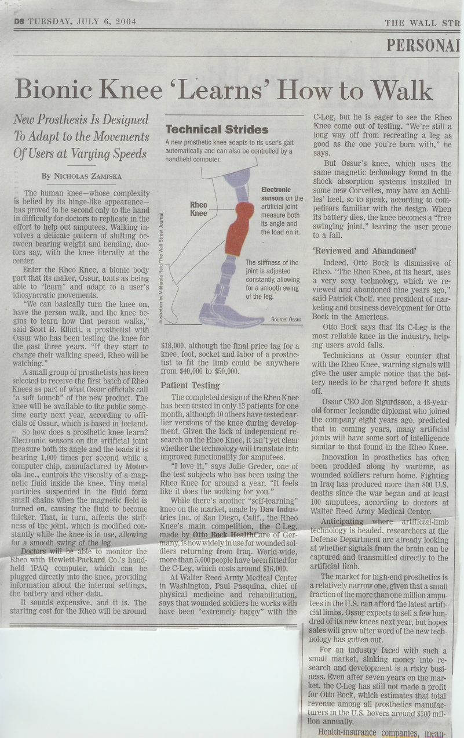
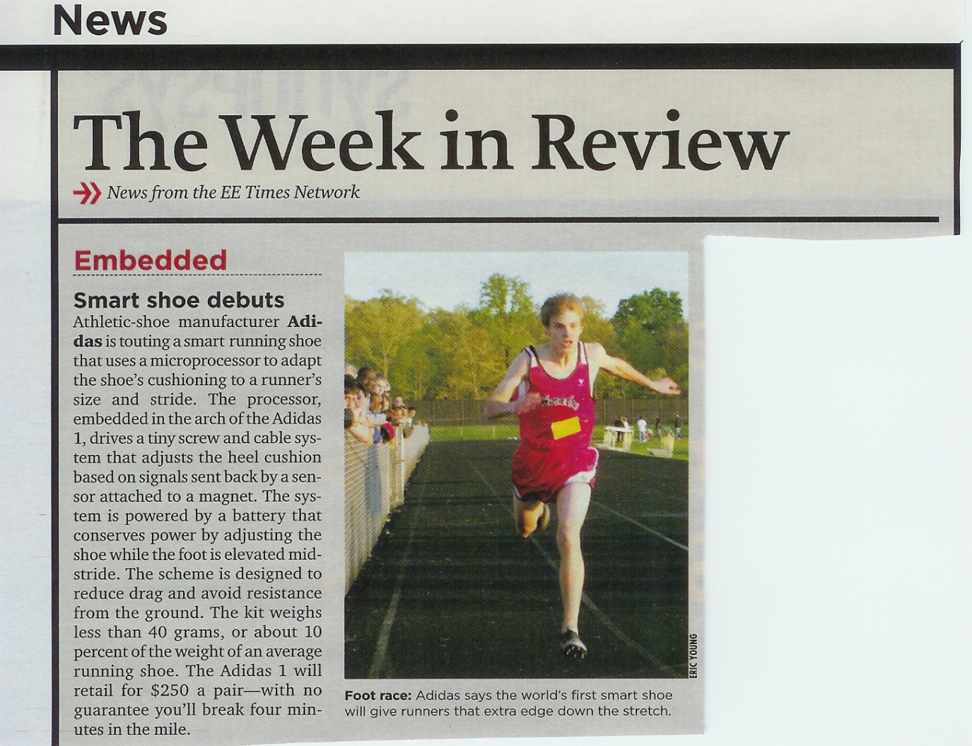
To the “pedestrian”

Slide 10
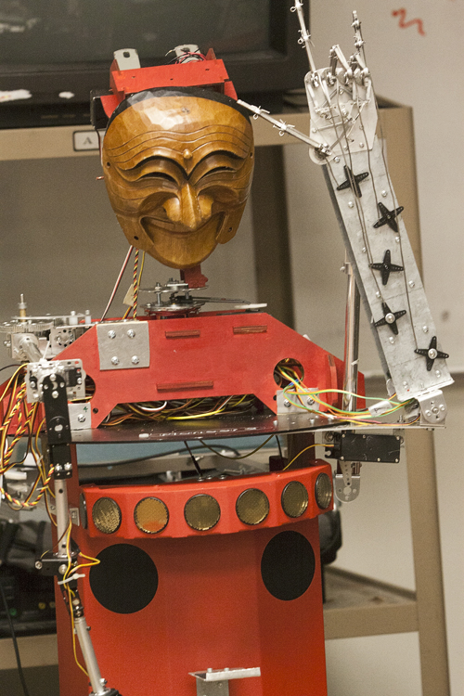
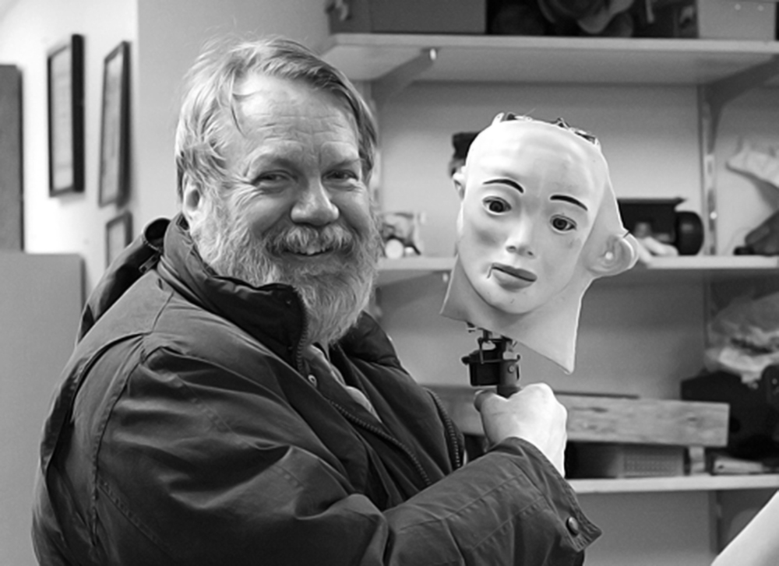
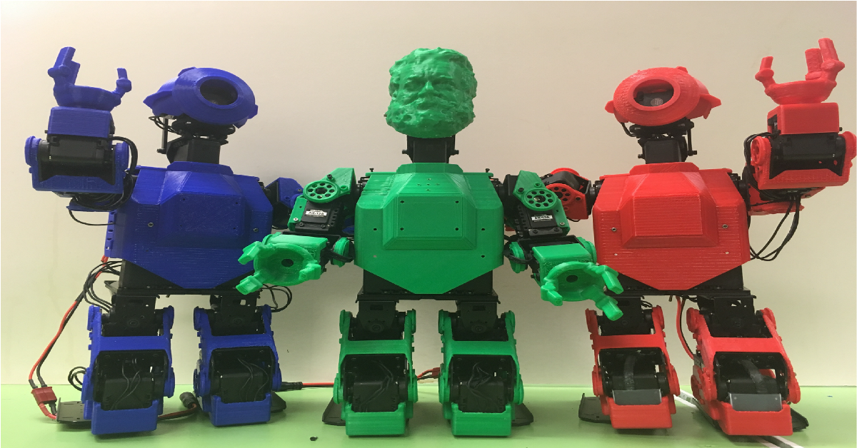
Our Robots

Slide 11
Digital Systems
Two Valued (Binary) System
On/Off
High/Low Voltage
Open/Closed Switch (vs. “Dimmer” Switch)
Magnetized/Unmagnetized
1/0

Slide 12
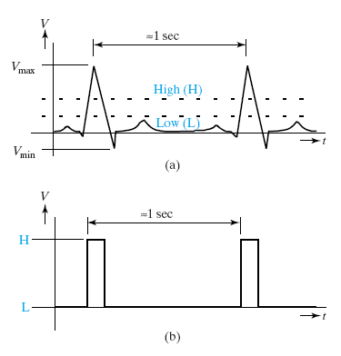
Digital vs. Analog Systems
Analog systems
continuous change
Digital systems
discrete change

Slide 13
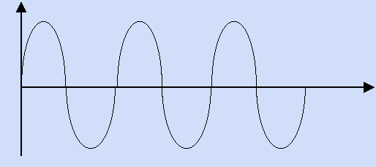
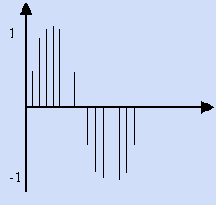
Digital vs. Analog
Continuous
(Analog audio)
Discrete
(Digital audio: CD, MP3)

Slide 14
Lecture 1
Topics
Radix number representations
Decimal, Binary, Octal, Hexadecimal
Conversions
Decimal to Binary, Octal, Hexadecimal
Binary, Octal, Hexadecimal to Decimal
Group of 3 for Octal
Group of 4 for Hexadecimal

Slide 15
Decimal and Binary Numbers

Slide 16
Decimal
MSD = most significant digit
Radix or Base 10 (Why?)
LSD = least significant digit
MSD
100 10 1
10³ 10² 10¹ 10⁰
6 2 3 4
6234₁₀
LSD
6234₁₀ = 6 x 10³ + 2 x 10² + 3 x 10¹ + 4 x 10⁰
d_{n}d_{n-1}…d₁d₀ = d_{n} x 10^{n} + d_{n-1} x 10^{n-1} + … d₁ x 10¹ + d₀ x 10⁰
where: 0 ≤ d ≤ 9
Zero referencing

Slide 17
01
02
03
04
05
06
07
08
09
10
11
12
13
14
15
16
17
18
19
20
21
22
…
Useful tables to remember
1
2
4
8
16
32
64
128
256
512
1024
2048
00
01
02
10
11
12
20
21
22
000
001
010
011
100
101
110
111
decimal
binary
ternary
Powers of two

Slide 18
Decimal
Question: How many unique (non-negative) n digit decimal numbers are there?
10^{n}
1 digit: 0-9, 10 (10¹)
2 digits: 00-99, 100 (10²)
3 digits: 000-999, 1000 (10³)
Question: What’s the largest n digit decimal number?
10^{n}-1
For n=2 it is 10²-1 = 99

Slide 19
Binary
MSB = most significant bit
Radix or Base 2 (Why?)
LSB = least significant bit
MSB
8 4 2 1
2³ 2² 2¹ 2⁰
1 1 0 1
1101₂
word size
LSB
bit
(binary digit)
1101₂ = 1 x 2³ + 1 x 2² + 0 x 2¹ + 1 x 2⁰
d_{n}d_{n-1}…d₁d₀ = d_{n} x 2^{n} + d_{n-1} x 2^{n-1} + … d₁ x 2¹ + d₀ x 2⁰
where: 0 ≤ d ≤ 1
Zero referencing

Slide 20
Binary
4 bit “nibble”
8 bit “byte”
MSB
1101101110010001
LSB
This example: 16 bit word

Slide 21
Binary
Question: How many different (non-negative) n bit binary numbers are there?
2^{n}
1 bit: {0,1} 2 (2¹)
2 bits: {00, 01, 10, 11}, 4 (2²)
3 bits: {000, 001, 010, 011, 100, 101, 110, 111}, 8 (2³)
Question: What’s the largest n bit binary number (what’s the largest number you can represent in an n bit word)?
2^{n}-1

Slide 22
Binary
Question: How many bits (what word size) do you need to represent a number n in binary?
Let’s first ask: How many bits do you need to represent n different binary numbers?
⎡log₂ n⎤
1 bit: n = (2¹) numbers
2 bits: n = (2²) numbers
3 bits: n = (2³) numbers
m bits: n = 2^{m} numbers
Ceiling function because we need an integer number of bits
Now, to represent number n, how many different numbers? n+1, so
⎡log₂ (n+1)⎤
0 and 1
00, 01, 10 and 11
n=4, then ⎡log (4+1)⎤ = 3
100

Slide 23
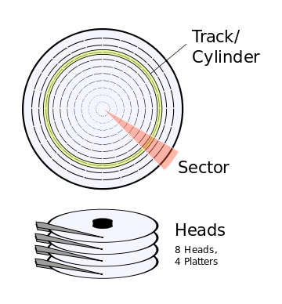
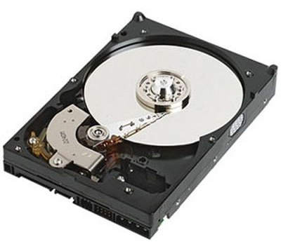
Example: Disk Drives
Early ATA specification for hard disk drives
Identified sectors of 512 (2⁹) bytes each
Cylinder (16 bits), numbered [0..2¹⁶-1]
Head (4 bits), numbered [0..2⁴-1]
Sector (8 bits), numbered [1..2⁸-1]
Limited hard disk capacity
2¹⁶ x 2⁴ x (2⁸-1) x 2⁹ bytes
= 127.5 x 2³⁰ = 127.5 GB
= 136902082560 ≈ 137 x 10⁹ bytes (137 GB)
Notes:
Because disk drives capacity is touted by marketing, they use decimal to make them seem larger! Note: not same as formatted/unformatted capacity, etc.

Slide 24
Decimal Fractions

Slide 25
Decimal Fractions
100 10 1 1/10 1/100 1/1000
10³ 10² 10¹ 10⁰ 10⁻¹ 10⁻² 10⁻³
6 2 3 4 . 1 2 5
6234.125₁₀
6234.125₁₀ = 6 x 10³ + 2 x 10² + 3 x 10¹ + 4 x 10⁰
+ 1 x 10⁻¹ + 2 x 10⁻² + 5 x 10⁻³
d_{n}d_{n-1}…d₁d_{0 .}d_{-1…}d_{-m} = d_{n} x 10^{n} + d_{n-1} x 10^{n-1} + … d₁ x 10¹
+ d₀ x 10⁰ + d₋₁ x 10⁻¹ + … d_{-m} x 10^{-m}
where: 0 ≤ d ≤ 9

Slide 26
Binary Fractions (“Fixed Point”)
8 4 2 1 1/2 1/4 1/8
2³ 2² 2¹ 2⁰ 2⁻¹ 2⁻² 2⁻³
1 1 0 1 . 1 0 1
1101.101₂
1101.101₂ = 1 x 2³ + 1 x 2² + 0 x 2¹ + 1 x 2⁰
+ 1 x 2⁻¹ + 0 x 2⁻² + 1 x 2⁻³
d_{n}d_{n-1}…d₁d_{0 .}d_{-1…}d_{-m} = d_{n} x 2^{n} + d_{n-1} x 2^{n-1} + … d₁ x 2¹
+ d₀ x 2⁰ + d₋₁ x 2⁻¹ + … d_{-m} x 2^{-m}
where: 0 ≤ d ≤ 1

Slide 27
Octal Numbers

Slide 28
Octal
Radix or Base 8 (Why?)
512 64 8 1
8³ 8² 8¹ 8⁰
2 7 3 6
2736₈
2736₈ = 2 x 8³ + 7 x 8² + 3 x 8¹ + 6 x 8⁰
d_{n}d_{n-1}…d₁d₀ = d_{n} x 8^{n} + d_{n-1} x 8^{n-1} + … d₁ x 8¹ + d₀ x 8⁰
where: 0 ≤ d ≤ 7
Why: binary quickly becomes cumbersome for larger numbers, octal has advantage of requiring fewer digits but easily convertible to binary

Slide 29
Octal
Radix or Base 8 (Why?)
Groups of 3 bits (8 = 2³⁾
4 2 1
4 2 1
4 2 1
4 2 1
2736₈ = 010 111 011 110₂
2
7
3
6
2736₈ = 010 111 011 110₂
Why: binary quickly becomes cumbersome for larger numbers, octal has advantage of requiring fewer digits but easily convertible to binary

Slide 30
Converting from Binary to Octal
Example: Convert 10111.11 to Octal
10111.11
Group by 3s
Extend leading, trailing 0s if needed
Convert each grouping to octal
2
7
6
4 2 1
4 2 1
4 2 1
… 010111.110 …
27.6₈

Slide 31
Hexadecimal Numbers

Slide 32
Hexadecimal
10 = A
11 = B
12 = C
13 = D
14 = E
15 = F
Radix or Base 16 (Why?)
4096 256 16 1
16³ 16² 16¹ 16⁰
2 7 3 6
2736₁₆
2736₁₆ = 2 x 16³ + 7 x 16² + 3 x 16¹ + 6 x 16⁰
d_{n}d_{n-1}…d₁d₀ = d_{n} x 16^{n} + d_{n-1} x 16^{n-1} + … d₁ x 16¹ + d_{o} x 16⁰
where: 0 ≤ d ≤ 15 !!
Why: Great if you’re a mutant (16 fingers!). Same reason as octal – better than binary for larger numbers, more popular than octal

Slide 33
Hexadecimal
10 = A
11 = B
12 = C
13 = D
14 = E
15 = F
4096 256 16 1
16³ 16² 16¹ 16⁰
2 A 3 F
2A3F₁₆
2A3F₁₆ = 2 x 16³ + A x 16² + 3 x 16¹ + F x 16⁰
2A3F₁₆ = 2 x 16³ + (10) x 16² + 3 x 16¹ + (15) x 16⁰
2A3F₁₆ = 10815₁₀

Slide 34
Hexadecimal
10 = A
11 = B
12 = C
13 = D
14 = E
15 = F
Radix or Base 16 (Why?)
Groups of 4 bits (16 = 2⁴)
8 4 2 1
8 4 2 1
8 4 2 1
8 4 2 1
2A3F₁₆ = 0010 1010 0011 1111₂
2
A
3
F
2A3F₁₆ = 0010 1010 0011 1111₂

Slide 35
Converting from Binary to Hex
Example: Convert 10111.11 to Hex
10111.11
Group by 4s
Extend leading, trailing 0s if needed
Convert each grouping to hex
1
7
C
8 4 2 1
8 4 2 1
8 4 2 1
… 00010111.1100 …
17.C₁₆

Slide 36
00
01
02
03
04
05
06
07
08
09
0A
0B
0C
0D
0E
0F
10
11
10 = A
11 = B
12 = C
13 = D
14 = E
15 = F
Useful tables to remember
00
01
02
03
04
05
06
07
10
11
12
13
14
15
16
17
20
21
22
23
24
25
26
27
30
hex
octal

Slide 37
Decimal Conversions

Slide 38
Decimal Conversions
Conversions from Decimal
“Subtract the Weights” Method
Repeated Radix Division (RRD)/Multiplication (RRM) Method
Conversions to Decimal
Polynomial Function Method

Slide 39
Subtract the Weights Method to convert from decimal to binary
Example: Convert 76₁₀ to binary
2⁸ = 256
2⁷ = 128
2⁶ = 64
2⁵ = 32
2⁴ = 16
2³ = 8
2² = 4
2¹ = 2
2⁰ = 1
1
0
0
1
1
0
0
76
64 12
12
- 8 4
4
- 4 0
MSB
Generates MSB first
LSB
76₁₀ = 1001100₂
Works for other bases, too
What’s the largest power of 2 that will divide into the quantity?

Slide 40
Repeated Radix Division (RRD) Method to convert to binary
Example: Convert 76₁₀ to binary
Remainder from division by 2
Result of division by2
2 | 76 0
| 38 0
| 19 1
| 9 1
| 4 0
| 2 0
| 1 1
LSB
Generates LSB first
MSB
76₁₀ = 1001100₂
Works for other bases, too
MSB

Slide 41
Repeated Radix Multiplication (RRM) Method to convert to binary
Example: Convert 0.125₁₀ to binary
0.125
x 2
0.250
0.250
x 2
0.500
0.500
x 2
1.000
MSB
LSB
Generates MSB first
Continue multiplying fractional part until 0
Record whole bits generated
0.001₂
Works for other bases, too

Slide 42
Polynomial Function Method
Example: Convert 4B.C2₁₆ to decimal
4B.C2₁₆ = 4 x 16¹ + B x 16⁰ + C x 16⁻¹ + 2 x 16⁻²
= 4 x 16 + (11) x 1 + 12 x 1/16 + 2 x 1/16²
= 4 x 16 + (11) x 1 + 12 x 1/16 + 2 x 1/16²
= 64 + 11 + 12 x 0.0625 + 2 x 0.00390625
= 75 + 0.75 + 0.0078125
= 75.7578125
Fancy name, but just the definition of a radix number

Slide 43
Conversion Summary
From Decimal
RRD Method for Integers (generates LSB first)
RRM Method for Fractions (generates MSB first)
To Decimal
Polynomial Function Method
Between Binary and Hex/Octal
Use Groups of 4 (Hex) or 3 (Octal)
Remember to extend leading/trailing 0s where necessary!
For Conversions Between Decimal/Binary
Consider Using Hex or Octal to Reduce Work
Then Convert Between Binary and Hex/Octal

Slide 44
Decimal | Binary | Octal | Hex
5 | 101 | 5 | 5
6 | 110 | 6 | 6
7 | 111 | 7 | 7
8 | 1000 | 10 | 8
9 | 1001 | 11 | 9
10 | 1010 | 12 | A
11 | 1011 | 13 | B
12 | 1100 | 14 | C
13 | 1101 | 15 | D
14 | 1110 | 16 | E
15 | 1111 | 17 | F

Slide 45
Questions, Problems and Exam Problems
What is the difference between analog and digital signals?
Give examples of digital circuits applications in real life?
Explain general radix notation for arbitrary radix.
Draw table of powers of two.
Draw counting in binary and ternary system with about 30 numbers each.
Explain how to convert from binary to decimal and decimal to binary.
How to convert a ternary number to a binary number?
How to convert a binary number to octal number?
How to convert a binary number to radix 5 number?
How to convert from a hex number to a binary number?
How to convert from a octal number to a hex number?
How to convert between a base 5 number to a base 7 number?

Slide 46
Sources
Mark G. Faust
John Wakerly
Notes:
I talk fast. Ask me to slow down. Let me know if there are words you don’t understand. Let me know if there are concepts you don’t understand.
Poll students: Where in program are you? prior EE/ECE classes? Programming? Work experience?

