Slide 1
Lecture 3
Topics
  IEEE 754 Floating Point
  Binary Codes
    BCD
    ASCII, Unicode
    Gray Code
    7-Segment Code
    M-out-of-n codes
  Serial line codes

Slide 2
Floating Point Numbers

Slide 3
Floating Point
Need to represent “real” numbers
Fixed point too restrictive for precision and range
Not unlike familiar “scientific notation”
+ 6.022 x 10²³
Sign
Mantissa
Exponent
Normalized mantissa – single digit to left of decimal point

Slide 4
IEEE 754 Floating Point Standard
Sign
Binary
Exponent
Significand
+ 1.101011 x 2¹²
Sign
Mantissa
Exponent
1
Fraction
A normalized (binary) mantissa will always have a leading 1
so we can assume it and get an extra bit of precision instead
Exponents are stored with a bias which is added to the exponent before being stored (allows fast magnitude compare)
Universally used on virtually all computers
Several levels of precision/range: Single, Double, Double-Extended

Slide 5
Floating-Point Standards
The IEEE has established a standard for floating-point numbers
The IEEE-754 single precision floating point standard uses an 8-bit exponent (with a bias of 127) and a 23-bit significand.
The IEEE-754 double precision standard uses an 11-bit exponent (with a bias of 1023) and a 52-bit significand.

Slide 6
IEEE 754 Single Precision Floating Point Standard

Slide 7
IEEE 754 Floating Point Standard
Single Precision – 32 bits, Bias = 127
1
8
23
±
Exponent + Bias
Significand
31
30
23
22
0
Observe that here we have Exponent plus BIAS
F = -1^{Sign} x (1+Significand) x 2^{(Exponent-Bias)}

Slide 8
IEEE 754 Floating Point Standard
Hidden 1
Example
F = -1^{Sign} x (1+Significand) x 2^{(Exponent-Bias)}
1
8
Remember to add 1
23
1
10000001
01000000000000000000000
31
30
23
22
0
-
129
= 0.25₁₀
= - 1.01₂ x 2⁽¹²⁹⁻¹²⁷⁾
= - 1.25 x 2⁽¹²⁹⁻¹²⁷⁾
= - 1.25 x 2²
= - 1.25 x 4
= - 5.0
= - 1.01₂ x 2⁽¹²⁹⁻¹²⁷⁾
= - 1.01₂ x 2²
= - 101₂
= - 5.0

Slide 9
IEEE 754 Floating Point Standard
Will commonly see these expressed as hex
1
8
23
1
10000001
01000000000000000000000
31
30
23
22
0
8+2
8+4
C0A00000
1010 A
1011 B
1100 C

Slide 10
Example of calculation of Floating-Point Representation
Example: Express -3.75 as a floating point number using IEEE single precision.
First, let’s normalize according to IEEE rules:
  3.75 = -11.11₂ = -1.111 x 2¹
  The bias is 127, so we add 127 + 1 = 128 (this is our final exponent+bias)
  The first 1 in the significand is implied, so we have:
  Since we have an implied 1 in the significand, this equates to
    -(1).111₂ x 2 ^{(128 – 127)} = -1.111₂ x 2¹ = -11.11₂ = -3.75.
(implied)
verification
F = -1^{Sign} x (1+Significand) x 2^{(Exponent-Bias)}

Slide 11
FP Ranges
For a 32 bit number
  8 bit exponent
  +/- 2²⁵⁶ ≈ 1.5 x 10⁷⁷
Accuracy
  The effect of changing lsb of significand
  23 bit significand 2⁻²³ ≈ 1.2 x 10⁻⁷
  About 6 decimal places

Slide 12
IEEE 754 Floating Point Standard:
SPECIAL CASES:
Zeros, Infinities, Denormalized

Slide 13
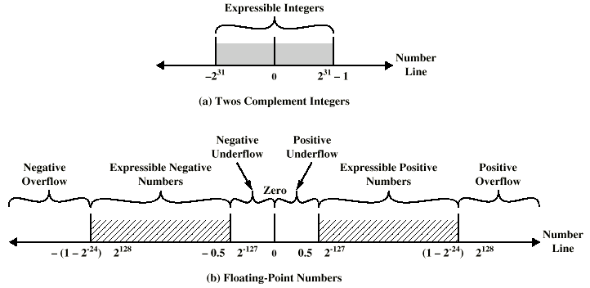
Expressible Numbers in two typical 32-bit formats

Slide 14
Representation of Floating Point Numbers
IEEE 754 single precision
31
30
23
22
0
Sign
Biased exponent
Normalized Mantissa (fraction, significand) (implicit 24th bit = 1)
Zero
(-1)^{s} × fraction × 2^{E-127}
1+Significand
Not a Number
Notes:
September 4, 1997
14

Slide 15
IEEE 754 Floating Point Standard
Some Special Cases
  Zero (no assumed leading 1)
    Exponent = 0, Significand = 0
  NaN (Not a Number), e.g. ∞
    Exponent = 255
  Denormalized (Subnormal) numbers
    Exponent = 0, Significand ≠ 0
    X = -1^{S} 2⁻¹²⁶ (0.fraction)
Standard FP number
F = -1^{Sign} x (1+Significand) x 2^{(Exponent-Bias)}
Bias = 127
Remember to subtract bias
Notes:
IEEE 754-2008 now calls them subnormal

Slide 16
Special-case numbers:
Zeros and Infinities
Zeroes:
➔ +0
➔ -0
Infinities:
➔ +∞
➔ -∞
0
00…0
00…0
1
00…0
00…0
0
11…1
00…0
1
11…1
00…0

Slide 17
Zeros
How do you represent 0?
  Sign = ?, Exponent = ?, Significand = ?
    Here’s where the hidden “1” comes back to bite you
    Hint: Zero is small. What’s the smallest number you can generate?
      Exponent = -127, Significand = 1.0
      -1⁰ (1.0) x 2⁻¹²⁷ = 5.87747 x 10⁻³⁹
IEEE Convention
  When E = 0 (Exponent = -127), we’ll interpret numbers differently…
    0 00000000 00000000000000000000000 = 0 not 1.0 x 2⁻¹²⁷
    1 00000000 00000000000000000000000 = -0 not -1.0 x 2⁻¹²⁷
Yes, there are “2” zeros.
Setting E=0 is also used to represent a few other small numbers besides 0.
In all of these numbers there is no “hidden” one assumed in F, and they are called the “unnormalized (denormalized) numbers”.
WARNING: be careful !

Slide 18
Positive Infinity,
Negative Infinity and Not a Number
IEEE floating point also reserves the largest possible exponent to represent “unrepresentable” large numbers
  Positive Infinity: S = 0, E = 255, F = 0
    0 11111111 00000000000000000000000 = +∞
    0x7f800000
  Negative Infinity: S = 1, E = 255, F = 0
    1 11111111 00000000000000000000000 = -∞
    0xff800000
  Other numbers with E = 255 (F ≠ 0) are used to represent exceptions or Not-A-Number (NAN)
  It does, however, attempt to handle a few special cases.

Slide 19
Special Values
Infinities and NANs
Condition for infinity and NaN
  exp = 111…1
Cases
  INFINITY
    exp = 111…1, frac = 000…0
    Represents value ∞ (infinity)
    Operation that overflows
    Both positive and negative
    E.g., 1.0/0.0 = −1.0/−0.0 = +∞, 1.0/−0.0 = −∞, log(0) = - ∞
  NOT A NUMBER (NaN)
    exp = 111…1, frac ≠ 000…0
    Represents case when no numeric value can be determined
    E.g., sqrt(–1), ∞ − ∞, √-1, -∞ x 42, 0/0, ∞/∞, log(-5)
Not a Number (NaN): E = 11…1; F != 00…0

Slide 20
IEEE 754 Floating Point Standard: subnormal (denormalized) numbers

Slide 21
Property of IEEE 754 Floating Point Standard:
Let us analyze the low-End of the IEEE Spectrum
denorm
gap
2^{-bias}
2^{1-bias}
2^{2-bias}
0
normal numbers with hidden bit start from here up
Distance from zero to smallest positive number is 1.00000000000000000000001 x 2⁻¹²⁷ ~= 2⁻¹²⁷
Distance to next number is 0.00000000000000000000001 x 2⁻¹²⁷ = 2⁻²³ x 2⁻¹²⁷ = 2⁻¹⁵⁰
FP numbers
S Exponent Significand
1 8 23
0 00000000 00000000000000000000000
0 00000000 00000000000000000000001
0 00000000 00000000000000000000010
0 00000000 00000000000000000000011
0 00000000 00000000000000000000100
= 0
= 1.00000000000000000000001 x 2⁻¹²⁷
= 1.00000000000000000000010 x 2⁻¹²⁷
= 1.00000000000000000000011 x 2⁻¹²⁷
= 1.00000000000000000000100 x 2⁻¹²⁷

Slide 22
The Denormalized Gap in the IEEE Spectrum
denorm
gap
2^{-bias}
2^{1-bias}
2^{2-bias}
0
normal numbers with hidden bit start from here up
“Denormalized Gap”
  As we see above, the gap between 0 and the next representable normalized number is much larger than the gaps between nearby representable numbers
  Addresses gap caused by implicit leading 1
  IEEE standard uses denormalized numbers to fill in the gap, making the distances between numbers near 0 more alike
    Denormalized numbers have a hidden “0” and…
    … a fixed exponent of -126
    X = -1^{S} 2⁻¹²⁶ (0.fraction)
Denormalized number
Zero is represented using 0 for the exponent and 0 for the mantissa (fraction).
Either, +0 or -0 can be represented, based on the sign bit.

Slide 23
Denormalized numbers to represent very small numbers
Fraction or mantissa
    E = 00…0 ➔ Different interpretation applies → denormalized numbers
For standard FP
    Smallest positive number in FP standard (a) is 1.000…000 x 2⁻¹²⁶
    Next number in FP standard (b) is 1.000…001 x 2⁻¹²⁶ = (2⁻¹²⁶ + 2⁻¹⁴⁹)
Subnormal Numbers - properties
  Implicit Exponent of -126
  F = -1^{Sign} x (Significand) x 2⁽⁻¹²⁶⁾
  Smallest positive number in subnormal is (a) = 0.000…001 x 2⁻¹²⁶ = 2⁻¹⁴⁹
  Next smallest number in subnormal is (b) = 0.000…010 x 2⁻¹²⁶ = 2⁻¹⁴⁸
    X = -1^{S} 2⁻¹²⁶ (0.fraction)

Slide 24
Denormalized (subnormal) numbers to represent very small numbers
Denormalized numbers have no hidden 1
Denormalized numbers allow numbers very close to 0
Denormalization rule: number represented is
  (-1)^{S}×0.fraction×2⁻¹²⁶ (single-precision)
  (-1)^{S}×0.fraction×2⁻¹⁰²² (double-precision)
Note: zeroes follow this rule
    X = -1^{S} 2⁻¹²⁶ (0.fraction)
Subnormal Numbers - properties
  Implicit Exponent of -126
  F = -1^{Sign} x (Significand) x 2⁽⁻¹²⁶⁾
  Smallest positive number in subnormal is (a) = 0.000…001 x 2⁻¹²⁶ = 2⁻¹⁴⁹
  Next smallest number in subnormal is (b) = 0.000…010 x 2⁻¹²⁶ = 2⁻¹⁴⁸
Fraction or mantissa

Slide 25
Denormalized Values
Condition
  exp = 000…0
Value
  Exponent value E = –Bias + 1
  Significand value M = 0.xxx…x₂
    xxx…x: bits of frac
Cases
  exp = 000…0, frac = 000…0
    Represents value 0
    Note that have distinct values +0 and –0
  exp = 000…0, frac ≠ 000…0
    Numbers very close to 0.0
    Lose precision as get smaller
    “Gradual underflow”
  (-1)^{S}×0.fraction×2⁻¹²⁷⁺¹⁼ ⁻¹²⁶ (single-precision)
Object Represented

Slide 26
Subnormal Numbers - properties
Exponent always zero
    Implicit Exponent of -126
    F = -1^{Sign} x (Significand) x 2⁽⁻¹²⁶⁾
    Smallest positive number (a) = 0.000…001 x 2⁻¹²⁶ = 2⁻¹⁴⁹
    Next smallest number (b) = 0.000…010 x 2⁻¹²⁶ = 2⁻¹⁴⁸
2⁻²³
For comparison for FP number
F = -1^{Sign} x (1+Significand) x 2^{(Exponent-Bias)}
Bias = 127

Slide 27
Summary of Floating Point
Real Number Encodings
−∞
+∞
-Normalized
-Denorm
+Denorm
+Normalized
NaN
−0
+0
NaN

Slide 28
Tiny examples for better explanation

Slide 29
Tiny Floating Point Example in IEEE Format
7
6
3
2
0
s
exp
frac
8-bit Floating Point Representation
  the sign bit is in the most significant bit.
  the next four bits are the exponent, with a bias of 7.
  the last three bits are the frac
Same General Form as IEEE Format
  normalized, denormalized
  representation of 0, NaN, infinity

Slide 30
Values Related to the Exponent
1 - 6
Exp exp E 2E
0 0000 -6 1/64 (denorms)
1 0001 -6 1/64
2 0010 -5 1/32
3 0011 -4 1/16
4 0100 -3 1/8
5 0101 -2 1/4
6 0110 -1 1/2
7 0111 0 1
8 1000 +1 2
9 1001 +2 4
10 1010 +3 8
11 1011 +4 16
12 1100 +5 32
13 1101 +6 64
14 1110 +7 128
15 1111 n/a (inf, NaN)
2 - 7
3 - 7
4 - 7
  exp = 4 exponent bits
  f = 3 fraction bits
  Bias is 7
7 - 7
8 - 7
F = -1^{Sign} x (1+Significand) x 2^{(Exponent-Bias)}
bias of 7

Slide 31
Dynamic Range
s exp frac E Value
0 0000 000 -6 0
0 0000 001 -6 1/8*1/64 = 1/512
0 0000 010 -6 2/8*1/64 = 2/512
…
0 0000 110 -6 6/8*1/64 = 6/512
0 0000 111 -6 7/8*1/64 = 7/512
0 0001 000 -6 8/8*1/64 = 8/512
0 0001 001 -6 9/8*1/64 = 9/512
…
0 0110 110 -1 14/8*1/2 = 14/16
0 0110 111 -1 15/8*1/2 = 15/16
0 0111 000 0 8/8*1 = 1
0 0111 001 0 9/8*1 = 9/8
0 0111 010 0 10/8*1 = 10/8
…
0 1110 110 7 14/8*128 = 224
0 1110 111 7 15/8*128 = 240
0 1111 000 n/a inf
closest to zero
Denormalized
numbers
largest denorm
smallest norm
closest to 1 below
Normalized
numbers
closest to 1 above
largest norm

Slide 32
Distribution of Values
6-bit IEEE-like format (another example)
  e = 3 exponent bits
  f = 2 fraction bits
  Bias is 3
Notice how the distribution gets denser toward zero.

Slide 33
Distribution of Values
(close-up view)
6-bit IEEE-like format
  e = 3 exponent bits
  f = 2 fraction bits
  Bias is 3

Slide 34
Interesting Numbers: comparison of single precision and double precision
Description exp frac Numeric Value
Zero 00…00 00…00 0.0
Smallest Positive Denorm. 00…00 00…01 2– ^{{23,52}} X 2– ^{{126,1022}}
  Single ≈ 1.4 X 10^{–45}
  Double ≈ 4.9 X 10^{–324}
Largest Denormalized 00…00 11…11 (1.0 – ε) X 2– ^{{126,1022}}
  Single ≈ 1.18 X 10^{–38}
  Double ≈ 2.2 X 10^{–308}
Smallest Positive Normalized 00…01 00…00 1.0 X 2– ^{{126,1022}}
  Just larger than largest denormalized
One 01…11 00…00 1.0
Largest Normalized 11…10 11…11 (2.0 – ε) X 2^{{127,1023}}
  Single ≈ 3.4 X 10³⁸
  Double ≈ 1.8 X 10³⁰⁸

Slide 35
OTHER IEEE 754 Floating Point Standards

Slide 36
Floating-Point Representation
In both the IEEE single-precision and double-precision floating-point standard, the significant has an implied 1 to the LEFT of the radix point.
  The format for a significand using the IEEE format is: 1.xxx…
  For example, 4.5 = .1001 x 2³ in IEEE format is 4.5 = 1.001 x 2².
    The 1 is implied, which means is does not need to be listed in the significand (the significand would include only 001).

Slide 37
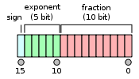

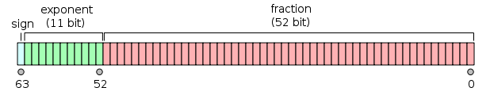
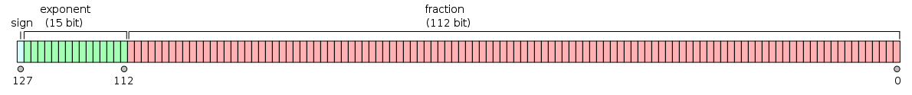
Four IEEE 754 Formats
Exponent +bias
Half precision (binary16)
Single precision (binary32)
Double precision (binary64)
Quadruple precision (binary128)

Slide 38
Single-Precision Range
Exponents 00000000 and 11111111 reserved
Smallest value
  Exponent: 00000001
  ⇒ actual exponent = 1 – 127 = –126
  Fraction: 000…00 ⇒ significand = 1.0
  ±1.0 × 2^{–126} ≈ ±1.2 × 10^{–38}
Largest value
  exponent: 11111110
  ⇒ actual exponent = 254 – 127 = +127
  Fraction: 111…11 ⇒ significand ≈ 2.0
  ±2.0 × 2⁺¹²⁷ ≈ ±3.4 × 10⁺³⁸

Slide 39
IEEE Double precision standard
E not 00…0 (decimal 0) or 11…1(decimal 2047)
Normalized rule: number represented is
(-1)^{S}×1.fraction×2^{E-1023}
1
11
52
S
E
fraction
For comparison
F = -1^{Sign} x (1+Significand) x 2^{(Exponent-Bias)}
Bias = 127

Slide 40
Double-Precision Range
Exponents 0000…00 and 1111…11 reserved
Smallest value
  Exponent: 00000000001
  ⇒ actual exponent = 1 – 1023 = –1022
  Fraction: 000…00 ⇒ significand = 1.0
  ±1.0 × 2^{–1022} ≈ ±2.2 × 10^{–308}
Largest value
  Exponent: 11111111110
  ⇒ actual exponent = 2046 – 1023 = +1023
  Fraction: 111…11 ⇒ significand ≈ 2.0
  ±2.0 × 2⁺¹⁰²³ ≈ ±1.8 × 10⁺³⁰⁸

Slide 41
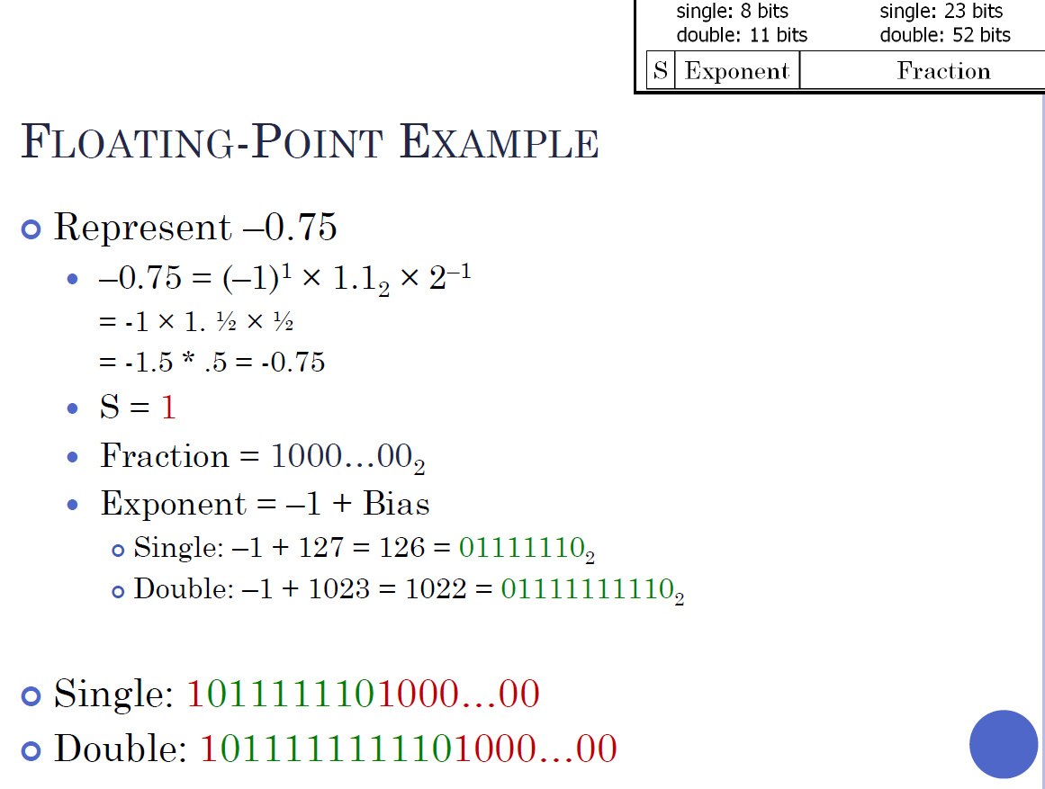

Slide 42
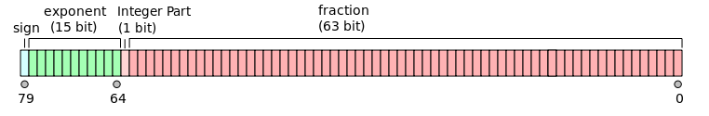
Other Formats: bias calculated from number of bits in the exponent
X86 Extended precision (80 bits)
How to calculate the bias?
Bias
Used in 8087 Math co-processor and subsequently in all x86 hardware floating point (intermediate operations).
Note explicit J-bit
2⁽⁵⁻¹⁾ – 1 = 2⁴ -1 = 15

Slide 43
Other IEEE 754 Formats: calculating bias for each case
Half precision (binary16)
5 bits in exponent so bias is 15 according to table
8 bits in exponent so bias is 127 according to table
Single precision (binary32)
Double precision (binary64)
11 bits in exponent so bias is 1023 according to table
Quadruple precision (binary128)
We use this table to calculate bias
15 bits in exponent so bias is 16383 according to table
No explicit bias = 127 in these formats

Slide 44
Interesting topics about floating point (not for exams)

Slide 45
Floating point AIN’T NATURAL
It is CRUCIAL for computer scientists to know that Floating Point arithmetic is NOT the arithmetic you learned since childhood
1.0 is NOT EQUAL to 10*0.1 (Why?)
  1.0 * 10.0 == 10.0
  0.1 * 10.0 != 1.0
  0.1 decimal == 1/16 + 1/32 + 1/256 + 1/512 + 1/4096 + … ==
    0.0 0011 0011 0011 0011 0011 …
  In decimal 1/3 is a repeating fraction 0.333333…
  If you quit at some fixed number of digits, then 3 * 1/3 != 1
Floating Point arithmetic IS NOT associative
  x + (y + z) is not necessarily equal to (x + y) + z
Addition may not even result in a change
  (x + 1) MAY == x

Slide 46

Floating Point Disasters - Ariane 5
$7B Rocket crashes (Ariane 5)
  When the first ESA Ariane 5 was launched on June 4, 1996, it lasted only 39 seconds, then the rocket veered off course and self-destructed.
  Cargo worth $500 million
Why
  Computed horizontal velocity as floating point number
    An inertial system, produced a floating-point exception while trying to convert a 64-bit floating-point number to an integer.
  Converted to 16-bit integer
  Worked OK for Ariane 4
  Overflowed for Ariane 5
    Used same software
    For Ariane 5 larger values were generated
http://www.around.com/ariane.html

Slide 47
Floating Point Disasters
Scud Missiles get through, 28 die
  In 1991, during the 1st Gulf War, a Patriot missile defense system let a Scud get through, hit a barracks, and kill 28 people. The problem was due to a floating-point error when taking the difference of a converted & scaled integer. (Source: Robert Skeel, "Round-off error cripples Patriot Missile", SIAM News, July 1992.)
Intel Ships and Denies Bugs
  In 1994, Intel shipped its first Pentium processors with a floating-point divide bug. The bug was due to bad look-up tables used to speed up quotient calculations. After months of denials, Intel adopted a no-questions replacement policy, costing $300M. (http://www.intel.com/support/processors/pentium/fdiv/)

Slide 48
Floating-Point Multiplication
Step 1:
Multiply significands
Add exponents
E_{R} = E₁ + E₂ -127
(do not need twice
the bias)
Step 2:
Normalize result
(Result of
[1,2) *[1.2) = [1,4)
at most we shift
right one bit, and
fix exponent
S
E
F
S
E
F
×
24 by 24
Small
ADDER
Subtract 127
Control
round
Add 1
Mux
(Shift Right by 1)
S
E
F
Do not worry about the details as for now

Slide 49
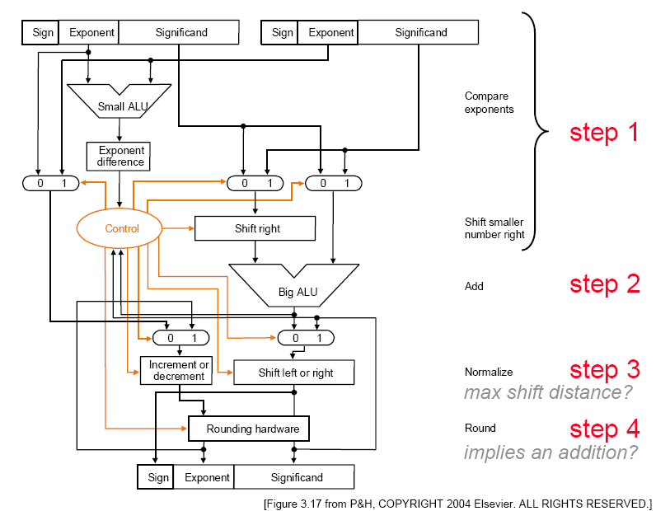
Floating-Point Addition
Do not worry about the details as for now

Slide 50
MIPS Floating Point
Floating point “Co-processor”
  32 Floating point registers
    separate from 32 general purpose registers
    32 bits wide each
    use an even-odd pair for double precision
Instructions:
  add.d fd, fs, ft # fd = fs + ft in double precision
  add.s fd, fs, ft # fd = fs + ft in single precision
  sub.d, sub.s, mul.d, mul.s, div.d, div.s, abs.d, abs.s
  l.d fd, address # load a double from address
  l.s, s.d, s.s
  Conversion instructions
  Compare instructions
  Branch (bc1t, bc1f)

Slide 51
BCD
(Binary Coded Decimal)

Slide 52
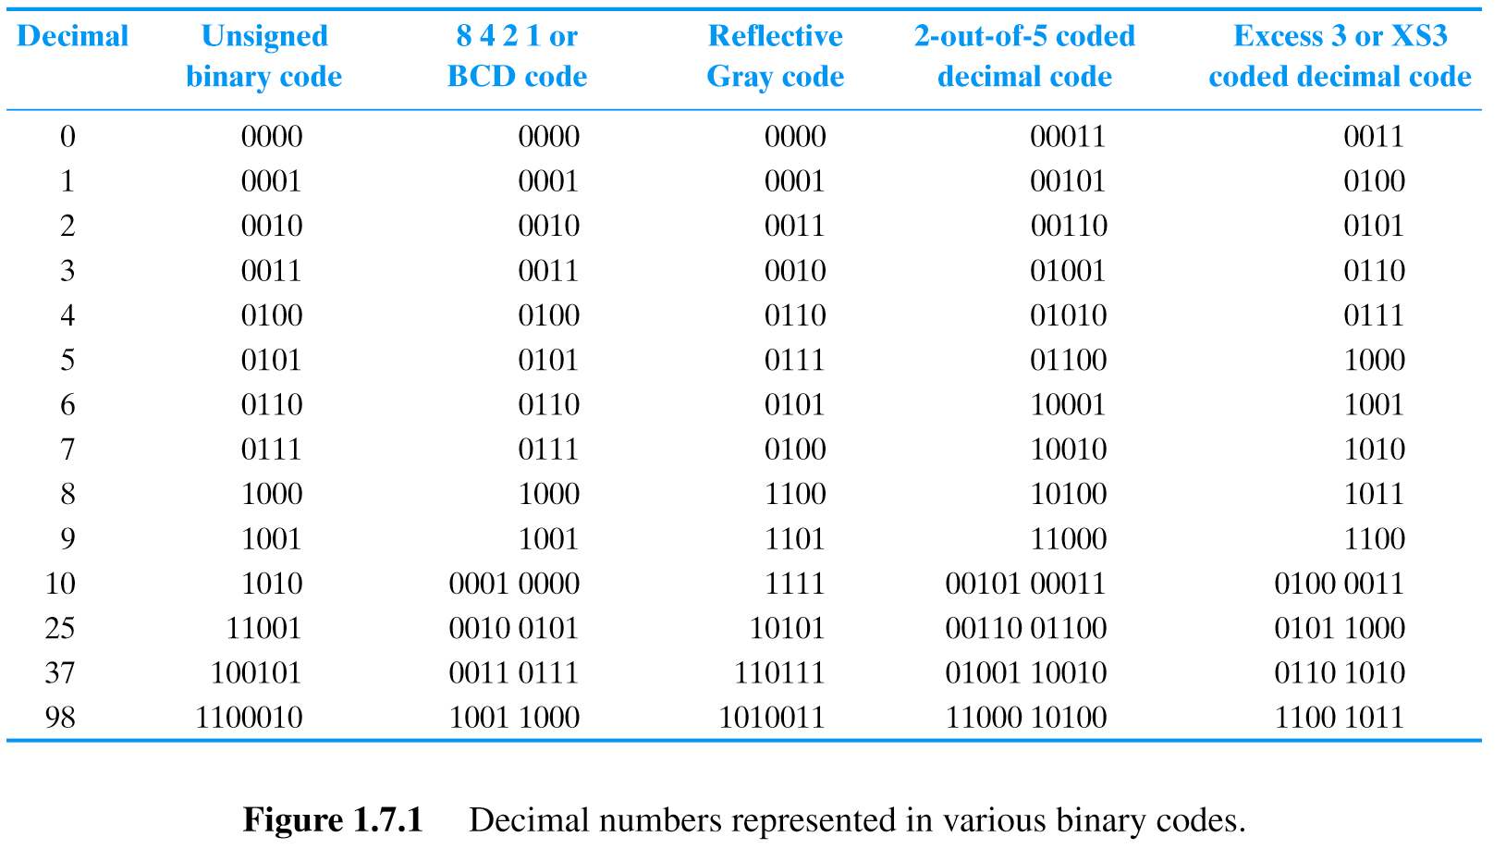
BCD (Binary Coded Decimal)
Used in early 4-bit μP
Simple displays
4 Bits/Decimal Digit
2
5

Slide 53
ASCII numbers

Slide 54
ASCII
American Standard Code for Information Interchange (pronounced: As’ key)
For encoding text
Universally used
  EBCDIC (old IBM mainframe standard) died
  Unicode for international (non-Roman) languages
    UTF-8 8-bit variable width encoding (1-4 bytes)
    UTF-16 16-bit variable width encoding
    UTF-32 32-bit fixed width encoding
UTF-8 commonly used for HTML/web browsers, FreeBSD, Linux
Gcc uses UTF-32

Slide 55
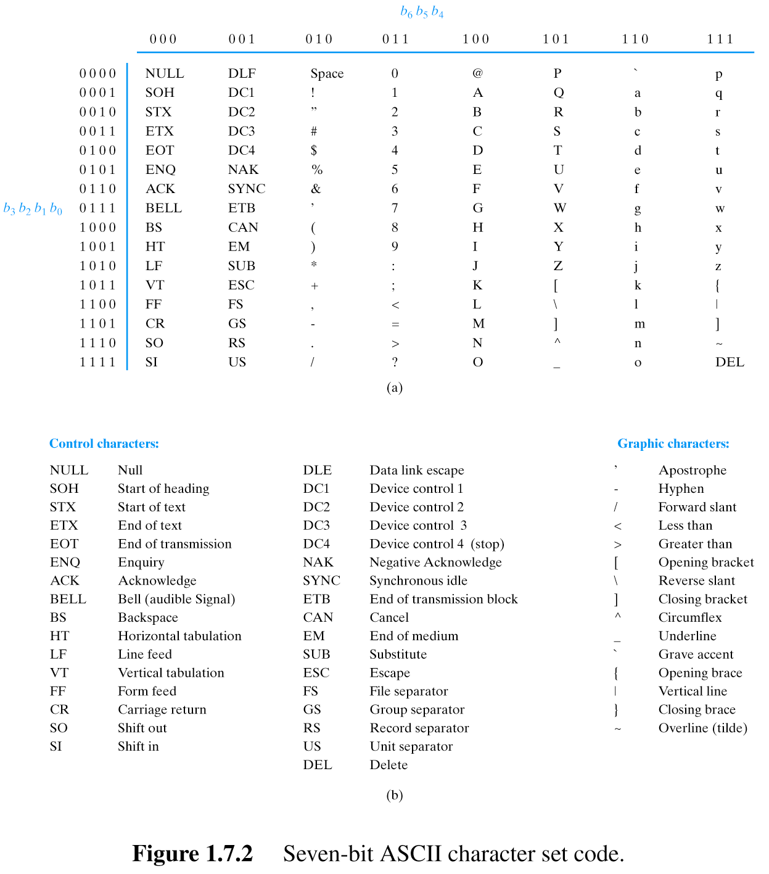
“ECE171”
As a string of characters
E C E 1 7 1
1000101100001110001010110001011011101100010000000

Slide 57
Gray Code

Slide 58
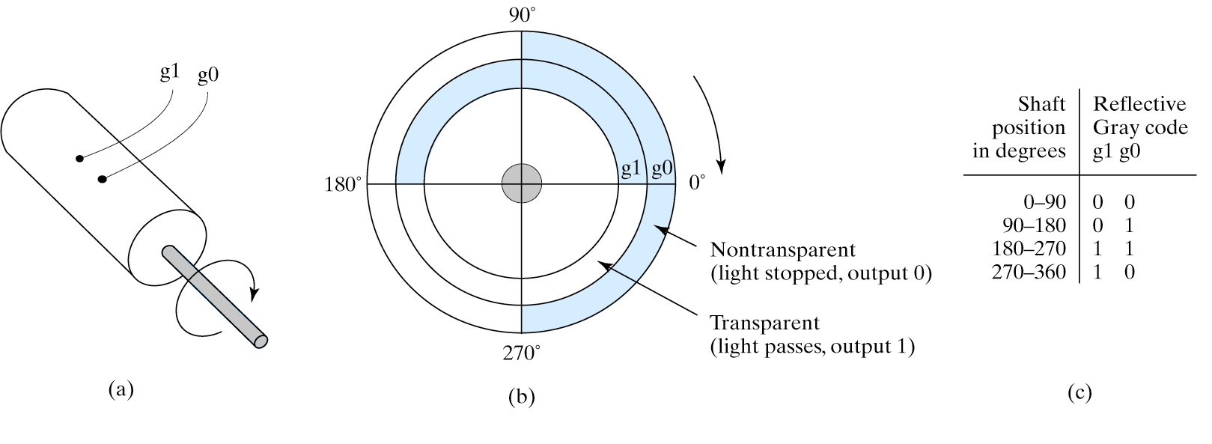
Reflective Gray Code (RGC). Mechanical Sensors.
Adjacent codes differ by single bit
  “Unit Distance Code”
Often used in interfacing mechanical sensors
Shaft position

Slide 59
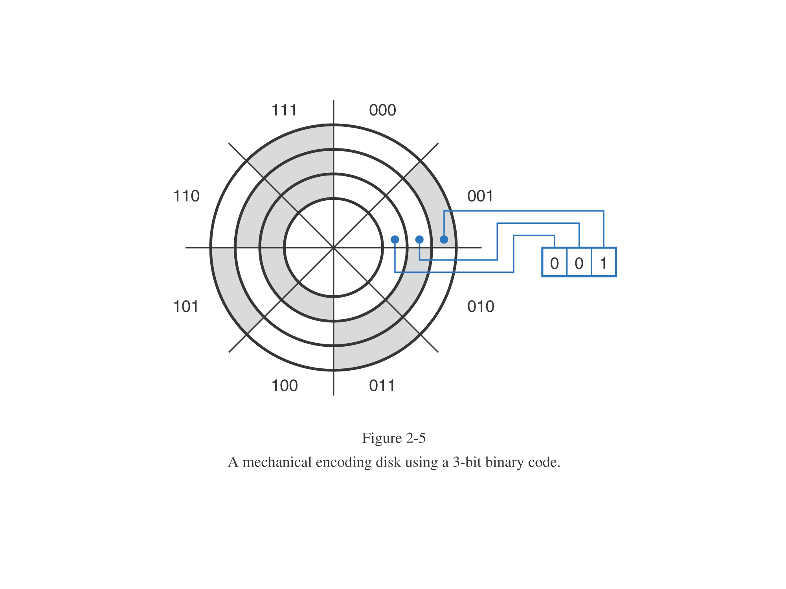
This is not Gray code.
More than one bit changes at a time

Slide 60
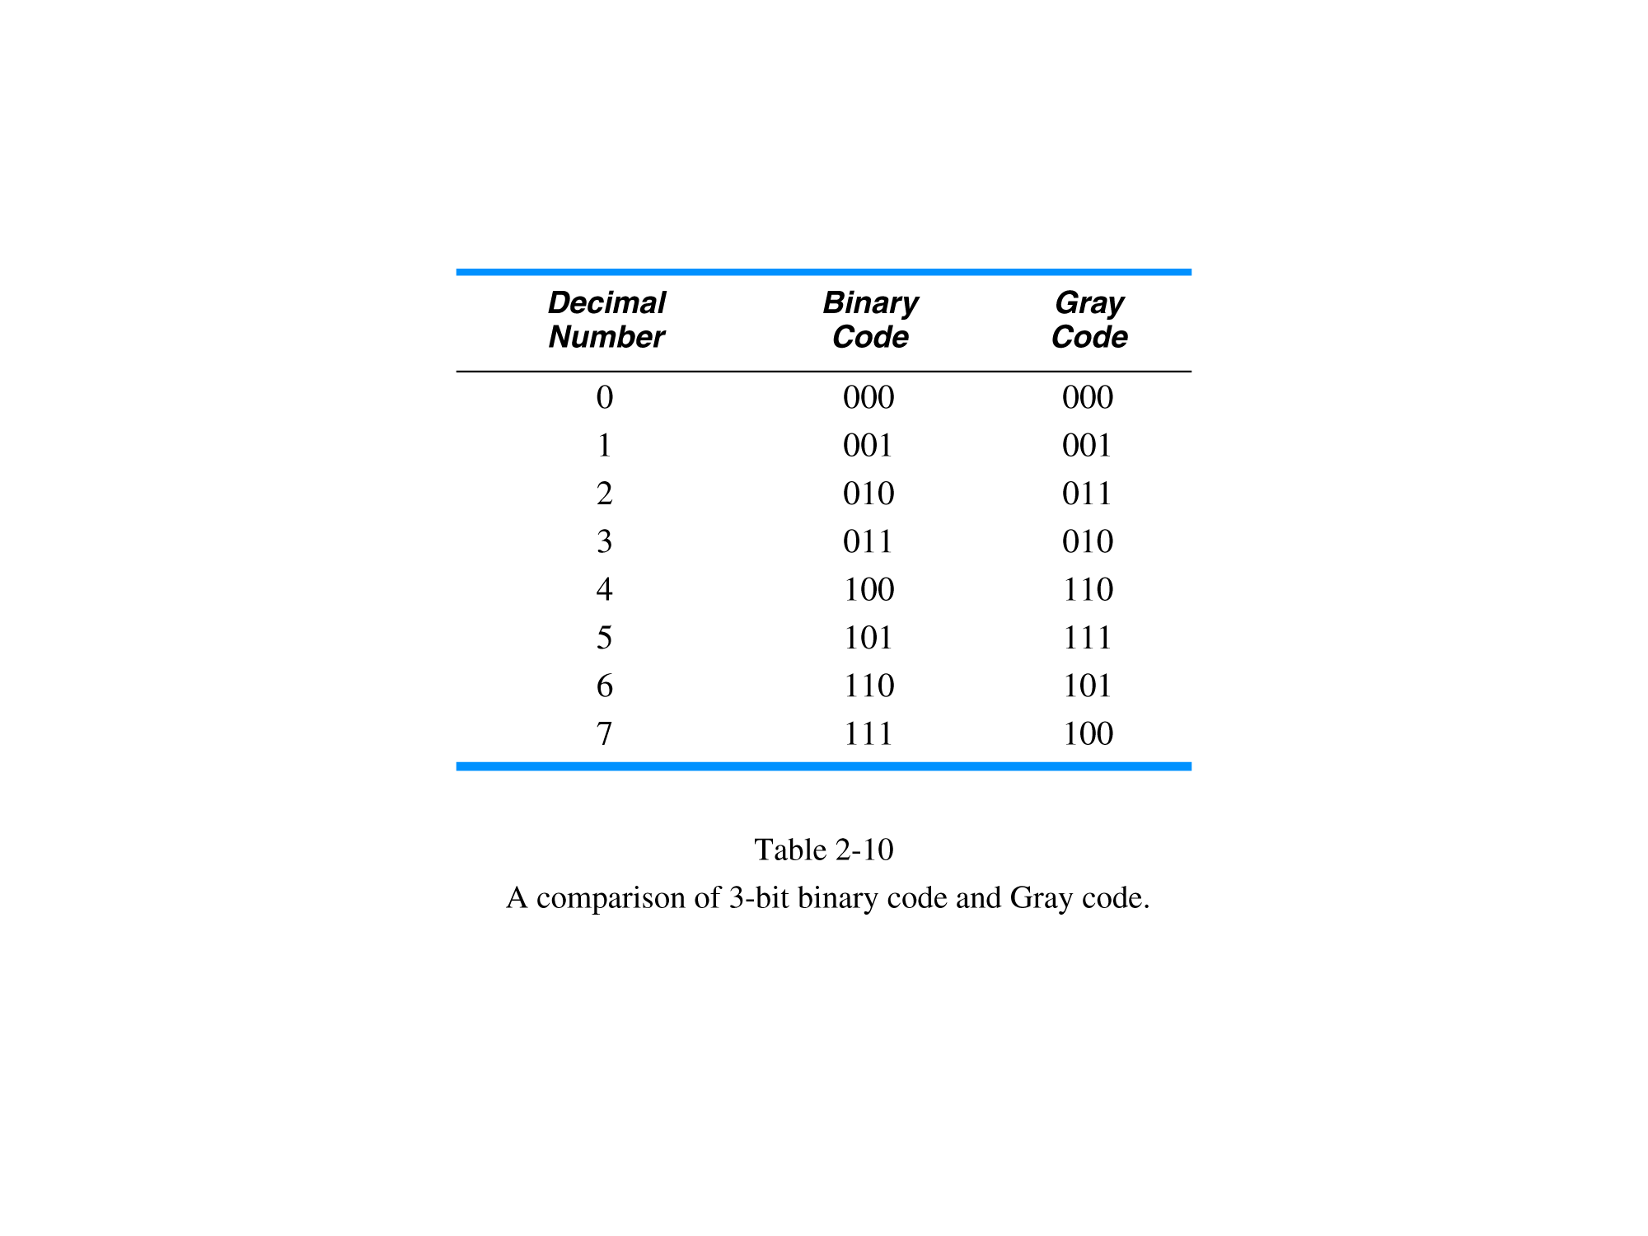

Slide 61
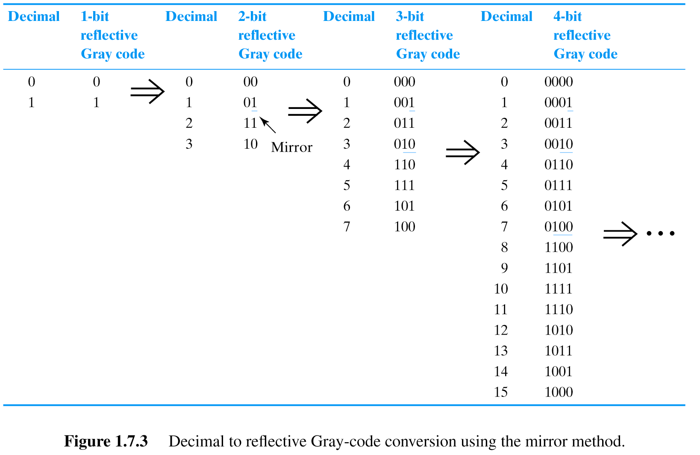
Reflective Gray Code

Slide 62
First bit the same:
A=a
a b c
A B C
Note that this bit is 1 when first two bits in binary code are different
B = a ⊕ b

Slide 63
a b c
A B C
Note that this bit is 1 when the second and third bits in binary code are different
C = b ⊕ c

Slide 64
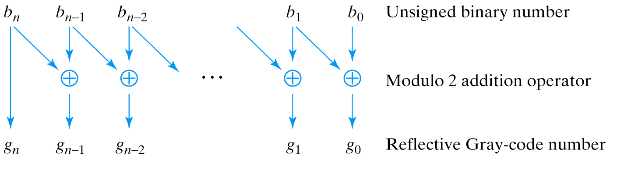
Reflective Gray Code (Conversion)
Notes:
Explain modulo 2 (XOR) addition

Slide 65
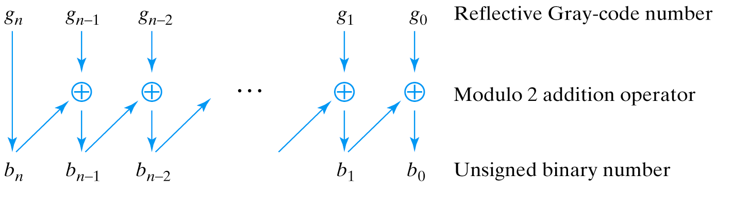
Reflective Gray Code (Conversion)
Notes:
Explain modulo 2 (XOR) addition

Slide 66
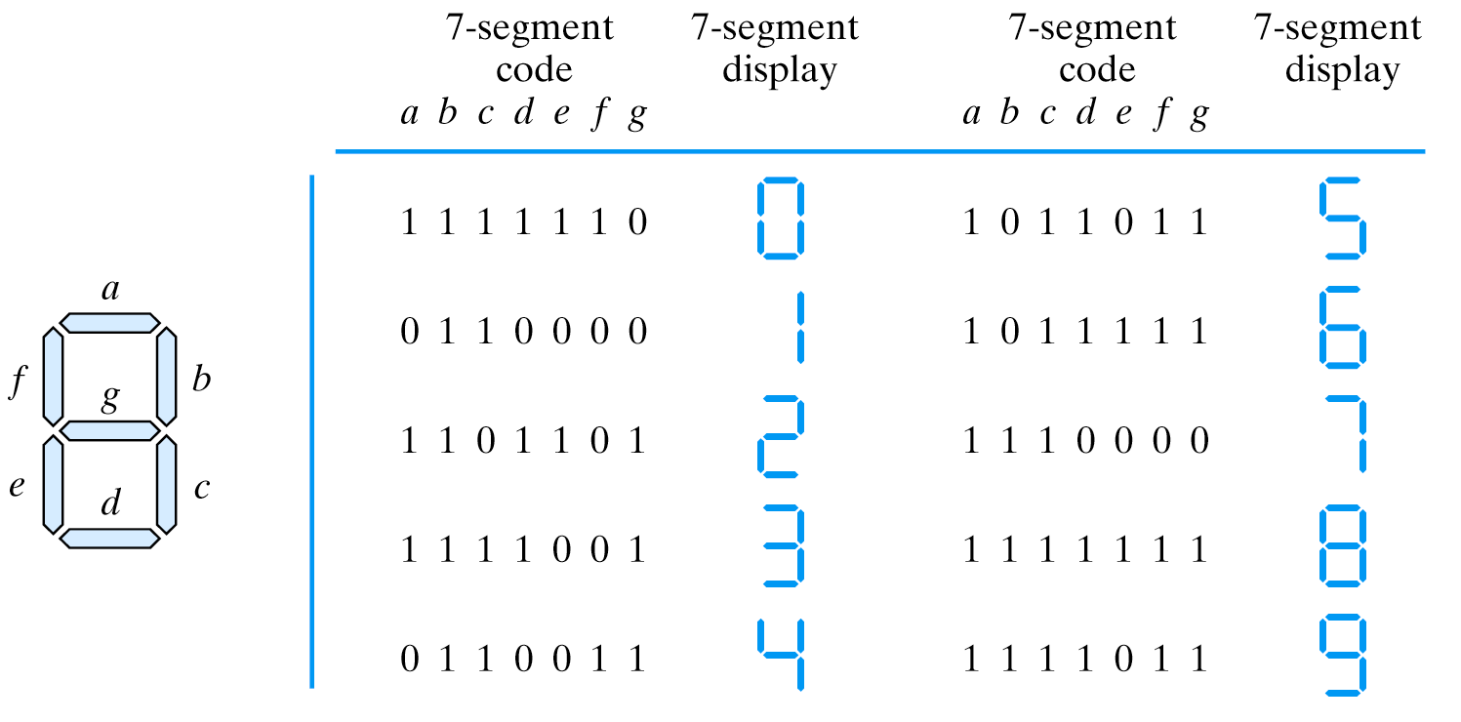
7-Segment Code

Slide 67
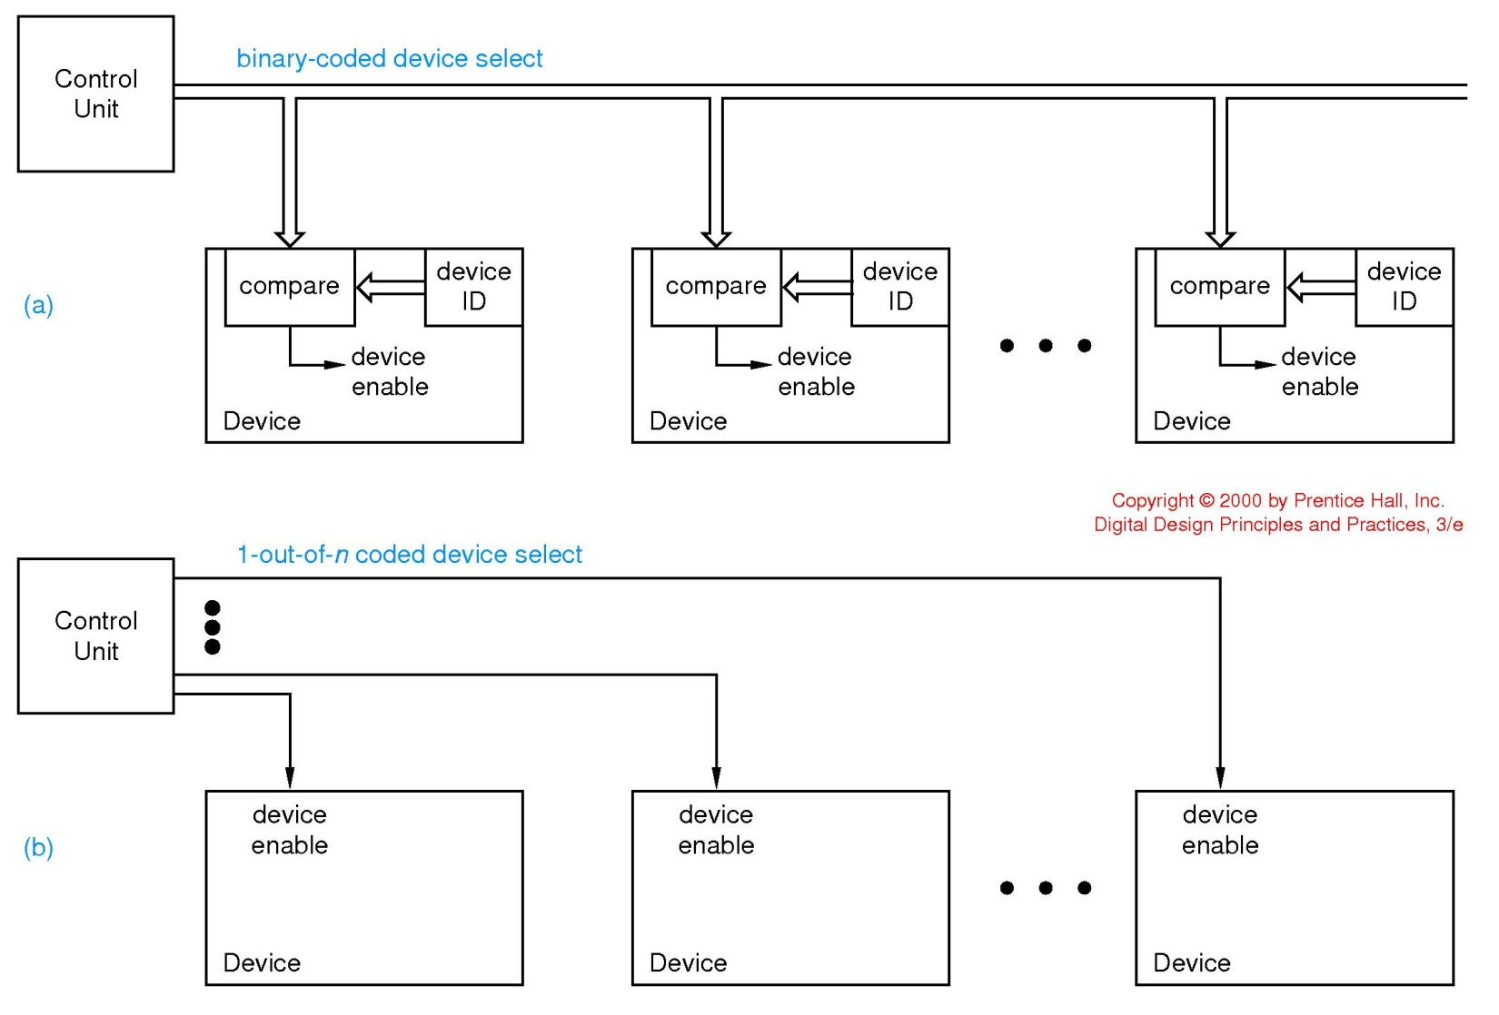
1-out-of-n codes (1-hot)
With binary coded device selection
8 devices
2³ = 8
therefore 3 bits (wires) suffice…
if devoted 8 wires…
used in SCSI disk drives, PCI enumeration
000
001
111
With 1-hot code coded device selection

Slide 68
Hypercubes

Slide 69
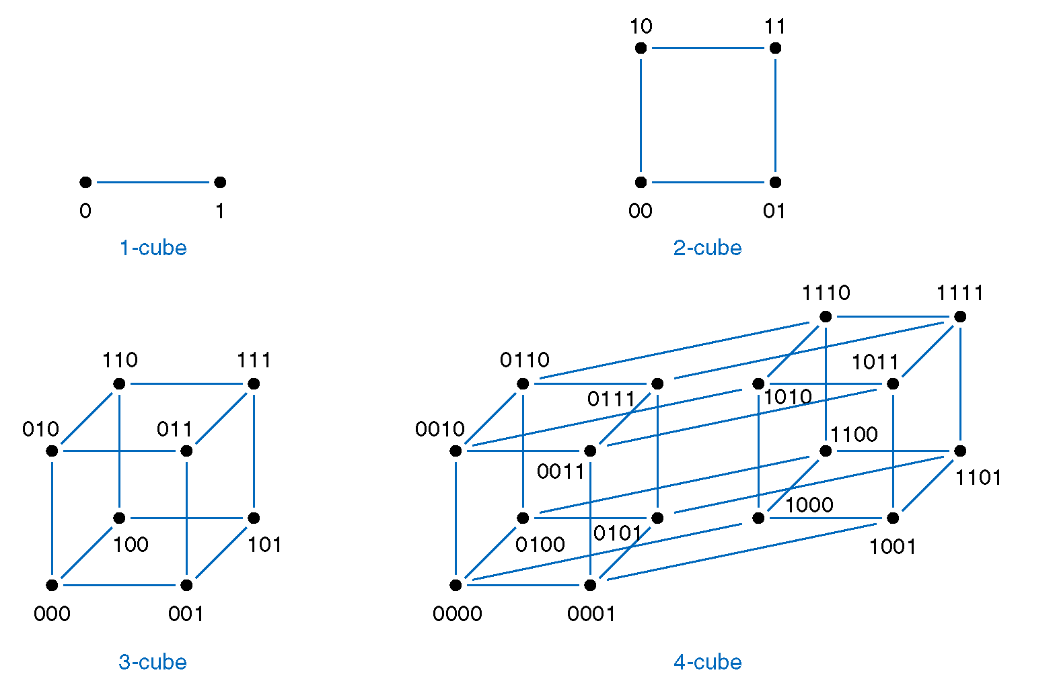
Hypercubes (n-cubes) for n=1, 2,3, and 4.

Slide 70
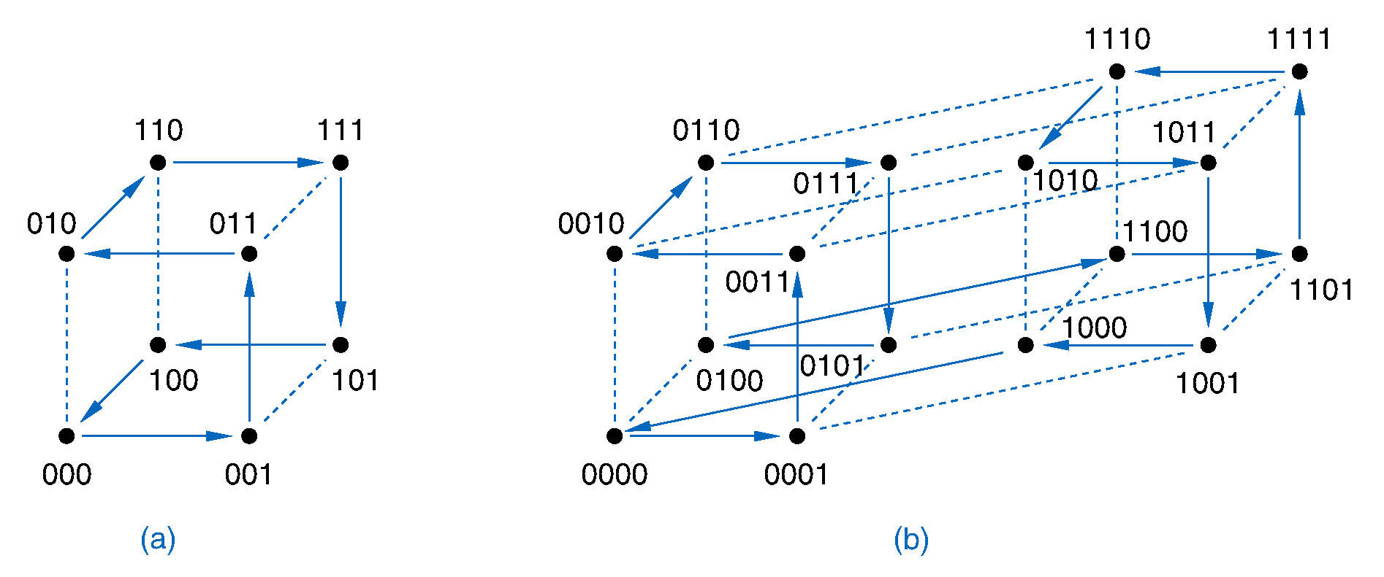
Traversing n-cubes in Gray-code order

Slide 71
Hypercubes for codes

Slide 72
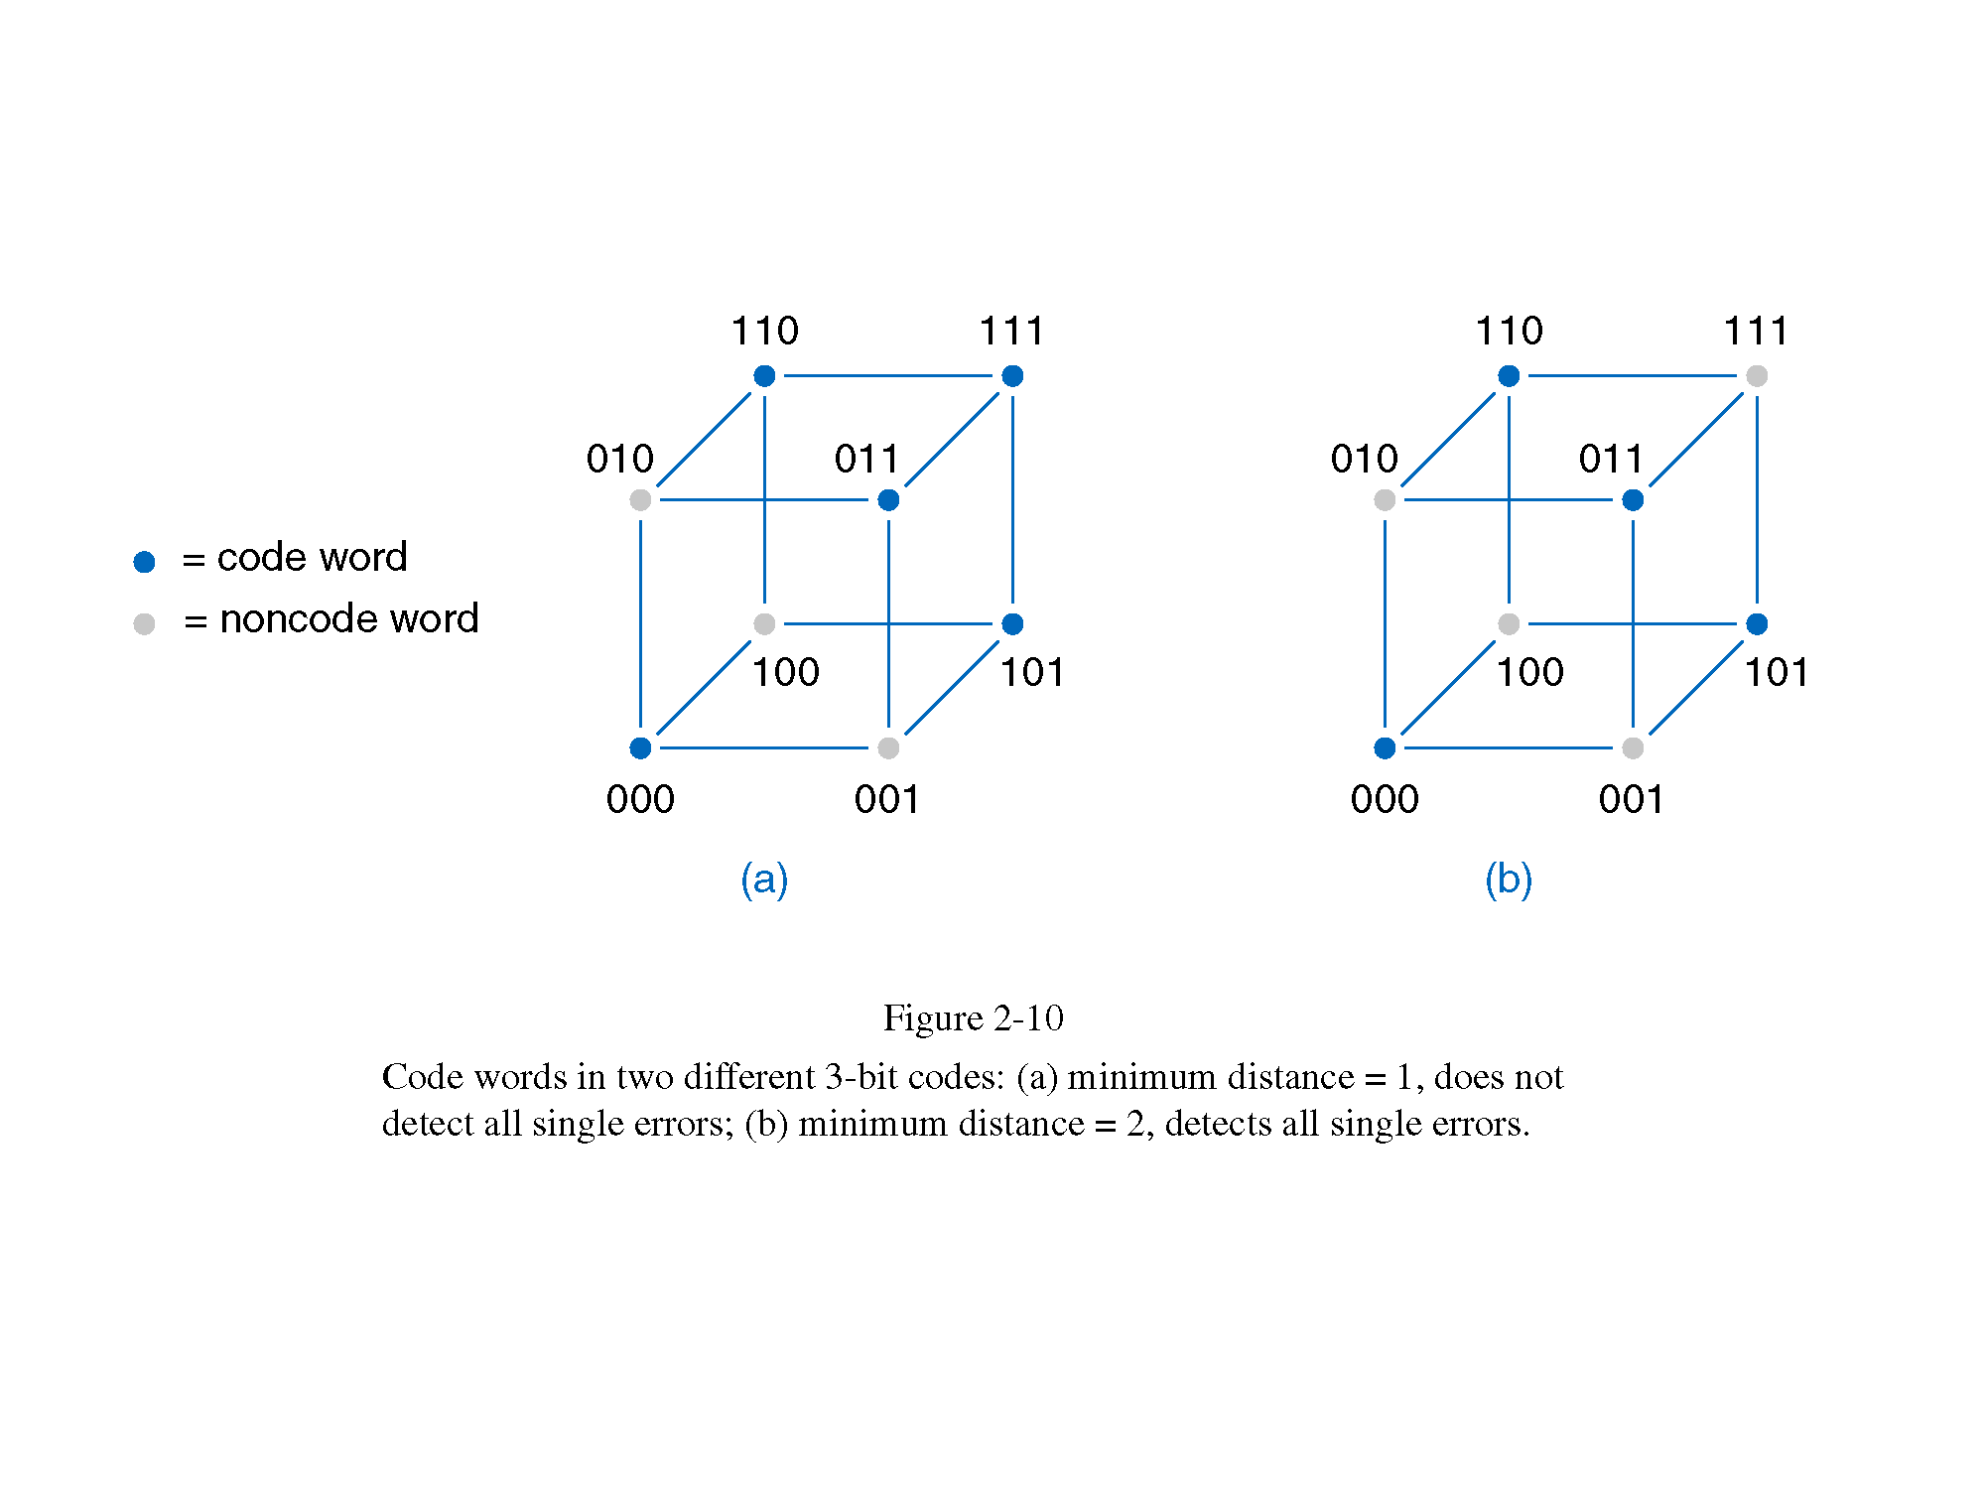
Using Hypercubes to design error-detecting and error-correcting codes.

Slide 73
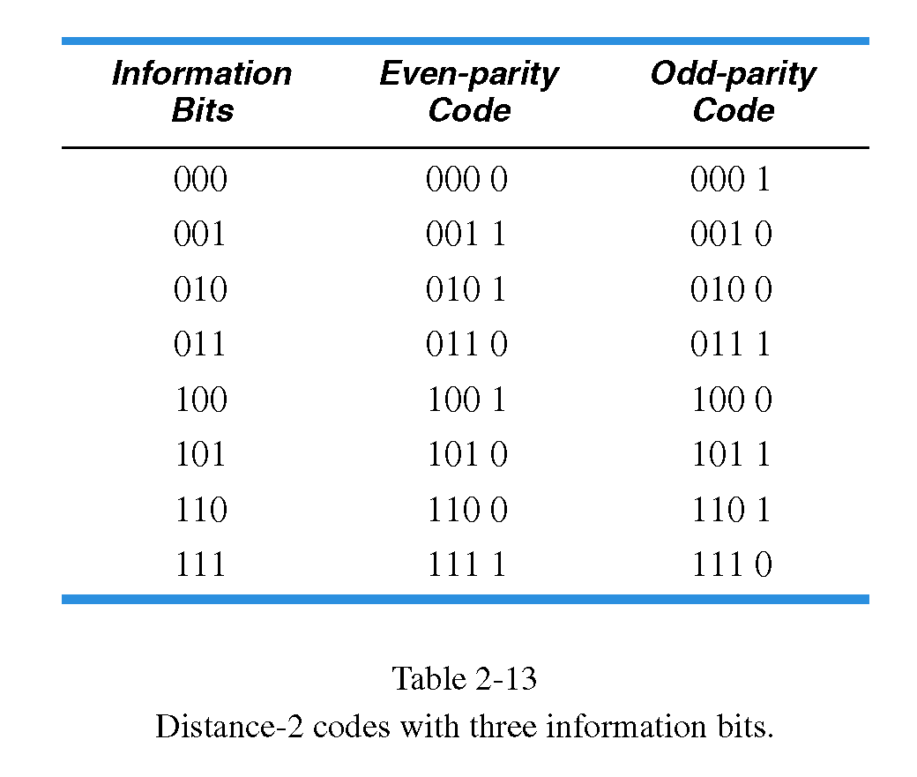
Even-parity Codes and Odd-parity Codes

Slide 74
Using Hypercubes to Minimize Boolean Functions
abc’
abc
ab
a’bc
ac
ab’c
a’b’c’
F= ab+bc+ac+a’b’c’
bc

Slide 75
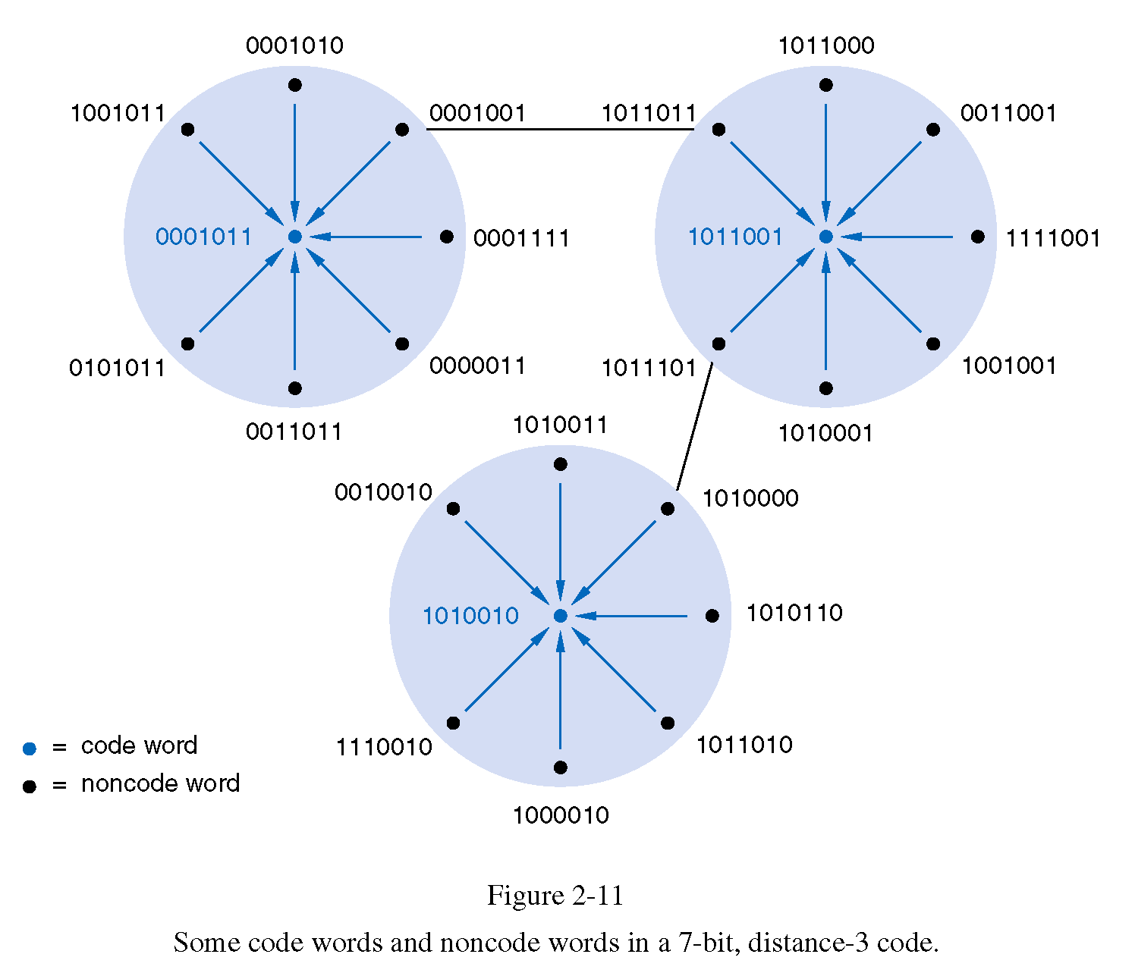
0001011
Hamming Distance 3 of codewords
Hamming Distance 1 from center
1011001
1010010
Hamming Distance 1 from centerv
center
We have 3 codewords on 7 positions.
Their Hamming distance is 3

Slide 76
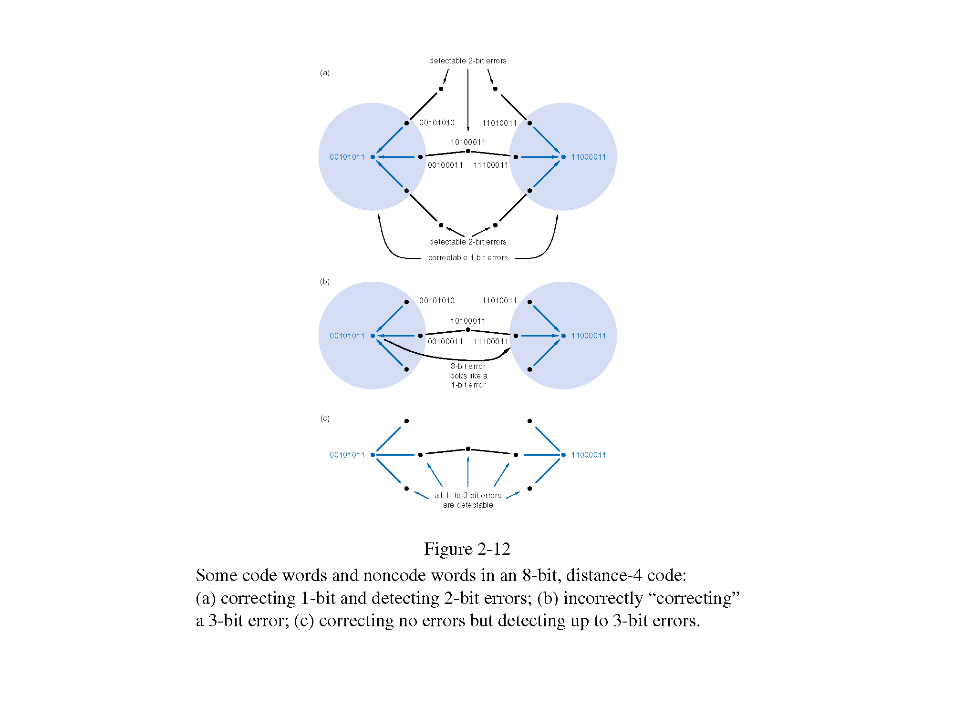

Slide 78
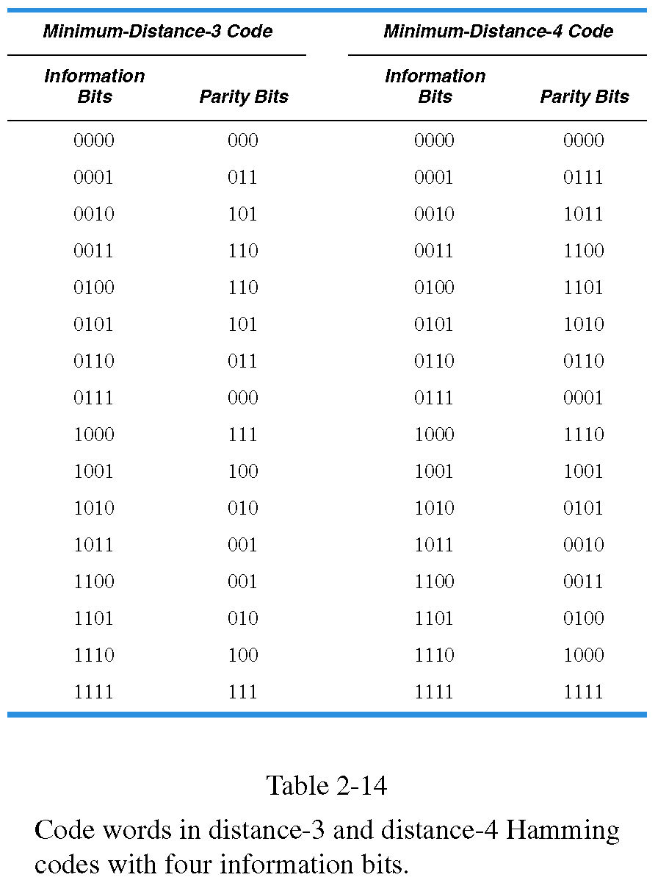
See next slide
Natural binary order

Slide 79
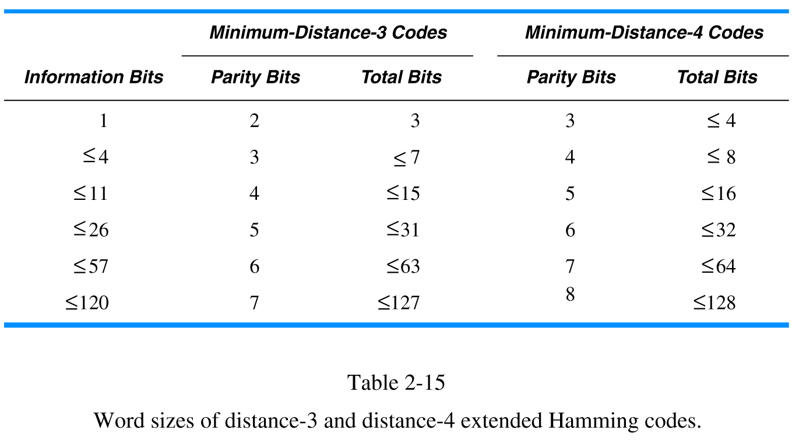

Slide 80
Error Detection and Correction
Notes:
Parity, ECC, CRC

Slide 81
Error Detection and Correction
Errors occur during data storage/retrieval and transmission
  Noise, cross-talk, EMI, cosmic rays, impurities in IC materials
  More common with high speeds, lower voltages
Use m-out-of-n codes to detect errors
  Not all possible codes are used (valid)
  Errors in used (valid) codes (hopefully) produce unused (invalid) codes
Notes:
Parity, ECC, CRC

Slide 82
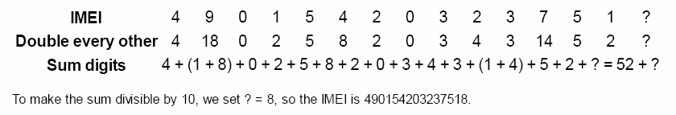
Example of Error Detection and Correction
Example: Luhn Algorithm
  Credit cards, IMEI (International Mobile Equipment Identity)
    Start from right, double every second digit
    Add all digits
    Add a final check digit to ensure sum is multiple of 10
Notes:
Parity, ECC, CRC

Slide 83
Serial Data Transmission & Storage

Slide 84
Serial Data Transmission & Storage
Low Voltage Differential Signaling
Parallel
  Storage: each bit of word read/written simultaneously
  Transmission: each bit has separate signal path
Serial
  Reduce costs
  Simplify design
  Higher speed (LVDS, skew)
Applications
  USB
  PCI Express

Slide 85
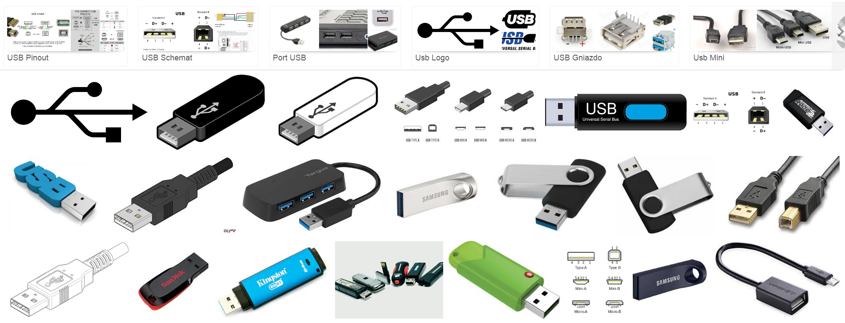
Universal Serial Bus (USB)

Slide 86
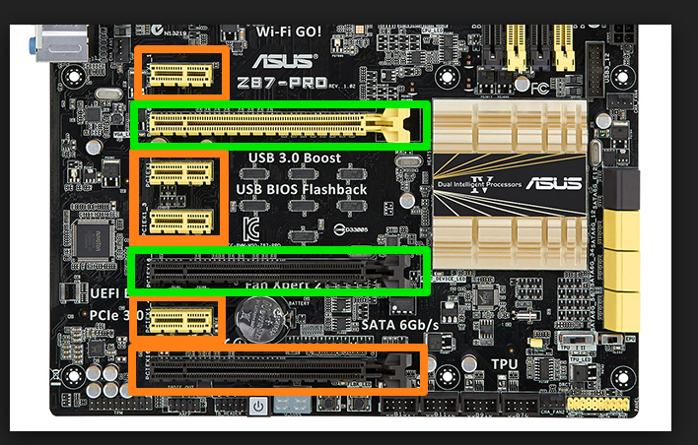
PCI Express

Slide 87
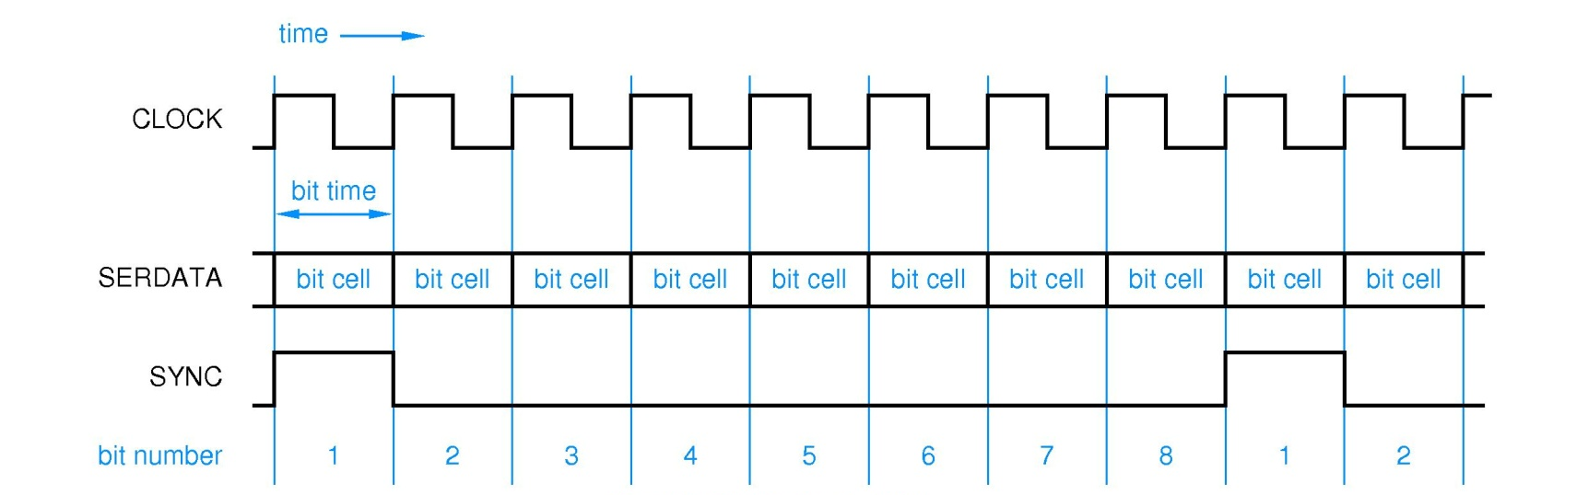
Serial Data Transmission & Storage
Clock
  Determines rate at which bits are transmitted (“bit rate”)
  “bit time”= clock period (1/bit rate) = “bit cell”
Sync
  Determines start of byte (or packet)
Data Format
  Determined by “line code”

Slide 88
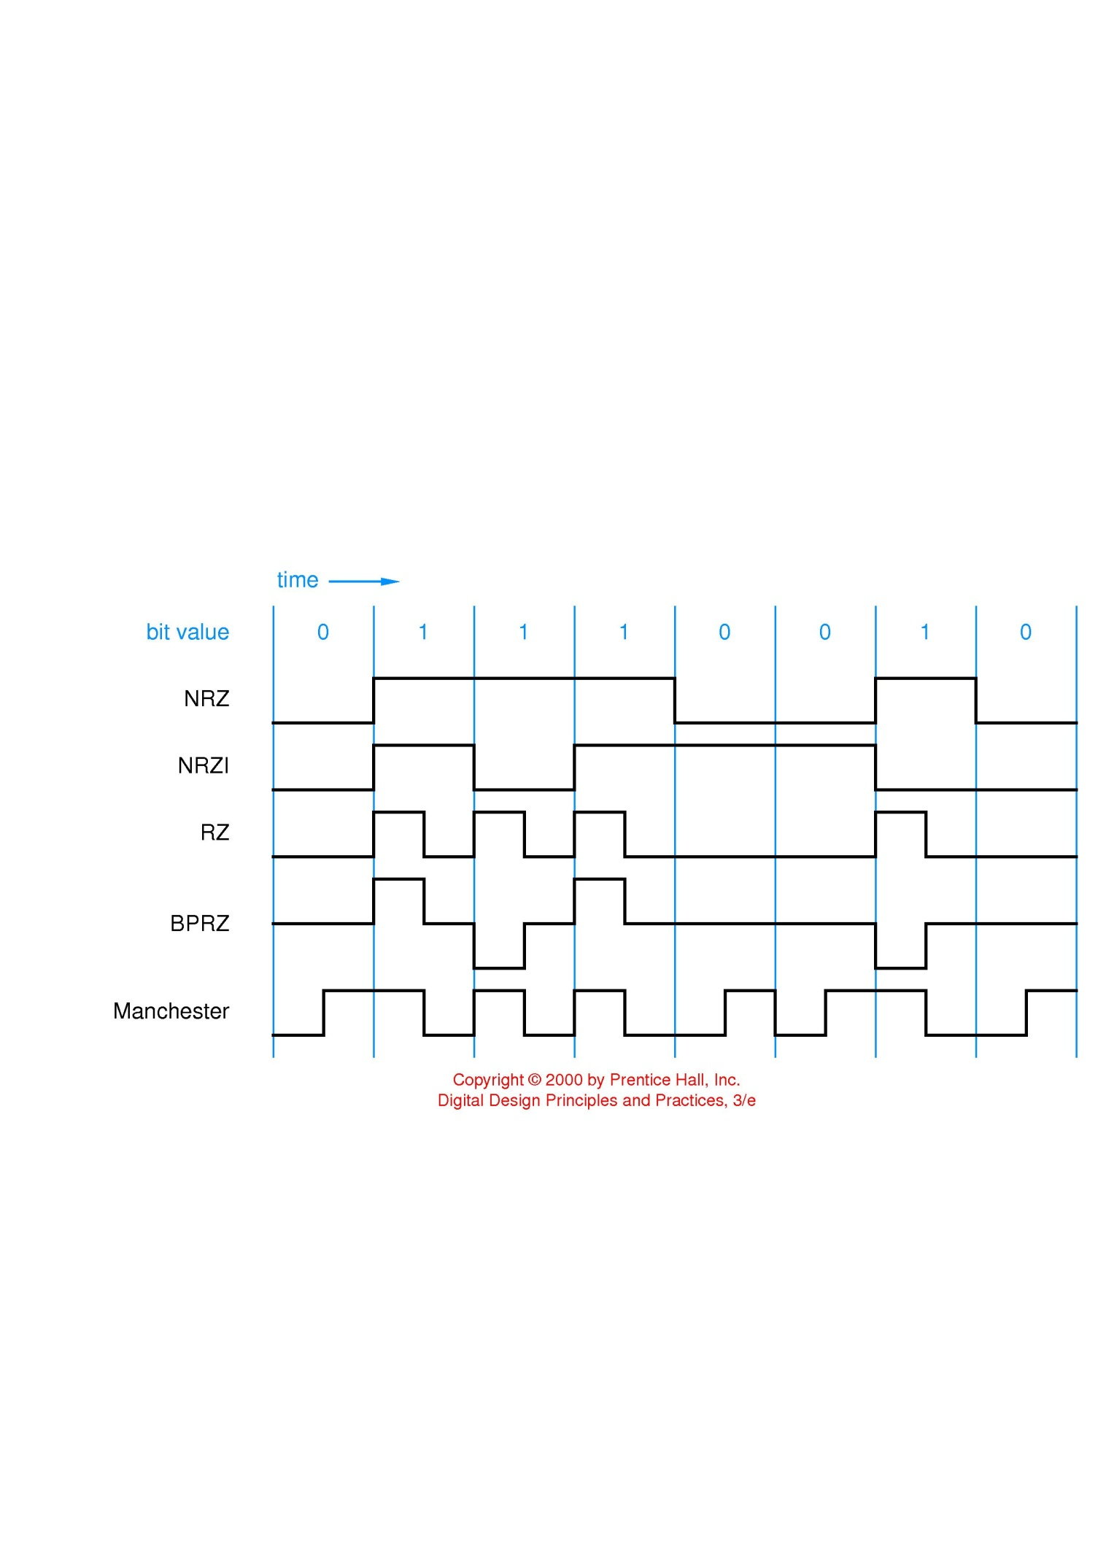
Codes for Serial Data Transmission and Storage – NRZ and NRZI
NRZ – Non Return to Zero
NRZI – Non Return to Zero Invert (on ones)
  Transition based
  Differential signaling: USB
Toggles on ones
Does not toggle on zeros
NRZI is a transition based code
disk drives store don’t store 0s/1s
but adjacent places may have different/same flux as neighbor,
LVDS applications
May need/want to explain source synchronous vs. embedded clocks and clock recovery
Low Voltage Differential Signaling

Slide 89
Codes for Serial Data Transmission and Storage – RZ, BPRZ and Manchester
RZ – Return to Zero
BPRZ – Bipolar Return to Zero
  “DC balanced”
  MLT-3 (100 Base T Ethernet)
Manchester encoding
  Guarantees a transition in every bit cell
  Facilitates clock recovery
  Requires higher bandwidth
  Original coax-based 10 Mbps Ethernet
Other techniques for DC balancing (and edge density)
  m-out-of-n-codes (e.g. 8B10B): Gigbabit Ethernet
Returns to zero after every “one” of data
Transition from 0 to 1 for zeros
Transition from 1 to 0 for ones

Slide 90
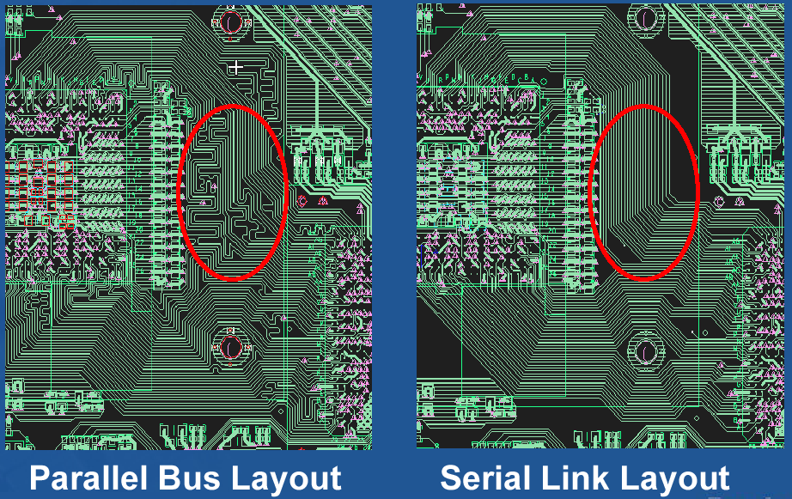
Why Serial?
“Parallel”
“Serial”
Device A
Device B
Device A
+
Device B
-
+
-
10 bidirectional wires at 250Mbps
pair unidirectional wires at 2500Mbps (2.5Gbps)

Slide 91
Traditional Parallel Bus
Device A
Device B
Same clock
Because clock is distributed to both sender and receiver, its arrival time at sender and receiver is not simultaneous.
Therefore there will be a skew with respect to the sent or received data.
Traditional Parallel Bus is used in low to medium 100 MHz range
It has some issues
  Board trace length has an effect on skew
  There is a clock skew across devices

Slide 92
Traditional Parallel Bus
Device A
Device B
Issues
  Faster data rate squeezes “eye”
Does everyone know what’s meant by “eye”
– it’s the window during which data is expected to be valid.
“Guardband” is test term which refers to the necessary “safety”, closing the eye.
This is an issue in system performance, error rates, and of course in testing.

Slide 93
Source Synchronous Bus
Clock goes with data when we transmit from B to A
Clock goes with data when we transmit from B to A
Device A
Device B
Used in 200MHz to 1.6GHz range
Clock signal is “forwarded” with data
Design impact of Source Synchronous Bus:
  Board layout track length mismatch
  still adds to skew
  Eliminates skew error term caused by clock domain skew
  Allows faster cycle times than parallel

Slide 94
Embedded Clock
Data
Clock
Clock signal embedded with data
Clock signal is “embedded” with data
  Received used digital phase locked loop (DPLL) to “recover” clock and determine where bit times are
  Edge density must be guaranteed by encoding scheme
Examples
  PCI Express, USB, Serial RapidIO, Infiniband
  Intel’s new QuickPath Interconnect
We’ll look at the encoding scheme which ensures this in a moment

Slide 95
Edge Lock Technique (Tracking Receiver)
Device
A
Device
B
Device A sends pulse train to Device B
Device B “locks” onto edges
to be in sync with pulse stream
In order to achieve locking and clock recovery we need to ensure a certain density of edge transitions – this is where the encoding scheme comes in…

Slide 96
Ensuring Edge Density: m-of-n codes
Some 8-bit code words have too few 1s (or 0s) to ensure edge density sufficient to recover clock
8b10 encoding (developed by IBM in 1983)
  Use 10-bit code words, but only use a subset of the available 2¹⁰ code words
    No more than five 0s or 1s in a row
    Balanced number of 0s and 1s (difference between count of 0s and 1s in a string of at least 20 bits is no more than two.
  Benefits
    Ensure edge density
    Avoid DC bias at receiver from imbalance
      Running disparity for unbalanced codewords
  256 data characters
    All 8-bit bytes
    12 control characters (INIT, etc)
8 bit byte
10 bit code
Table lookup
Device A
Device B
Parallel
Data
TX FIFO
8B/10B
Encoder
Serializer
+
_
Deserializer
8B/10B
Decoder
RX FIFO
Parallel
Data
Parallel
Data
RX FIFO
8B/10B
Decoder
Deserializer
+
_
Serializer
8B/10B
Encoder
TX FIFO
Parallel
Data

Slide 97
Questions, Problems and EXAM Problems (1)
What is a floating point number?
Explain the IEEE 754 Floating Point Standard
What are subnormal numbers?
Give examples of several IEEE 754 formats
Convert number 253₁₀ to BCD code.
Convert number 0101001101₂ to BCD code.
Why do you think BCD code was invented?
What are the origins of Gray code?
Encode your first name in ASCI code.

Slide 98
Questions and Problems (2)
Questions, Problems and EXAM Problems (2)
10. Draw an equivalent of the mechanical device from slide “Reflective Gray Code (RGC). Mechanical Sensors” that will have 16 sections. What will be accuracy of the angle detected by this device.
11. How would you use this mechanical device in a robot?
12. Create a table specifying conversion from natural binary code to 7-segment code.
13. Create a table that will specify the conversion from natural binary code to 1-hot code.
14. Create a table that will specify the conversion from some maximal number of natural binary codewords to two-out-of-4 code.

Slide 99
Questions and Problems (3)
Questions, Problems and EXAM Problems (3)
15. What are the advantages of 1-out-of-n and 2-out-of-n codes?
16. What do you know about USB bus?
17. What do you know about PCI Express?
18. Explain Serial Data Transmission concept.
19. Compare serial and parallel data transmission.
20. Encode 0011010111 in NRZ code.
21. Encode 0011010111 in NRZI code.
22. Encode 0011010111 in NRZ code.
23. Encode 0011010111 in RZ code.
24. Encode 0011010111 in BPRZ code.
25. Encode 0011010111 in Manchester code.

Slide 100
Questions and Problems (4)
Questions, Problems and EXAM Problems (4)
26. Explain the concept of Source Synchronous
27. Explain the concept of Embedded Clock Bus.
28. Explain the concept of Edge Lock Technique
29. Why m-of-n codes ensure Edge Density?
30. Explain two examples of error-detecting codes.
31. What is Differential Signaling?
32. Low Voltage Differential Signaling
33. What is LVDS?

Slide 101
Questions and Problems (5)
Questions, Problems and EXAM Problems (5)
34. Explain the concept of Source Synchronous
35. Explain the concept of Embedded Clock Bus.
36. Explain the concept of Edge Lock Technique
37. Why m-of-n codes ensure Edge Density?
38. Explain two examples of error-detecting codes.
39.What is Differential Signaling?
40.Low Voltage Differential Signaling
41. What function is represented in
the hypercube
in the right?

Slide 102
Questions, Problems and EXAM Problems (6)
Questions and Problems (6)
F = -1^{Sign} x (1+Significand) x 2^{(Exponent-Bias)}
42.Represent Positive One in single precision
  Sign = +, Exponent = 0, Significand = 1.0
    1 = -1⁰ (1.0) x 2⁰
    S = 0, E = 0 + 127, F = 1.0 – ‘1’
    0 01111111 00000000000000000000000 = 0x3f800000
43. Represent One-half in single precision
  Sign = +, Exponent = -1, Significand = 1.0
    ½ = -1⁰ (1.0) x 2⁻¹
    S = 0, E = -1 + 127, F = 1.0 – ‘1’
    0 01111110 00000000000000000000000 = 0x3f000000
44. Represent Minus Two in single precision
  Sign = -, Exponent = 1, Significand = 1.0
    -2 = -1¹ (1.0) x 2¹
    1 10000000 00000000000000000000000 = 0xc0000000
45. Your task is to represent -1, -1/2 and 2 in single precision
E = +1 + 127=128

Slide 103
46. Represent 0.75 as a floating point number in single precision
Questions and Problems (7)
Questions, Problems and EXAM Problems (7)
0.75 _{ten} = 0.11 _{two} = 1.1 x 2 ⁻¹
1.1 = 1. fraction → fraction = 1
E – 127 = -1 → E = 127 -1 = 126 = 01111110_{two}
S = 0
00111111010000000000000000000000 = 0x3F400000

Slide 104
Sources
Prof. Mark G. Faust
John Wakerly
Internet
Jeremy R. Johnson
Anatole D. Ruslanov
William M. Mongan

