Slide 1
Lecture 5
Topics
  Canonical or Standard Forms of Functions
    SOP (Sum of Products) form
    POS (Product of Sums) form
    Relationship Between MinTerms and MaxTerms
    Converting Between Compact Forms of Functions
  Minimizing (Reducing) Functions
    Karnaugh Maps (K-maps)
    Product term sharing

Slide 2
Boolean Equations

Slide 3
Obtaining a Boolean Equation
In Ecotopia it’s generally illegal to use a car pool lane during weekdays if the car doesn’t have at least two occupants.
However, hybrid vehicles can use the lanes any time regardless of the number of occupants.
SUVs (even with two or more occupants) are never allowed to use the car pool lanes (unless they are also hybrids).
Write a Boolean expression in SOP form for F(W, O, S, H) which is 1 if the car is permitted to use the car pool lane today.
W is 1 if today is a weekday.
O is 1 if there are two or more occupants, S is 1 if the vehicle is an SUV, H is 1 if the vehicle is a hybrid.
W O S H F
----------
0 0 0 0 1
0 0 0 1 1
0 0 1 0 0
0 0 1 1 1
0 1 0 0 1
0 1 0 1 1
0 1 1 0 0
0 1 1 1 1
1 0 0 0 0
1 0 0 1 1
1 0 1 0 0
1 0 1 1 1
1 1 0 0 1
1 1 0 1 1
1 1 1 0 0
1 1 1 1 1
ECOTOPIA EXAMPLE

Slide 4
Another Example: Deriving Boolean Equations
A truth table is a complete, unambiguous definition of a Boolean function…
But how do we get a Boolean expression from a truth table?
  SOP or POS
X Y Z F
0 0 0 0
0 0 1 0
0 1 0 0
0 1 1 1
1 0 0 1
1 0 1 0
1 1 0 1
1 1 1 0
F = X⋅Y⋅Z + X⋅Y⋅Z + X⋅Y⋅Z

Slide 5
Another Example: Obtaining SOP Forms of Functions
F(A,B) = F(0,0)⋅A⋅B + F(0,1)⋅A⋅B + F(1,0)⋅A⋅B + F(1,1)⋅A⋅B
= 0⋅A⋅B + 1⋅A⋅B + 1⋅A⋅B + 1⋅A⋅B
= 0 + A⋅B + A⋅B + A⋅B
= A⋅B + A⋅B + A⋅B
A B F(A,B)
0 0 0 = F(0,0)
0 1 1 = F(0,1)
1 0 1 = F(1,0)
1 1 1 = F(1,1)
Canonical or Standard
SOP Form
Standard Product Term
(Minterm)
Reduced Form
A + B
OR truth table
Notes:
Comes from Claude Shannon’s MS work. Simplified way of looking at it: just list the “terms” of AB (and complements) which result in function value of 1.

Slide 6
Minterms and Maxterms
Notes:
Majority Function

Slide 7
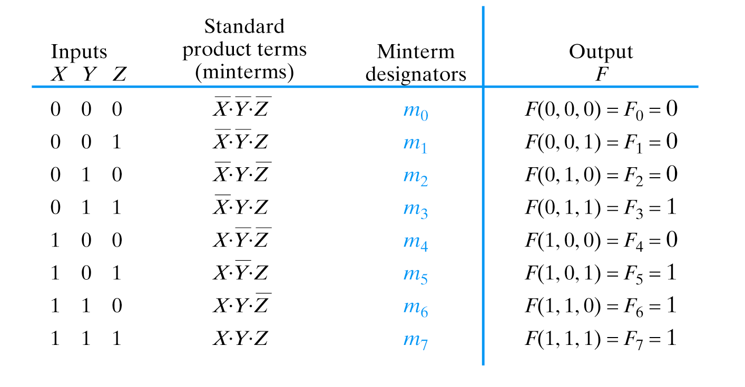
Minterms
Notes:
Majority Function

Slide 8
Compact Minterm Form
F(A,B) = F(0,0)⋅A⋅B + F(0,1)⋅A⋅B + F(1,0)⋅A⋅B + F(1,1)⋅A⋅B
= Σ³_{i=0} (F_{i} ⋅ m_{i})
= 0 ⋅ m₀ + 1 ⋅ m₁ + 1 ⋅ m₂ + 1 ⋅ m₃
= m₁ + m₂ + m₃
= Σ m(1,2,3)
= Σ (1,2,3)
A B F(A,B)
0 0 0 = F(0,0)
0 1 1 = F(0,1)
1 0 1 = F(1,0)
1 1 1 = F(1,1)
OR truth table
Notes:
Comes from Claude Shannon’s MS work. Simplified way of looking at it: just list the “terms” of AB (and complements) which result in function value of 1.

Slide 9
Minterms
Σ (3,5,6,7)

Slide 10
Generalized Compact Minterm Form
F(X₁, X₂,… X_{n}) = Σ (minterms for 1s of the function)
Pay attention, this is negation of function F
F(X₁, X₂,… X_{n}) = Σ (minterms for 0s of the function)

Slide 11
Obtaining POS Forms of Functions
F(A,B) = (F(0,0) + A + B) ⋅ (F(0,1) + A + B)
⋅ (F(1,0) + A + B) ⋅ (F(1,1) + A + B)
= (0 + A + B) ⋅ (0 + A + B) ⋅ (0 + A + B) ⋅ (1 + A +B)
= (A+B) ⋅ (A+B) ⋅ (A+B) ⋅ (1)
= (A+B) ⋅ (A+B) ⋅ (A+B)
AND truth table
A B F(A,B)
0 0 0 = F(0,0)
0 1 0 = F(0,1)
1 0 0 = F(1,0)
1 1 1 = F(1,1)
Canonical or Standard
POS Form
Standard Sum Term
(Maxterm)
Reduced Form
A ⋅ B
Notes:
Comes from Claude Shannon’s MS work. Simplified way of looking at it: just list the “terms” of AB (and complements) which result in function value of 1.

Slide 12
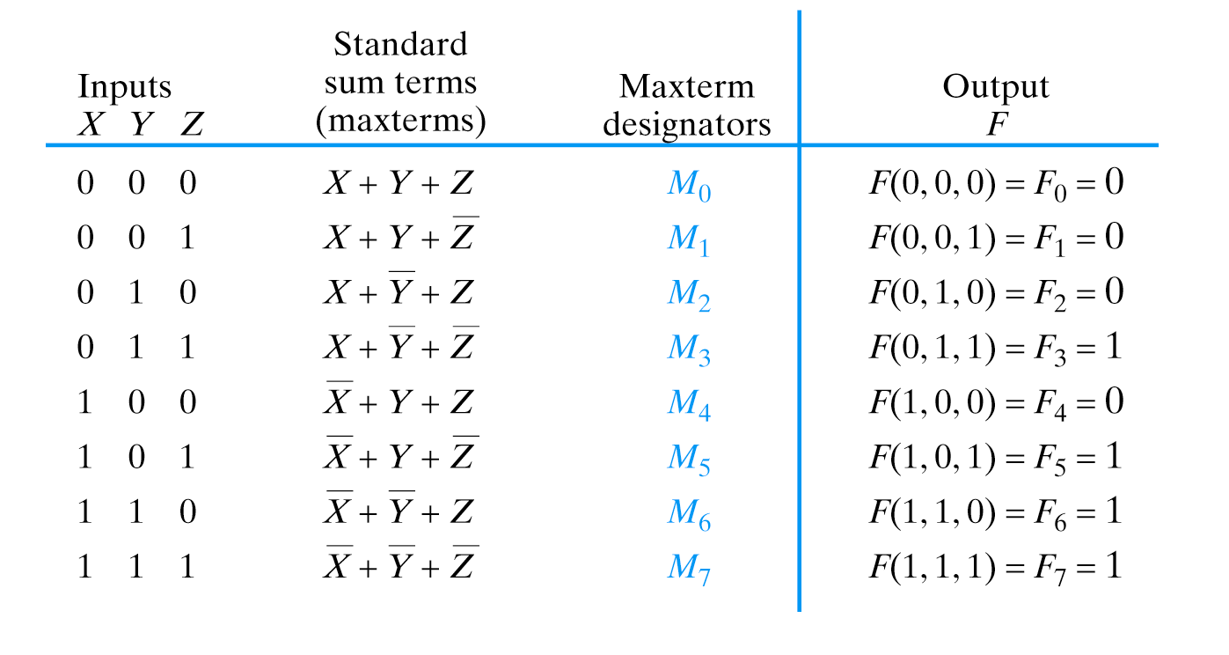
Maxterms
Notes:
Majority Function

Slide 13
Compact Maxterm Form
F(A,B) = (F(0,0) + A + B) ⋅ (F(0,1) + A + B)
⋅ (F(1,0) + A + B) ⋅ (F(1,1) + A + B)
= Π³_{i=0} (F_{i} + M_{i})
= (0 + M₀) ⋅ (0 + M₁) ⋅ (0 + M₂) ⋅ (1 + M₃)
= M₀ ⋅ M₁ ⋅ M₂
= Π M(0,1,2)
= Π (0,1,2)
AND truth table
A B F(A,B)
0 0 0 = F(0,0)
0 1 0 = F(0,1)
1 0 0 = F(1,0)
1 1 1 = F(1,1)
Notes:
Comes from Claude Shannon’s MS work. Simplified way of looking at it: just list the “terms” of AB (and complements) which result in function value of 1.

Slide 14
Maxterms
Π (0,1,2,4)
Notes:
Majority Function

Slide 15
Generalized Compact Maxterm Form
Canonical SOP
F(X₁, X₂,… X_{n}) = Π (maxterms for 0s of the function)
negation
Canonical POS
F(X₁, X₂,… X_{n}) = Π (maxterms for 1s of the function)

Slide 16
Relationship Between Minterms and Maxterms
m_{i} = M_{i}, M_{i} = m_{i}
Σ = Π, Π = Σ

Slide 17
Canonical SOP and POS forms using minterms and maxterms

Slide 18
An example: Given the accompanying truth table, write the compact minterm form for F for its 1s and 0s. Write the standard SOP form for each.
Compact minterm form 1s:
F = Σ(3,4,6)
X Y Z F
0 0 0 0
0 0 1 0
0 1 0 0
0 1 1 1
1 0 0 1
1 0 1 0
1 1 0 1
1 1 1 0
Corresponding SOP form:
F = X⋅Y⋅Z + X⋅Y⋅Z + X⋅Y⋅Z
Compact minterm form 0s:
F = Σ(0,1,2,5,7)
Corresponding SOP form:
F = X⋅Y⋅Z + X⋅Y⋅Z + X⋅Y⋅Z + X⋅Y⋅Z + X⋅Y⋅Z
This is example problem 15, page 85. Solution on page 107.

Slide 19
An example: Given the accompanying truth table, write the compact maxterm form for F for its 1s and 0s. Write the standard POS form for each.
This uses the same truthtable as the preceding problem but asks for maxterms
Compact maxterm form 1s:
X Y Z F
0 0 0 0
0 0 1 0
0 1 0 0
0 1 1 1
1 0 0 1
1 0 1 0
1 1 0 1
1 1 1 0
F = Π(3,4,6)
Corresponding POS form:
F = (X+Y+Z) ⋅ (X+Y+Z) ⋅ (X+Y+Z)
Compact maxterm form 0s:
F = Π(0,1,2,5,7)
Corresponding POS form:
F = (X+Y+Z) ⋅ (X+Y+Z) ⋅ (X+Y+Z)
⋅ (X+Y+Z) ⋅ (X+Y+Z)

Slide 20
Function Minimization: Reduce Number of Literals and Terms
Simplify for Comprehension
Reduce Number of Components
Reduce Amount of Wiring/Routing
Smaller Circuit/Board Area
Lower Cost
Higher Reliability
Notes:
Now we can derive an equation for a Boolean function from a truth table. How about minimizing it?

Slide 21
Function Minimization: Reduce Number of Literals and Terms
Apply Boolean Algebra
Employ Computer Algorithm
  Quine-McCluskey tabular algorithm
  Boozer
  McBoole
  Espresso and Espresso/Exact (CAD packages)
Systematic Algebraic Reduction (SAR)
Karnaugh Maps (K-Maps)

Slide 22
Karnaugh Maps

Slide 23
Karnaugh (K) Maps
A graphical representation of Boolean function
Easy to perform functional reduction
Relies on adjacency (Gray code) of minterms
  Adjacent (horizontal/vertical & wrap around) cells
  differ in only one variable (complement)
Number form and Variable form

Slide 24
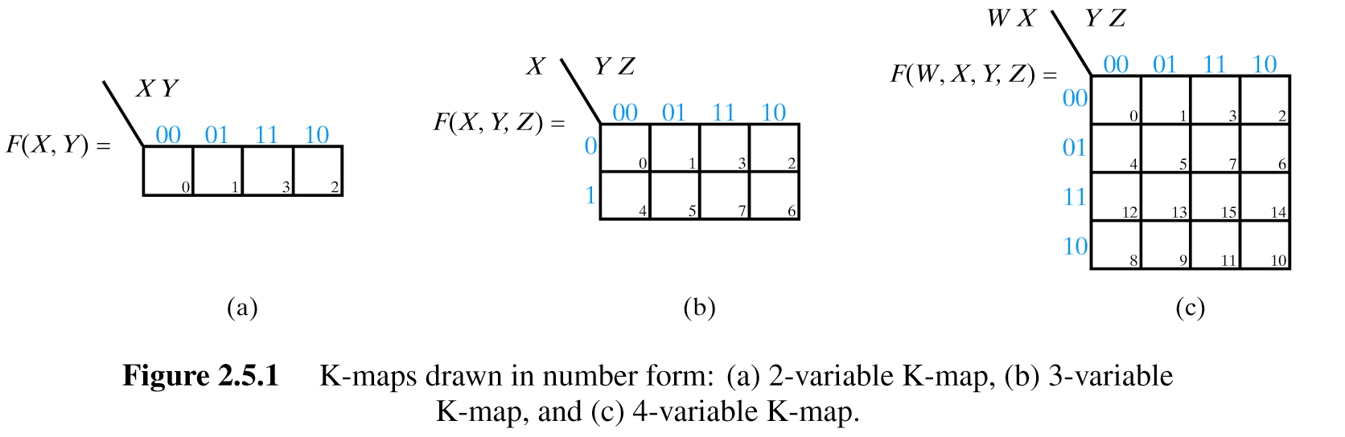
K-Maps
2 Variable K-Map (Number Form)
Gray code!
Minterm numbers

Slide 25
K-Maps
3 Variable K-Map (Number Form)
Gray code!
Minterm numbers

Slide 26
K-Maps
4 Variable K-Map (Number Form)
Gray code!
Minterm numbers

Slide 27
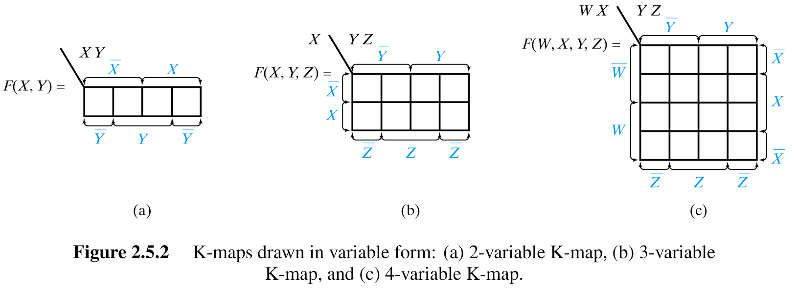
K-Maps
2 Variable K-Map (Variable Form)
May be more useful if plotting partially reduced functions
Careful! Preserve Gray code!

Slide 28
K-Maps
3 Variable K-Map (Variable Form)

Slide 29
K-Maps
4 Variable K-Map (Variable Form)

Slide 30
My Preference…
Y
Y
W
X
W
Z

Slide 31
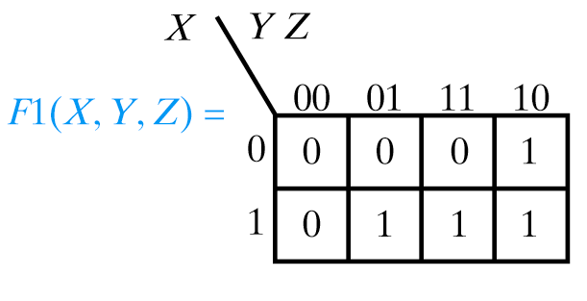
Plotting Functions in K-Maps
Plot the function F1(X,Y,Z) = Σ(2,5,6,7)
X Y Z F1
0 0 0 0
0 0 1 0
0 1 0 1
0 1 1 0
1 0 0 0
1 0 1 1
1 1 0 1
1 1 1 1
Notes:
May be given function in truth table, compact minterm/maxterm, or partially reduced (equation) form…
We’ll look at 1st two first

Slide 32
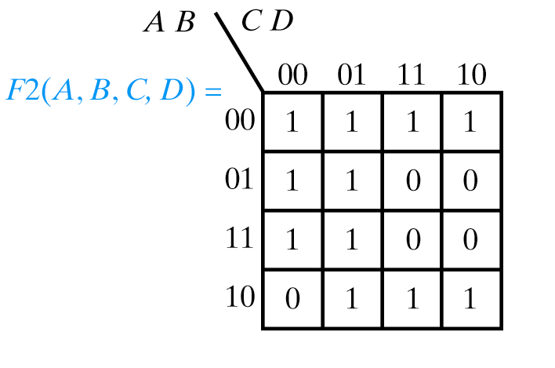
Plotting Functions in K-Maps
Plot the function F2(A,B,C,D) = Σ(6,7,8,14,15)
Plot 0s!

Slide 33
Don’t Care Outputs

Slide 34
Don’t Care Outputs
BCD
A B C D Prime
0 0 0 0 0
0 0 0 1 1
0 0 1 0 1
0 0 1 1 1
0 1 0 0 0
0 1 0 1 1
0 1 1 0 0
0 1 1 1 1
1 0 0 0 0
1 0 0 1 0
1 0 1 0 X
1 0 1 1 X
1 1 0 0 X
1 1 0 1 X
1 1 1 0 X
1 1 1 1 X
0
1
2
3
4
5
6
7
8
9
.
.
.
.
.
.
Output of Function Doesn’t Matter
  Typically impossible input condition
  Use X instead of 0 or 1

Slide 35
Don’t Care Outputs
Compact Minterm and Maxterm Form
F3(A,B,C) = Σ(2,6) + Σmd(3,5,7)
F3(A,B,C) = Σ(0,1,4) + Σmd(3,5,7)
F3(A,B,C) = Π(0,1,4) ⋅ ΠMd(3,5,7)
F3(A,B,C) = Π(2,6) ⋅ ΠMd(3,5,7)
A B C F3
0 0 0 0
0 0 1 0
0 1 0 1
0 1 1 X
1 0 0 0
1 0 1 X
1 1 0 1
1 1 1 X

Slide 36
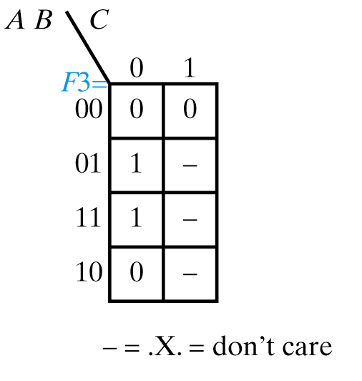
Plotting K-Maps with Xs
F3(A,B,C) = Σ(2,6) + Σmd(3,5,7)
A B C F3
0 0 0 0
0 0 1 0
0 1 0 1
0 1 1 X
1 0 0 0
1 0 1 X
1 1 0 1
1 1 1 X

Slide 37
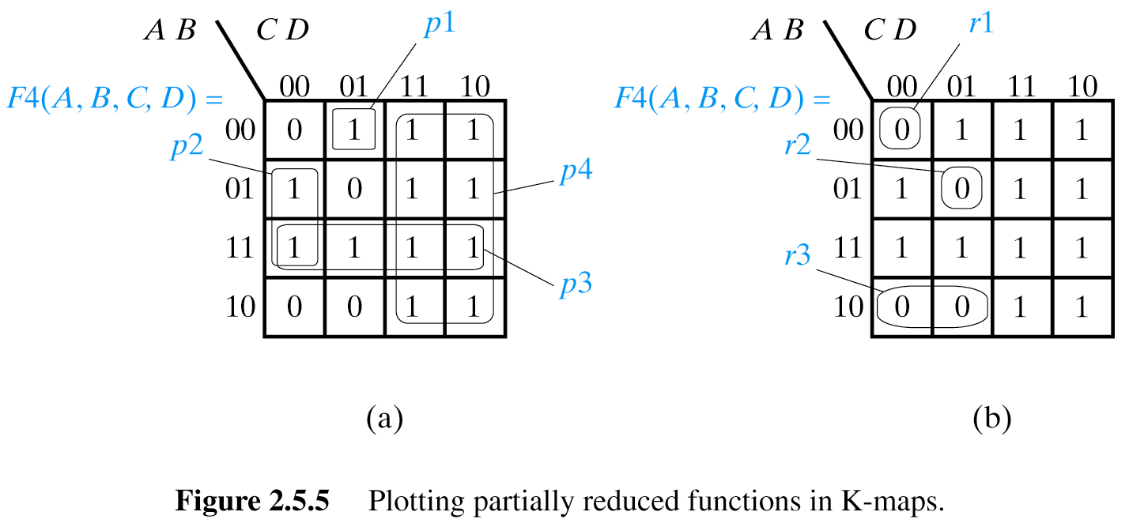
Plotting K-Maps from functions in partially reduced form
F4(A,B,C,D) = A⋅B⋅C⋅D + B⋅C⋅D + A⋅B + C
p₁
p₂
p₃
p₄
This is Sum of Products of literals, called SOP
Notes:
Need to explain. Think of missing variables as input don’t cares (X) and look for row/col where fits (e.g. C = XXCX and we care only about squares where C is 1 regardless of other variables). All variables present in term: single cell; one variable missing: 1x2, two variables missing: 2x4, etc…

Slide 38
Plotting K-Maps from functions in partially reduced form
F4(A,B,C,D) = A⋅B⋅C⋅D + A⋅B⋅C⋅D + A⋅B⋅C
r₁
r₂
r₃
Notes:
Need to explain. Think of missing variables as input don’t cares (X) and look for row/col where fits (e.g. C = XXCX and we care only about squares where C is 1 regardless of other variables).

Slide 39
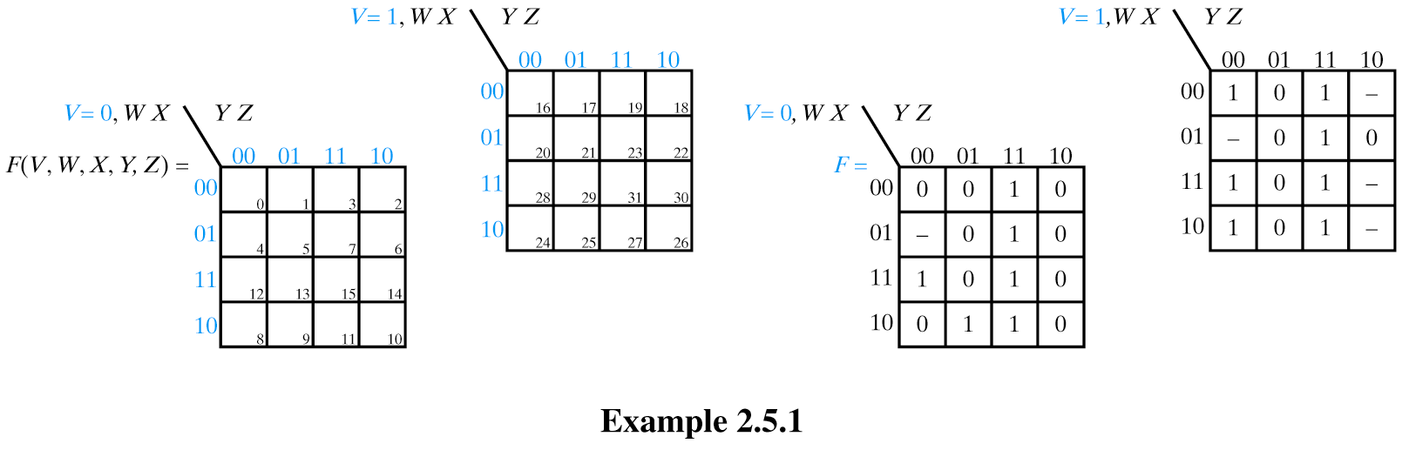
K-Maps for functions of 5 variables
F(V,W,X,Y,Z)
m₀ through m₁₅
m₁₆ through m₃₁
Notes:
Don’t usually go beyond 4 or 5 variables because there are good S/W packages to do this.
Split map into two (think of them as stacked). Still maintain Gray code.

Slide 40
K-Maps for functions of 5 variables
F(V,W,X,Y,Z) = Σ(3,7,9,11,12,15,16,19,23,24,27,28,31)
+ Σmd(4,18,20,26,30)
Notes:
Don’t usually go beyond 4 or 5 variables because there are good S/W packages to do this.
Split map into two (think of them as stacked). Still maintain Gray code.

Slide 41
Another type of K-Maps for functions of 5 variables
c,d,e
a,b
 | 000 | 001 | 011 | 010 | 110 | 111 | 101 | 100
00
01
11
10
Axis of symmetry (of mirror for d and e)

Slide 42
Another type of K-Maps for functions of 6 variables
d,e,f
a,b,c
 | 000 | 001 | 011 | 010 | 110 | 111 | 101 | 100
000
001
011
010
110
111
101
100

Slide 43
Using K-Maps to Reduce Functions

Slide 44
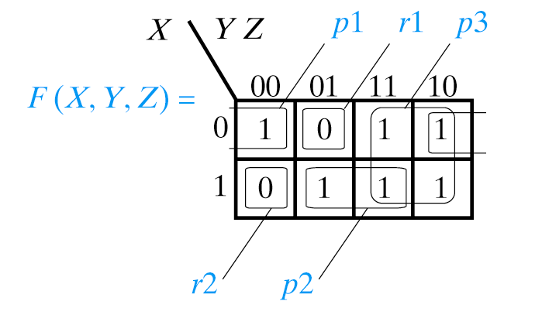
Using K-Maps to Reduce Functions
Assume you’ve plotted the K-map for F(X,Y,Z) as follows:

Slide 45
Using K-Maps to Reduce Functions
You want to obtain a reduced expression for F(X,Y,Z) in SOP form
Notes:
Smallest expressions → largest cube sizes

Slide 46
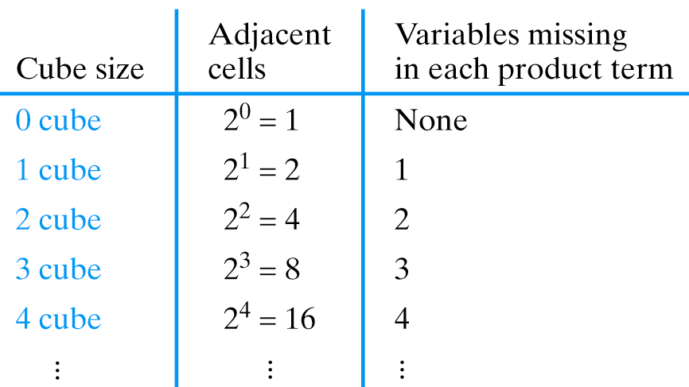
Using K-Maps to Reduce Functions
You want to obtain a reduced expression for F(X,Y,Z) in SOP form
Need to “cover” 1s
Fewest product terms
Simplest expressions
  (fewest variables)
Notes:
Smallest expressions → largest cube sizes

Slide 47
Using K-Maps to Reduce Functions
Circle all isolated 0-cubes
Circle all 1-cubes not completely contained in a larger cube
Continue for 2, 3, 4-cubes
Write the product terms (prime implicants) and OR them together
Write the expression for each product term

Slide 48
Using K-Maps to Reduce Function F in SOP form
F(X,Y,Z) = p1 + p2 + p3 = X⋅Z + X⋅Z + Y
Notes:
Smallest expressions → largest cube sizes

Slide 49
Using K-Maps to Reduce Functions
F(X,Y,Z) = r1 + r2 = X⋅Y⋅Z + X⋅Y⋅Z
Notes:
Smallest expressions → largest cube sizes

Slide 50
K-Maps (Some Terminology)
Implicant: Product term of a function
Prime Implicant: Product term for a cube which is not completely contained in another cube
Essential Prime Implicant: Product term which provides the only covering for a given minterm and must always be used in the set of product term
Optional Prime Implicant: Product term which provides an alternative covering for a given minterm and may be used in the set of product terms
Redundant (Non-Essential) Prime Implicant: Product term for a cube which is completely contained in another cube (correct, but won’t lead to a minimum function)

Slide 51
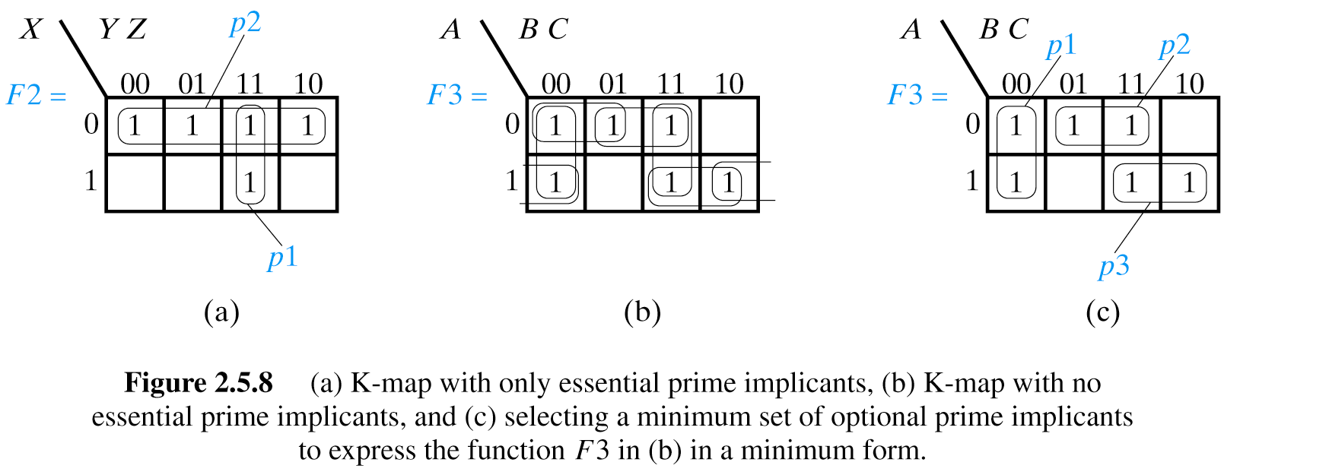
K-Map with only essential prime implicants

Slide 52
K-Map with no essential prime implicants

Slide 53
K-Map with no essential prime implicants

Slide 54
K-Map with no essential prime implicants: alternative!

Slide 55
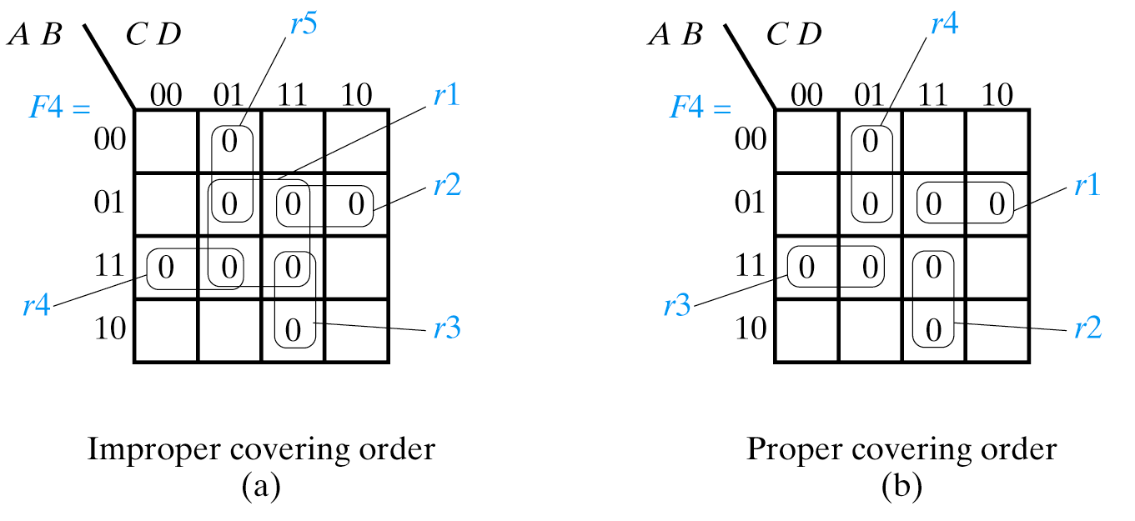
Covering Order is Essential

Slide 56
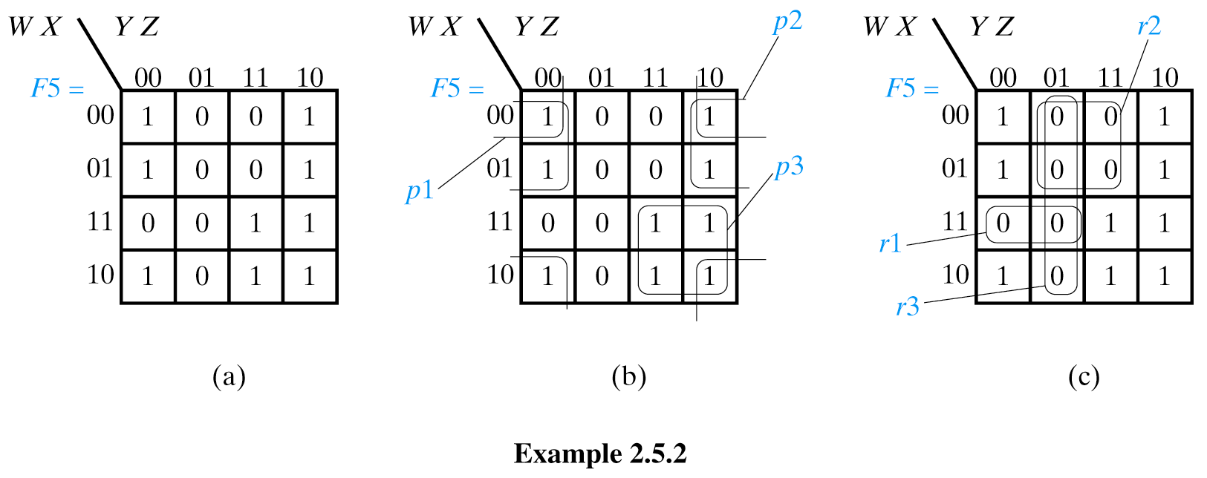
Using K-Maps to Reduce Functions
Given the following K-map, which minimum SOP form of the function
has the smallest literal count (the one for the 1s or the 0s)?
F(W,X,Y,Z) =
F(W,X,Y,Z) =
Notes:
Smallest expressions → largest cube sizes

Slide 57
Using K-Maps to Reduce Functions
lc = 6
F(W,X,Y,Z) = p1 + p2 + p3 = X⋅Z + W⋅Z + W⋅Y

Slide 58
Using K-Maps to Reduce Functions
This is POS form
lc = 7
F(W,X,Y,Z) = r1 + r2 + r3 = W⋅X⋅Y + W⋅Z + Y⋅Z

Slide 59
Using K-Maps to Reduce Functions
Given the following K-map, which minimum SOP form of the function
has the smallest literal count (the one for the 1s or the 0s)?
F(W,X,Y,Z) = p1 + p2 + p3 = X⋅Z + W⋅Z + W⋅Y
lc = 6
F(W,X,Y,Z) = r1 + r2 + r3 = W⋅X⋅Y + W⋅Z + Y⋅Z
lc = 7
Notes:
Smallest expressions → largest cube sizes

Slide 60
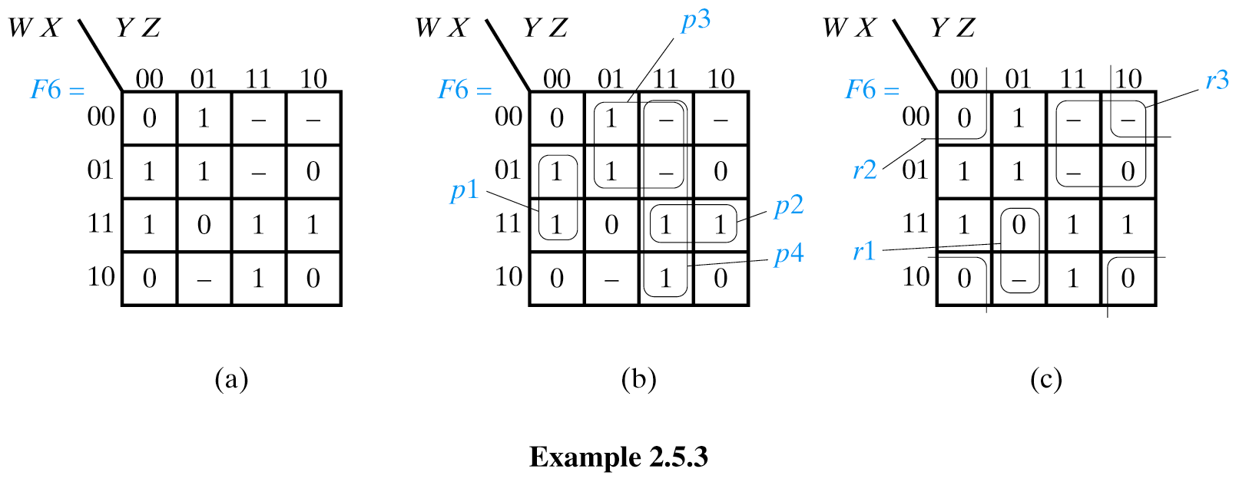
Using K-Maps to Reduce Functions
Given the following K-map, which minimum SOP form of the function
has the smallest literal count (the one for the 1s or the 0s)?
F(W,X,Y,Z) =
F(W,X,Y,Z) =
Only use don’t cares to allow larger cube sizes to be covered
Notes:
Smallest expressions → largest cube sizes

Slide 61
Using K-Maps to Reduce Functions
Only use don’t cares to allow larger cube sizes to be covered
lc = 10
F(W,X,Y,Z) = p1+p2+p3+p4 = X⋅Y⋅Z + W⋅X⋅Y + W⋅Ζ + Y⋅Z
Notes:
Smallest expressions → largest cube sizes

Slide 62
Using K-Maps to Reduce Functions
Only use don’t cares to allow larger cube sizes to be covered
lc = 7
F(W,X,Y,Z) = r1 + r2 + r3 = W⋅Y⋅Z+ X⋅Z + W⋅Y
Notes:
Smallest expressions → largest cube sizes

Slide 63
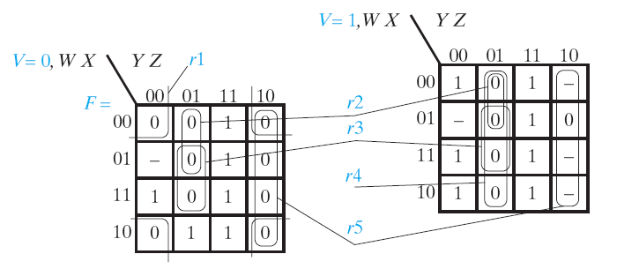
K-Maps for functions of 5 variables
F(V,W,X,Y,Z) = Σ(3,7,9,11,12,15,16,19,23,24,27,28,31)
+ Σmd(4,18,20,26,30)
Notes:
Don’t usually go beyond 4 or 5 variables because there are good S/W packages to do this.
Split map into two (think of them as stacked). Still maintain Gray code.

Slide 64
Parallel
Adder Design

Slide 65
Let us remind the Unsigned Binary (UB) Addition
Examples (4-bit word)
2 + 6
11 + 6
1
1
1
1
1
11
+ 6
17
0010
0110
2
+ 6
8
1011
0110
+
+
1000
10001
Overflow
17 > 2⁴-1

Slide 66
The parallel Ripple Carry Adder is built from Full Adders
Consider a circuit to add two 4-bit numbers:
A3 A2 A1 A0
+ B3 B2 B1 B0
CO4 S3 S2 S1 S0
Truth table would have 8 inputs (2⁸ = 256 rows) and 5 outputs,
requiring 5 minimized functions (5 8-variable K-maps).
But operation at each bit position (after A0/B0) is identical:
CO_{i}
A_{i}
+ B_{i}
CO_{i+1} S_{i}
“bit slice”
We iterate the Full Adder several times

Slide 67
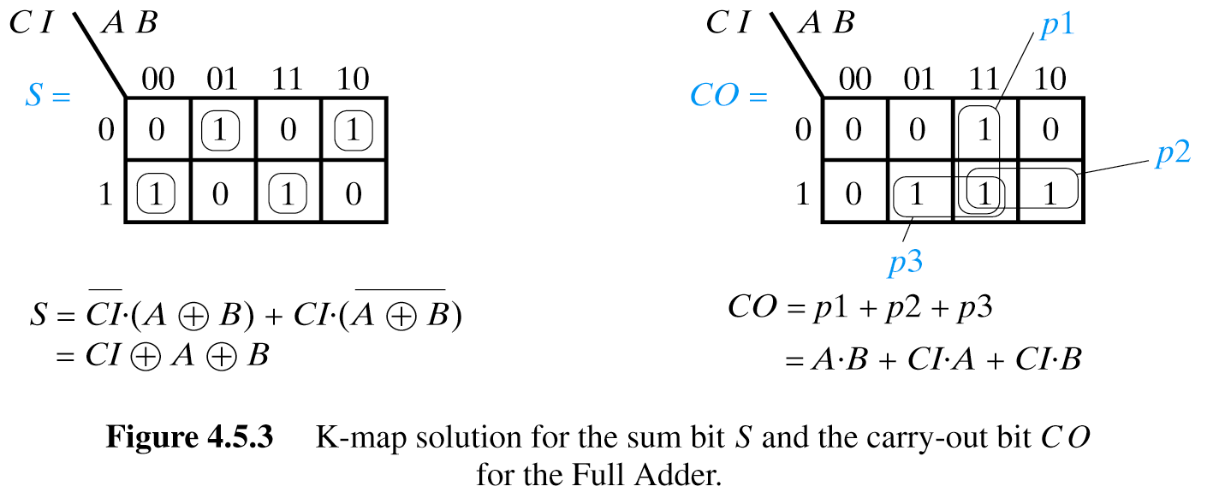
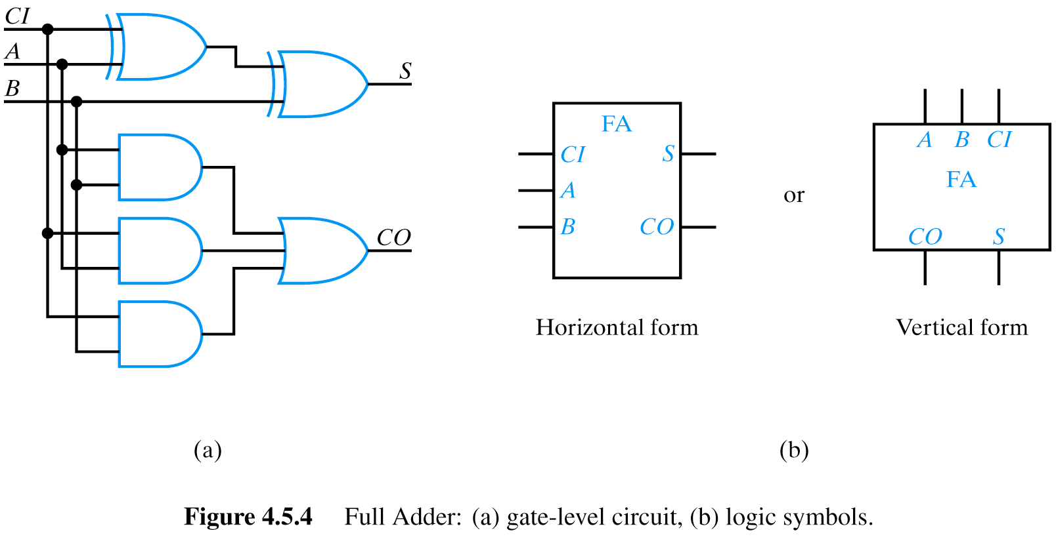
Full Adder Truth Table
CI A B CO S
0 0 0 0 0
0 0 1 0 1
0 1 0 0 1
0 1 1 1 0
1 0 0 0 1
1 0 1 1 0
1 1 0 1 0
1 1 1 1 1

Slide 68
Parallel Adder Design (Iterative Circuit)
C₀
C₁
B₂
A₂
C₂
A₃
C₃
A₀
B₁
B₃
B₀
A₁
C₄
S₀
S₁
S₂
S₃
Least significant bits are here
Most significant bits are here
The same full adder repeated 4 times in an iterative circuit.
This one is called Ripple Carry Adder

Slide 69
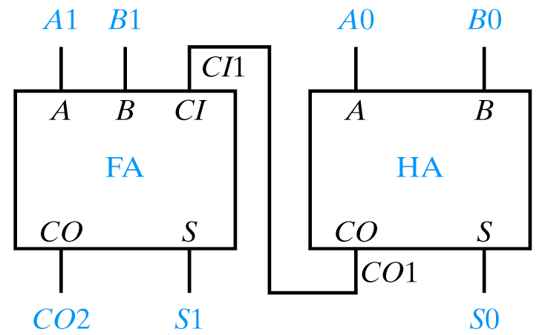
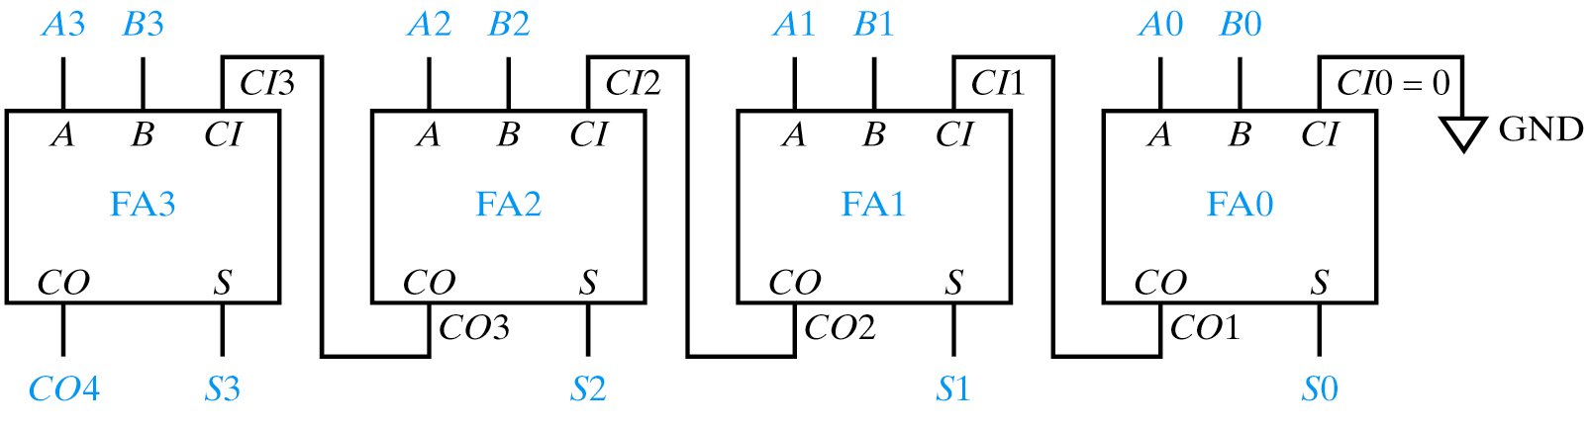
Ripple Carry Adder
This is Ripple Carry Adder for two bits. Adds numbers with two bits each.
A1 A0
+ B1 B0
CO2 S1 S0
Most significant bits are here
The Ripple Carry Adder below is for four bits. Adds numbers A and B with four bits each.
Least significant bits are here

Slide 70
Subtractor Design
Based on your knowledge of negative numbers in two-complement, design a parallel subtractor similar to the parallel adder from last slides.
Combine the design of the above subtractor and the parallel adder to a single circuit with control signal X that controls subtraction or addition of two numbers, A and B. If X=0 the circuit should add A and B. If X=1 the circuit should do the subtraction A-B.
Repeat the above problems for sign-magnitude systems.
Repeat the above problems for one’s-complement system.

Slide 71
ECOTOPIA REVISITED
“1” if car is permitted to use pool today
H is 1 if the vehicle is a hybrid
S is 1 if the vehicle is an SUV,
O is 1 if there are two or more occupants
W is 1 if today is a weekday.
W O S H F
----------
0 0 0 0 1
0 0 0 1 1
0 0 1 0 0
0 0 1 1 1
0 1 0 0 1
0 1 0 1 1
0 1 1 0 0
0 1 1 1 1
1 0 0 0 0
1 0 0 1 1
1 0 1 0 0
1 0 1 1 1
1 1 0 0 1
1 1 0 1 1
1 1 1 0 0
1 1 1 1 1
In Ecotopia it’s generally illegal to use a car pool lane during weekdays if the car doesn’t have at least two occupants.
However, hybrid vehicles can use the lanes any time regardless of the number of occupants.
SUVs (even with two or more occupants) are never allowed to use the car pool lanes (unless they are also hybrids).
Write a Boolean expression in SOP form for F(W, O, S, H) which is 1 if the car is permitted to use the car pool lane today.
W is 1 if today is a weekday.
O is 1 if there are two or more occupants, S is 1 if the vehicle is an SUV, H is 1 if the vehicle is a hybrid.

Slide 72
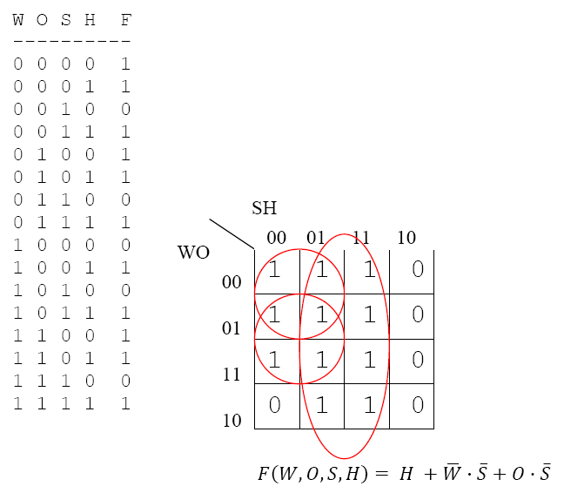
ECOTOPIA REVISITED
S is 1 if the vehicle is an SUV,
H is 1 if the vehicle is a hybrid
W is 1 if today is a weekday.
O is 1 if there are two or more occupants
Car is permitted to use pool if it is a hybrid or it is not a hybrid and it is not a weekday or it is not a hybrid and there are more than two occupants
“1” if car is permitted to use pool today

Slide 73
Circuits with Multiple Outputs
Product Term Sharing

Slide 74
Circuits with Multiple Outputs
Product Term Sharing
x₁
x₂
x₃
x₄
f₁
f₂
This is SOP

Slide 75
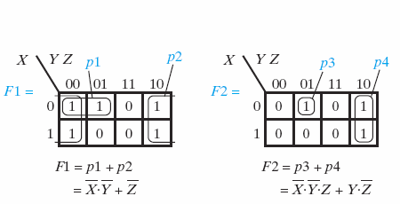
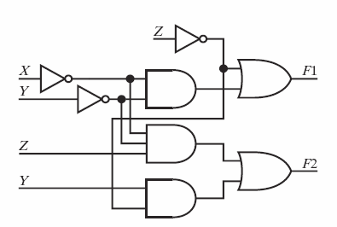
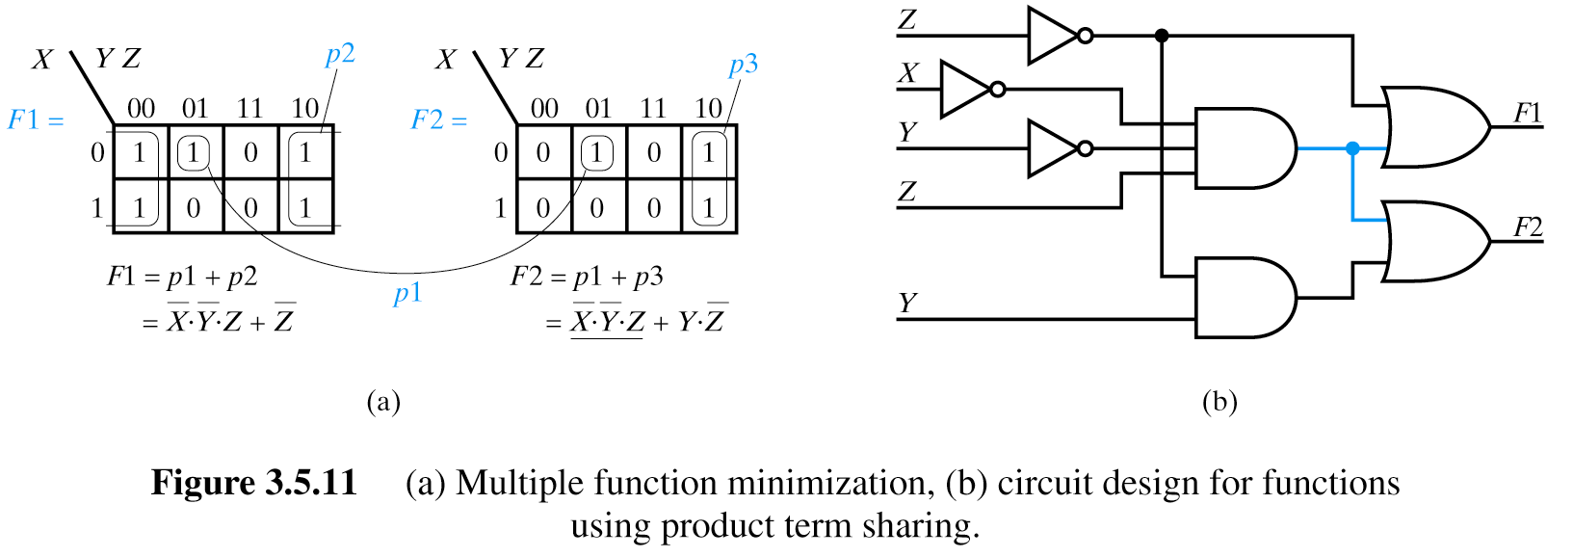
Product Term Sharing
May Result in K-Maps Different from Optimizing Separate Functions

Slide 76
Look for Shared Terms
F1 = Σm(11,12,13,14,15)
= AB + ACD
AB
00
01
11
10
AB
CD
00
01
11
10
00
0
0
1
0
CD
00
0
0
1
0
01
0
0
1
0
01
0
0
1
0
11
1
1
1
0
11
0
0
1
1
10
0
0
1
0
10
0
0
1
0
F3= Σm(3,7,12,13,14,15)
= A’CD+AB
AB
00
01
11
10
Minimize separately
00
0
0
1
0
01
0
0
1
0
11
1
1
1
1
F2= Σm(3,7,11,12,13,15)
= A’CD + ABC’ + ACD
10
0
0
0
0

Slide 77
Implementation with Shared Terms
A
B
F1 = AB + ACD
A
C
D
F2= A’CD + ABC’ + ACD
A
B
C’
A’
F3= A’CD+AB
C
D

Slide 78
Design example: two-bit comparator
A B C D LT EQ GT
0 0 0 0 0 1 0
0 1 1 0 0
1 0 1 0 0
1 1 1 0 0
0 1 0 0 0 0 1
0 1 0 1 0
1 0 1 0 0
1 1 1 0 0
1 0 0 0 0 0 1
0 1 0 0 1
1 0 0 1 0
1 1 1 0 0
1 1 0 0 0 0 1
0 1 0 0 1
1 0 0 0 1
1 1 0 1 0
N1
A
LT
EQ
GT
A B < C D
A B = C D
A B > C D
B
N2
C
D
block diagram
and
truth table
we'll need a 4-variable Karnaugh map
for each of the 3 output functions

Slide 79
Design example: two-bit comparator (cont’d)
A
A
A
0 0
1 0
0 0
0 0
1 0
0 1
0 0
0 0
0 1
0 0
1 1
1 1
D
D
D
1 1
1 1
0 1
0 0
0 0
0 0
1 0
0 1
0 0
0 0
0 0
1 0
C
C
C
B
B
B
K-map for LT
K-map for EQ
K-map for GT
LT =
EQ =
GT =
A' B' D + A' C + B' C D
A' B' C' D' + A' B C' D + A B C D + A B' C D’
B C' D' + A C' + A B D'
EQ =
Another variant that can be extended to any size comparator
= (A xnor C) • (B xnor D)
LT and GT are similar (flip A/C and B/D)

Slide 80
Design example: two-bit comparator (cont’d)
A B C D
two alternative
implementations of EQ
with and without XOR
EQ
XNOR is implemented with
at least 3 simple gates
EQ

Slide 81
Another solution to this problem
A
A
A
0 0
0 0
Free groups from here
1 1
1 1
1 1
1 1
0 0
1 0
0 1
1 0
Free groups from here
0 1
0 0
D
D
D
1 1
1 1
0 1
0 0
1 1
1 1
0 1
1 0
0 0
0 0
0 0
1 0
C
C
C
B
B
B
K-map for LT
K-map for EQ
K-map for GT
LT =
EQ =
GT =
A' B' D + A' C + B' C D
A' B' C' D' + A' B C' D + A B C D + A B' C D’
B C' D' + A C' + A B D'
EQ =
Another variant that can be extended to any size comparator
= (A xnor C) • (B xnor D)
LT and GT are similar (flip A/C and B/D)

Slide 82
Another solution to this problem
A
A
A
0 0
0 0
Free groups from here
1 1
1 1
1 1
1 1
0 0
1 0
0 1
1 0
Free groups from here
0 1
0 0
D
D
D
1 1
1 1
0 1
0 0
1 1
1 1
0 1
1 0
0 0
0 0
0 0
1 0
C
C
C
B
B
B
K-map for LT
K-map for EQ
K-map for GT
LT =
EQ =
GT =
A' B' D + A' C + B' C D
A' B' C' D' + A' B C' D + A B C D + A B' C D’
B C' D' + A C' + A B D'
A B C D
LT
From Kmap
LT
EQ
From Kmap
A B C D
GT
GT
Better than previous solutions

Slide 83
Design example: 2x2-bit multiplier
A2 A1 B2 B1 P8 P4 P2 P1
0 0 0 0 0 0 0 0
0 1 0 0 0 0
1 0 0 0 0 0
1 1 0 0 0 0
0 1 0 0 0 0 0 0
0 1 0 0 0 1
1 0 0 0 1 0
1 1 0 0 1 1
1 0 0 0 0 0 0 0
0 1 0 0 1 0
1 0 0 1 0 0
1 1 0 1 1 0
1 1 0 0 0 0 0 0
0 1 0 0 1 1
1 0 0 1 1 0
1 1 1 0 0 1
A1
A2
B1
B2
P1
P2
P4
P8
block diagram
and
truth table
4-variable K-map
for each of the 4
output functions

Slide 84
Design example: 2x2-bit multiplier (cont’d)
K-map for P8
K-map for P4
A2
A2
0 0
0 0
0 0
0 0
0 0
0 0
0 0
0 0
P4 = A2B2B1'
+ A2A1'B2
B1
B1
0 0
0 0
1 0
0 0
0 0
0 0
0 1
1 1
B2
P8 = A2A1B2B1
B2
A1
A1
K-map for P2
K-map for P1
A2
A2
0 0
0 0
0 0
1 1
0 0
0 1
0 0
1 0
P1 = A1B1
B1
B1
0 1
0 1
0 1
1 0
0 1
0 0
1 0
0 0
B2
P2 = A2'A1B2
+ A1B2B1'
+ A2B2'B1
+ A2A1'B1
B2
A1
A1

Slide 85
Design example: BCD increment by 1
I8 I4 I2 I1 O8 O4 O2 O1
0 0 0 0 0 0 0 1
0 0 0 1 0 0 1 0
0 0 1 0 0 0 1 1
0 0 1 1 0 1 0 0
0 1 0 0 0 1 0 1
0 1 0 1 0 1 1 0
0 1 1 0 0 1 1 1
0 1 1 1 1 0 0 0
1 0 0 0 1 0 0 1
1 0 0 1 0 0 0 0
1 0 1 0 X X X X
1 0 1 1 X X X X
1 1 0 0 X X X X
1 1 0 1 X X X X
1 1 1 0 X X X X
1 1 1 1 X X X X
I1
I2
I4
I8
O1
O2
O4
O8
block diagram
and
truth table
4-variable K-map for each of
the 4 output functions

Slide 86
Design example: BCD increment by 1 (cont’d)
I8
I8
O8
O4
0 0
0 0
X 1
X 0
0 1
0 1
X 0
X 0
I1
O8 = I4 I2 I1 + I8 I1'
O4 = I4 I2' + I4 I1' + I4’ I2 I1
O2 = I8’ I2’ I1 + I2 I1'
O1 = I1'
I1
0 1
0 0
X X
X X
1 0
0 1
X X
X X
I2
I2
I4
I4
I8
O2
I8
O1
0 0
1 1
X 0
X 0
1 1
0 0
X 1
X 0
I1
I1
0 0
1 1
X X
X X
0 0
1 1
X X
X X
I2
I2
I4
I4

Slide 87
K-Maps: Caveats!
Empty K-Map must be constructed correctly
  Gray Code: Adjacent cells differ in only one variable
K-Map must be plotted correctly
  Minterms from truth table or compact form
  Minterms from partially reduced expressions
K-Map must be circled correctly
  Start with smallest cubes first!
  Remember that K-Maps “wrap” at edges
Use 1s for F, 0s for F

Slide 88
Short List of Rules for Exor Logic
A ⊕ A = 0
A ⊕ A’ = 1
A ⊕ 1=A’
A’ ⊕ 1=A
A ⊕ 0=A
A ⊕ B= B ⊕ A
A B = B A
A(B ⊕ C) = AB ⊕ AC
A+B = A ⊕ B ⊕ AB
A+B = A ⊕ B when AB = 0
A ⊕ (B ⊕ C) = (A ⊕ B) ⊕ C
(A B) C = A (B C)
A+B = A ⊕ B ⊕ AB =
A⊕ B(1 ⊕ A) = A ⊕ BA’
These rules are sufficient to minimize Exclusive Sum of Product expression for small number of variables
We will use these rules in the class for all kinds of reversible, quantum, optical, etc. logic. Try to remember them or put them to your “creepsheet”.

Slide 89
Chess Patterns
W
Y
1 1
0 1 0 1
1 1
1 0 1 0
1 1
0 0
0 1 0 1
W⊕Y
1 1
0 0
1 0 1 0
1 0 1 0
W⊕X ⊕ Y ⊕ Z

Slide 90
Chess Patterns
1 1 1 1
0 1 0 1
0 0 0 0
0 1 0 1
1 1 1 1
0 1 0 1
W⊕X
0 0 0 0
Y⊕ Z
0 1 0 1
1 0 1 0
0 1 0 1
0 1 0 1
1 0 1 0
1 0 1 0
0 1 0 1
1 0 1 0
0 1
0 1
1 0 1 0
W⊕X ⊕ Y ⊕ Z ⊕ 1
W⊕X ⊕ Y ⊕ Z

Slide 91
Chess Patterns for functions of 5 variables
DE
DE
AB
00
01
11
10
AB
10
11
01
00
00
00
01
mirror
01
11
11
10
10
E
CDE
AB
000
001
011
010
110
111
101
100
00
1
0
1
0
0
1
0
1
01
1
0
1
0
0
1
0
1
11
1
0
1
0
0
1
0
1
10
1
0
1
0
0
1
0
1
D
D ⊕ E

Slide 92
EXOR Patterns
1 1 1 1
0 0 1 1
0 0 0 0
0 0 1 1
1 1 1 1
1 1 0 0
0 0 0 0
WX⊕ Y
0 0 1 1
W⊕X
0 0 1 0
0 1 0 0
0 0 1 0
1 0 1 1
1 1 0 1
0 1 0 0
0 1 0 0
0 0
1 0
0 1 0 0
WX ⊕ YZ
W X ⊕ Y Z

Slide 93
Example of Application in Quantum Computing

Slide 94
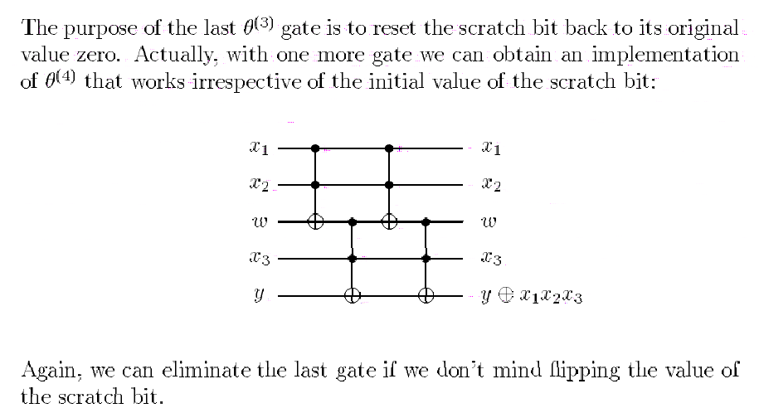
Use of Toffoli Gate
x₁x₂⊕w
x₁x₂⊕w ⊕ x₁x₂
(x₁x₂⊕w)x₃ ⊕y
(x₁x₂⊕w)x₃ ⊕y ⊕ wx₃

Slide 95
Example of Application in Robotics

Slide 96
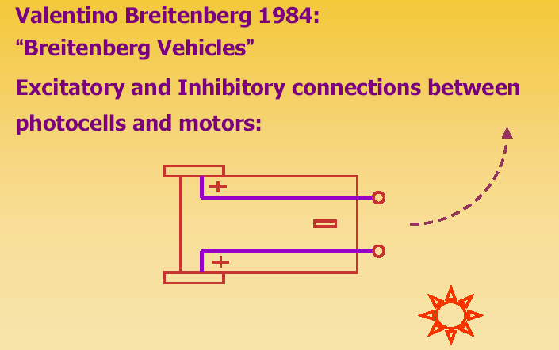
Another Example: Braitenberg Vehicles and Quantum BV

Slide 97
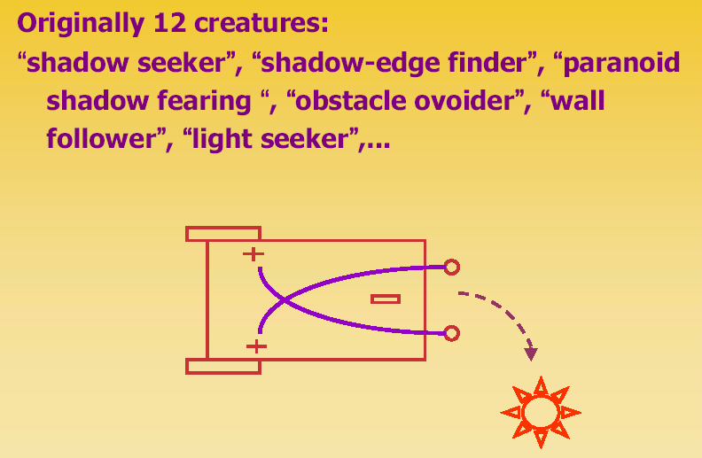
Braitenberg Vehicles

Slide 98
Braitenberg Vehicles
Instead of only analog components we can have binary components such as logic gates and circuits.
We can use analog-to-digital converters for sensors and digital-to-analog converters for motors and lights.

Slide 99
Essence of logic synthesis approach to learning

Slide 100
Example of Logical Synthesis in Machine Learning
John
Mark
Jim
Dave
Alan
Mate
Robert
Nick

Slide 101
Good guys
John
Mark
Dave
Jim
Bad guys
Alan
Mate
Robert
Nick
A - size of hair
B - size of nose
C - size of beard
D - color of eyes

Slide 102
Good guys
John
Mark
Dave
Jim
A’ B’CD
A’ B’CD
A’ BCD
A’ BCD’
A - size of hair
CD
00
01
11
10
B - size of nose
AB
00
-
-
1
-
C - size of beard
01
–
-
1
1
D - color of eyes
11
-
–
-
-
10
-
-
-
-

Slide 103
Bad guys
Alan
Mate
Robert
Nick
ABCD
A’ B’C’D
A’ BC’D’
AB’C’D
A - size of hair
CD
00
01
11
10
B - size of nose
AB
00
-
-
1
-
C - size of beard
01
0
0
1
1
D - color of eyes
11
-
–
0
-
10
-
0
-
-
A’C

Slide 104
Generalization 1:
Bald guys with beards are good
Generalization 2:
All other guys are no good
A - size of hair
CD
00
01
11
10
AB
B - size of nose
00
-
-
1
-
C - size of beard
01
0
0
1
1
D - color of eyes
11
-
–
0
-
A’C
10
-
0
-
-

Slide 105
Example of Application in Machine Learning: Decision Trees

Slide 106
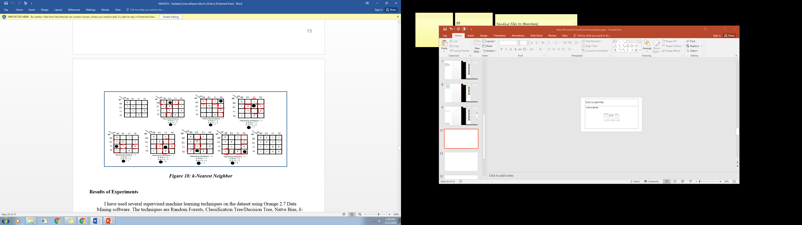
Using Kmaps to illustrate cofactoring or splitting
THIS METHOD ASSUMES NO PRUNNING
a=0
a=1
c=0
c=1
c=1
c=0
1
0
1
a*c
a*c
b=1
SOLUTION
a*c
+
b=0
+
a*c
a*c
*b*d
0
d
a*c
*b*d
The same as

Slide 107
Using Kmaps to illustrate cofactoring or splitting
THIS METHOD ASSUMES PRUNNING when there is more ones than zeros in a cofactor group or more zeros than ones
a=0
a=1
c=0
c=1
c=1
c=0
0
1
1
0
a*c
*b*d
In this cofactor a*c we have more zeros than ones so we prune to constant 0
The same as
SOLUTION
a*c
+
a*c

Slide 108
Conclusion on Prunning
SOLUTION without PRUNNING
a*c
+
+
a*c
a*c
*b*d
SOLUTION with PRUNNING
a*c
+
a*c
These are two different functions.
PRUNNING OR NO PRUNNING CAN LEAD TO OVERFITTING

Slide 109
PROJECT EXAMPLE
Full Adder in VERILOG
YOU WILL HAVE A PROJECT

Slide 110
Various specifications of combinational circuits
Natural Language Specification
Hypercube
Truth Table
Karnaugh Map
Logic Equations
Schematic of a circuit
Verilog Code

Slide 111

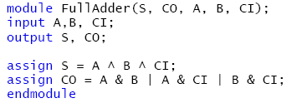

Verilog Dataflow Example: Full Adder
CI A B CO S
0 0 0 0 0
0 0 1 0 1
0 1 0 0 1
0 1 1 1 0
1 0 0 0 1
1 0 1 1 0
1 1 0 1 0
1 1 1 1 1

Slide 112
Verilog Structural Example: Full Adder

Slide 113
Verilog Structural Example: Full Adder

Slide 114
COLLECTION OF PROBLEMS FOR MIDTERM
(with partial solutions)

Slide 115
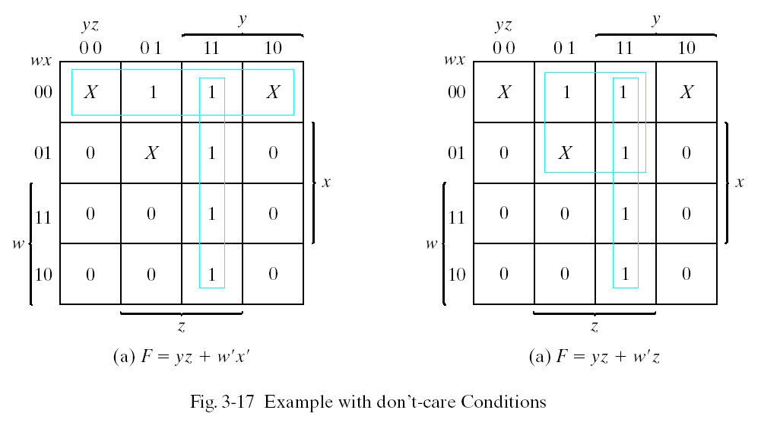
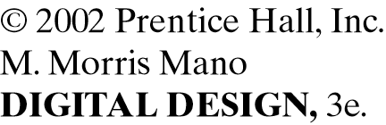
Problem 1: Minimize Function F as SOP
Given is function from Fig. 3.17.
Synthesize minimum SOP and draw the circuit.

Slide 116
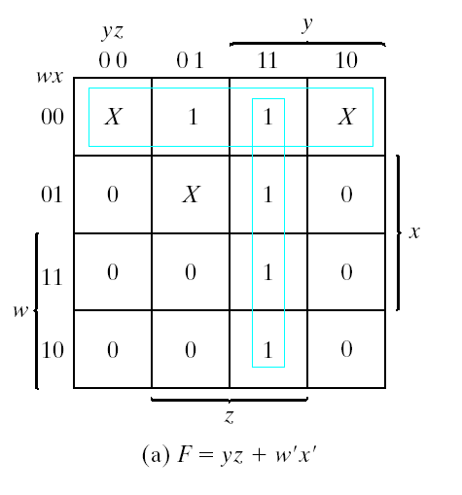
Problem 2: Minimize Function F as POS
f’ = z’ + wy’ Complement of f
f = z(w’ + y) Product of Sums
f = w’z + yz Sum of Products
f = w’x’ + yz
Another sum of products
In this example there are two solutions for SOP with the same cost of literals. Cost of inputs to gates is different.
Given is function from Figure above.
Synthesize minimum POS and draw the circuit.

Slide 117

NAND Implementations of AND, OR, and NOT Gates
Problem 3: Realize NOT , AND and OR functions using only NAND gates.
NOT Gate
x
f
f = x’
x
AND Gate
f
y
f = ((xy)’)’ = xy
x
OR Gate
f
f = (x’y’)’ = x + y
y
Draw schematics of circuits realizing NOT, AND and OR Gates using only NAND gates.
Repeat this problem using only logic operators that realize function f=x’a + xb

Slide 118

NOR Implementations of AND, OR, and NOT Gates
Problem 4: Realize NOT, OR and AND functions using NOR gates only
NOT Gate
x
f
f = x’
x
OR Gate
f
y
f = ((x + y)’)’ = x + y
x
AND Gate
f
f = (x’ + y’)’ = xy
y
Draw schematics of circuits realizing NOT, AND and OR Gates using only NOR gates.
Repeat this problem using only logic operators that realize function f = (x’+a) * (x+b)

Slide 119
Problem 5: Write basic logic formulas related to EXOR gate
XOR gates have the following interesting properties:
x ⊕ 0 = x
x ⊕ 1 = x’
x ⊕ x = 0
x ⊕ x’ = 1
x ⊕ y’ = x’ ⊕ y = (x ⊕ y)’
x ⊕ y = y ⊕ x
x ⊕ y ⊕ z = (x ⊕ y) ⊕ z = x ⊕ (y ⊕ z)
Write formulas for exor of x and 0, x and 1 and other similar formulas for EXOR gate.
Prove that they are true using truth tables.

Slide 120



Two-Input XOR Implementation Using AND, OR, and NOT Gates
Problem 6: Draw schematics of EXOR gate from AND, OR and NOT gates
x
x ⊕ y
y
Draw logic diagram for EXOR gate using AND, OR and NOT gates. There are several solutions not shown above.

Slide 121
Two-Input XOR Implementation Using NAND Gates
Problem 7: Realize EXOR gate using only four NAND gates and no other gates.
x
x ⊕ y
y
Draw logic diagram for EXOR gate using only four NAND gates.
How many NOR gates you need to realize EXOR? Try to minimize this circuit.

Slide 122
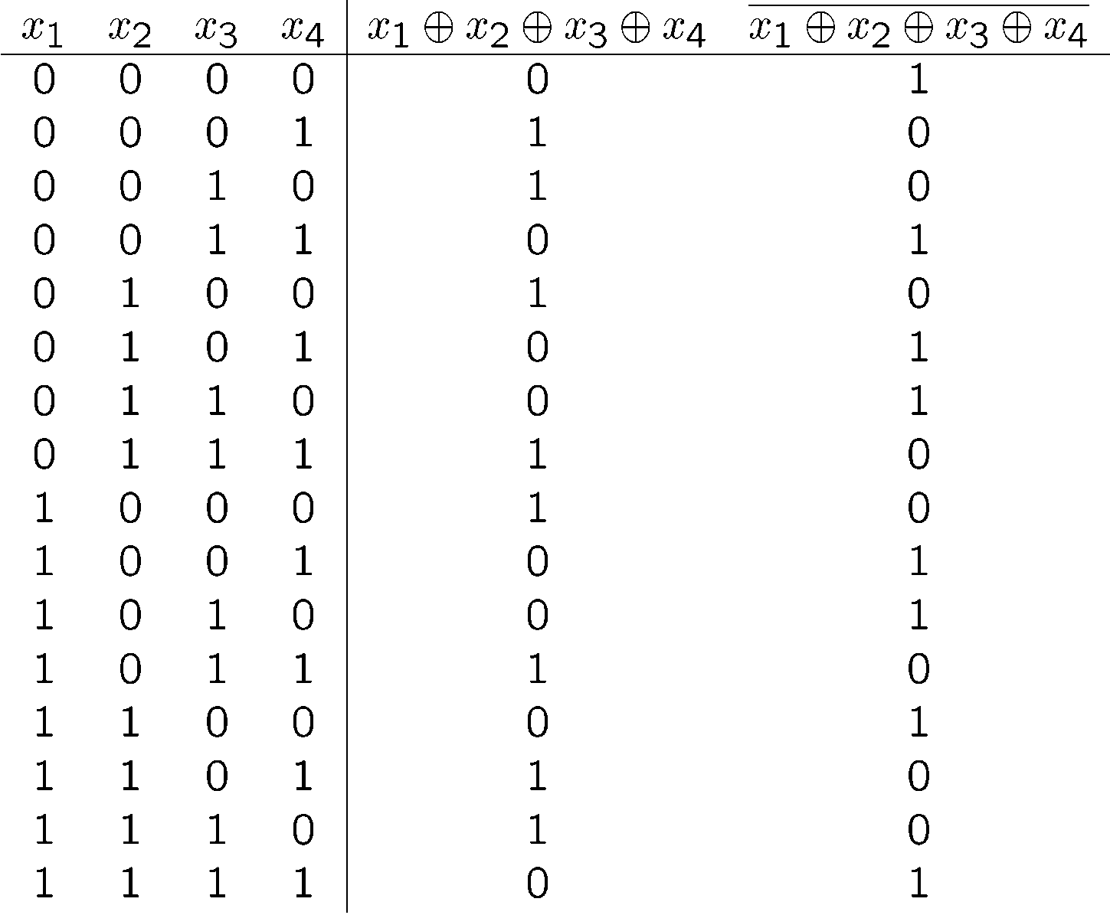
Problem 8: Minimize Parity functions of 4 variables
Using the truth tables of parity functions from the left, realize both of them in a circuit with minimum number of arbitrary gates AND, OR, EXOR and NOT

Slide 123
Karnaugh Maps for Four-Input
XOR and XNOR Gates
Realize these maps with the minimum number of EXOR gates and no other gates.
You may use constants.

Slide 124
Example of XOR Extraction
Problem 9: Minimize Function using only two EXOR, one NOT and one AND gates
Given a Boolean function f, is it possible to simplify this complex sum of products function using XOR and XNOR gates?
Consider the following Karnaugh Map:
NOTE:
This Boolean function uses six terms in sum of products form.
Realize these maps with the minimum number of EXOR, AND and NOT gates and no other gates. You may use constants.
Draw the schematic.

Slide 125
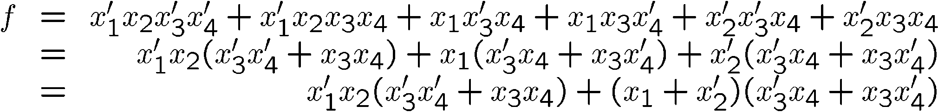
Example of XOR Extraction
XNOR
XOR

Slide 126
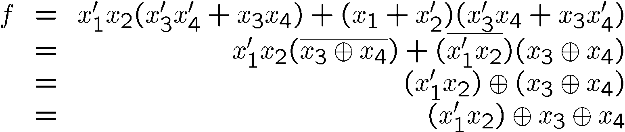
Example of XNOR Extraction
Simplifying…
Arguably, this simplified expression using two XOR gates will require fewer total gates to implement the function

Slide 127
Example of Reuse of Intermediate Nodes
Problem 10: Realize functions f1 and f2 from equations below using minimum number of gates AND and OR
Consider the following functions f₁ and f₂:
f₁ = x + y
f₂ = xz + yz = (x + y)z
A more advanced solution is the following:
x
f₁
y
f₂
z
Realize functions f1 and f2 using only AND and OR gates.
Repeat this problem using only NAND gates.
Repeat this these problem using only NOR gates.
Draw the schemata.

Slide 128
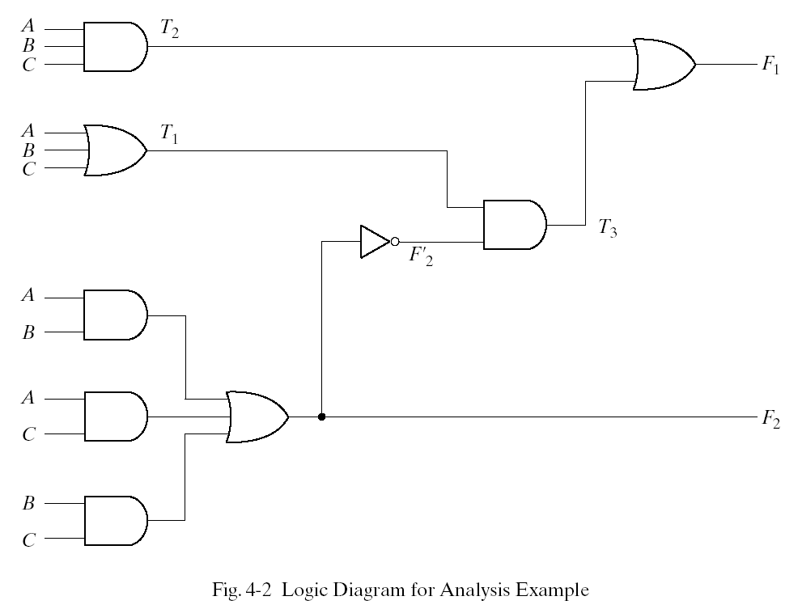

Example of Analyzing a Combinational Circuit
Problem 11: Analyze the function from the circuit given below
NOTE:
Step 1 adds labels T₁, T₂, T₄, T₅, and T₆ to to the diagram.
Step 2 is repeated to label F₂, F’₂, T₃, and F₁ in order.
Step 4 is performed to find the Boolean functions in terms of inputs.
T₄
T₅
T₆

Slide 129
Determining the Boolean Functions
The combinational circuit on the previous slide contains two outputs that need to be expressed as Boolean functions of the three inputs
To express these functions, Boolean functions for each intermediate node (T₁, T₂, T₃, T₄, T₅, T₆, and F’₂) must be determined

Slide 130
Determining the Boolean Functions for Each Logic Gate
F₁ = T₂T₃
F₂ = T₄ + T₅ + T₆
T₁ = A + B + C
T₂ = ABC
T₃ = T₁F’₂
T₄ = AB
T₅ = AC
T₆ = BC
F’₂ = (F₂)’

Slide 131
Determining the Boolean Function for F₁
F₁ = T₂ + T₃
= ABC + T₁F’₂
= ABC + (A + B + C)(F₂)’
= ABC + (A + B + C)(T₄ + T₅ + T₆)’
= ABC + (A + B + C)(AB + AC + BC)’
= ABC + (A + B + C)(A’ + B’)(A’ + C’)(B’ + C’)
= ABC + (A’B + A’C + AB’ + B’C)(A’B’ + B’C’ + A’C’)
= ABC + A’B’C + A’BC’ + AB’C’

Slide 132
Determining the Boolean Function for F₂
F₂ =T₄ + T₅ + T₆
= AB + AC + BC
Question:
What combinational circuit is shown in this example?
Answer:
The combinational circuit implements a 1-bit full adder:
  A and B are single-bit inputs and C is the carry-in
  F₁ is the sum and F₂ is the carry-out

Slide 133
Full Adder Truth Table
A full adder circuit performs 1-bit addition
The truth table shown to the right describes a 1-bit addition circuit
The inputs to the circuit are A, B, and C (carry-in)
The outputs of the circuit are F₁ (sum) and F₂ (carry-out)
A | B | C | F₁ | F₂
0 | 0 | 0 | 0 | 0
0 | 0 | 1 | 1 | 0
0 | 1 | 0 | 1 | 0
0 | 1 | 1 | 0 | 1
1 | 0 | 0 | 1 | 0
1 | 0 | 1 | 0 | 1
1 | 1 | 0 | 0 | 1
1 | 1 | 1 | 1 | 1
Draw the truth table.
Using the truth table, draw a Kmap.
Using Kmap, find the realization using the minimum number of EXOR gates and other gates such as NOT, AND and OR.
Draw the schemata.
Repeat this problem using only NAND gates.
Repeat this these problem using only NOR gates.
Draw the schemata.
Problem 11: Draw truth table of a full adder

Slide 134
Textbook Example
Design a combinational circuit to convert from BCD code to Excess-3 code
Step 1: Determine the inputs and outputs of the circuit
  Four inputs labelled A, B, C, and D
  Four outputs labelled w, x, y, and z
  The label names were chosen arbitrarily in this case
Problem 12: Convert from BCD code to Excess-3 code

Slide 135
Step 2: Truth Table
Input BCD Code |  |  |  | Output Excess-3 Code
A | B | C | D | w | x | y | z
0 | 0 | 0 | 0 | 0 | 0 | 1 | 1
0 | 0 | 0 | 1 | 0 | 1 | 0 | 0
0 | 0 | 1 | 0 | 0 | 1 | 0 | 1
0 | 0 | 1 | 1 | 0 | 1 | 1 | 0
0 | 1 | 0 | 0 | 0 | 1 | 1 | 1
0 | 1 | 0 | 1 | 1 | 0 | 0 | 0
0 | 1 | 1 | 0 | 1 | 0 | 0 | 1
0 | 1 | 1 | 1 | 1 | 0 | 1 | 0
1 | 0 | 0 | 0 | 1 | 0 | 1 | 1
1 | 0 | 0 | 1 | 1 | 1 | 0 | 0

Slide 136
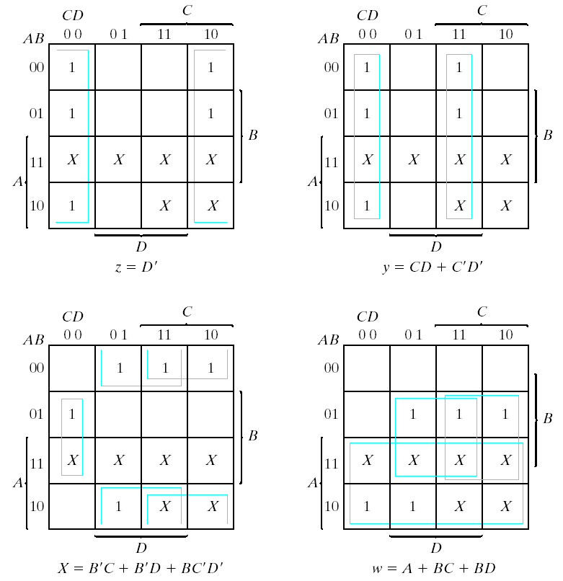
Step 3: Boolean Simplification

Slide 137
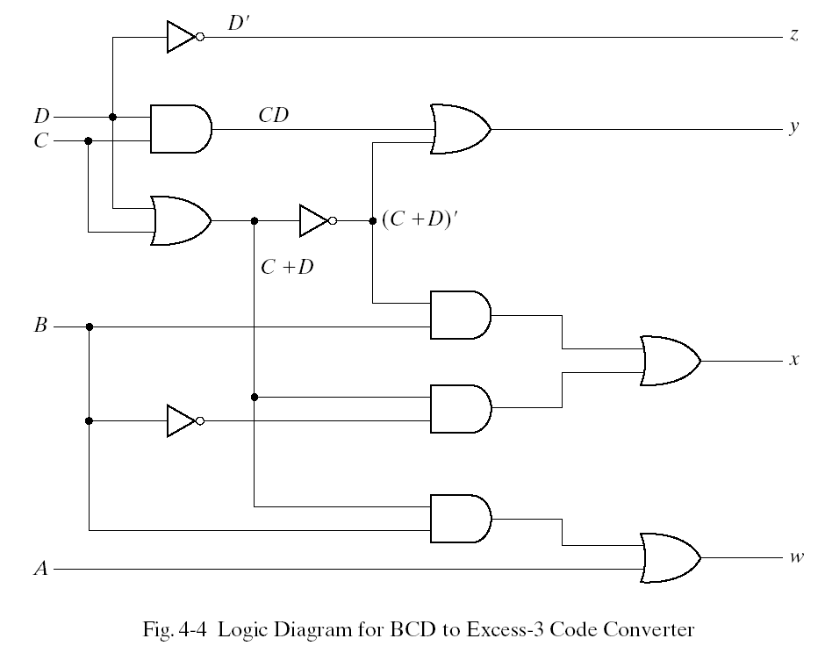
Step 4: Logic Diagram

Slide 138
Problem 13. Design of The Half Adder and Full Adder
C
A
A | B | C | S
0 | 0 | 0 | 0
0 | 1 | 0 | 1
1 | 0 | 0 | 1
1 | 1 | 1 | 0
Half Adder
(HA)
S
B
NOTE:
From the truth table, it can be seen that S = A ⊕ B and C = AB
Design full adder from half adders and in other variant directly.

Slide 139
Implementations of the Half Adder
A
A
S
B’
B
S
A’
A
C
B
B
B
A
C
B
Implementation 1
S = AB’ + A’B
C = AB
Implementation 2
S = A ⊕ B
C = AB

Slide 140
The Full Adder
A_{i}
B_{i}
A_{i} | B_{i} | C_{i} | C_{i+1} | S_{i}
0 | 0 | 0 | 0 | 0
0 | 0 | 1 | 0 | 1
0 | 1 | 0 | 0 | 1
0 | 1 | 1 | 1 | 0
1 | 0 | 0 | 0 | 1
1 | 0 | 1 | 1 | 0
1 | 1 | 0 | 1 | 0
1 | 1 | 1 | 1 | 1
C_{i+1}
Full Adder
(FA)
C_{i}
S_{i}

Slide 141
The Full Adder
Recall that a full adder can be built as follows:
NOTE:
A_{i} = A
B_{i} = B
C_{i} = C
S_{i} = F₁
C_{i+1} = F₂

Slide 142

The Full Adder
However, the full adder can also be built as follows:
A_{i} | B_{i} | C_{i} | C_{i+1} | S_{i}
0 | 0 | 0 | 0 | 0
0 | 0 | 1 | 0 | 1
0 | 1 | 0 | 0 | 1
0 | 1 | 1 | 1 | 0
1 | 0 | 0 | 0 | 1
1 | 0 | 1 | 1 | 0
1 | 1 | 0 | 1 | 0
1 | 1 | 1 | 1 | 1
C_{i+1}
Half Adder
(HA)
A_{i}
Half Adder
(HA)
B_{i}
S_{i}
C_{i}

Slide 143
Questions and EXAM Problems (1)
Explain how to derive Boolean Equations from a Truth Table.
Explain how to derive Boolean Equations from a circuit schematic.
What are minterms.
How to obtain an equation based on minterms from a Truth Table?
How to obtain a circuit based on minterms?
What is SOP form?
What is POS form?
Write an equation for a function that is not in POS and not in SOP form. Show circuit.
What are maxterms? How they are used in logic synthesis?
Generalized Compact Minterm Form, give examples.
Generalized Compact Maxterm Form, give examples.
Draw Kmap for a function of two variables in two different ways.
Draw Kmap for a function of three variables in two different ways.
Draw Kmap for a function of four variables in two different ways.
Draw Kmap for a function of five variables in two different ways.

Slide 144
Questions and EXAM Problems (2)
16. What is an Implicant? How to find it on Kmap?
17. What is a Prime Implicant. How to find it on Kmap?
18. What is an Essential Prime Implicant. How to find it on Kmap?
19. What is Optional Prime Implicant. How to find it on Kmap?
20. What is Redundant (Non-Essential) Prime Implicant. How to find it on Kmap?
21. Give example of a function that is composed only from essential prime implicants.
22. Give example of a function in which the largest prime implicant will be not included in the minimal solution.
23. What is a don’t care? What is an incompletely specified function?
24. Give example of POS circuit with term sharing.

Slide 145
Questions and EXAM Problems (3)
25. What are chess patterns?
26. Show chess pattern a⊕b on Kmap of three variables and next on Kmap of 4 variables.
27. Show chess pattern a⊕b on Kmap of 5 variables.
28. Show chess pattern a⊕b ⊕ c on Kmap of 5 variables.
29. What are exor patterns?
30. Show exor pattern ae⊕bc ⊕ d on Kmap of 5 variables.
31. Show exor pattern a ⊕ e⊕b ⊕ c ⊕ ad on Kmap of 5 variables.

Slide 146
EXOR Patterns
Questions and EXAM Problems (4)
0 0 0 0
1 0 0 1
0 0 0 0
0 0 1 0
1 1 0 0
0 0 0 1
0 0 1 1
1 0 1 0
0 0 1 0
0 1 0 1
0 1 0 0
1 0 1 0
1 0 1 1
0 1 1 1
1 0 1 0
0 0
1 0
1 0 1 0
Minimize functions above using only EXOR and AND gates and literals.

Slide 147
Challenge Problems for ambitious students
Problem 1. Express function AB+CD+A’C using only EXORs and AND gates
Problem 2. Prove that
(A+B)’ = A ⊕ B ⊕ AB ⊕1
Problem 3 . Prove that A+B = A ⊕ B when AB = 0 without using Kmaps or truth tables.
Problem 4. Given are three functions of three inputs:
A = NOT(a), B = NOT(b), C = NOT(c).
You have only two inverters. You can have an arbitrary large set of two-input AND and OR gates.
Realize these three functions with the gates that you have at your disposal. You cannot use other gates. You can use only two inverters. Draw the schematic of the solution

Slide 148
Sources
Prof. Mark G. Faust
John Wakerly
Caetano Boriello
Morris Mano

