Slide 1
Lecture 6
Topics
  Combinational Logic Circuits
    Graphic Symbols (IEEE and IEC)
    Switching Circuits
    Analyzing IC Logic Circuits
    Designing IC Logic Circuits
    Detailed Schematic Diagrams
    Using Equivalent Symbols

Slide 2
Combinational Logic Circuits
Combinational Logic
  Outputs depend only upon the current inputs (not previous “state”)
Positive Logic
  High voltage (H) represents logic 1 (“True”)
  “Signal BusGrant is asserted High”
Negative Logic
  Low voltage (L) represents logic 1 (“True”)
  “Signal BusRequest# is asserted Low”

Slide 3
Graphic Symbols

Slide 4
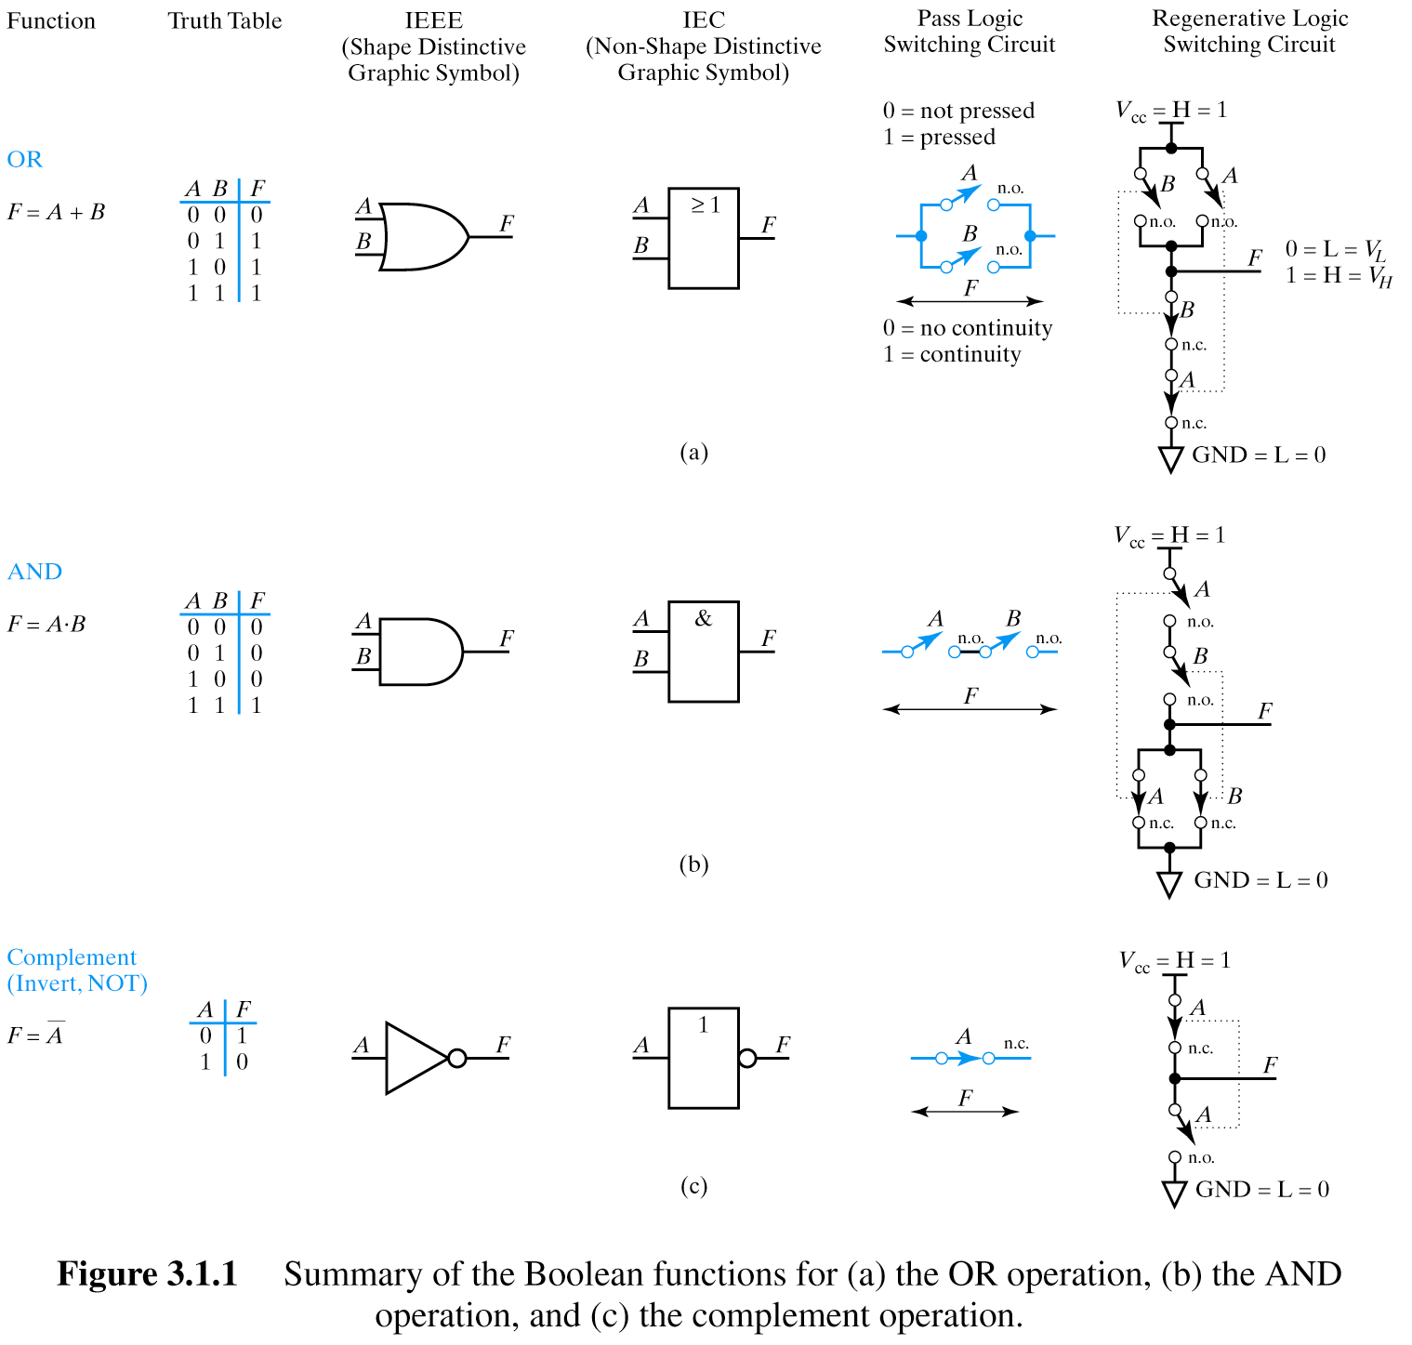
IEEE: Institute of Electrical
and Electronics Engineers
IEC: International Electro-
technical Commission

Slide 5
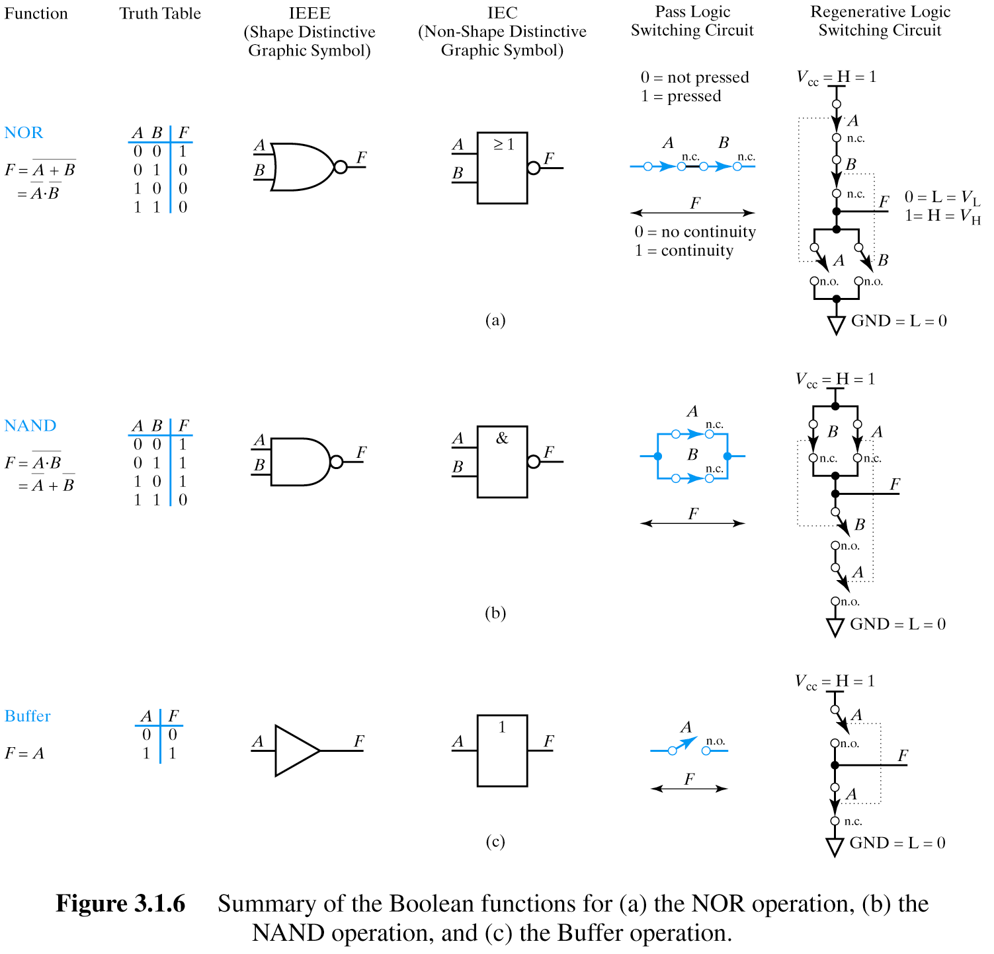

Slide 6
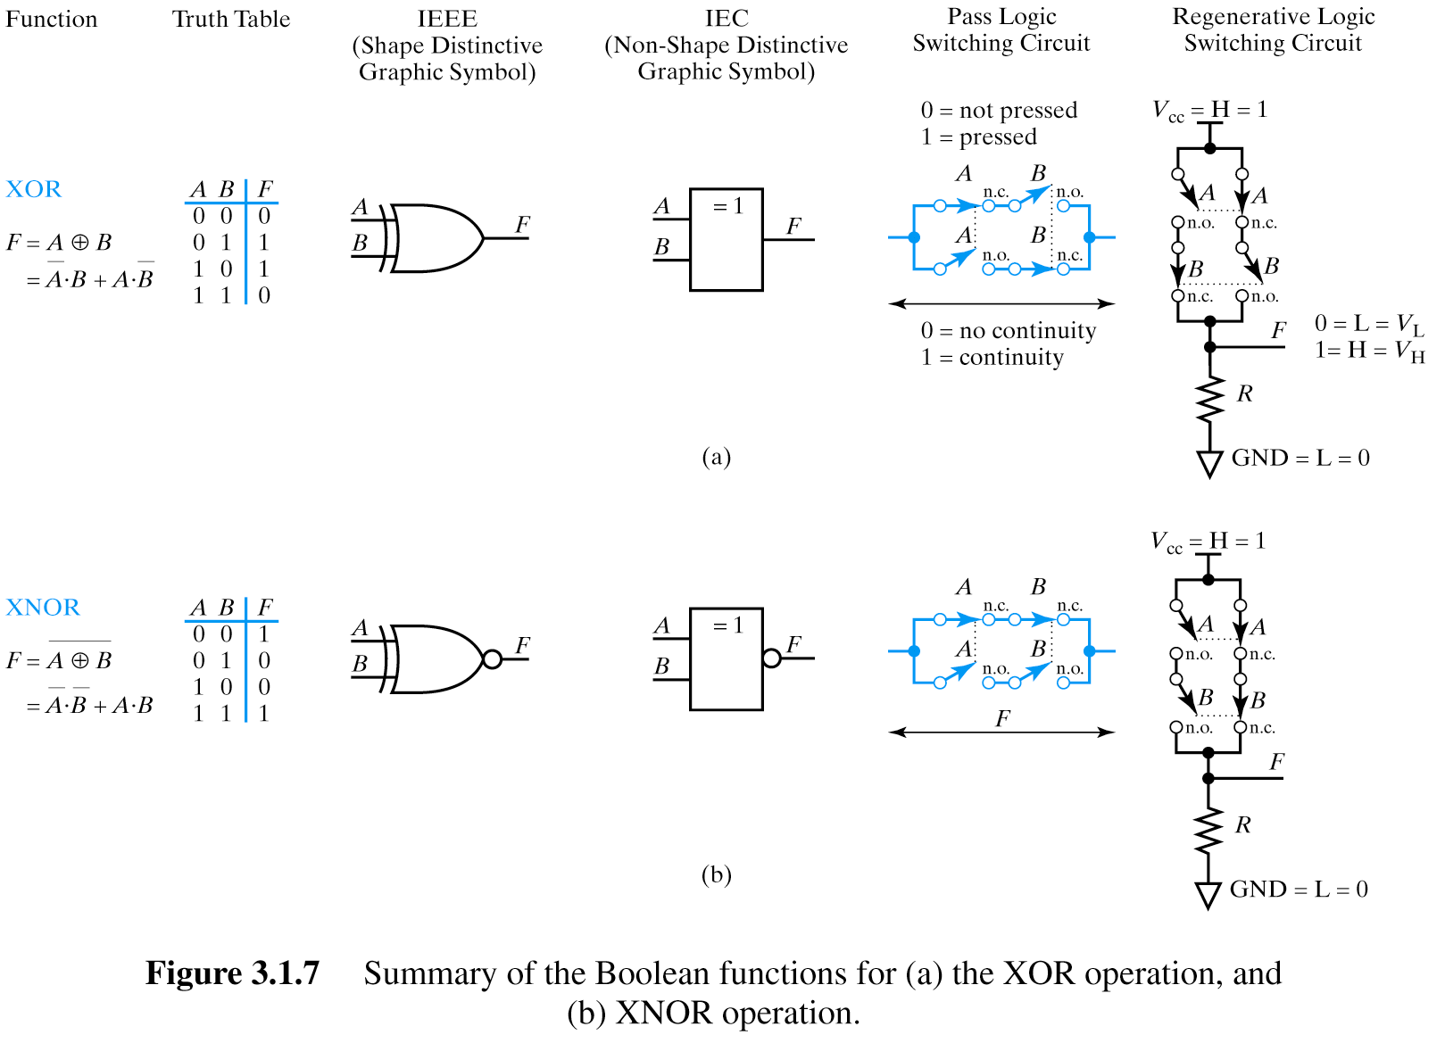

Slide 7
Pass Logic versus Regenerative Logic

Slide 8
OR gate using Pass Logic and using Regenerative Logic
n.o. = normally open
n.c. = normally closed
These regenerative logic switching circuits that we’ll be seeing are actually very close to the way real CMOS ICs are implemented and can be a useful model for us without getting into the details of how the transistors actually work.
In particular, note the voltage differential and direction of current flow!

Slide 9
AND gate using Pass Logic and using Regenerative Logic
n.o. = normally open
n.c. = normally closed

Slide 10
NOT gate using Pass Logic and using Regenerative Logic
n.o. = normally open
n.c. = normally closed

Slide 11
NOR gate using Pass Logic and using Regenerative Logic
n.o. = normally open
n.c. = normally closed

Slide 12
NAND gate using Pass Logic and using Regenerative Logic
n.o. = normally open
n.c. = normally closed

Slide 13
Buffer gate using Pass Logic and using Regenerative Logic
n.o. = normally open
n.c. = normally closed

Slide 14
XOR gate using Pass Logic and using Regenerative Logic
n.o. = normally open
n.c. = normally closed

Slide 15
XNOR gate using Pass Logic and using Regenerative Logic
n.o. = normally open
n.c. = normally closed

Slide 16
All Possible
Two-Variable Functions

Slide 17
All Possible Two Variable Functions
Question: How many unique functions of two
variables are there?
Recall earlier question…

Slide 18
Truth Tables
Question: How many rows are there in a truth table
for n variables?
2^{n}
0
1
2
3
.
.
.
63
B₅ B₄ B₃ B₂ B₁ B₀ F
0 0 0 0 0 0 0
0 0 0 0 0 1 1
0 0 0 0 1 0 1
0 0 0 0 1 1 0
.
.
.
1 1 1 1 1 1 1
As many rows as unique combinations
of inputs
Enumerate by counting in binary
2⁶ = 64

Slide 19
Two Variable Functions
Question: How many unique combinations of 2^{n} bits?
n
0
1
2
3
.
.
.
63
B₅ B₄ B₃ B₂ B₁ B₀ F
0 0 0 0 0 0 0
0 0 0 0 0 1 1
0 0 0 0 1 0 1
0 0 0 0 1 1 0
.
.
.
1 1 1 1 1 1 1
2
2
Enumerate by counting in binary
2⁶ = 64
2⁶⁴
Notes:
Just as we enumerated the number of rows in the truth table by “counting” in binary, we can enumerate all the unique possible functions by “counting” the vector’s possible values in binary.

Slide 20
All Possible Two Variable Functions
Question: How many unique functions of two
variables are there?
B₁ B₀ F
0 0 0
0 1 1
1 0 1
1 1 0
2² = 4 rows
4 bits
Number of unique 4 bit words = 2⁴ = 16

Slide 21
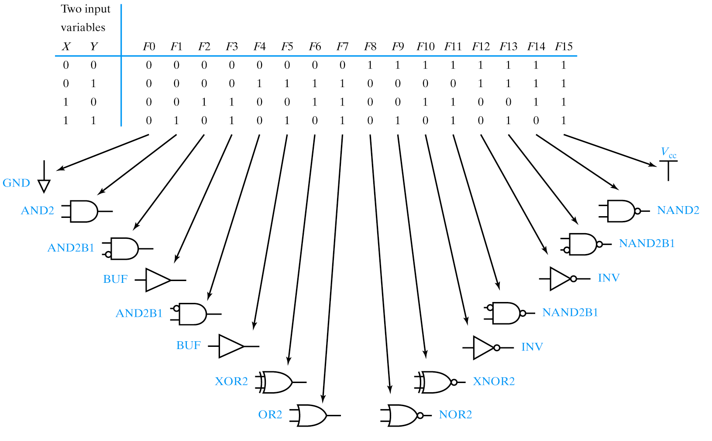

Slide 22
Analyzing Logic Circuits

Slide 23
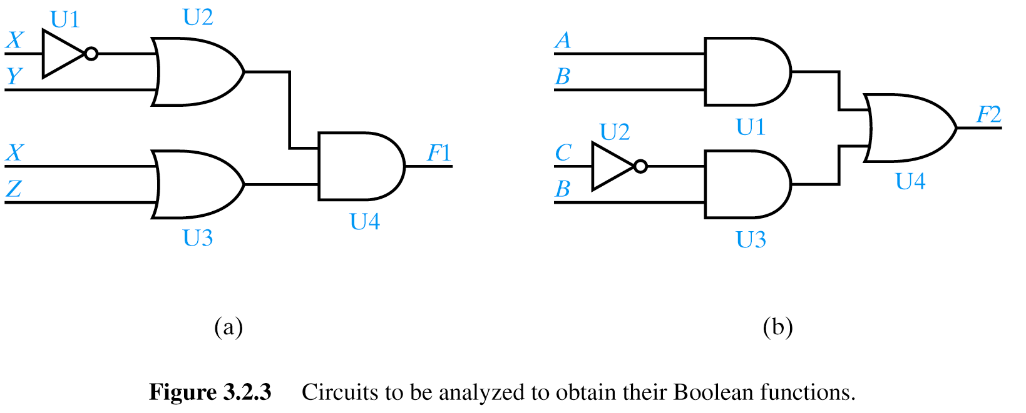
Analyzing Logic Circuits
X
X + Y
(X + Y)⋅(X + Z)
X + Z
Reference Designators (“Instances”)

Slide 24
Analyzing Logic Circuits
A⋅B
A⋅B + B⋅C
C
B⋅C

Slide 25
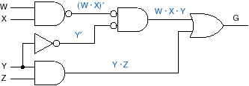
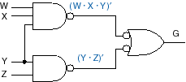
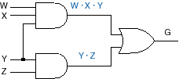
Another example

Slide 26
Designing Logic Circuits

Slide 27
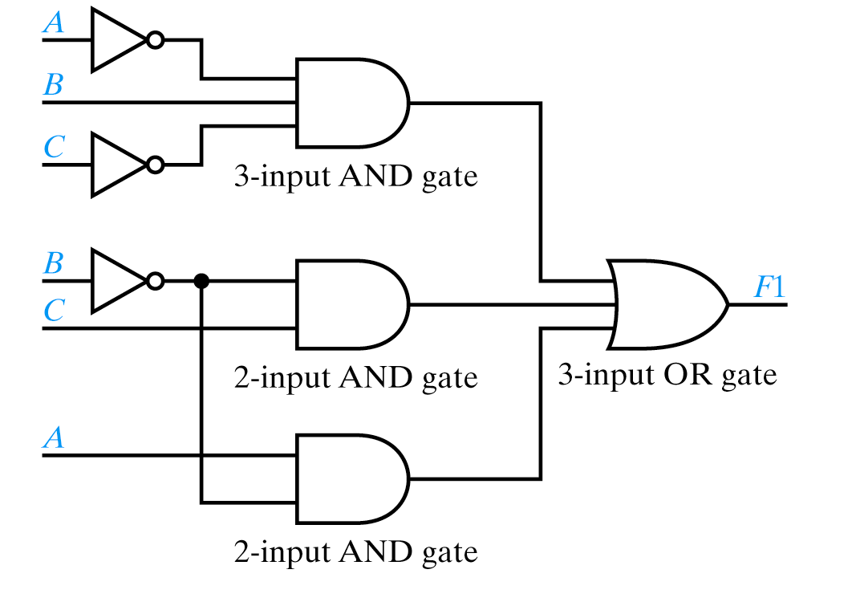
Designing Logic Circuits
F1 = A⋅B⋅C + B⋅C + A⋅B
SOP form with 3 terms → 3 input OR gate

Slide 28
Designing Logic Circuits
F1 = A⋅B⋅C + B⋅C + A⋅B
Complement already available

Slide 29
Some Terminology
F1 = A⋅B⋅C + B⋅C + A⋅B
Signal line – any “wire” to a gate input or output

Slide 30
Some Terminology
F1 = A⋅B⋅C + B⋅C + A⋅B
Net – collection of signal lines which are connected

Slide 31
Some Terminology
F1 = A⋅B⋅C + B⋅C + A⋅B
Fan-out – Number of inputs an IC output is driving
Fan-out of 2
Notes:
Book confused “fan-out” with “maximum fan-out”

Slide 32
Some Terminology
F1 = A⋅B⋅C + B⋅C + A⋅B
Fan-in – Number of inputs to a gate
Fan-in of 3
Book confused “fan-out” with “maximum fan-out”

Slide 33
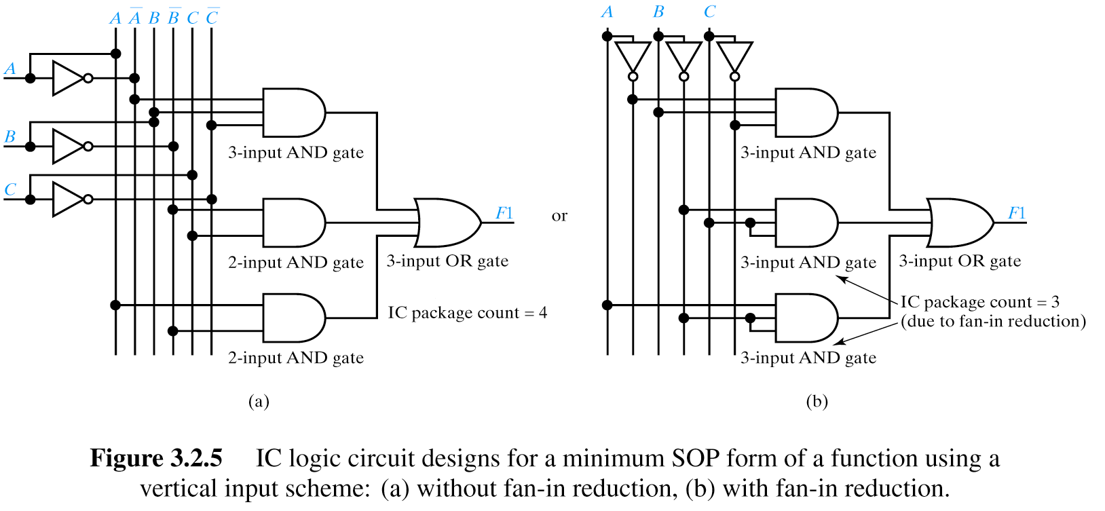
Vertical Layout Scheme – SOP Form

Slide 34
Vertical Layout Scheme – SOP Form

Slide 35
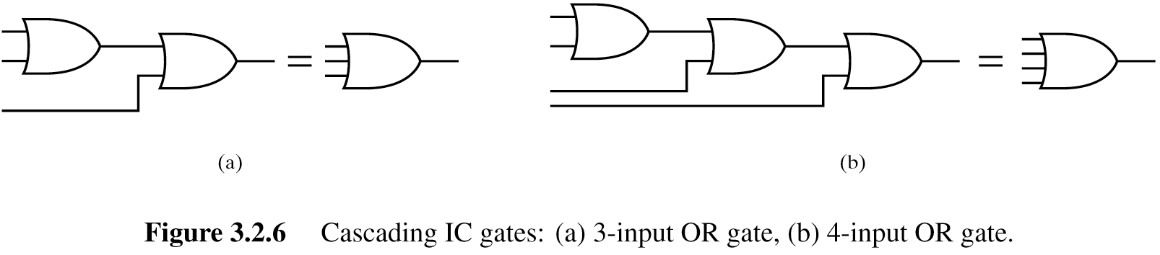
>2 Input OR Gates Not Available for all IC Technologies
Solution: “Cascading” gates

Slide 36
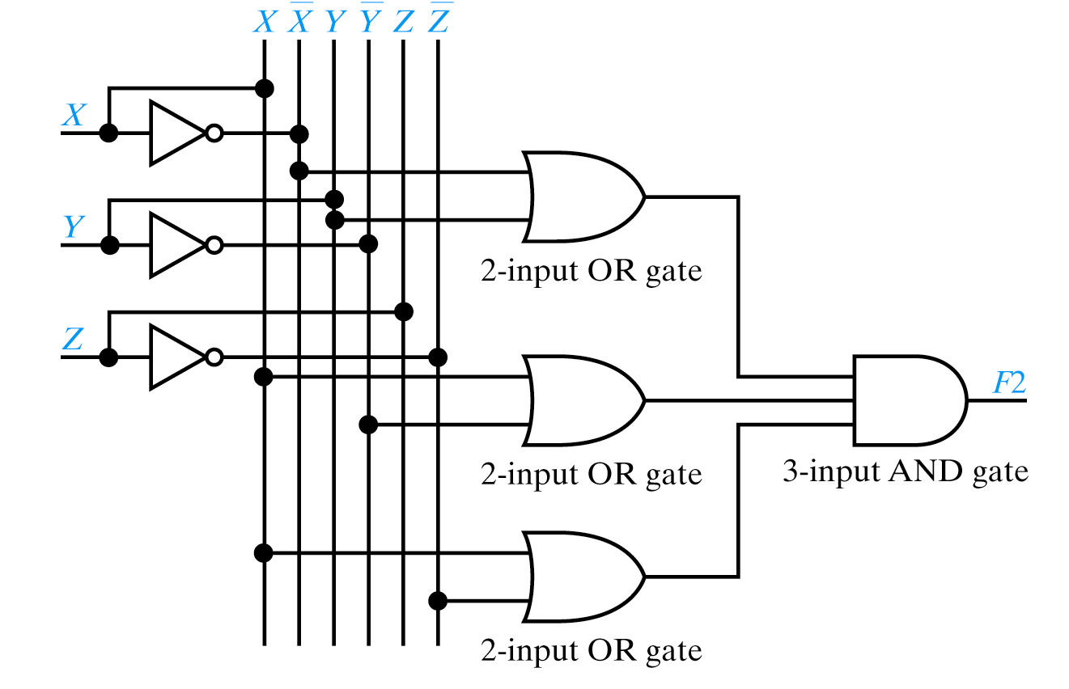
Vertical Layout Scheme – POS Form
F2 = (X+Y)⋅(X+Y)⋅(X+Z)

Slide 37
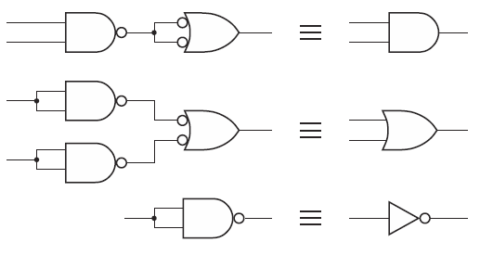
Designing Using DeMorgan Equivalents
Often prefer NAND/NOR to AND/OR when using real ICs
  NAND/NOR typically have more fan-in
  NAND/NOR “functionally complete”
  NAND/NOR usually faster than AND/OR

Slide 38
NAND and NOR gates

Slide 39
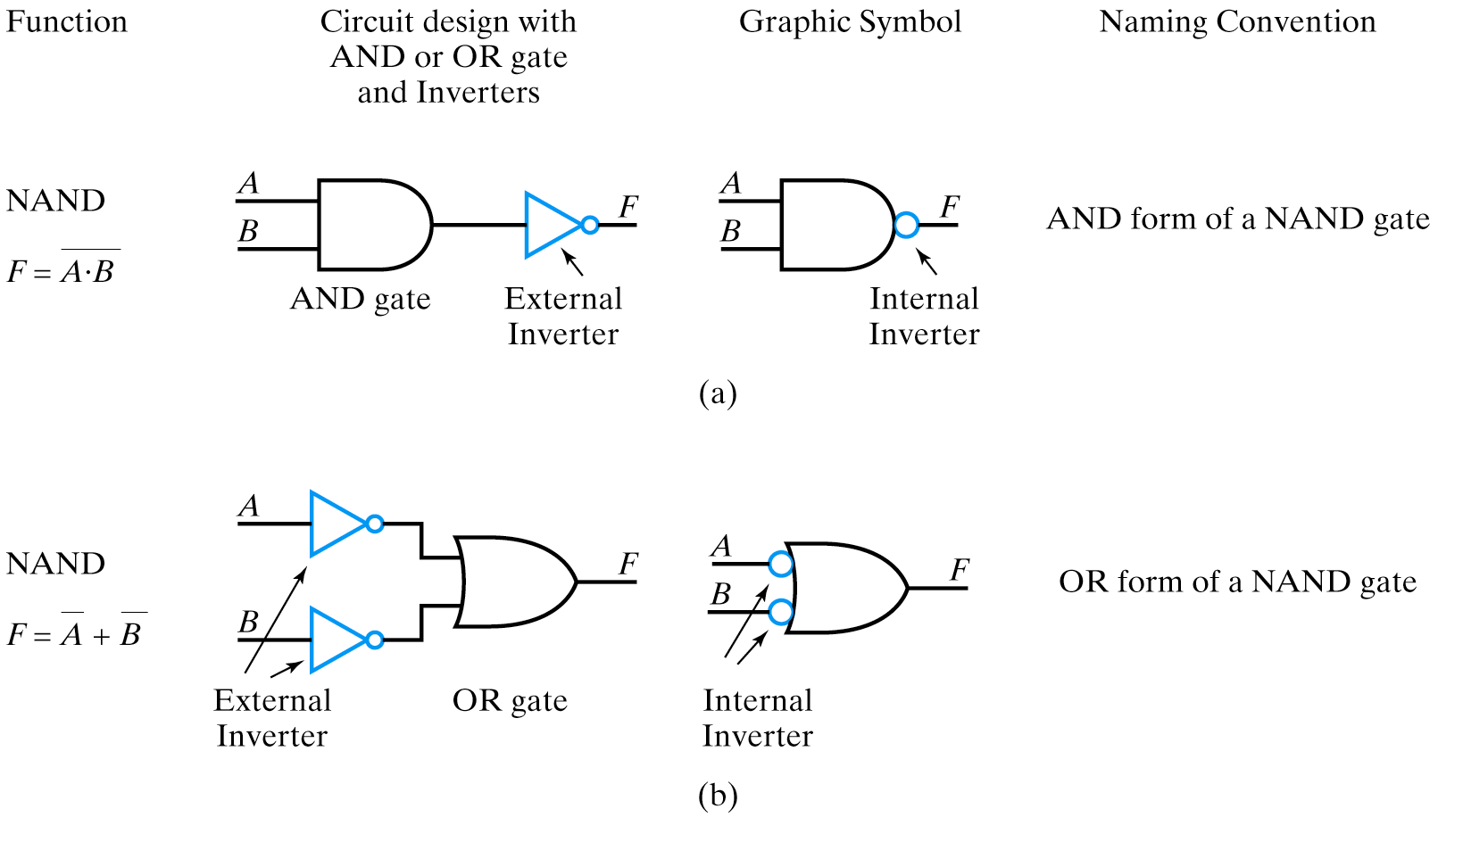
AND/OR forms of NAND
DeMorgan’s Theorem

Slide 40
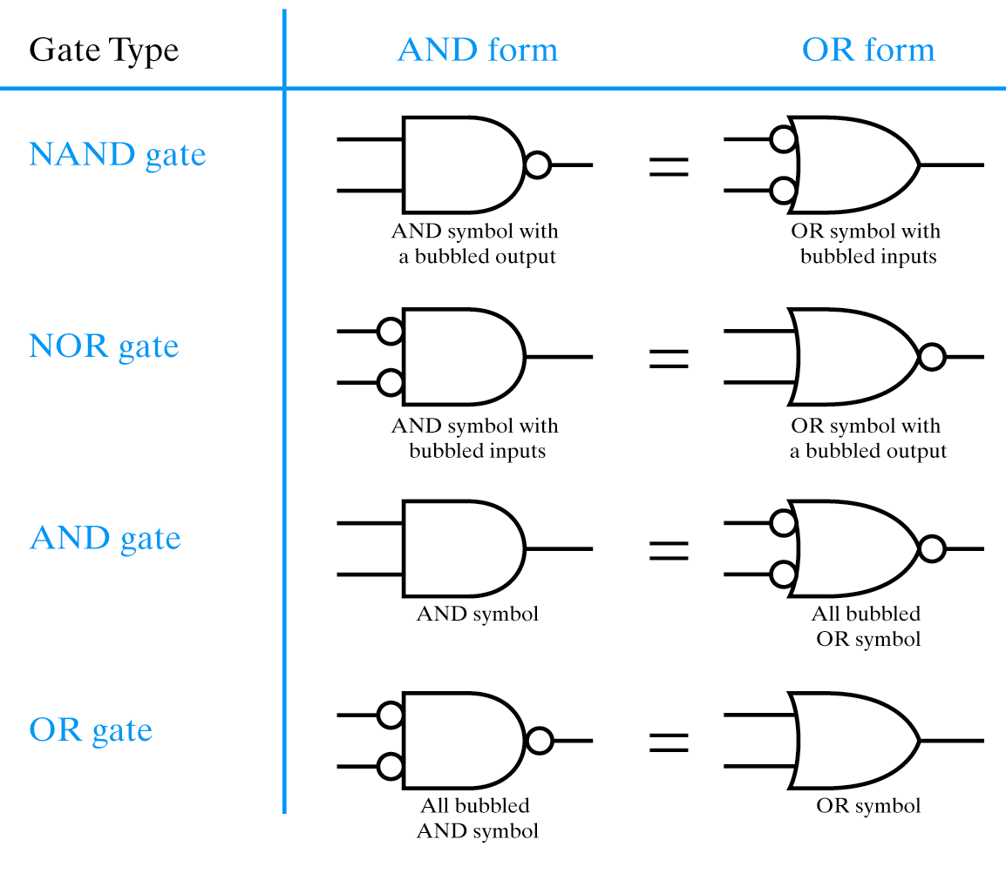
Summary of AND/OR forms
Change OR to AND
“Complement” bubbles

Slide 41
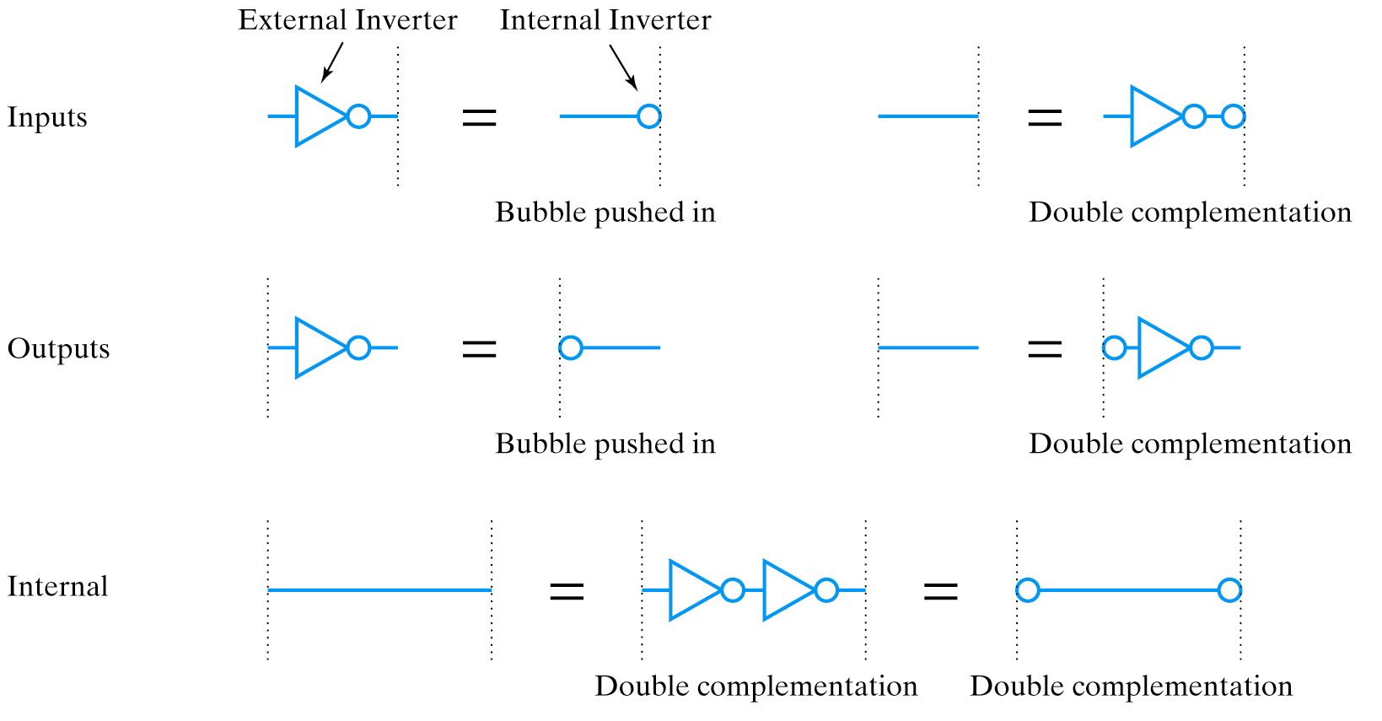
Equivalent Signal Lines

Slide 42
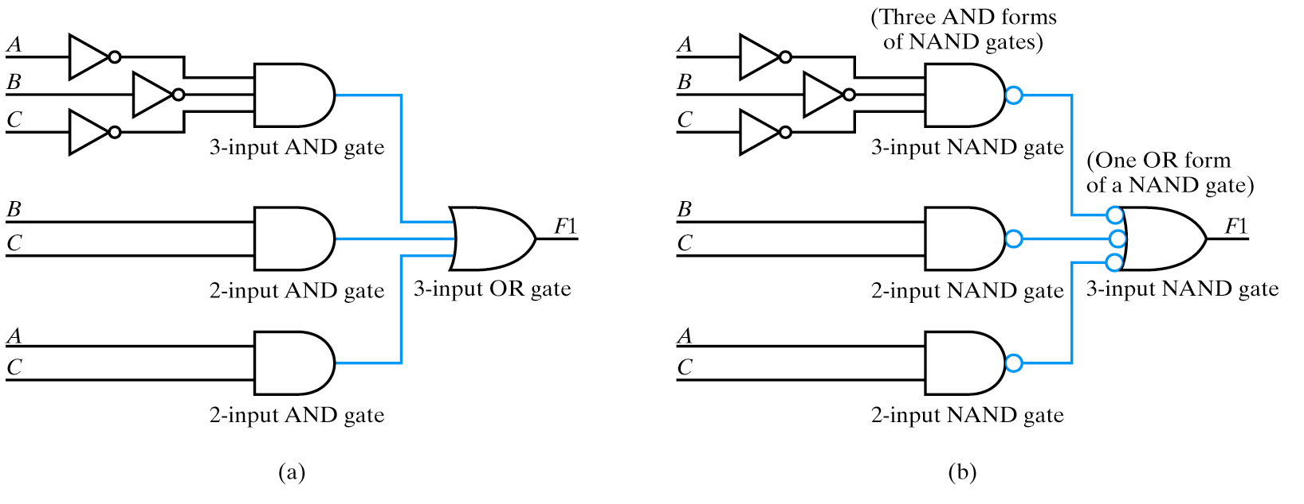
NAND/NAND Example

Slide 43
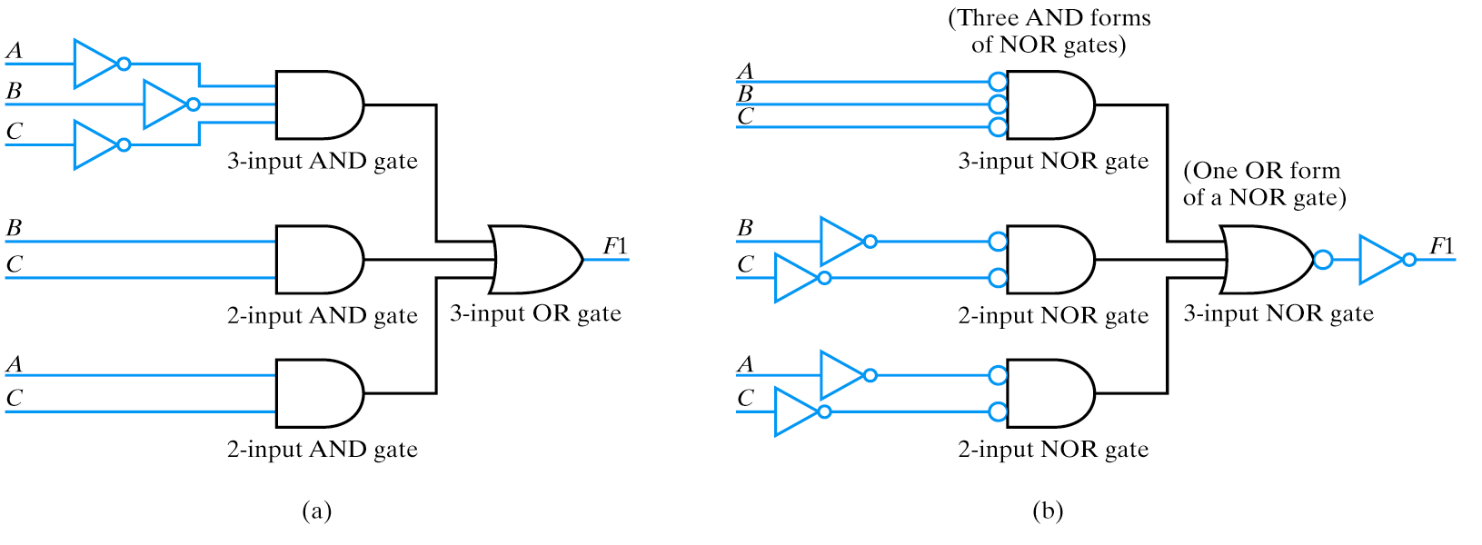
NOR/NOR Example

Slide 44
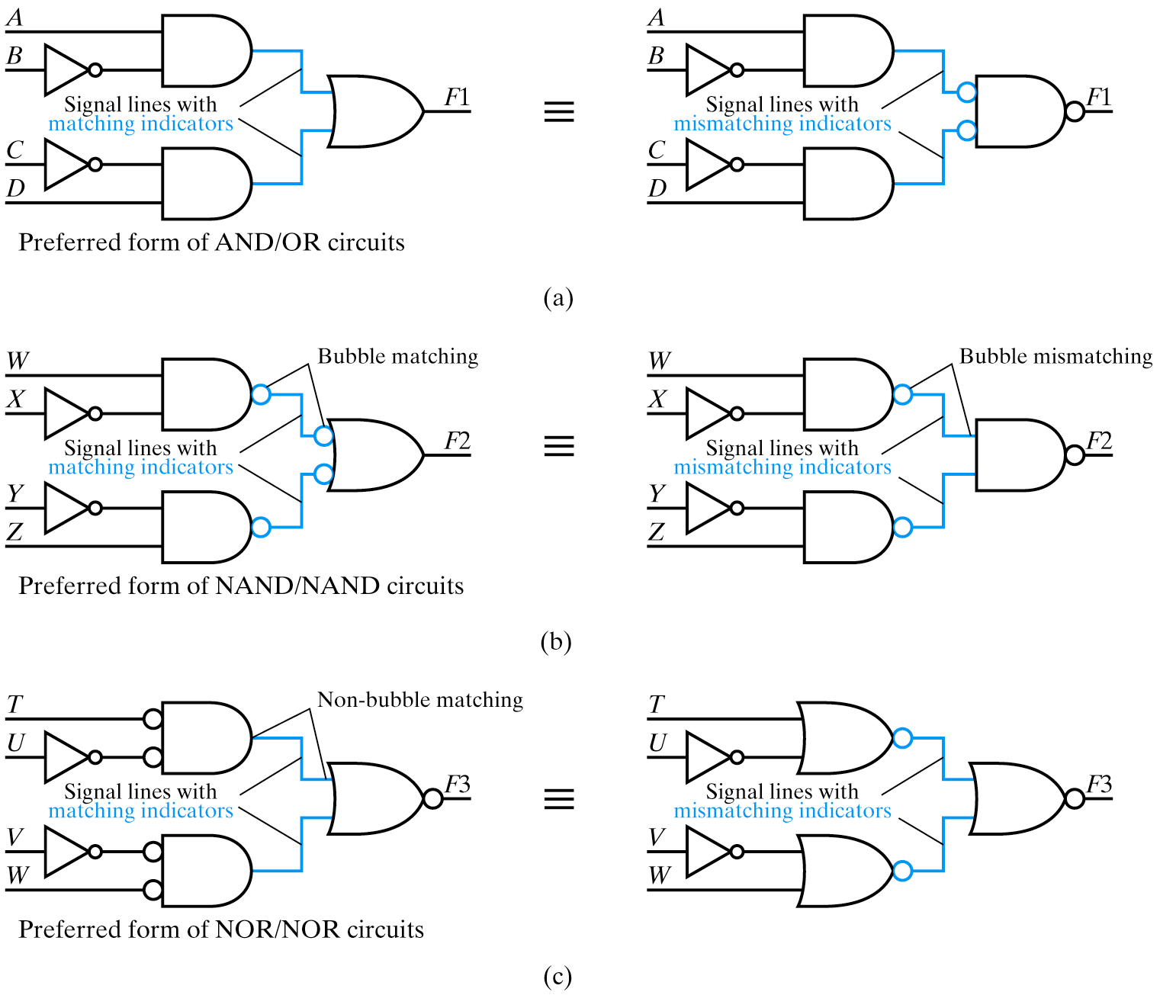

Slide 45
Few more advanced topics

Slide 46
Duality
Swap 0 & 1, AND & OR
  Result: Theorems still true
Why?
  Each axiom (A1-A5) has a dual (A1′-A5′)
Counterexample:
X + X ⋅ Y = X (T9)
X ⋅ X + Y = X (dual)
X + Y = X (T3′)
????????????
X + (X ⋅ Y) = X (T9)
X ⋅ (X + Y) = X (dual)
(X ⋅ X) + (X ⋅ Y) = X (T8)
X + (X ⋅ Y) = X (T3′)
parentheses,
operator precedence!

Slide 47
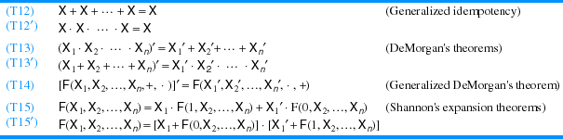
N-variable Theorems
Prove using finite induction
Most important: DeMorgan theorems

Slide 48
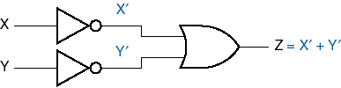



DeMorgan Symbol Equivalence

Slide 49



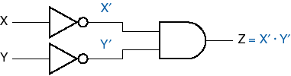
Likewise for OR
(be sure to check errata!)

Slide 50
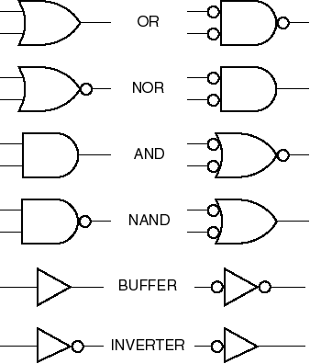
DeMorgan Symbols

Slide 51
Three Methods of analysis of combinational Circuits

Slide 52
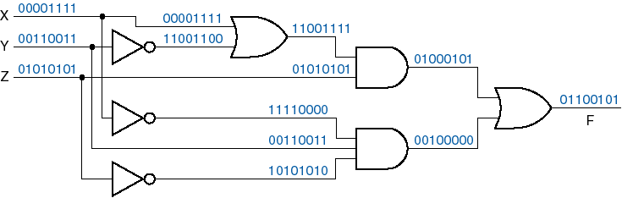
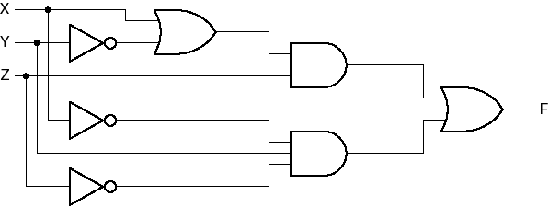
Combinational analysis

Slide 53
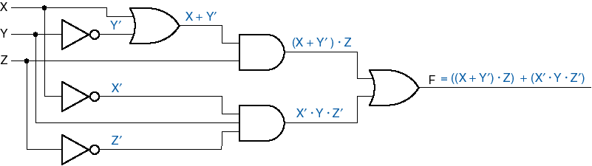
Signal expressions
Multiply out:
F = ((X + Y′) ⋅ Z) + (X′ ⋅ Y ⋅ Z′)
= (X ⋅ Z) + (Y′ ⋅ Z) + (X′ ⋅ Y ⋅ Z′)

Slide 54
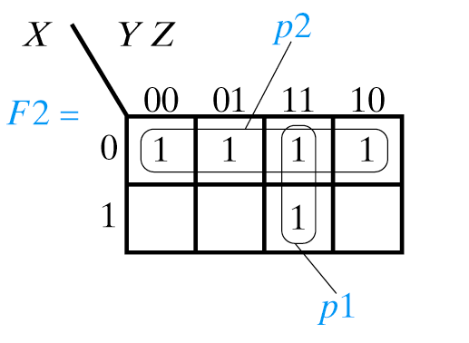
Signal Kmaps
X’
1 1
1
1 1
1
1 1
1 1 1 1
1 1
OR-ing Kmaps
Y’
1
1
1
1 1
1
1
1
1 1
You perform Boolean operations on the whole Kmaps.

Slide 55
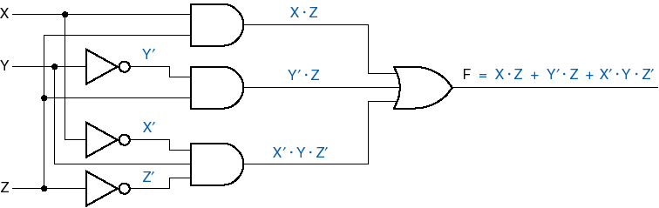
New circuit, same function

Slide 56
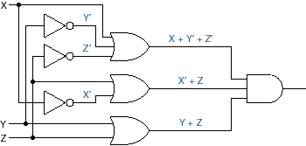

“Add out” logic function
Circuit:

Slide 57
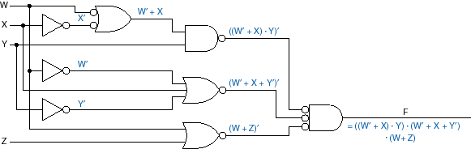
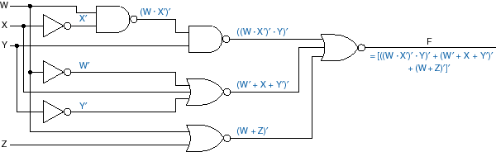
Shortcut: Symbol substitution

Slide 58
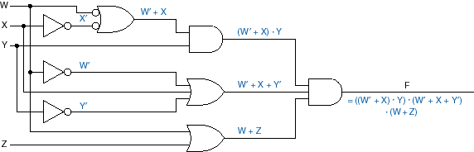
Different circuit, same function

Slide 59
Verification of solutions

Slide 60
Verification of your solutions helps you in most cases to avoid errors
Circuit
Logic Expression
Truth Table
Karnaugh Map
SYNTHESIS PROCESS
Optimized Logic Expression
Optimized Circuit with AND , OR and NOT gates
Optimized Circuit with NAND , NOR and NOT gates

Slide 61
Verification of your solution is a reverse process
BLUE ARROWS ARE SYNTHESIS PROCESS
Circuit
Logic Expression
Truth Table
Karnaugh Map
RED ARROWS ARE VERIFICATION PROCESS
Optimized Logic Expression
Optimized Circuit with AND , OR and NOT gates
Optimized Circuit with NAND , NOR and NOT gates

Slide 62
Practical Example of Verification of a solution

Slide 63
Given is an expression Z ⊕ X’Y.
1. Draw a Kmap.
SYNTHESIS
1 1
1 1
1 1
1 1
2. Given the Karnaugh Map find circuit from AND, OR and NOT gates.
You find SOP = X’YZ’ + XZ + Y’Z
1 1
1 1
You factorize SOP = X’YZ’ + Z(X + Y’) and get the circuit below.

Slide 64
VERIFICATION
Verification Method 1
1. You start from circuit
2. You write equation for each gate
X’
1 1
1
1 1
1
1 1
1 1 1 1
1 1
OR-ing Kmaps
Y’
1
1
1
1 1
1
1
1
1 1
You perform Boolean operations on the whole Kmaps.
Other verification Method 2 uses Kmaps for each gate. The result is a Kmap.

Slide 65
Verification of your solution is a reverse process to synthesis
RED ARROWS ARE VERIFICATION METHODS
Truth Table
Circuit
Logic Expression
If required you create Truth Table from KMap
If required you create logic circuit of given style from KMap
If required you create logic equation of given style from KMap
Karnaugh Map
Verification Method 2 created the Kmap for F
Verification Method 1 created the expression for F
Optimized Logic Expression
Optimized Circuit with AND , OR and NOT gates
Optimized Circuit with NAND , NOR and NOT gates

Slide 66
You will increase your exam, quizz or homework scores if you will verify your solutions

Slide 67

Perkowski says, based on his own experience:
Clever Engineer verifies his/her solutions before showing them to her/his boss

Slide 68

Stupid Engineer does NOT verify his/her solutions before showing them to her/his boss and gets into troubles

Slide 69
Questions and Exam Problems(1)
Draw and explain OR gate in pass transistor logic.
Draw and explain AND gate in pass transistor logic.
Draw and explain NOT gate in pass transistor logic. Draw and explain XOR gate in pass transistor logic.
Draw and explain NAND gate in pass transistor logic.
Draw and explain NOR gate in pass transistor logic.
Draw and explain OR gate in regenerative logic.
Draw and explain AND gate in regenerative logic.
Draw and explain NOT gate in regenerative logic.
Draw and explain XOR gate in regenerative logic.
Draw and explain NAND gate in regenerative logic.
Draw and explain NOR gate in regenerative logic.
Difficult: how to realize all functions of two variables using multiplexers? How many MUX you need? What size?

Slide 70
Questions and EXAM Problems (2)
13. How to analyze SOP circuits?
14. How to analyze POS circuits?
15. How to verify your solutions to combinational logic circuits?
16. How to analyze arbitrary circuits with NAND,NOR and other gates and many levels?
17. How to realize SOP with NANDs?
18. How to realize SOP with NORs?
19. How to realize POS with NANDs?
20. How to realize POS with NORs?
21. How to realize arbitrary logic circuit (schematics) with NANDs?
22. Show example of sharing subfunctions in a circuit that has only NAND gates.
23. Show example of sharing subfunctions in a circuit that has only NOR gates.
24. How to realize a circuit with AND, OR, NOT and EXOR operations using only NAND gates?
25. How to realize a circuit with AND, OR, NOT and EXOR operators using only XNOR and NAND gates?

Slide 71
Solution to the very difficult problem
Supposedly solved by 4 students in 2014

Slide 72
ROLE OF INVERTERS IN MULTI-LEVEL CIRCUITS AND THE TWO-INVERTER PROBLEM”.
Before we proceed to synthesis with NAND and IMPLY gates let us consider the importance of negation in multi-output combinational logic. We solve the famous 2-Inverter problem.
Problem Formulation. Assume that inverter is very expensive and AND and OR gates are for free. Given are two inverters only and an unlimited number of AND and OR gates. Synthesize a three-output function: FA = A’, FB = B’, FC = C’ using only these gates.
The reader is asked not to look to the solution below and try to solve this problem by himself.
This problem is truly difficult and takes much time even from smart students. However, creating systematically Karnaugh Maps for all available functions allows to find a solution as in Figure 11.2.1. Thus we find:
FA = A’ = Z’(B+C) + Z’F’ + F’(BC),
FB = B’ = Z’(A+C) + Z’F’ + F’(AC),
FC = C’ = Z’(A+B) + Z’F’ + F’(AB)
A question however arrives: “how the intermediate functions in Figure 11.2.1 were selected, as we can easily see that there are many more functions that can be created using two inverters and unlimited number of AND and ORs?” One answer is = “use symmetry, because problem is symmetric”. But a better answer is to use the concept of “dissected pairs” which will be introduced below for practical synthesis with the minimum (or reduced) number of inverters.
One more question to the reader: “how to best generalize our results from Figure 11.2.1 above?” Getting some intuitions while solving this problem will help much the reader to understand methods from this and next chapters.

Slide 73
FA = A’ = Z’(B+C) + Z’F’ + F’(BC),
FB = B’ = Z’(A+C) + Z’F’ + F’(AC),
FC = C’ = Z’(A+B) + Z’F’ + F’(AB)
Figure 11.2.1. Step by step solution to the “two inverter problem”.

Slide 74
FA = A’ = Z’(B+C) + Z’F’ + F’(BC),
FB = B’ = Z’(A+C) + Z’F’ + F’(AC),
FC = C’ = Z’(A+B) + Z’F’ + F’(AB)
FA
B C
Z’(B+C)
A C
Z’(A+C)
FB
A B
A B
Z’(A+B)
FC
Z
A C
B C
F
AB C

Slide 75
Sources
Prof. Mark G. Faust
John Wakerly

