Slide 1
Lecture 13
Topics
  Latches
  Flip Flops
  Algorithmic State Machines

Slide 2
Latches

Slide 3
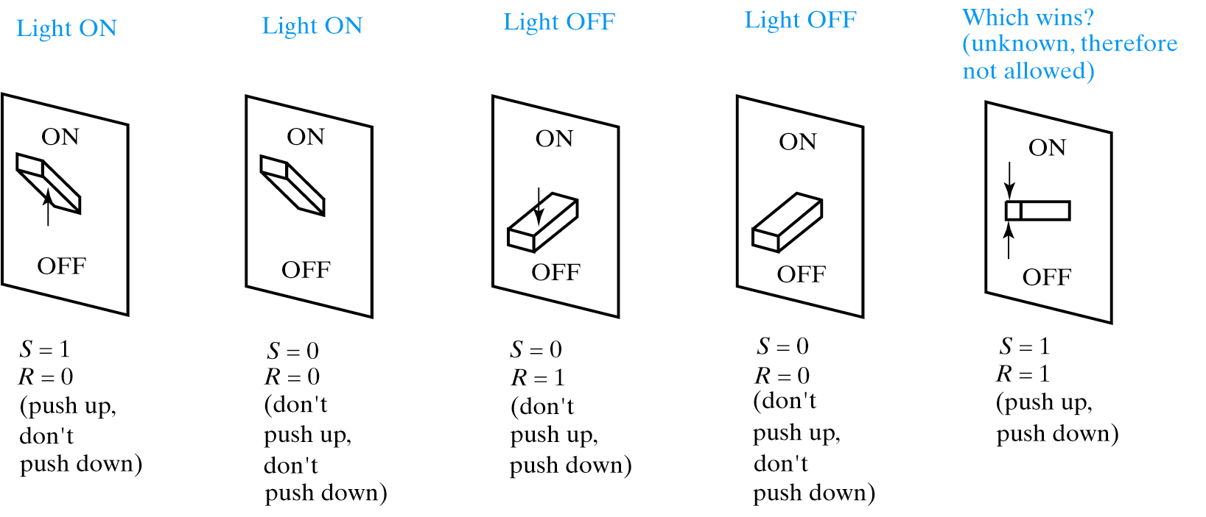
Possible States for Light Switch

Slide 4
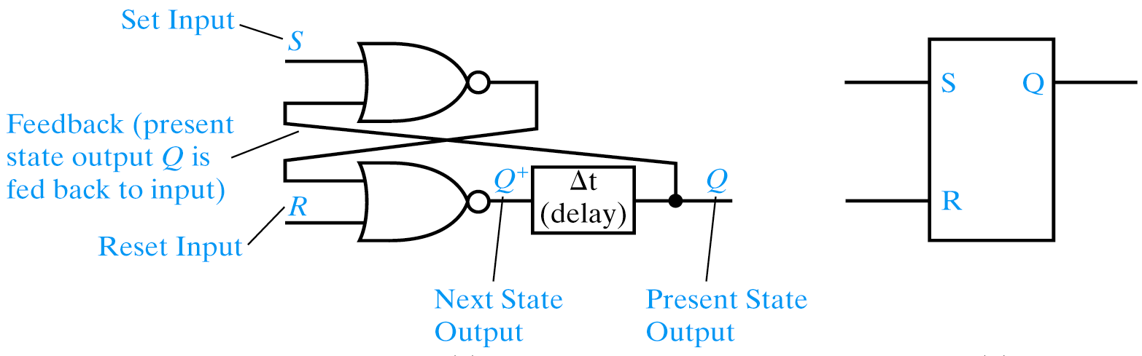
S-R Latch
S R Q⁺
0 0 Q
0 1 0
1 0 1
1 1 0
S-R latch is reset dominant
Different ways to name/nomenclature for current/next state. Text uses Q+ for next.

Slide 5
Alternative Nomenclature for latches
Present State Next State
Output Symbol Output Symbol
Q Q
Q Q(t+1)
Qt Q(t+1)
Qn Q(n+1)
Q0 Q
Y Y⁺
y Y

Slide 6
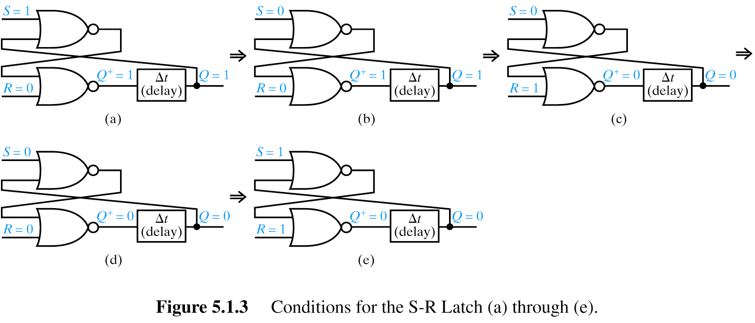
S-R Latch States
S-R latch is
reset dominant

Slide 7
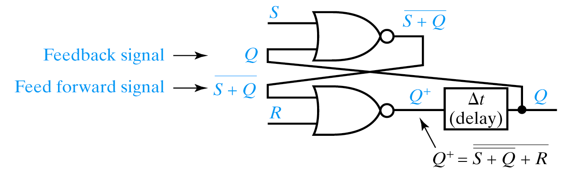
Characteristic Equations for SR latch

Slide 8
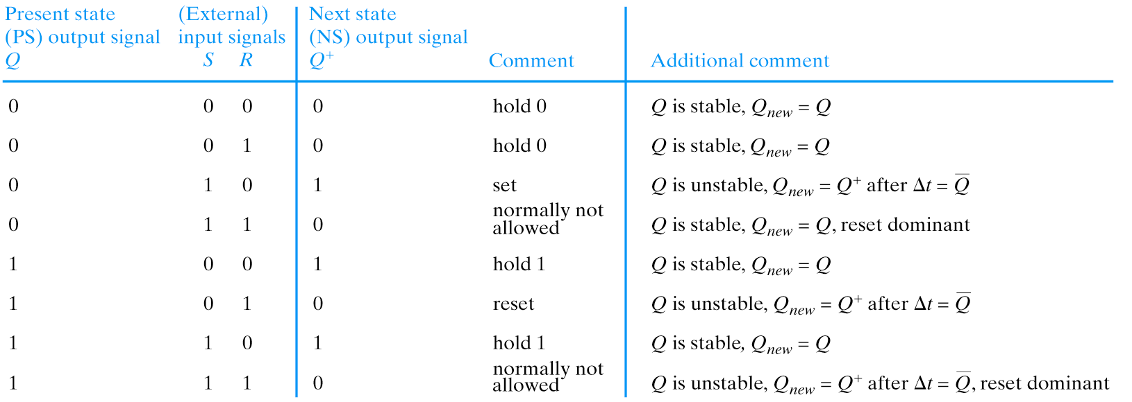
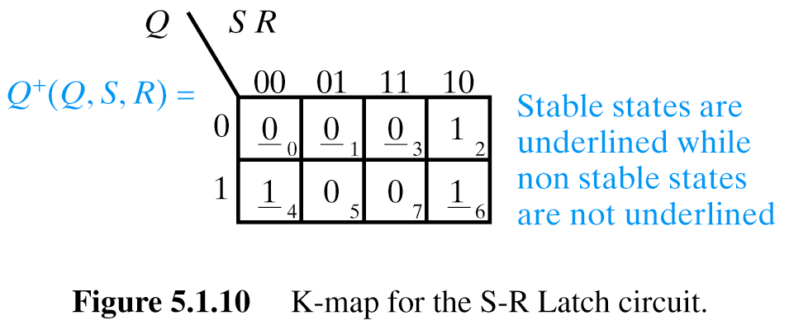
Present State/Next State Table (PS/NS) for SR Latch

Slide 9
Present State/Next State Table (PS/NS) for SR Latch
Another notation, stable states in circles, I think it is a better notation
Students should be able to analyze and draw transitions in a machine

Slide 10
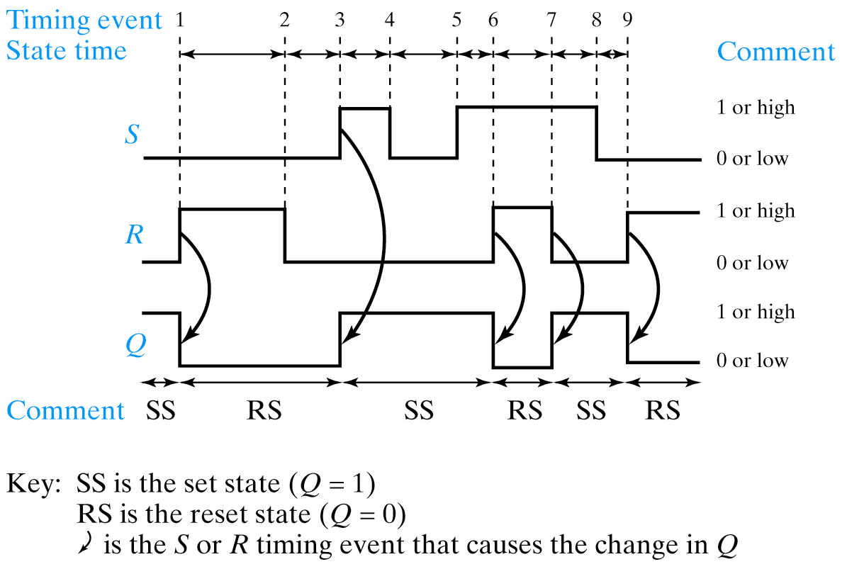
Timing Diagram for SR Latch

Slide 11
Detailed Discussion of Timing Diagram for SR Latch

Slide 12
Races
Just as we used K-maps to not only reduce Boolean equations but to detect hazards, we can use K-maps to analyze anomalous latch behavior as well.
Race is when two or more inputs change simultaneously.
May or may not be a critical race.
Depends upon the behavior of the circuit.

Slide 13
Critical Races
Can happen when two signals change at the same time

Slide 14
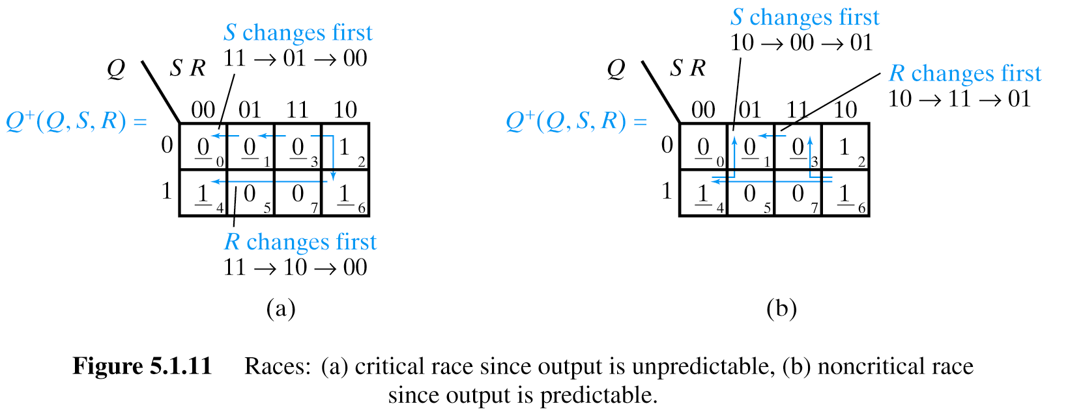
Critical Race
We start in State represented by minterm m3. (stable state) Q is 0, SR are 11s.
Both S and R are transitioning to 0.
Notice we take different paths through the K-map depending upon whether R or S transitions first.
If S transitions first, we transition to state m0 where Q+ remains Q (no transitions on output).
However, if R transitions first, we attempt to set the latch, resulting in Q+ = 1.
Then, when S transitions we go to state m4.
Not only do we end up in different states, but we have different values on the Q output – all depending upon minor differences in relative timing between transitions on S/R.
This is a critical race.
Start from here

Slide 15
Critical Race
Critical Race

Slide 16
Non-Critical Races

Slide 17
Non-critical race:
Start in state m6 (stable) with SR 10. Both S and R are going to change.
If S changes first, we go to state m4 (a stable state) with no transition on output.
Then when R changes we transition to state m1, also a stable state, and with an output of 0.
If R changes first, we transition to state m3, a stable state with a transition to 0 on output.
When S subsequently changes we transition to m1, another stable state where Q remains 0.
Non-critical race – OK and correct behavior regardless of which signal transitions first.
Non-critical Race

Slide 18
Metastable State

Slide 19
Metastable State
An often overlooked condition in which the output can remain in an illegal (even oscillating) state for an indeterminant period of time.
Metastability can be caused by a runt pulse (a positive or negative pulse which never achieves either a value of a 1 or 0).
  This can occur when two inputs to a gate change near simultaneously (see hazards earlier).
Metastability can also occur when two inputs to a latch change near simultaneously.
Condition also arises when synchronizing with external events (e.g. asynchronous inputs to synchronous finite state machines).

Slide 20
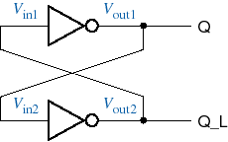
Bistable element
The simplest sequential circuit
Two states
  One state variable, say, Q
First we discuss correct behavior of a bistable element
HIGH
Let us set this to High and see what will happen

Slide 21
Bistable element
The simplest sequential circuit
Two states
  One state variable, say, Q
HIGH
LOW

Slide 22
Bistable element
The simplest sequential circuit
Two states
  One state variable, say, Q
HIGH
LOW
LOW

Slide 23
Bistable element
The simplest sequential circuit
Two states
  One state variable, say, Q
HIGH
LOW
LOW
HIGH

Slide 24
Bistable element
The simplest sequential circuit
Two states
  One state variable, say, Q
LOW
Let us set this to Low and see what will happen

Slide 25
Bistable element
The simplest sequential circuit
Two states
  One state variable, say, Q
LOW
HIGH

Slide 26
Bistable element
The simplest sequential circuit
Two states
  One state variable, say, Q
LOW
HIGH
HIGH

Slide 27
Bistable element
The simplest sequential circuit
Two states
  One state variable, say, Q
LOW
HIGH
HIGH
LOW

Slide 28
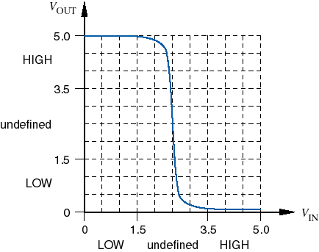
Analog analysis
Assume pure CMOS thresholds, 5V rail
Theoretical threshold center is 2.5 V

Slide 29
Analog analysis
Assume pure CMOS thresholds, 5V rail
Theoretical threshold center is 2.5 V
2.5 V
Now we discuss incorrect behavior of a bistable element

Slide 30
Analog analysis
Assume pure CMOS thresholds, 5V rail
Theoretical threshold center is 2.5 V
2.5 V
2.5 V

Slide 31
Analog analysis
Assume pure CMOS thresholds, 5V rail
Theoretical threshold center is 2.5 V
2.5 V
2.5 V
2.5 V

Slide 32
Analog analysis
Assume pure CMOS thresholds, 5V rail
Theoretical threshold center is 2.5 V
2.5 V
2.5 V
2.5 V
2.5 V

Slide 33
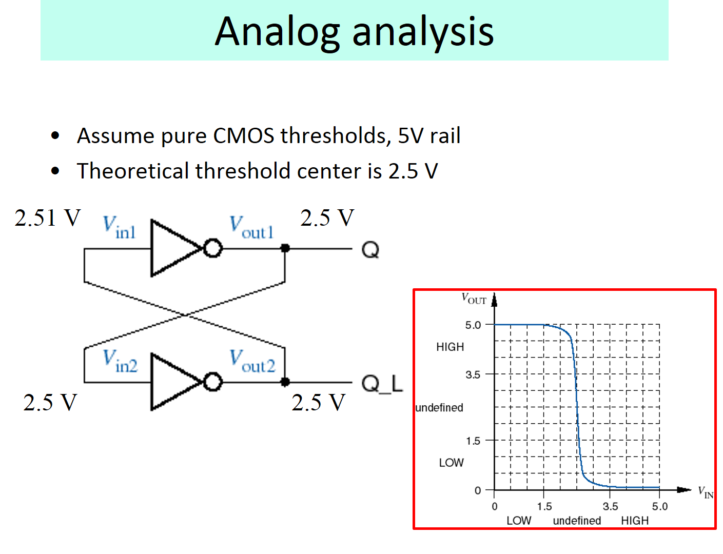

Slide 34


Slide 35


Slide 36


Slide 37
ANIMATED = Analog analysis
Assume pure CMOS thresholds, 5V rail
Theoretical threshold center is 2.5 V
2.5 V
4.8 V
2.51 V
2.5 V
2.0 V
0.0 V
2.5 V
2.0 V
0.0 V
4.8 V
5.0 V
2.5 V

Slide 38
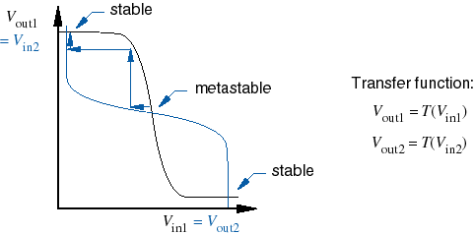
Metastability
Metastability is inherent in any bistable circuit
Two stable points, one metastable point
stable
stable

Slide 39
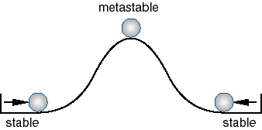
Another look at metastability

Slide 40


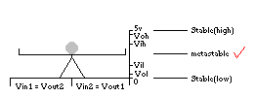
“sube y baja” behavior

Slide 41
Why all the harping on metastability?
All real systems are subject to it
  Problems are caused by “asynchronous inputs” that do not meet flip-flop setup and hold times.
  Details in Chapter-7 flip-flop descriptions and in Section 8.9 (later in quarter).
Especially severe in high-speed systems
  since clock periods are so short, “metastability resolution time” can be longer than one clock period.
Many digital designers, products, and companies have been burned by this phenomenom.

Slide 42
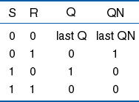
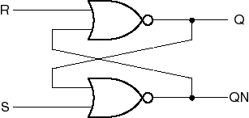
Back to the bistable….
How to control it?
  Screwdriver
  Control inputs
S-R latch
Correct behavior

Slide 43
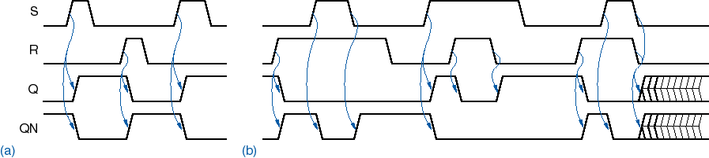
S-R latch operation without metastability
Correct behavior

Slide 44
S-R latch operation with metastability
Metastability is possible
if S and R are negated
simultaneously.
(try it in Foundation)
Correct behavior
44

Slide 45
State Machines

Slide 46
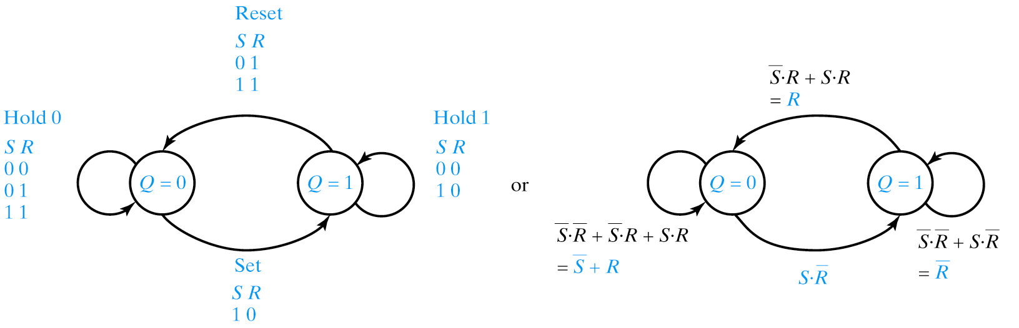
State Diagrams – example of state diagram for an SR Latch
S R Q Q⁺
0 0 0 0
0 0 1 1
0 1 0 0
0 1 1 0
1 0 0 1
1 0 1 1
1 1 0 0
1 1 1 0
S R Q⁺
0 0 Q
0 1 0
1 0 1
1 1 0

Slide 47
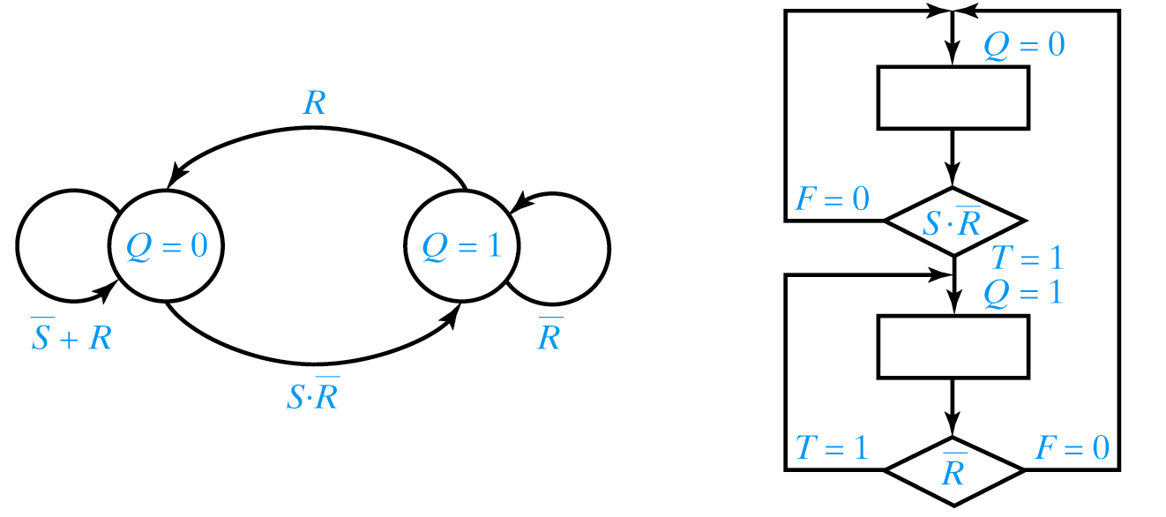
Algorithmic State Machines (ASM)
false
true
The student should be able to transform state diagram to algorithmic state machine and vice versa

Slide 48
Clock Circuits

Slide 49
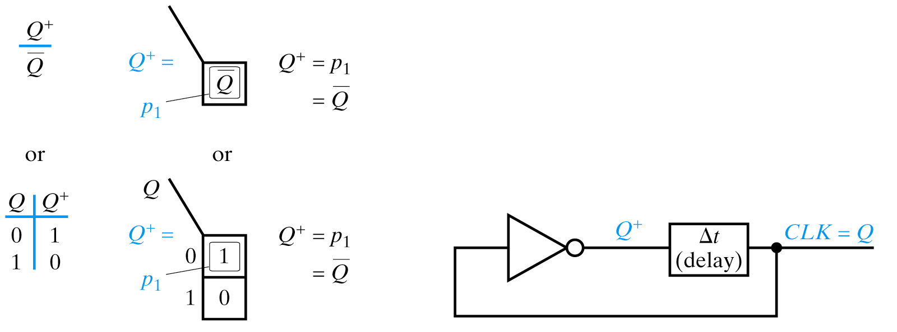
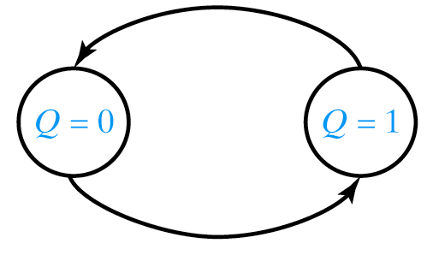
Clock (Oscillator) Circuit
PS/NS Table
K-map
State Diagram
Delay Model

Slide 50
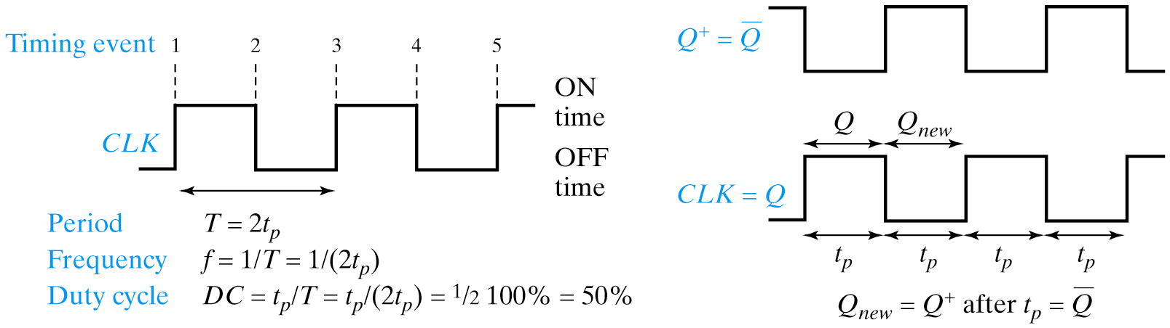
Clock Waveforms, T, t_{p} and f
Delay
  Buffers
  Additional (maintain odd number) inverters
  RC circuit
  Crystal Oscillator

Slide 51
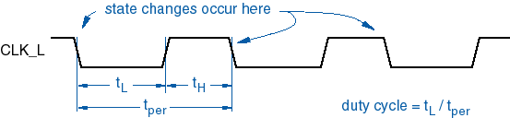
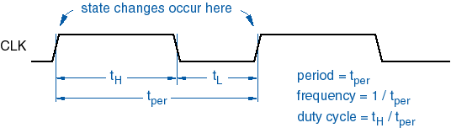
Clock signals
Very important with most sequential circuits
  State variables change state at clock edge.
State changes with leading slope
State changes with falling slope

Slide 52
Gated Sequential Circuits
Addition of control input
  Gated Latch (Level Activated)
  Edge-Triggered Flip Flop
  Pulse Triggered Flip Flop

Slide 53
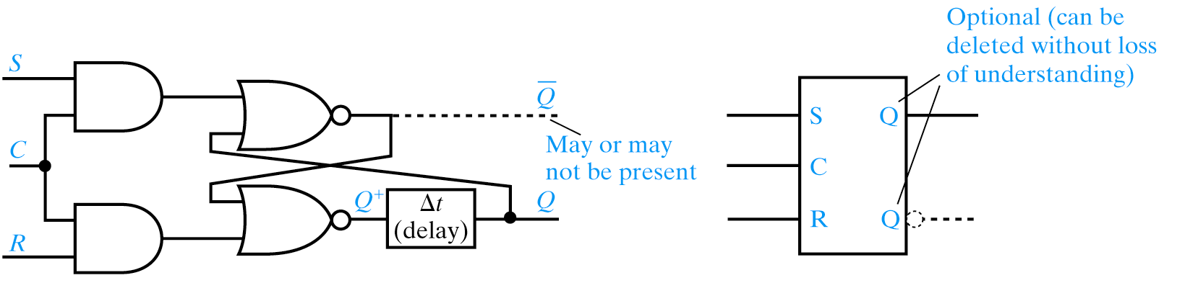
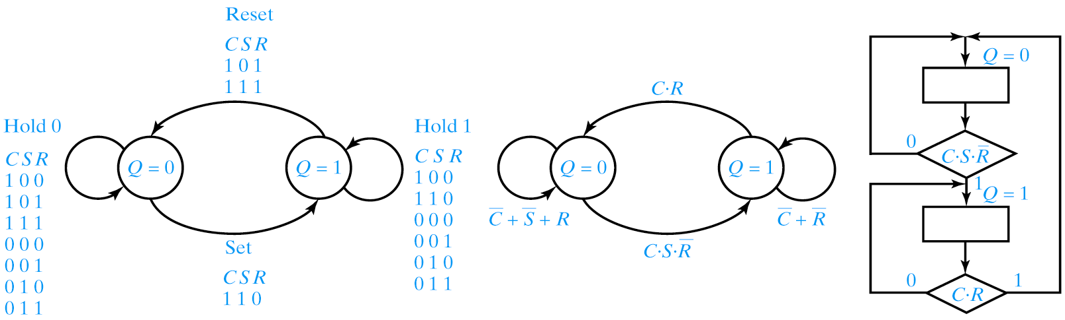
Gated SR Latch

Slide 54
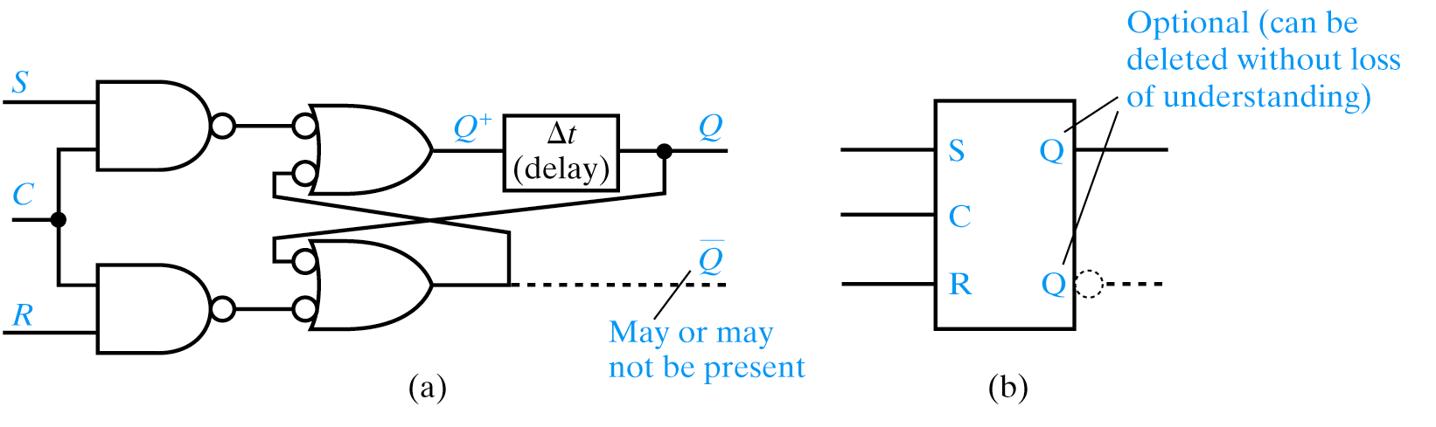
Gated SR Latch Using NANDs

Slide 55
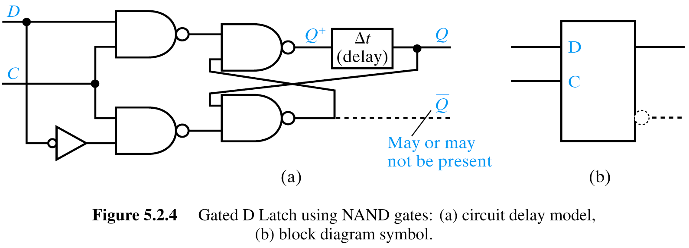
Gated D Latch
D Q⁺
0 0
1 1
D Latch is Hazard Free (product terms chain-linked)

Slide 56
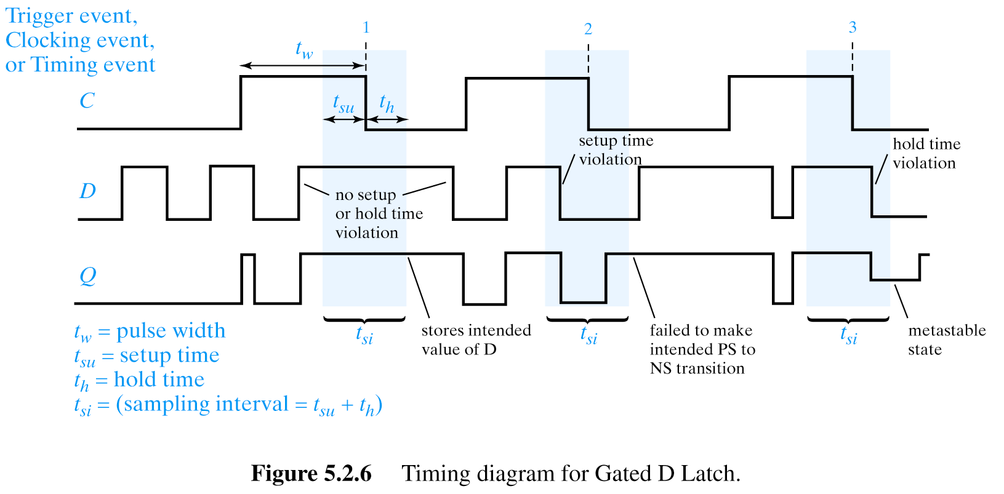
Timing of a Gated D Latch
Illustration of correct behavior of Gated D Latch
t_{su} = setup time
t_{h} = hold time
t_{w} = pulse width
t_{si} = t_{su}+t_{h} = sampling period
Clock changes to 1
Length of Signal D was longer than t_{si} and D=1 included interval t_{si}
This pulse is too short, FF did not change to stable 1
Good behavior, signal D was long enough, longer than setup time

Slide 57
Gated D Latch Timing
Illustration of two cases of incorrect behavior of
Gated D Latch
Bad behavior, signal D was NOT long enough, hold time was violated
Good behavior, signal D was long enough, longer than setup time
Bad behavior, signal D was NOT long enough, setup time was violated

Slide 58
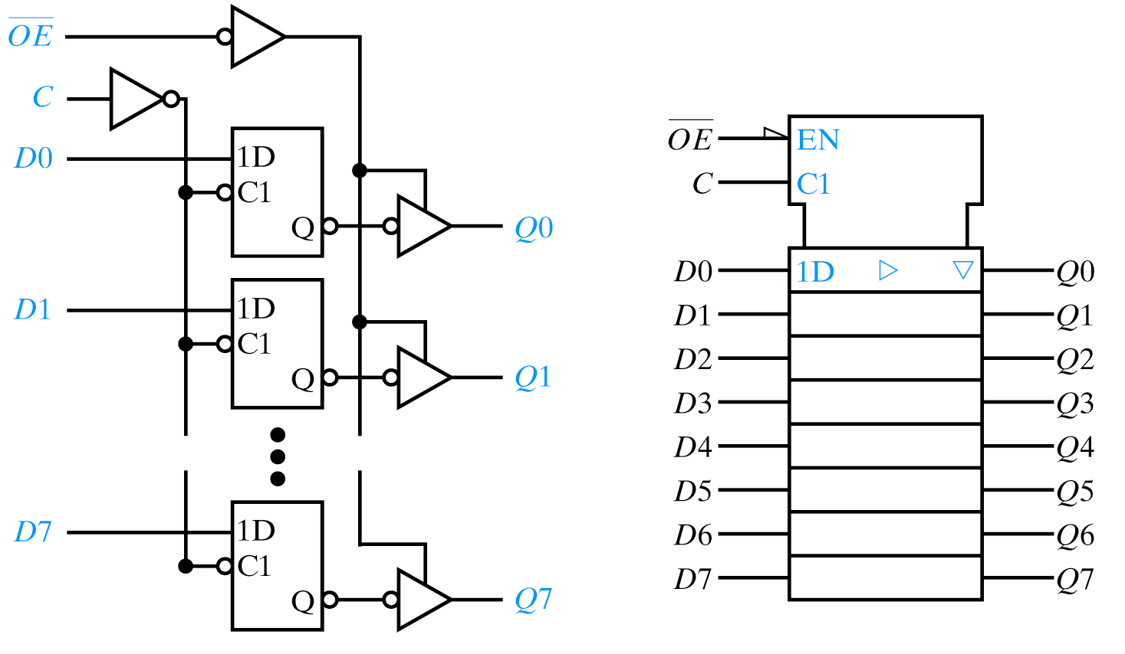
Use of gated D latches as Storage Elements
Tri-state
Tri-state

Slide 59
D Flip-Flop

Slide 60
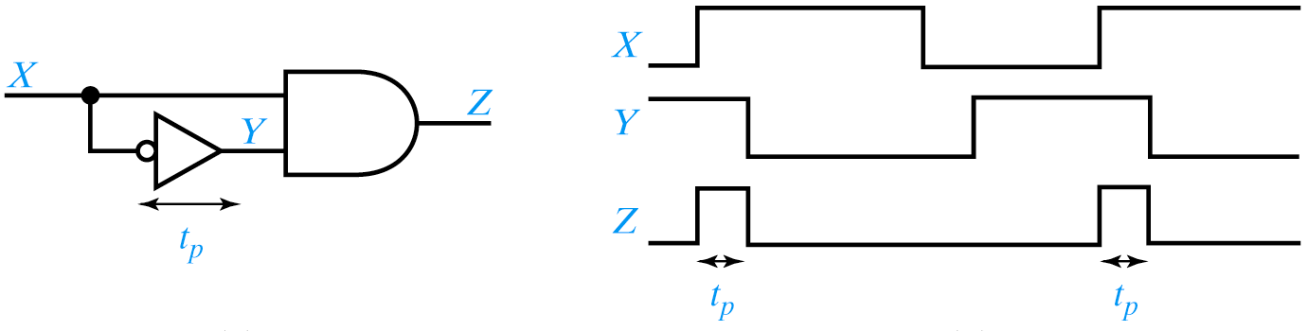
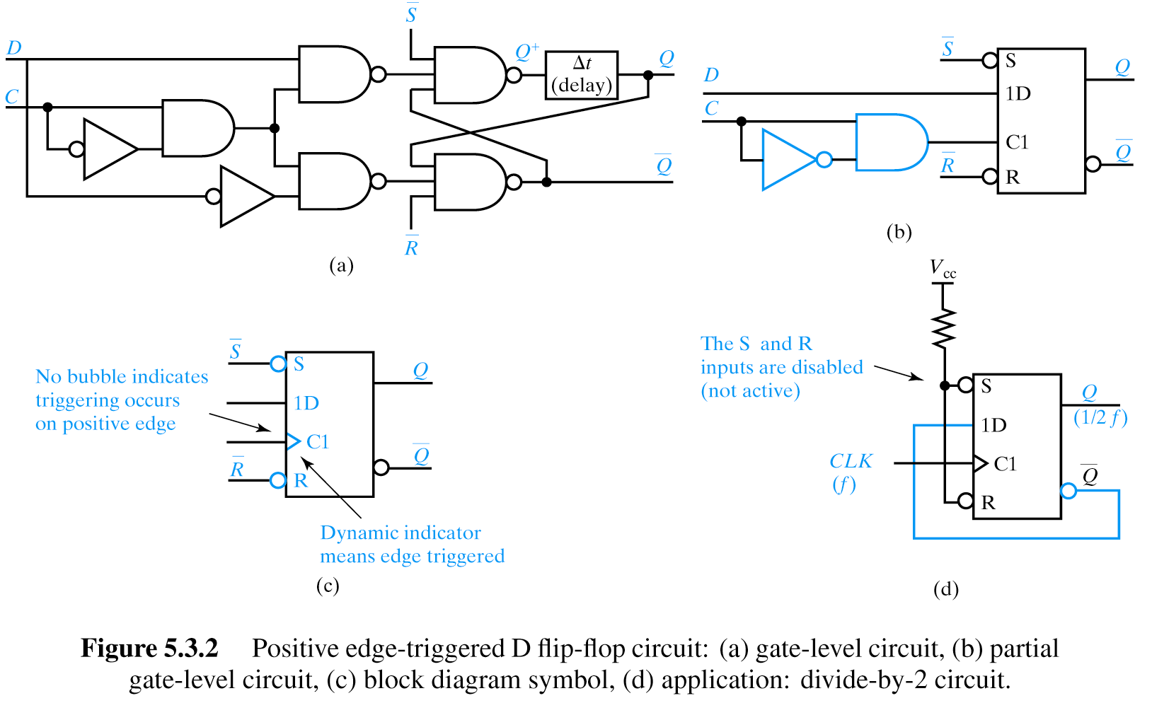
Flip Flop Circuits
Pulse Narrowing Circuit
Explain pulse-narrowing circuit. Attach as front end to D flip flop’s C input.

Slide 61
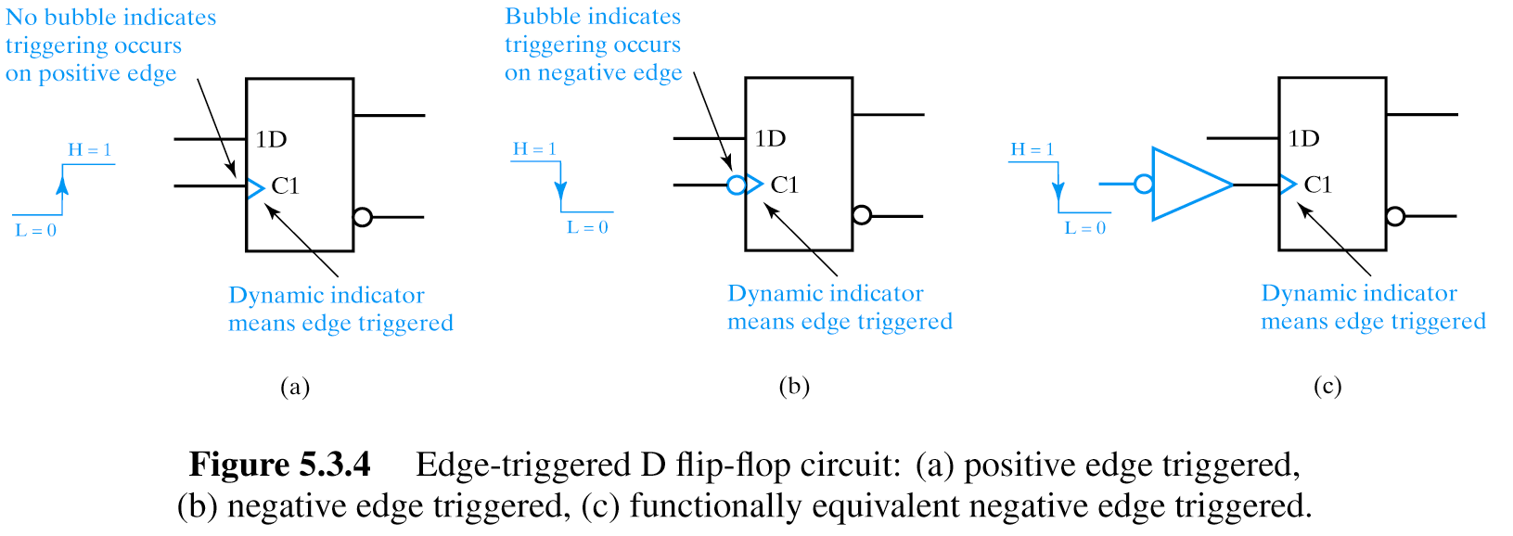
Edge-Triggered D Flip Flop

Slide 62
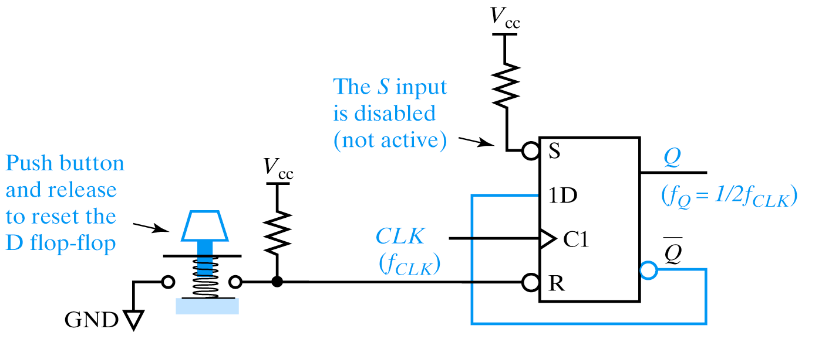
Manual Reset of D Flip Flop
Generates half clock frequency

Slide 63
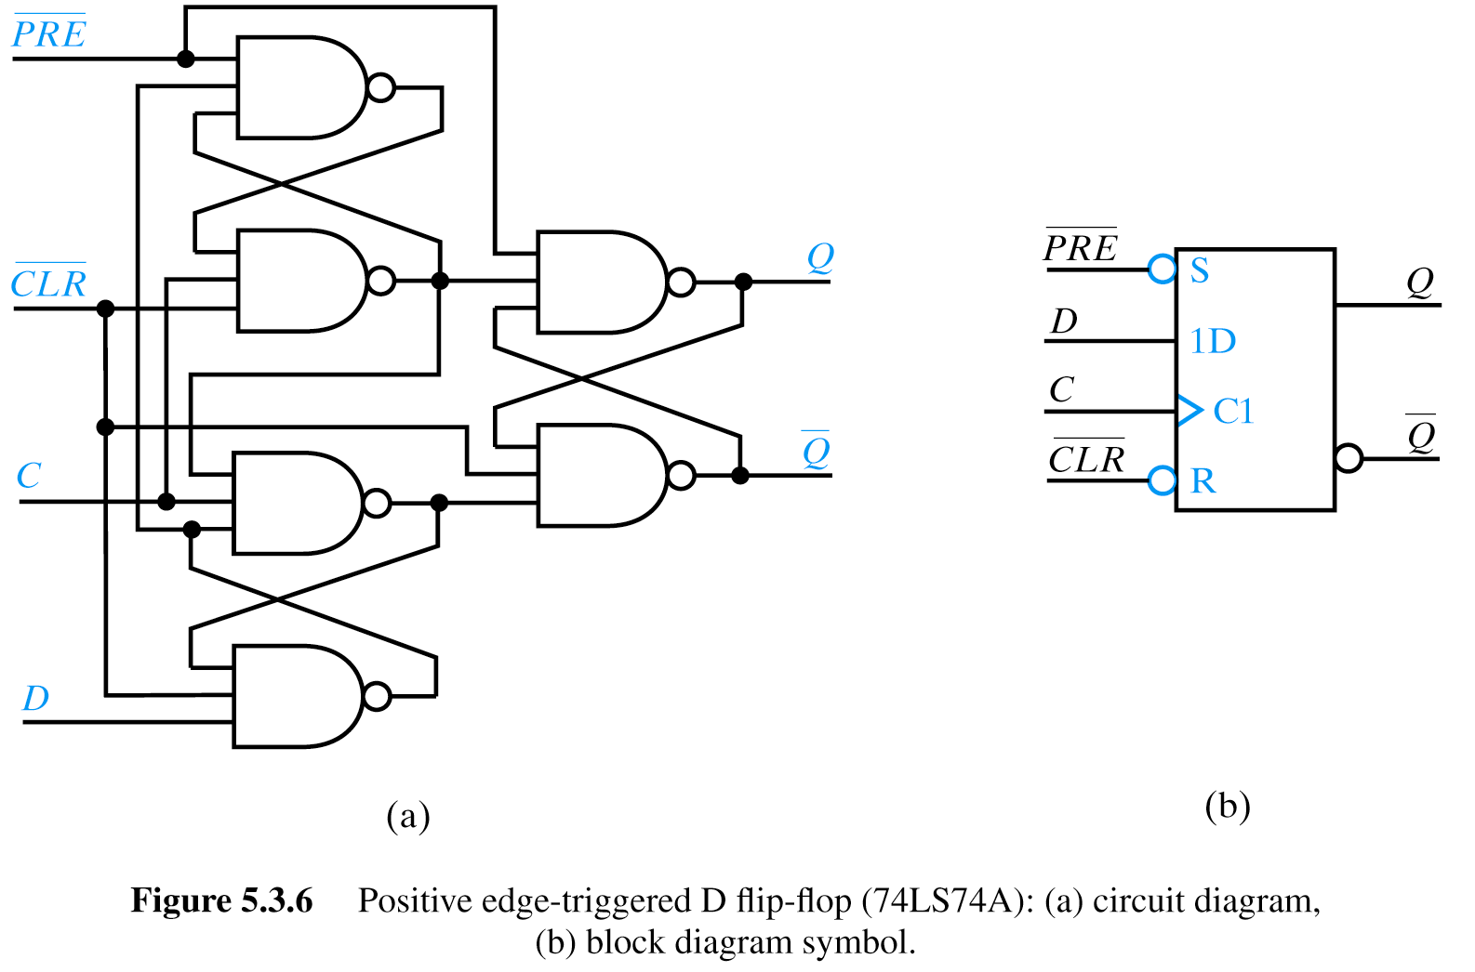
74LS74A

Slide 64

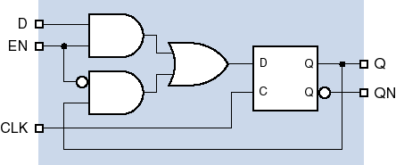

Other D flip-flop variations
Negative-edge triggered
Clock enable
We read to FF only when Enable signal is =1
Otherwise the old state of the FF is preserved in a feedback loop. This is an important circuit. The MUX on the input is important in other applications.

Slide 65
Important
These were asynchronous circuits that are used as parts of synchronous circuits.
Now we will be not concerned with designing asynchronous circuits, although they exist in every synchronous circuit.
We will design on the level of SYNCHRONOUS circuits.

Slide 66
Simple Applications of Flip-Flops:
Shifters and Counters

Slide 67
Shifters and Counters
D
Q
D
Q
D
Q
Shifter to right, analyze its behavior
c
c
c
D
Q
D
Q
D
Q
Johnson or Moebius counter, analyze its behavior
c
c
c
Q’
All FFs connected to the same clock
Students should be able to convert the logic diagrams like these to state graphs and state tables

Slide 68
Shifters that is Cyclical and shifts to right
D
Q
D
Q
D
Q
Shifter to right, analyze its behavior
c
c
c
000
100
110
111
010
011
001
101

Slide 69
Shifters that takes negated output as input and works as an inexpensive counter.
Johnson or Moebius counter, analyze its behavior
D
Q
D
Q
D
Q
c
c
c
Q’
000
001
All connected to the same clock
100
011
110
111

Slide 70
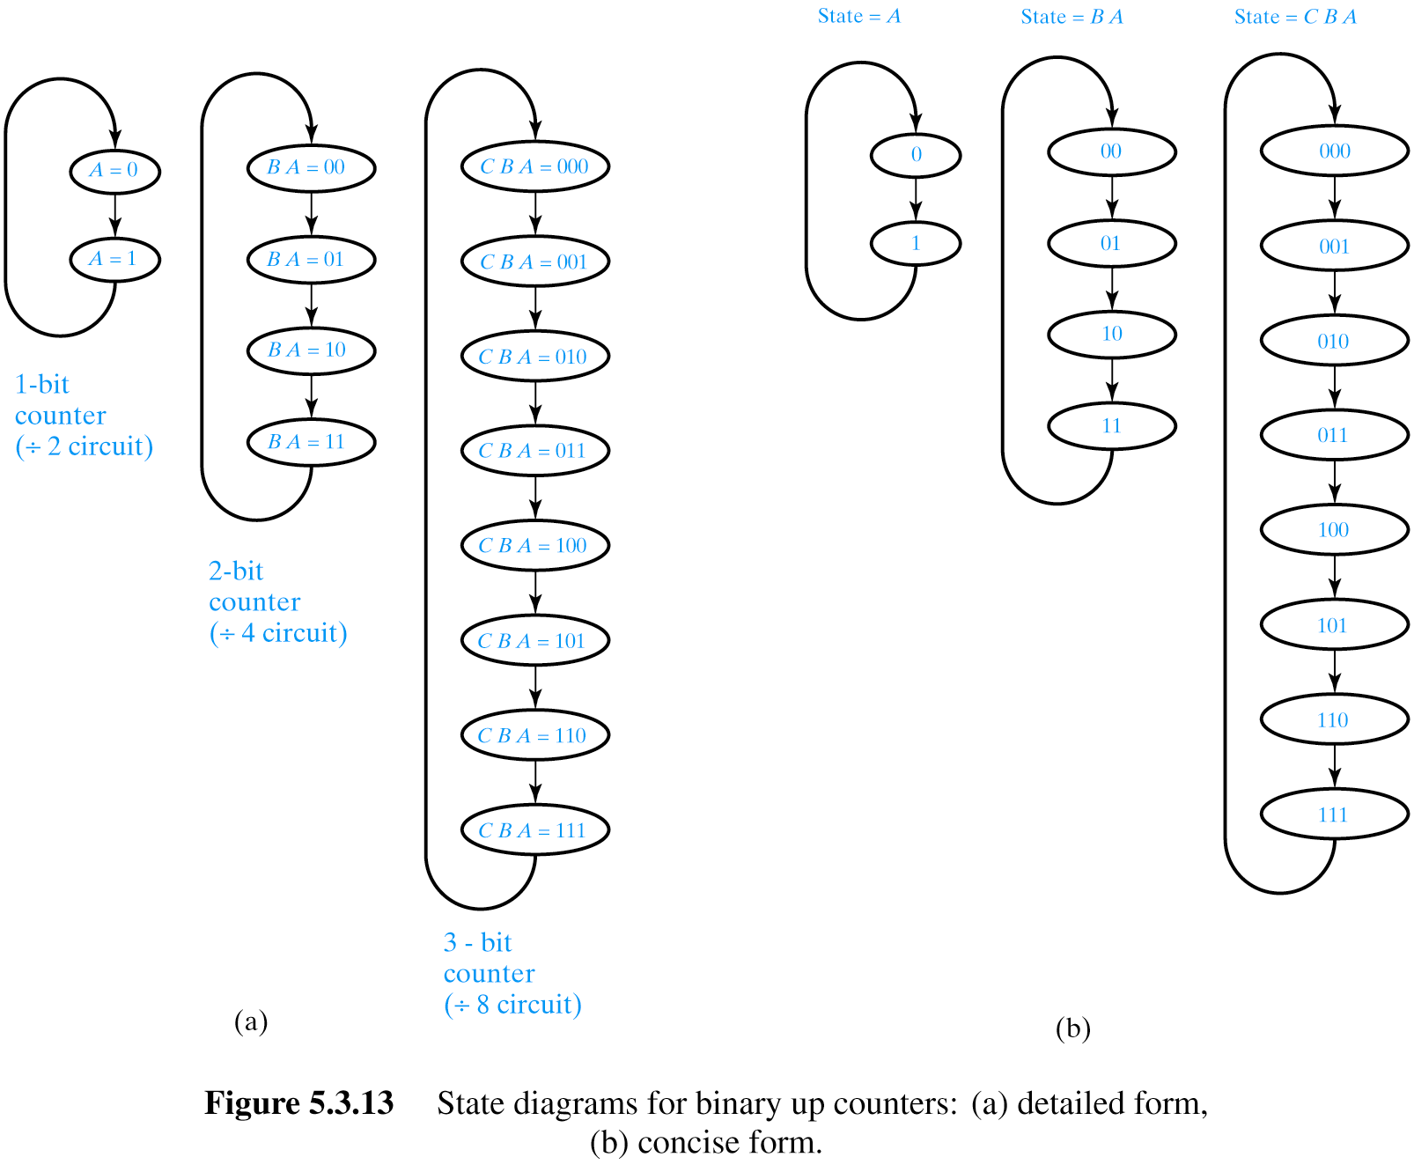
State Diagrams for Binary Up Counters
Typical Problems.
Build the counter from this state diagram using only T flip-flops.
Build modulo-5 counter from D flip-flops
Students should be able to convert the state diagrams like these to finite state machine schemata from flip-flops and logic gates.

Slide 71
Generalized Registers
Control bits select operation executed in the Generalized Register
1 2 3
0
1 2 3
0
1 2 3
0
D
Q
D
Q
D
Q
c
c
Green connection selected by control 00 are shift non-cyclically to right
Blue connections selected by control 01 are shift cyclically to the left
You should be able to add connections for any other operations on this Generalized Register

Slide 72
Shifters and Counters
EXOR gate
D
Q
D
Q
D
Q
Linear Counter, analyze its behavior
c
c
c
Arbitrary logic function
General Autonomous FSM with shifts and arbitrary logic function, analyze its behavior
D
Q
D
Q
D
Q
c
c
c
Q’
Students should be able to convert the logic diagrams like these to state graphs and state tables
ANALYSIS OF MACHINES IS IMPORTANT AND WILL BE ON EXAM

Slide 73
Flip-Flops for testing

Slide 74
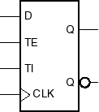
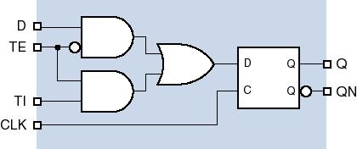
SCAN Flip-flops are used for testing
Scan
TEST ENABLE
TEST INPUT

Slide 75
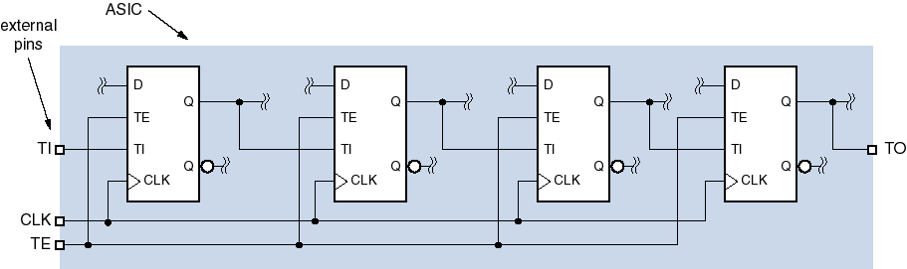
Scan flip-flops -- for testing
TE = 0 ==> normal operation
TE = 1 ==> test operation
  All of the flip-flops are hooked together in a daisy chain from external test input TI.
  Load up (“scan in”) a test pattern, do one normal operation, shift out (“scan out”) result on TO.

Slide 76
Other types of Flip-Flops

Slide 77
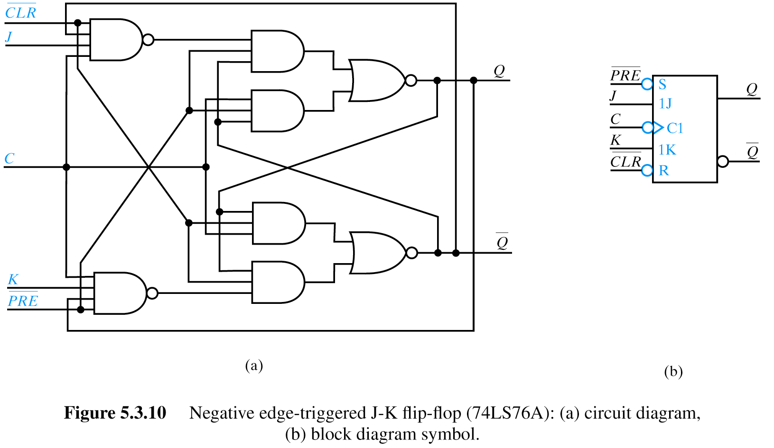
JK Flip Flops
J K Q⁺ Comment
0 0 Q No change
0 1 0 Reset
1 0 1 Set
1 1 Q Toggle

Slide 78

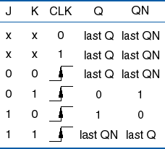
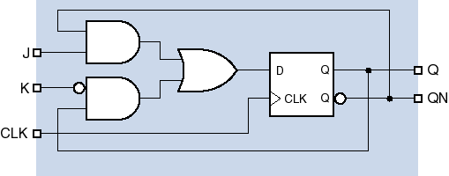
J-K flip-flops
Not used much anymore
Don’t worry about them
Interesting concept to be used in design

Slide 79
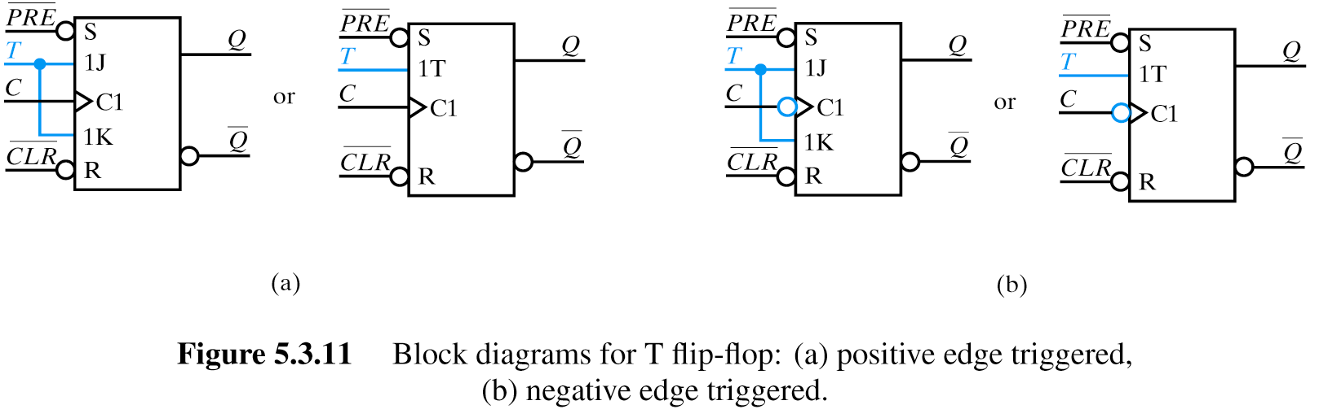
T Flip Flops
J = K=T Q⁺ Comment
0 0 0 Q No change
0 1
1 0
1 1 1 Q Toggle
T flip-flop created from JK flip-flop
T flip-flop working from leading slope of clock
T flip-flop working from falling slope of clock

Slide 80
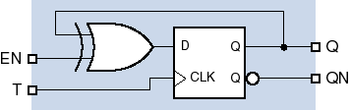
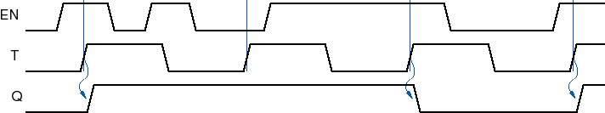
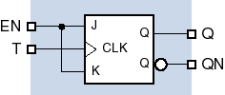

T flip-flops
Important for counters
When EN=1 it toggles with leading slope of T, when EN=0 no change of state
When EN=1 it toggles, when EN=0 no change of state

Slide 81
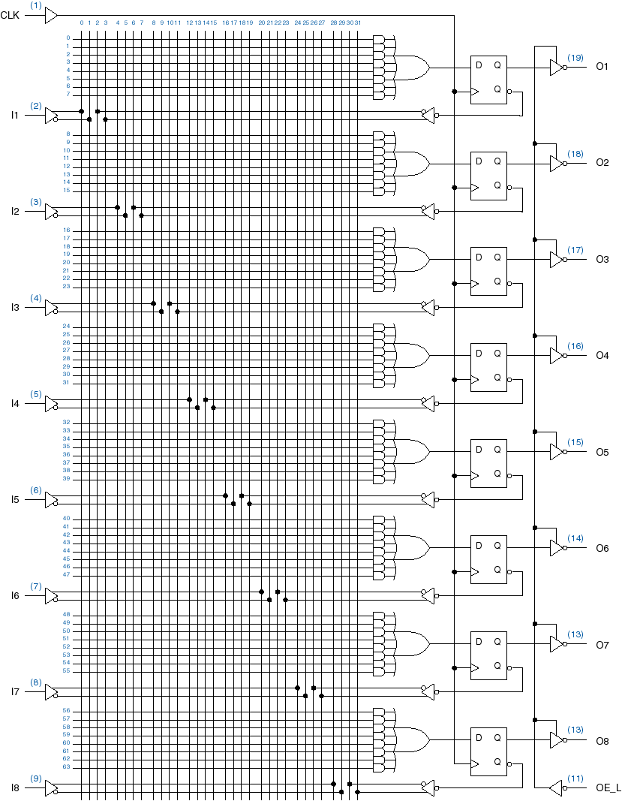
Sequential PALs
Tri=state
16R8

Slide 82
Analysis of a Counter from JK Flip-Flops

Slide 83
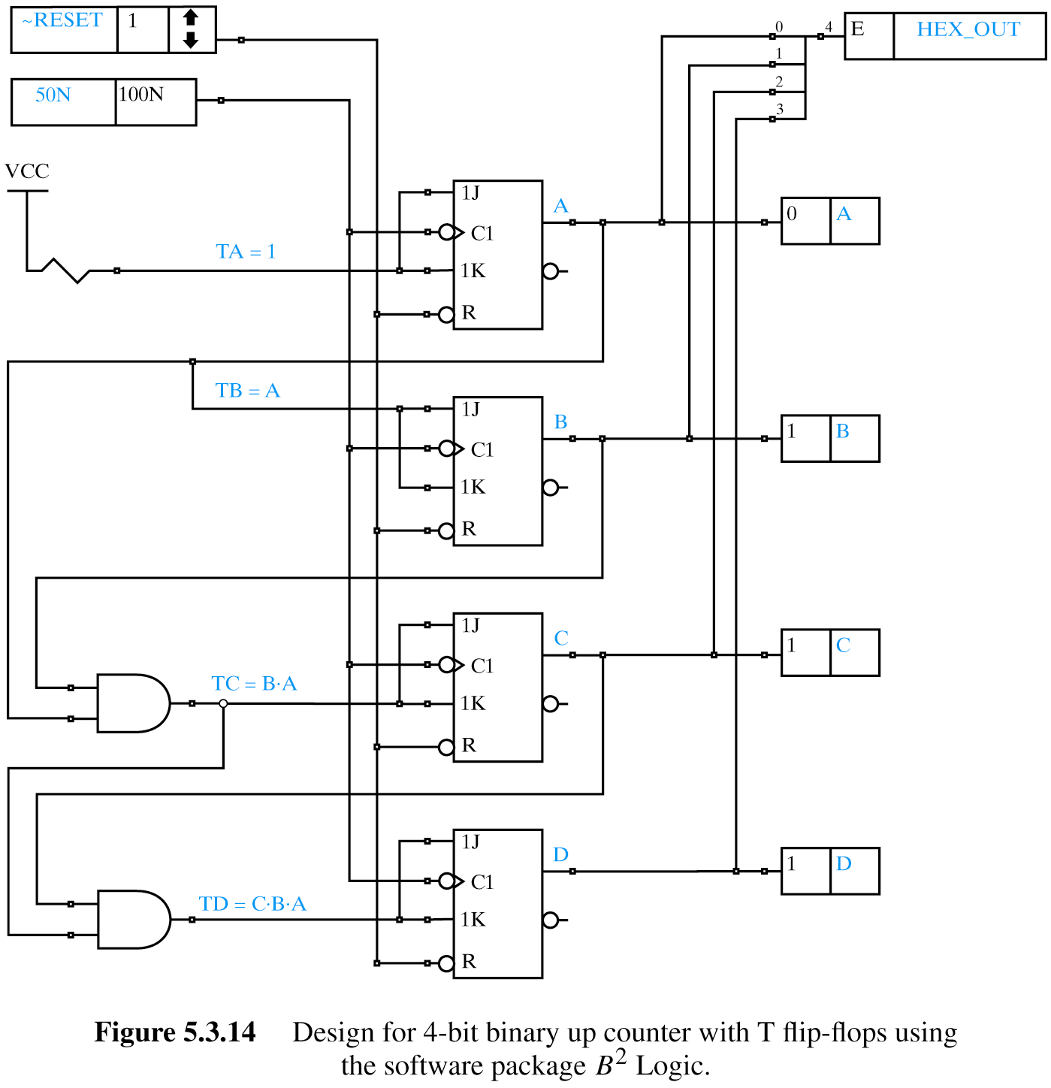
4-Bit Binary Up Counter
A Counter built from JK flip-flops
A
B
Question to students:
Find what is the sequence of states of this counter by analyzing the circuit using method shown previously
C
D
T flip flops ideal for counters (remain same or toggle)!

Slide 84
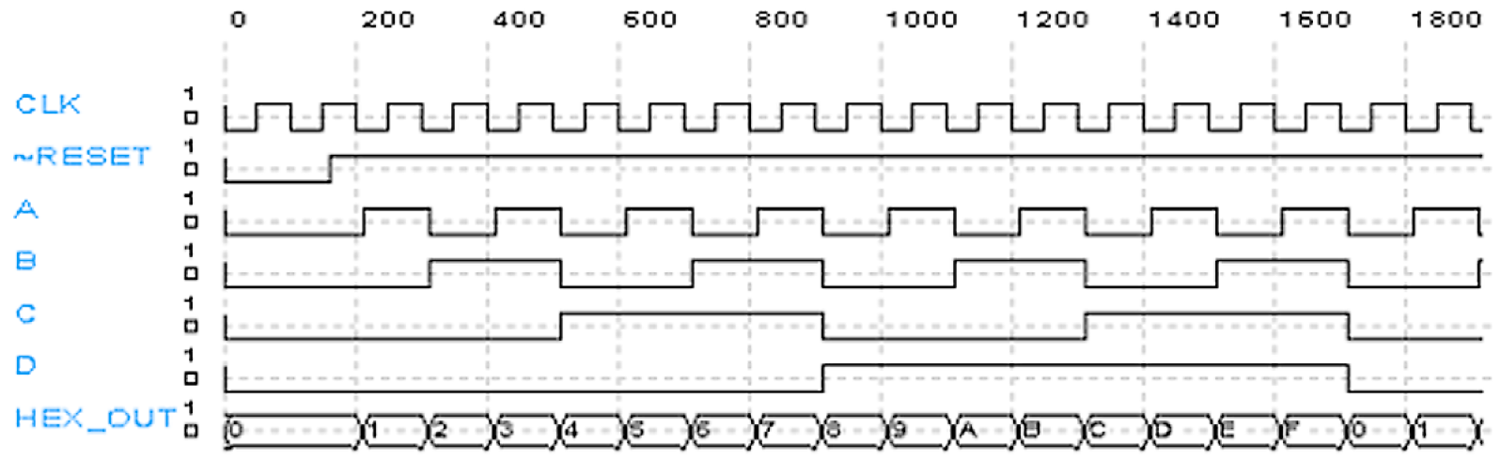
Counter Timing Diagram
States of individual flip-flops
What is a period of this counter? What is the binary sequence of states?
000
000

Slide 85
State Machines
State Transition Diagrams
Next State Tables
Mealy and Moore Machines
  Mealy: Output logic uses current state and inputs
  Moore: Output logic uses only current state
One Hot vs. Encoded State Machines

Slide 86
Iterative Circuits versus State Machines

Slide 87
REMINDER: Cell Table to design iterative circuits
Cell table: analogous to state table
Example: 0101 pattern detector
    Assuming the same assignment for states (A: 00, B: 01, C: 11, D: 10): each cell same as the combinational logic of the sequential circuit derived for the 0101 sequence detector in future slides for state machine.
Input sequence of arbitrary length
Initial carry
Present states
Sequence 0101 recognized for the first time
Sequence 0101 recognized for the second time
Next states
outputs
Two carry signals denote the state of recognition of our sequence 0101

Slide 88
Synthesis for Iterative Circuit
Example: synthesize an n-cell iterative network
    Each cell has one cell input x_{i} and one cell output z_{i}
    z_{i} = 1: if and only if either one or two of the cell inputs x₁, x₂, …, x_{i} have value 1
    States A, B, C, D: 0, 1, 2, (3 or more) of the cell inputs to preceding cells have value 1
    Cell table Cell Output-carries and cell-output table
Encode:
A=00
B=01
C=11
D=10
This is like three Kmaps in one. First for Y_{i1}, second for Y_{i2}, third for z_{i}
After encoding the table becomes a KMap

Slide 89
X₁
X₂
X₃
X₄
0
0
Z₁
Z₂
Z₃
Z₄
Observations:
This is a systematic method to design iterative circuits
This method is very similar to designing finite state machines that will covered soon.
Good example are comprators, adders, subtractors, comparators.

Slide 90
Synthesis for Finite State Machine
yi1 yi2\ xi | 0 | 1
00 | 0 | 0
01 | 0 | 1
11 | 1 | 1
10 | 1 | 1
yi1 yi2\ xi | 0 | 1
00 | 0 | 1
01 | 1 | 1
11 | 1 | 0
10 | 0 | 0
Y_{i1}
Y_{i2}
yi1 yi2\ xi | 0 | 1
00 | 0 | 1
01 | 1 | 1
11 | 1 | 0
10 | 0 | 0
D1 Q1
These must be D ffs
D2 Q2
z_{i}

Slide 91
Comparison of Iterative Circuit and Finite State Machine
X₁
X₂
X₃
X₄
0
0
Z₁
Z₂
Z₃
Z₄
The internal state in Flip-flops in Finite State Machine corresponds to the value of the carry signal in Iterative Circuit.
Data are given sequentially in FSM and in parallel in Iterative Circuit
D1 Q1
D2 Q2

Slide 92
Now we create a feedback through flip-flops, not an iterative circuit as before.
Please understand similarity and difference.
This is very important, you can expect this on Finals.

Slide 93
Larger Practical Examples of State Machines

Slide 94
Example 1:
T-bird tail-lights

Slide 95

ANIMATED: T-bird tail-lights example

Slide 96


Slide 97


Slide 98


Slide 99

State diagram for lights
Name of state
Alarm state, all lights
Idle state, no lights
Inputs:
LEFT, RIGHT, HAZ
Outputs:
Six lamps
(function of state only)
LC, LB, LA, RC, RB, RA
hazard
Name of input

Slide 100


Encoded or One-Hot?
First we have decide what kind of encoding we need.
Encoded
  8 states
  2³ = 8
  Need 3 flip flops
  Need to determine state assignment
One-hot
  Dedicate a flip flop per state
  Need 8 flip flops
The best method is to start synthesis starting from the state graph like in the last slide

Slide 101
First Method to calculate outputs for Moore Machine

Slide 102
Implementation
(Encoded, Moore Machine)
Current State
Next
State
Logic
Output
Logic
Inputs
Outputs
Realization of output logic

Slide 103

Output logic: outputs are functions of only states
Inputs:
LEFT, RIGHT, HAZ
Outputs:
Six lamps
(function of state only)
LC, LB, LA, RC, RB, RA
outputs
states
LC = L3 + LR3
LB = L2 + L3 + LR3
LA = L1 + L2 + L3 + LR3
RA = R1 + R2 + R3 + LR3
RB = R2 + R3 + LR3
RC = R3 + LR3
states
This table shows Output signals for internal states
We create equations for outputs, based on the table from the left
Observe that we need only OR gates applied to FFs that encode states
This method can be used for both One –Hot encoding and binary encoding.
This method is not minimal

Slide 104
Variant to calculate output functions in which the binary encoding of internal states is used

Slide 105


Output logic: outputs are functions of only states
LC = L3 + LR3
LB = L2 + L3 + LR3
LA = L1 + L2 + L3 + LR3
RA = R1 + R2 + R3 + LR3
RB = R2 + R3 + LR3
RC = R3 + LR3
Q2
Q1
Q0
This table shows Output signals for internal states
We create equations based on the table from the left
This method is not minimal but does not require Kmaps
LC = Q2’⋅Q1⋅Q0’ + Q2⋅Q1’⋅Q0’
LB = Q2’⋅Q1⋅Q0 + Q2’⋅Q1⋅Q0’ + Q2⋅Q1’⋅Q0’
LA = Q2’⋅Q1’⋅Q0 + Q2’⋅Q1⋅Q0 + Q2’⋅Q1⋅Q0’ + Q2⋅Q1’⋅Q0’
RA = Q2⋅Q1’⋅Q0 + Q2⋅Q1⋅Q0 + Q2⋅Q1⋅Q0’ + Q2⋅Q1’⋅Q0’
RB = Q2⋅Q1⋅Q0 + Q2⋅Q1⋅Q0’ + Q2⋅Q1’⋅Q0’
RC = Q2⋅Q1⋅Q0’ + Q2⋅Q1’⋅Q0’
This table shows Encoding of internal states

Slide 106
Methods to create transition function

Slide 107

Two Methods to create the Next State Logic
State transition table for encoded states
Next step depends on implementation choice
  Synthesize or Structural with choice of FFs
Encoding of internal states
This table is created from the state graph AND the encoding of internal states

Slide 108
Method 1 to create transition function. E
This method is easy but not minimal

Slide 109
Transition Equations for Q2* = D2
Q2* = Q2’⋅ Q1’ ⋅ Q0’ ⋅ (HAZ + LEFT ⋅ RIGHT)
+ Q2’ ⋅ Q1’ ⋅ Q0’ ⋅ (RIGHT ⋅ HAZ’ ⋅ LEFT’)
+ Q2’ ⋅ Q1’ ⋅ Q0 ⋅ (HAZ)
+ Q2’ ⋅ Q1 ⋅ Q0 ⋅ (HAZ)
+ Q2 ⋅ Q1’ ⋅ Q0 ⋅ (HAZ’)
+ Q2 ⋅ Q1’ ⋅ Q0 ⋅ (HAZ)
+ Q2 ⋅ Q1 ⋅ Q0 ⋅ (HAZ’)
+ Q2 ⋅ Q1 ⋅ Q0 ⋅ (HAZ)
Q2* = Q2’⋅ Q1’ ⋅ Q0’ ⋅ (HAZ + RIGHT)
+ Q2’ ⋅ Q0 ⋅ HAZ
+ Q2 ⋅ Q0
The simplification of equation for Q2* is done using transformations of equation on the left or using Kmaps.

Slide 110
Transition Equations for Q1* = D1
Q1* = Q2’ ⋅ Q1’ ⋅ Q0 ⋅ (HAZ’)
+ Q2’ ⋅ Q1 ⋅ Q0 ⋅ (HAZ’)
+ Q2 ⋅ Q1’ ⋅ Q0 ⋅ (HAZ’)
+ Q2 ⋅ Q1 ⋅ Q0 ⋅ (HAZ')
Q1* = Q0 ⋅ HAZ’

Slide 111
Transition Equations for Q0* = D0
Q0* = Q2’ ⋅ Q1’ ⋅ Q0’ ⋅ (LEFT ⋅ HAZ’ ⋅ RIGHT’)
+ Q2’ ⋅ Q1’ ⋅ Q0’ ⋅ (RIGHT ⋅ HAZ’ ⋅ LEFT’)
+ Q2’ ⋅ Q1’ ⋅ Q0 ⋅ (HAZ’)
+ Q2 ⋅ Q1’ ⋅ Q0 ⋅ (HAZ’)
Q0* = Q2’⋅ Q1’ ⋅ Q0’ ⋅ HAZ’ ⋅ (LEFT ⊕ RIGHT)
+ Q1’ ⋅ Q0 ⋅ HAZ’
No guarantee these are minimal. They certainly aren’t SOP. What we do next depends upon how we’re going to implement the FSM.
Could just give them whole thing to ABEL or some other tool and let it generate minimal SOP.
Also, transition equation isn’t same as excitation equation (unless we’re using D FFs)

Slide 112
Optimizing the speed of my machine

Slide 113
Implementation
(Encoded, Moore Machine)
Current State
Next
State
Logic
Output
Logic
Inputs
Outputs
What should the clock’s period be?

Slide 114
How Fast Can the Clock Be?
You want the signal to propagate as fast as possible through this logic
Combinational
Logic
FF 1
FF 2
FF t_{pd}
FF t_{setup}
Combinational t_{pd}
D1
Propagation delay
Q
D2
Clock

Slide 115

Clock Skew
Even with careful routing, clock will not arrive
at all FFs at the same time. This skew in clock
arrival time affects max clock rate.
Clock Period_{min} = FF t_{pd} + FF t_{setup} + C t_{pd} + t_{skew}
FF t_{pd}
FF t_{setup}
Clock Skew
D1
Q
Combinational t_{pd}
D2
Clock

Slide 116

Another notation to explain clock period calculations
Clock Period_{min} = FF t_{pd} + FF t_{setup} + C t_{pd} + t_{skew}
t_{clk} = t_{ffpd} + t_{comb} + t_{setup-time-margin} + t_{setup}

Slide 117
Method 2 when costs of flip-flops are not that important to create transition function

Slide 118

One-Hot Transitions
IDLE* = IDLE ⋅ (HAZ + LEFT + RIGHT)’ + L3 + R3 + LR3
L1* = IDLE ⋅ LEFT ⋅ HAZ’ ⋅ RIGHT’
R1* = IDLE ⋅ RIGHT ⋅ HAZ’ ⋅ LEFT’
L2* = L1 ⋅ HAZ’
R2* = R1 ⋅ HAZ’
L3* = L2 ⋅ HAZ’
R3* = R2 ⋅ HAZ’
LR3* = IDLE ⋅ (HAZ + LEFT ⋅ RIGHT) + (L1 + L2 + R1 + R2) ⋅ HAZ
Flip-flop L1 has value 1 when machine is in state L1.
Otherwise it has value 0.
This is one-hot coding. Easy and fast.
No decoding of state required

Slide 119
Behavioral Verilog
If you understand Boolean Equations and the methods presented above, it is very easy to write Verilog code for every Finite State Machine.
Below I give a template how to create a behavioral specification of any state machine in Verilog.
You should be able to reuse this template, only change the Boolean Equations.

Slide 120
Better Still – Behavioral Verilog
Inputs:
LEFT, RIGHT, HAZARD
Outputs:
Six lamps
(function of state only)
LC, LB, LA, RC, RB, RA
Encoding of outputs
parameter
IDLE = 8'b00000001,
L1 = 8'b00000010,
L2 = 8'b00000100,
L3 = 8'b00001000,
R1 = 8'b00010000,
R2 = 8'b00100000,
R3 = 8'b01000000,
LR3 = 8'b10000000;
reg [7:0] State, NextState;
case (State)
IDLE:
begin
if (Hazard | Left & Right)
NextState = LR3;
else if (Left)
NextState = L1;
else if (Right)
NextState = R1;
else
NextState = IDLE;
end
L1: begin
if (Hazard)
NextState = LR3;
else
NextState = L2;
end
L2: begin
if (Hazard)
NextState = LR3;
else
NextState = L3;
end
L3: begin
NextState = IDLE;
end
R1: begin
if (Hazard)
NextState = LR3;
else
NextState = R2;
end
R2: begin
if (Hazard)
NextState = LR3;
else
NextState = R3;
end
R3: begin
NextState = IDLE;
end
LR3:begin
NextState = IDLE;
end
endcase

Slide 121
Better Still – Behavioral Verilog
Inputs:
LEFT, RIGHT, HAZARD
Outputs:
Six lamps
(function of state only)
LC, LB, LA, RC, RB, RA
case (State)
IDLE:
begin
if (Hazard | Left & Right)
NextState = LR3;
else if (Left)
NextState = L1;
else if (Right)
NextState = R1;
else
NextState = IDLE;
end
Left &(Hazard | Left & Right)’ =
Left & (Hazard’ & (Left & Right)’) = Left & Hazard’ (Left’ | Right’) =
Left & Hazard’ & Right’
Here we show how the Verilog Code can be transformed using Boolean Algebra to the state graph.

Slide 122
Example 2:
Traffic Light Controller

Slide 123

Example: Traffic Light Controller
N
Sensors in road detect approaching car on NS and EW roads, generating input signals NScar and EWcar respectively.
Lights are controlled by outputs NSlite and EWlite.
Traffic lights should change only if there is a car approaching from the other direction.
Otherwise the lights should remain unchanged.
W
E
S
sensors
lights
Internal state
NScar
Traffic Light Controller
NSlite
EWlite
EWcar
Internal state
Clock
r
Output state

Slide 124



Example: Traffic Light Controller
State assignment
= 0
=1
r
CurrentState’
CurrentState
State assignment
NSgreen = 0
EWgreen = 1
Output function

Slide 125
Example: Traffic Light Controller. General Method
01,11
10,11
00
10
00
01
r
Create directly Gray Code and KMap
State\ Inputs | 00 | 01 | 11 | 10
NSgreen | NSgreen | EWgreen | EWgreen | NSgreen
EWgreen | EWgreen | EWgreen | NSgreen | NSgreen
ENCODE
Nsgreen = 0
Ewgreen = 1
You minimize these Kmaps using methods that you know from previous lectures.
Draw the schematic with logic and FFs.
After encoding you obtain an encoded table, which in general you separate to several KMaps, as shown in several examples before.

Slide 126
Example 3:
NRZ to Manchester Encoder

Slide 127
Behavioral Verilog 2
If you understand Boolean Equations and the methods presented above, it is very easy to write Verilog code for every Finite State Machine.
Below I give another template how to create a behavioral specification of any state machine in Verilog.
You should be able to reuse this template, only change the Boolean Equations.

Slide 128
//
// Moore FSM for serial line conversion: NRZ to Manchester encoding
//
module NRZtoManchester(Clock, Clear, BitIn, BitOut);
input Clock, Clear, BitIn;
output BitOut;
reg BitOut;
// define states using same names and state assignments as state diagram and table
// Using one-hot method, we have one bit per state
parameter
S0 = 4'b0001,
S1 = 4'b0010,
S2 = 4'b0100,
S3 = 4'b1000;
reg [3:0] State, NextState;
// Update state or reset on every - clock edge
always @(negedge Clock)
begin
if (Clear)
begin
State <= S0;
$display("Reset: S0");
end
else
begin
State <= NextState;
$display("State: %d",State);
end
end
BitIn
NRZ to
Manchester
Encoder
BitOut
Clock
Clear
States and state assignment
Verilog
Description of sequential part with clearing and next state, this is universal.
Changes with negative slope.

Slide 129
// Outputs depend only upon state (Moore machine)
always @(State)
begin
case (State)
S0: BitOut = 1'b0;
S1: BitOut = 1'b0;
S2: BitOut = 1'b1;
S3: BitOut = 1'b1;
endcase
end
// Next state generation logic
always @(State or BitIn)
begin
case (State)
S0: if (BitIn)
NextState = S3;
else
NextState = S1;
S1: if (BitIn)
$display("S1 Error!");
else
NextState = S2;
S2: if (BitIn)
NextState = S3;
else
NextState = S1;
S3: if (BitIn)
NextState = S0;
else
$display("S3 Error!");
endcase
end
endmodule
Output logic for every internal state
Rising edge of BitClock coincides with rising edge of FSM clock.
BitIn changes at falling edge of BitClock
Use falling edge of FSM clock for synchronization (will be at midpoint of bit time) so no danger of sampling BitClock while it’s changing
Transition logic
S0
0
0
S1
0
1
1
0
0
S3
1
S2
1
1

Slide 130
Method 3 in which we minimize the transition functions optimally
SYNTHESIS OF NRZ TO MANCHESTER ENCODER USING KMAPS AND MINIMIZATION
SYNTHESIS OF MACHINES IS IMPORTANT AND WILL BE ON EXAM

Slide 131


Pay attention to don’t cares created
S0
0
0
S1
0
PS | B_{in} = 0 | B_{in} = 1
S0 | S1 | S3
S1 | S2 | -
S3 | - | S0
S2 | S1 | S3
00
01
11
10
1
1
0
0
S3
1
S2
1
1

Slide 132
Example 4:
Airplane Gear

Slide 133
Airplane Gear Example
inputs
  PilotLever
  Operated by pilot to control landing gear
  (1:down 0:up)
  PlaneOnGround
  Sensor 1 when plane on ground
  GearIsUp
  Sensor 1 when landing gear fully up
  GearIsDown
  Sensor 1 when landing gear fully down
  TimeUp
  1 when two second timer expired
  Valve
  Controls position of valve (1:lowering 0:raising)
  Pump
  Activates hydraulic pump (1: activate)
  ResetTimer
  1 to reset count-down timer, 0 to count
  RedLED
  Indicates landing gear in motion
  GreenLED
  Indicates landing gear down
PilotLever
Valve
PlaneOnGround
Airplane Landing Gear Control
Pump
GearIsUp
RedLED
GearIsDown
GreenLED
TimeUp
ResetTimer
Do not retract landing gear if plane on ground
Plane should be airborne two seconds before retracting gear
Respond to changes in lever position
(in case plane started with lever in up position)
outputs

Slide 134
State Transition Diagram
~PlaneOnGround
TimeUp & ~PilotLever
Waiting
for
TakeOff
Waiting
for
Timer
Raising
Gear
Gear
Up
Reset
GearIsUp
PlaneOnGround
PilotLever
~PilotLever
PilotLever
~PilotLever
Gear
Down
Lowering
Gear
PlaneOnGround
GearIsDown
State | Reset Timer | Pump | Valve | RedLED | GreenLED
WaitingforTakeoff | 1 | 0 | X | 0 | 1
WaitingforTimer | 0 | 0 | X | 0 | 1
RaisingGear | X | 1 | 0 | 1 | 0
GearUp | X | 0 | X | 0 | 0
LoweringGear | X | 1 | 1 | 1 | 0
GearDown | X | 0 | X | 0 | 1
Output functions

Slide 135
Airplane Landing Gear Example
  Lever
  Operated by pilot to control landing gear
  (0:down 1:up)
  OnGround
  Sensor 1 when plane on ground
  GearUp
  Sensor 1 when landing gear fully up
  GearDown
  Sensor 1 when landing gear fully down
  Valve
  Controls position of valve (0:lowering 1:raising)
  Pump
  Activates hydraulic pump
  RedLED
  Indicates landing gear in motion
  GreenLED
  Indicates landing gear down
Lever
Valve
Airplane Landing Gear Control
OnGround
Pump
GearUp
RedLED
GearDown
GreenLED
Do not retract landing gear if plane on ground
Plane should be airborne two seconds before retracting gear

Slide 136
What students can do with this example ?
You can complete this example using any of the several method shown above.
I suggest first to use Method 2 based on One-Hot Encoding.
Next use Method 3.
Next describe the problem using Verilog.

Slide 137
Example 5:
Design Using JK Flip-flops

Slide 138
DESIGN EXAMPLE 6: Counter using JK
Design Procedure:
Specification ⇒ State Diagram ⇒ State Table ⇒
Excitation Table ⇒ Karnaugh Map ⇒ Circuit Diagram
Example: 2-bit Counter -> 2 FF's
x=0
current next
state input state FF inputs
A B x A B Ja Ka Jb Kb
0 0 0 0 0 0 d 0 d
0 0 1 0 1 0 d 1 d
0 1 0 0 1 0 d d 0
0 1 1 1 0 1 d d 1
1 0 0 1 0 d 0 0 d
1 0 1 1 1 d 0 1 d
1 1 0 1 1 d 0 d 0
1 1 1 0 0 d 1 d 1
x=1
00
x=1
x=0
01
11
x=0
x=1
x=1
10
x=0
Encoded internal state
B
B
B
B
d d
d
d
1
d d
x
1 d
x
d
1
x
d d
x
1
1 d
d
1
x
A
B
A
A
A
A
J Q
C
K Q'
J Q
C
K Q'
d d
d
d
Ja
Ka
Jb
Kb
clock
Ja = Bx Ka = Bx Jb = x Kb = x

Slide 139
Example 7: Registers, Shifters, Generalized Registers
Register
A₀
A₁
A₂
A₃
Q
C
Q
C
Q
C
Q
C
D
D
D
D
Clock
I₀
I₁
I₂
I₃
Shift Register, non-cyclic, shifts to right
Serial
Input
Clock
D Q
C
D Q
C
D Q
C
D Q
C
Serial
Output
Bidirectional Shift Register with Parallel Load
A₀
A₁
A₂
A₃
This is example of “Generalized Register”
Q
Q
Q
Q
D
C
D
C
D
C
D
C
Students please analyze this circuit and understand what it does.
4 x 1
MUX
4 x 1
MUX
4 x 1
MUX
4 x 1
MUX
Clock
S₀S₁
SeriaI
Input
I₀
I₁
I₂
Serial
Input
I₃
control

Slide 140
Example 8: Counter modulo 16 with JK flip-flops that act as T flip-flops
A₀
A₁
A₂
A₃
Q
Q
Q
Q
J K
J K
J K
J K
Clock
Counter
Enable
Output
Carry

Slide 141
Example 9:
Vending Machine
Taken from Katz & Borriello, “Contemporary Logic Design”

Slide 142
Example: vending machine
Release item after 15 cents are deposited
Single coin slot for dimes, nickels
No change
Reset
nickel
N
Vending
Machine
FSM
Open
Coin
Sensor
Release
Mechanism
D
dime
Clock

Slide 143
Example: vending machine.
Create a tree
Suitable abstract representation
  tabulate typical input sequences:
    3 nickels
    nickel, dime
    dime, nickel
    two dimes
  draw state diagram:
    inputs: N, D, reset
    output: open chute
  assumptions:
    assume N and D asserted
    for one cycle
    each state has a self loop
    for N = D = 0 (no coin)
Reset
S0
N
D
S1
S2
N
D
N
D
S3
S4
[open]
S5
[open]
S6
[open]
N
D
S7
[open]
S8
[open]

Slide 144
Example: vending machine.
Minimize machine to minimum number of states
Minimize number of states - reuse states whenever possible
Reset
present inputs next output
state D N state open
0¢ 0 0 0¢ 0
0 1 5¢ 0
1 0 10¢ 0
1 1 – –
5¢ 0 0 5¢ 0
0 1 10¢ 0
1 0 15¢ 0
1 1 – –
10¢ 0 0 10¢ 0
0 1 15¢ 0
1 0 15¢ 0
1 1 – –
15¢ – – 15¢ 1
0¢
N
5¢
D
N
D
10¢
N + D
15¢
[open]
symbolic state table

Slide 145
Example: vending machine: Encoding (or state assignment) of internal states
Uniquely encode states
present state inputs next state output
Q1 Q0 D N D1 D0 open
0 0 0 0 0 0 0
0 1 0 1 0
1 0 1 0 0
1 1 – – –
0 1 0 0 0 1 0
0 1 1 0 0
1 0 1 1 0
1 1 – – –
1 0 0 0 1 0 0
0 1 1 1 0
1 0 1 1 0
1 1 – – –
1 1 – – 1 1 1

Slide 146


Example: Moore implementation
Remember location of don’t cares!
Q1
Q1
Q1
Mapping to logic
D1
D0
Open
0 0 1 1
0 1 1 1
X X 1 X
1 1 1 1
0 1 1 0
1 0 1 1
X X 1 X
0 1 1 1
0 0 1 0
0 0 1 0
X X 1 X
0 0 1 0
N
N
N
D
D
D
Q0
Q0
Q0
D1 = Q1 + D + Q0 N
D0 = Q0’ N + Q0 N’ + Q1 N + Q1 D
OPEN = Q1 Q0

Slide 147
Example: vending machine –
One Hot Encoding
One-hot encoding
present state inputs next state output
Q3 Q2 Q1 Q0 D N D3 D2 D1 D0 open
0 0 0 1 0 0 0 0 0 1 0
0 1 0 0 1 0 0
1 0 0 1 0 0 0
1 1 - - - - -
0 0 1 0 0 0 0 0 1 0 0
0 1 0 1 0 0 0
1 0 1 0 0 0 0
1 1 - - - - -
0 1 0 0 0 0 0 1 0 0 0
0 1 1 0 0 0 0
1 0 1 0 0 0 0
1 1 - - - - -
1 0 0 0 - - 1 0 0 0 1
D0 = Q0 D’ N’
D1 = Q0 N + Q1 D’ N’
D2 = Q0 D + Q1 N + Q2 D’ N’
D3 = Q1 D + Q2 D + Q2 N + Q3
OPEN = Q3

Slide 148
Various procedures for Moore sequential circuits
Natural Language Specification of FSM
Red is most important
State Table of FSM
State Graph of FSM
Algorithmic State Machine
Use Method 3 to calculate transition functions
Use Method 2 to calculate transition functions, calculate output functions
Use Method 1 to calculate transition functions, calculate output functions
Logic Equations
Use other Methods to calculate transition functions, calculate output functions
Verilog Code

Slide 149
Short Presentation of Mealy Machines

Slide 150
Comparison of Mealy and Moore state diagrams
Moore machine
  outputs associated with state
Mealy machine
  outputs associated with transitions
Reset
N’ D’ + Reset
Reset/0
(N’ D’ + Reset)/0
0¢
[0]
0¢
N’ D’
N’ D’/0
N
N/0
D
5¢
[0]
D/0
5¢
N’ D’
N’ D’/0
N
N/0
10¢
[0]
10¢
D
N’ D’
D/1
N’ D’/0
N+D
N+D/1
15¢
[1]
15¢
Reset’
Reset’/1

Slide 151
Example 10: Mealy implementation
Reset/0
Reset/0
present state inputs next state output
Q1 Q0 D N D1 D0 open
0 0 0 0 0 0 0
0 1 0 1 0
1 0 1 0 0
1 1 – – –
0 1 0 0 0 1 0
0 1 1 0 0
1 0 1 1 1
1 1 – – –
1 0 0 0 1 0 0
0 1 1 1 1
1 0 1 1 1
1 1 – – –
1 1 – – 1 1 1
0¢
N’ D’/0
N/0
D/0
5¢
N’ D’/0
N/0
10¢
D/1
N’ D’/0
N+D/1
15¢
Q1
Reset’/1
Open
0 0 1 0
0 0 1 1
X X 1 X
0 1 1 1
D0 = Q0’N + Q0N’ + Q1N + Q1D
D1 = Q1 + D + Q0N
OPEN = Q1Q0 + Q1N + Q1D + Q0D
N
D
Q0

Slide 152

Example 10: Mealy implementation (cont)
D0 = Q0’N + Q0N’ + Q1N + Q1D
D1 = Q1 + D + Q0N
OPEN = Q1Q0 + Q1N + Q1D + Q0D
make sure OPEN is 0 when reset
– by adding AND gate
When Reset is 1 then Reset’ is zero
Then Open is zero

Slide 153
Types of FSMs
inputs
combinational
logic for
next state
Moore
logic for
outputs
reg
outputs
state feedback
inputs
logic for
outputs
outputs
Mealy
combinational
logic for
next state
reg
state feedback
Mealy not on exams! ENJOY!
inputs
logic for
outputs
outputs
Synchronous Mealy
combinational
logic for
next state
reg
state feedback

Slide 154
Example 11:
Synchronous Mealy

Slide 155
Retiming
One FF Delay + one AND delay
D1
D
Q
We are shifting AND gate back through flip-flops and adding one delay after it, to preserve timing of this gate.
D2
D
Q
D1
D
Q
D
Q
D
Q
D2
One FF Delay + one AND delay

Slide 156
Using Retiming to realize Synchronous Mealy

Slide 157

Mealy to synchronous Mealy
D0 = Q0’N + Q0N’ + Q1N + Q1D
D1 = Q1 + D + Q0N
OPEN = Q1Q0 + Q1N + Q1D + Q0D
make sure OPEN is 0 when reset
– by adding AND gate
D0 *D1
I asked earlier to remember location of don’t cares
From Mealy
OPEN.d = Q1Q0 + Q1N + Q1D + Q0D
OPEN.d = (Q1 + D + Q0N)(Q0'N + Q0N' + Q1N + Q1D)
= Q1Q0N' + Q1N + Q1D + Q0'ND + Q0N'D
Known as don’t cares
Open.d
Q1
Open.d
Q1
0 0 1 0
0 0 1 1
1 0 1 1
0 1 1 1
0 0 1 0
0 0 1 1
X X 1 X
0 1 1 1
N
N
D
D
Q0
Q0
Our previous Mealy Solution

Slide 158
Moore to synchronous Mealy
D1 = Q1 + D + Q0 N
D0 = Q0’ N + Q0 N’ + Q1 N + Q1 D
OPEN = Q1 Q0
This was our Moore Solution
OPEN = Q1Q0 creates a combinational delay after Q1 and Q0 change in Moore implementation
This can be corrected by retiming, i.e., move flip-flops and logic through each other to improve delay
OPEN.d = (Q1 + D + Q0N)(Q0'N + Q0N' + Q1N + Q1D)
= Q1Q0N' + Q1N + Q1D + Q0'ND + Q0N'D
Implementation now looks like a synchronous Mealy machine
  it is common for programmable devices to have FF at end of logic

Slide 159
Questions and EXAM Problems (1)
Explain in your own words how the SR latch from two NOR gates works.
Explain in full detail timing of SR latch.
Create a latch from two NAND gates, similar to one from two NOR gates and explain in detail its timing.
Draw the table of this latch from NAND gates.
What are critical races? Give example of a circuit.
What are non-critical races? Give example of a circuit.
What are metastable states?
You must be able to derive a state machine table from the circuit of a latch.
You must be able to derive a state machine table from a state machine graph.
You must be able to derive a state machine table from a flowchart or Algorithmic State Machine.
Explain how a simple generator works.
Explain behavior of gated SR latch using NOR gates.
Explain behavior of gated SR latch using NAND gates.
Explain behavior of gated D latch using NOR gates.
Explain behavior of gated D latch using NAND gates.

Slide 160
Questions and Problems
Questions and EXAM Problems (2)
16. Explain in your own words how the Edge Triggered D Flip-Flop works.
17. Build a T flip-flop from D flip-flop and logic gates.
18. Build a JK flip-flop from D flip-flop and logic gates.
19. Build a T flip-flop from JK flip-flop.
20. Build a JK flip-flop from T flip-flop and logic gates.
21. Build a modulo 4 counter from D flip-flops and logic.
22. Build a modulo 4 counter from T flip-flops and logic.
23. Build a modulo 4 counter from JK flip-flops and logic.
24. Design a modulo 5 counter and draw its timing diagram.
25. How to design a modulo 32 counter?
26. How to design a modulo 33 counter?
27. Explain in your own words the difference of Mealy and Moore Machines.
28. What is the synchronous Mealy Machine and how it differs from standard Mealy Machine?
29. What is retiming?

Slide 161
Questions and Problems
Most Important EXAM Problems
29. Given is a circuit composed from D flip-flops and few logic gates. Create a state graph of this circuit.
30. Given is a circuit composed from D flip-flops and few logic gates. Create a state table of this circuit.
31. TYPICAL PROBLEM FOR EXAM, DEFINITELY WILL BE COVERED:
Given is an English Language formulation of some state machine.
  Create a state graph of this machine.
  Create a state table of this machine. (Moore).
  Create and minimize output logic functions of this machine.
  Create and minimize transition (excitation) functions of this machine.
  Draw the schematic of the machine with flip-flops and logic gates.
  Verify that your schematic really realizes the machine that its specification was given to you.
VERILOG NOT ON EXAM

Slide 162
Sources
Prof. Mark G. Faust
John Wakerly
Gaetano Borriello
Randy H. Katz

