Slide 1
Study of Existing Quantum Search Algorithms and Problem Formulations to Determine the Most Efficient Method to Solve Constraint Satisfaction Problems
By Sidharth Dhawan

Slide 2
Grover Algorithm

Slide 3
Applications of Quantum Computers
Classical computers today are fast.
However, in some cases, quantum computers are significantly faster.
  For example, Shor’s algorithm can solve semiprime factorization problems with exponential speedups over classical computers.
  Grover’s algorithm can achieve polynomial speedups in large, non-polynomial problems using unstructured search.
Notes:
Smaller slides

Slide 4
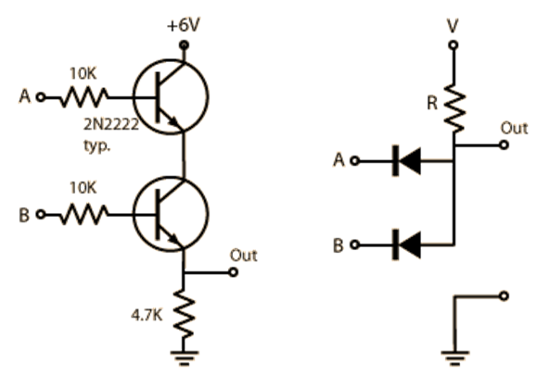
Superposition and Quantum Computers
A classical bit is represented by a classical entity, like a current of electrons
Thus, it is confined to two discrete states, “0” and “1”
It is relatively easy to determine its state.

Slide 5
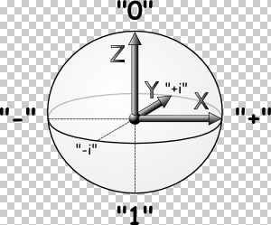
Superposition and Quantum Computers
A quantum bit represents information in a quantum mechanical entity, like an electron’s spin axis
Our tools cannot determine the precise state of a quantum entity
Thus, a qubit can exist in any combination of the states “0” and “1” (in other words, any point on the bloch sphere).
A classical bit is confined to the “poles”
The Bloch Sphere represents all possible quantum states.

Slide 6
Superposition and Search
We can use the Hadamard transform to create an even superposition between the |0> and |1> state in one qubit.
If I perform a collective Hadamard transform to a system of two qubits, the system as a whole can represent |00>, |01>, |10>, and |11>.
For this reason, quantum bits store more information than classical bits – I can represent 2ⁿ classical states with n qubits

Slide 7
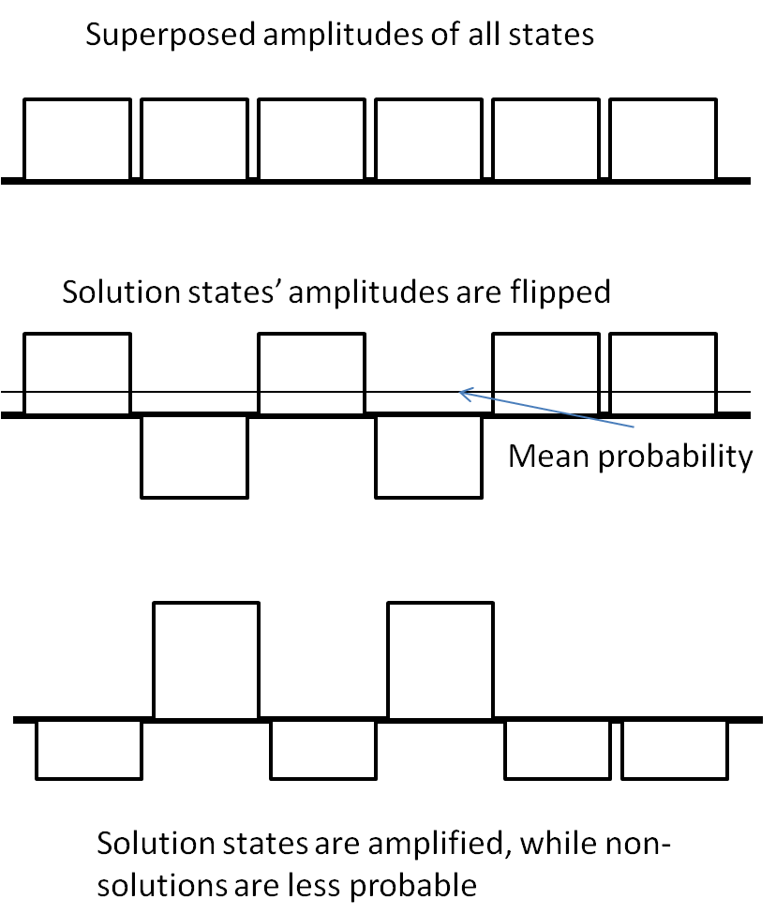
Quantum Unstructured Search (“Grover”)
Grover’s Algorithm uses this property of quantum information to perform an unstructured search more quickly
The initial input qubits are superposed to represent all possible solutions
The Oracle operation tags the phase of the solution states in this superposition
Another circuit then changes the phase information (which is hidden) into amplitude information (which we can detect).
This process is iterated √N times (as opposed to N iterations in classical logic) to maximally amplify the states.
H
ORACLE
H
H
…
…
…
…
H
H
H
H
Grover Loop (* √N)
Notes:
Explain Grover intuitively
Show an actual oracle being superposed into the “oracle” slot, and show repetition of Grover’s Algorithm
Explain more with animation; show repetition.
Talk about mirror circuits; show oracles with mirrors and same inputs/outputs.

Slide 8
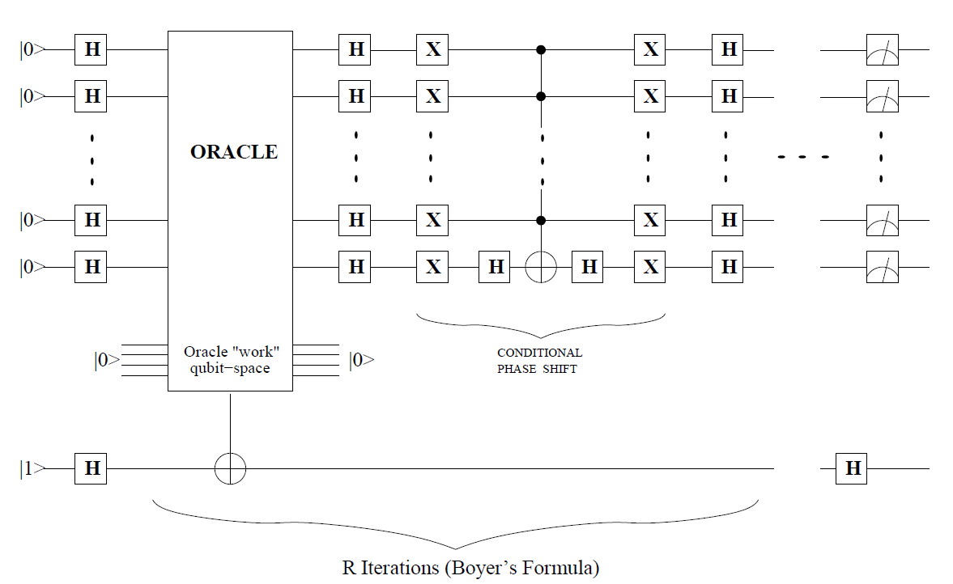
Circuit level representation of Grover
Notes:
Replace this with an animation?

Slide 9

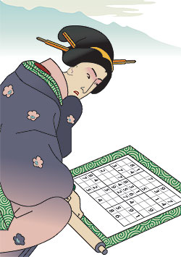
Applications of Grover Algorithm
Grover’s algorithm can provide quadratic speedup in NP Complete problems:
Examples of NP Complete problems are:
  Graph Coloring
  Maximum Clique
  Satisfiability
  Travelling Salesman
  DNA Sequencing
  Scheduling
  Sudoku
Notes:
Remove most of the grover/classical algorithm stuff
Examples are good
AI is not a problem
Use colors
Can just use bullet points; shorten.

Slide 10
The Oracle

Slide 11
The Oracle
The most important part of the Grover Circuit is the oracle.
An oracle is essentially a classical circuit that can recognize a state (combination of inputs) that is a solution.
In the Grover loop, the oracle searches through every solution simultaneously and “tags” the solution state with a phase change

Slide 12
The Oracle
Since the oracle operation is iterated √N times, a decrease in cost of one basic gate for the oracle would decrease the cost of the entire Grover loop by many more gates.
The number of input qubits is also important, because the Grover Circuit must be iterated 2⁽^{n/2}⁾ times.
For example, the Grover Circuit for SEND MORE MONEY costs 17 thousand trillion trillion more basic gates with the less efficient method

Slide 13
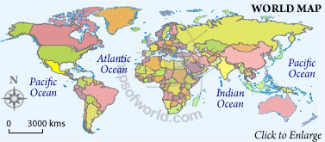
Graph Coloring
1
Graph coloring is an NP complete problem
It involves finding a “good” coloration for a system of n nodes connected by e edges
No two nodes connected by an edge can have the same color
2
3

Slide 14
Perkowski’s Method
Since there are three nodes, each can take on up to three colors
Each node is represented with ||log2(3)|| = 2 qubits so that the total number of possible collective states per node is more than three.
Node 1
Node 2
Node 3
≠
≠
≠
For example, the states|00> and |01> represent different colors.
I have to make sure no two nodes that are connected are assigned the same color using bit-by-bit inequality gates.

Slide 15
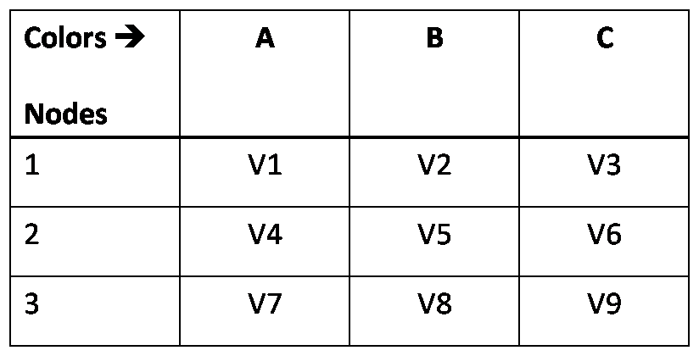
Hogg’s Method
In this method, each assignment of a color to a node is represented by a qubit, v1-v9.
No two elements of a row can coexist, because only one color can be assigned to a node. I use NAND gates to ensure this
If, for example, nodes one and two are connected, we must do: v1 NAND v4, v2 NAND v5, and v3 NAND v6.
One color / node
V1
V2
V3
V4
V5
V6
V7
V8
V9
Good Coloring
V1
V4
V7
V2
V5
V8
V3
V6
Notes:
Spend more time explaining this

Slide 16
Reversible Logic and Quantum Cost
An alternative classical logic implementation is called AND – EXOR logic.
It is reversible because you can determine inputs from the outputs.
This kind of logic is easier to simulate with most quantum technologies.
Notes:
QUICK

Slide 17
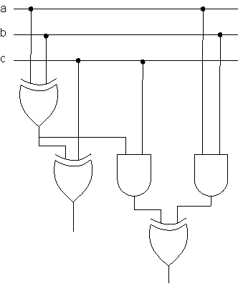
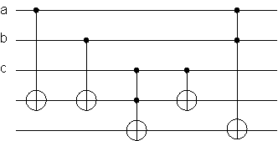
Reversible and Non Reversible Circuits
ab
Notes:
Insert pic of a reversible and non reversible circuit.

Slide 18
Quantum Cost
Gates | Cost in Basic Gates
Quantum NOT | 1
Hadamard Gate | 1
CNOT Gate | 1
3 input Toffoli Gate | 5
N input Toffoli Gate | Best Case: 32n-96 Worst Case: (2^{n+1}) -3
Notes:
Update.

Slide 19
N-Bit Toffoli Cost
I have used two estimates to calculate the cost of a toffoli gate.
  32m – 96, plus one garbage bit, for m > 5
  2⁽^{m+1}⁾ – 3 , where m is the number of controlling bits
The difference between these costs should be underscored.
For example, one technique for building the SEND MORE MONEY oracle costs about 100,000 basic gates with the best case method and over a googol with the worst case method.
Notes:
Used two estimates to calculate n-bit toffoli cost
Less text; use a table.

Slide 20
Goal
  In this paper, the costs of these two data-encoding methods for building Grover Oracles are compared by testing both for four problems:
    Satisfiability (SAT),
    Maximum Clique,
    SEND MORE MONEY
    Graph Coloring
Notes:
Change “question”, “hypothesis” layout. Shorten

Slide 21
Cost Derivation for Graph Coloring

Slide 22
Graph Coloring
1
Graph coloring is an NP complete problem
It involves finding a “good” coloration for a system of n nodes connected by e edges
No two nodes connected by an edge can have the same color
2
3

Slide 23
Cost Derivation for Graph Coloring
Node 1
1
Node 2
Node 3
≠
≠
≠
2
3
One color / node
V1
V2
V3
V4
V5
V6
V7
Step 1: An oracle is created for a specific case of each problem.
V8
V9
Good Coloring
V1
V4
V7
V2
V5
V8
V3
V6

Slide 25
Cost Derivation for Graph Coloring
…
1
n
AND with n²(n-1)/2+en inputs
2
3
n²(n-1)/2 NAND gates
4
5
6
One color / node
V1
V2
V3
V4
V5
V6
V7
V8
V9
Step 2: How many gates are needed in a generic case with n nodes and e edges?
Good Coloring
V1
V4
e*n NAND gates
V7
V2
V5
V8
V3
V6

Slide 26

Cost Derivation for Graph Coloring
STEP 2:
e*n + n²(n-1)/2 NANDs = 5(en+n²(n-1)/2) pulses
STEP 3:
m – input NAND = 32m – 96 pulses (best case)
STEP 4:
Final NAND = 32(en+n²(n-1)/2)-96 basic gates
STEP 1:
2-input NAND = Toffoli = 5 basic gates
Total Cost:
(2*STEP 2+ STEP 4)=
42(en+n²(n-1)/2) – 96
Basic gates
Step 3: Convert gates to cost with cost formulas

Slide 27
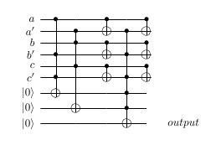
The Mirror Circuit
At the end of the oracle, the qubits in the “Work space” must be returned to their original states for the next oracle operation.
Because this is reversible logic, we can simply use the reverse of the gates originally applied – this is called a mirror circuit, and it must be factored into cost estimates
The Oracle
The Mirror circuit
Notes:
Insert picture of Oracle with Mirror

Slide 28
Cost Derivation – Perkowski’s Method
…
1
n
AND with e inputs
e Inequality gates
2
3
4
5
6
Node 1
Node 2
Node 3
≠
≠
≠
Step 2: How many gates are needed in a generic case with n nodes and e edges?

Slide 29
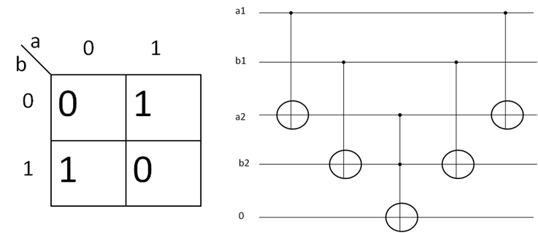
The Inequality Gate
The Feynman gate outputs “1” when both inputs are not equal
Thus, we create Feynman gates between corresponding qubits of different nodes
All the results are ORed with a final Toffoli gate – the output will be one if ANY inputs are one
Thus, because there are 2q+1 NOT gates, 2q Feynman gates, and a q-input Toffoli gate, the cost is (2q+1)+(2q)+(32q-96) = 36q-95
a1
a2
b1
b2
output

Slide 30
Cost Derivation – Perkowski’s Method
STEP 3:
e – input NAND = 32e – 96 pulses (best case)
STEP 2:
e Inequality Gates = e(36q-95)
STEP 1:
Inequality Gate = 36q-95 basic gates
Total Cost:
(2*STEP 2+ STEP 3)=
2e(36q-79)-96
Basic gates
Step 3: Convert gates to cost with cost formulas

Slide 31

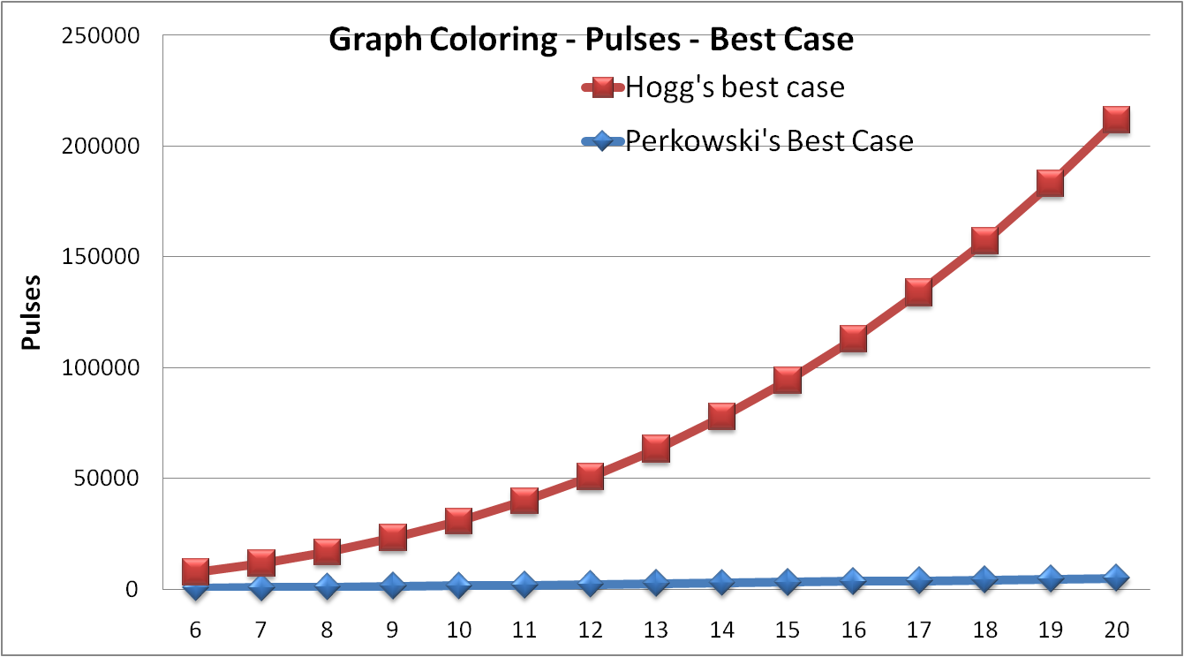
Cost Derivation for Graph Coloring
42
Step 4: Once I figured out my formulas for all problems, I graphed them and compared the results to see which method works better.
Notes:
Send these slides to dr. Perkowski.

Slide 32
Send more money

Slide 33
SEND MORE MONEY
The goal of this problem is to find a correct integer assignment to each of the letters so that the equation above is satisfied
We can tackle this problem better by reducing it to smaller equations, as shown
S E N D
+
M O R E
M O N E Y
D + E = 10*C1 + Y
C1 + N + R = 10*C2 + E
C2 + E + O = 10*C3 + N
C3 + S + M =10*M + O

Slide 34
SEND MORE MONEY - Perkowski
Perkowski’s method:
The oracle on the right uses Perkowski’s method to solve the problem
Each letter is represented by four qubits and can take on ten values.
This emulates the formulas with gates
  for example, the conditions D + E and 10*c1+Y are plugged into the bottom equality gate
Best case cost:
  5,186 basic gates and 126 Qubits
Notes:
Illustrate this circuit more. Show smaller parts of this

Slide 36
Inequality Gates
Every combination of two letters must be inputs to an inequality gate
Thus, we need n(n-1)/2 inequality gates.
Recall that the cost of an inequality gate is 4n+1 in Feynmans and inverters, plus (in this case) a four-controlled toffoli gate (29). Thus, our gate costs 46 basic gates.
Since n=8 (letters) and q=4, the total cost of this step is 8(7)/2 * (46) = 1288 basic gates.
Notes:
Note: the calculated cost of an inequality gate is wrong in the paper.

Slide 37
<10 Block
Each letter should have a value of less than ten
A simple “<10” block could be created by the operation (a1*(a2+a3))’,
  Since 10 is 1010 in binary, both the most significant bit and either the second or third must be one if a number is greater than ten.
This circuit will consist of a toffoli gate, an OR gate (which is a Toffoli gate plus four inverters), and a final inverter. It will cost 16 basic gates
Seven of these are required, one per letter. Thus the cost of this step is 112 basic gates.

Slide 39
D + E = 10*C1 + Y
C1 + N + R = 10*C2 + E
C2 + E + O = 10*C3 + N
C3 + S + M =10*M + O
There are two types of equations that must be described with adder circuits.
For example, there is c1+ N+ R, which requires full adders.
Also, there is 10*c1 + Y, which must be described using half-adders

Slide 40
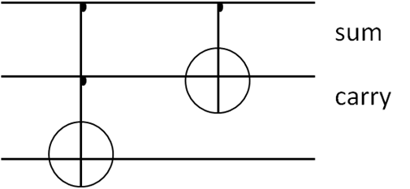
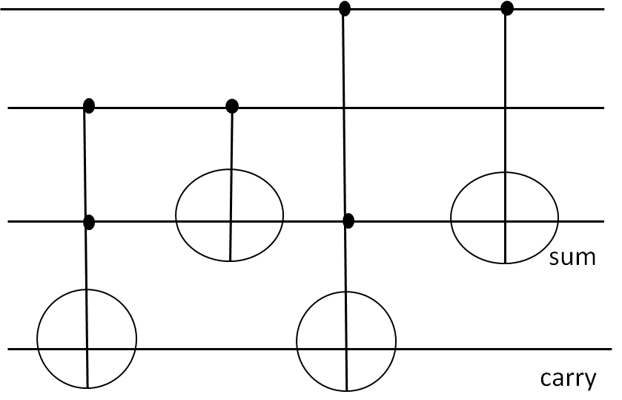
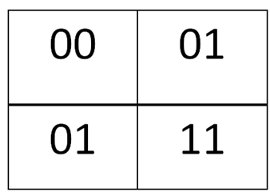
Adder Gates
a
A half adder circuit is shown on the right
  This circuit adds two inputs
  As shown in the truth tables below, sum is represented by EXOR, while carry is represented by AND.
The cost of this gate is 6 basic gates.
A full adder gate is shown on the bottom right:
  In a full adder gate, the sum is represented by: a EXOR b EXOR c.
  The carry is represented by ab EXOR ac EXOR bc.
The cost is 12 basic gates.
b
sum
carry
a
b
sum
c
carry
a\b
0
1
a\bc
00
01
11
10
0
00 | 01 | 10 | 01
01 | 10 | 11 | 10
0
1
1

Slide 41
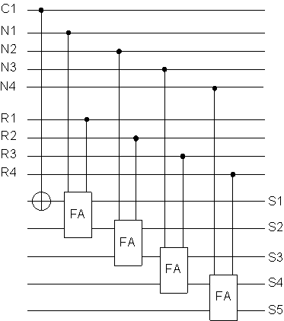
Adder Tree
C1+N+R:
A full adder tree can be used to add two letters, as shown
The “carry” from the first full adder is carried into the second
The cost of one of these trees is four full adder gates, plus one feynman gate to bring the “carry” gate down to one ancilla bit. Thus, it costs 4(12) +1 = 49 basic gates.
Notes:
Add “Full Adder” pic from vizio

Slide 42
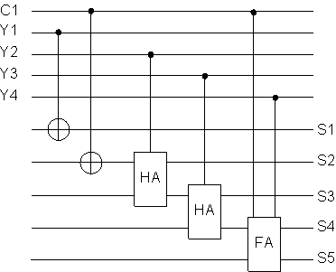
Adders for 10*c1 + Y
In binary, 10 = 1010.
Since all the carries are one qubit, 10*c1 = c1, 0, c1, 0.
Thus, S1 will equal Y1
C1+Y2 will be a half-adder, because only two qubits are being added
C1 only needs to be added to Y2 and Y4, thus, the only Full adder will come at the end, because this is the only time three qubits are being added.
Thus, the cost is 2 feynmans, two half-adders, and a full adder = 26 basic gates
Notes:
Insert pic of the adder circuit

Slide 43
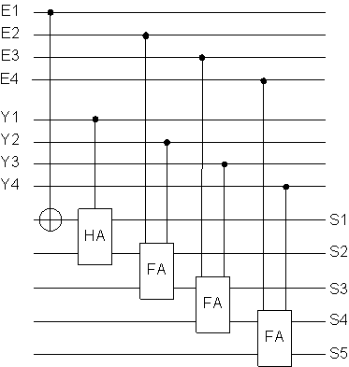
Special Case: E+D
In this case, only the first adder is a half adder, and the rest are full adders, because there is no carry bit.
Thus, the cost is 43 basic gates
Notes:
Insert picture of this adder.

Slide 44
Total Cost of adders
There are three equations of type: c1+N+R
There are four equations of type: 10*c1+Y
There is one equation of type: E+D
Thus, total cost of all adders is:
  3(49) + 4(26) + (43) = 294 basic gates.
Notes:
Remember, M must have first three bits equal 0.

Slide 46
Equality Gates
This circuit will have four equality gates. They will each operate on two five-qubit inputs (the outputs of the adder gates)
An equality gate costs 4n, plus a (in this case) five-controlled Toffoli gate, which costs 52 qubits, best case
Thus, the total cost will be 72 per circuit, and 288 basic gates for all four circuits.

Slide 48
The Letter M
The letter M is represented by four qubits, so that we can use it in inequality gates. However, it can only be zero or one, because it is a carry.
Thus, we need a three-input NOR gate to make sure that three of its qubits all equal zero.
This will cost 6 inverters and a 3-controlled Toffoli (13), or 19 basic gates total.

Slide 49
Final Toffoli Gate
There are 8(8-1)/2 = 28 outputs from the first inequality section
There are 4 outputs from the equations, and 1 output from the letter M.
There are 7 outputs from the “<10” block.
Thus, there are 40 inputs, so the cost is 32(40)-96 = 1184 basic gates.
Notes:
992, 19,

Slide 50
Total cost: 2(1288 + 112+ 294 + 288 + 19)+1184 = 5186 basic gates

Slide 51
Hogg’s Method
Since
each one of 8 letters can take 9 values (1 to 9), and
each one of 3 carry’s can take 2 values(0,1),
this oracle requires 78 variables
Notes:
The best case cost is 93138 basic gates and 949 Qubits

Slide 52
SEND MORE MONEY – Hogg’s Method
D + E = 10*C1 + Y
C1 + N + R = 10*C2 + E
C2 + E + O = 10*C3 + N
C3 + S + M =10*M + O
Hogg’s oracle will require us to figure out all possible assignments to the four formulas
  For example, the assignments 1,2,0,3 and 1,3,0,4 for the variables D, E, c1, and Y, (respectively) satisfy the first equation
  We then use AND and OR gates to make sure that at least one of these assignments are satisfied
  There are about 160 such equations; each of these will require a five or six input Toffoli gate, and then a massive OR gate at the end.
  The total cost of all these gates is 35213 basic gates, and four output qubits.
Notes:
Show smaller parts of this circuit

Slide 53
SEND MORE MONEY – Hogg’s Method
No two letters can be assigned the same value
This will require n(n-1)/2 NAND gates, times the number of values(10) = 10(8)(7)/2 = 280 NAND gates
The total cost of this step is thus 1400 basic gates
280 output qubits are involved
Notes:
No two values can be assigned to one letter

Slide 54
SEND MORE MONEY – Hogg’s Method
Next, no two values can be assigned to the same letter
This will require n(n-1)/2 NAND gates, where n = 10, and this will need to be repeated 8 times, for a total of 360 NAND gates
Thus, the total cost is 1800 basic gates
360 output qubits are involved

Slide 55
SEND MORE MONEY – Hogg’s Method
For the final Toffoli gate, there are 4+360+280 = 644 controlling qubits
Thus, the best case cost is 32(644)-96 = 20512 basic gates
  The worst case cost is 2⁶⁴⁵ - 3, which is over a googol.
The overall cost amounts to 2(1800+1400+35213) + 20512 = 97216 basic gates, best case, including mirror circuits.

Slide 56
SATISFIABILITY

Slide 57
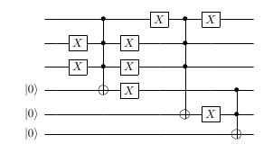
Satisfiability
(a’+b+c)(a+b’+c’)
The Problem: Find a Boolean (1 or 0) assignment of variables that gives an output of one in a formula such as the one shown on the top right.
Perkowski’s method:
This formula is emulated by gates. In other words, I simply do: {(a NOT) OR b OR c} AND {a OR (b NOT) OR (c NOT)} with quantum gates. NOT gates are represented by X’s in the figure.
Hogg’s method
This is exactly the same, except that no NOT gates are needed; instead, inputs are taken from different qubits. However, we also need inequality (CNOT) gates to make sure no two representative qubits have the same value.
For a large number of AND-ed terms and NOT-ed terms, and few variables, it is possible that Hogg’s method could be more efficient than Perkowski’s method because Perkowski’s method requires more NOT gates.
a
b
c
Perkowski’s method
Hogg’s Method – costs more qubits
Notes:
Split up this slide.

Slide 58
MAXIMUM CLIQUE

Slide 59
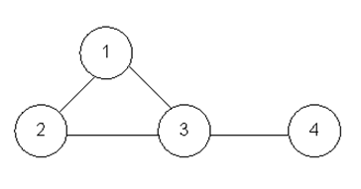
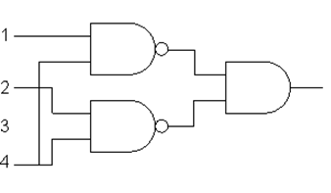
Maximum Clique
The Problem: Find the largest number of interconnected nodes in a graph
Perkowski’s Method:
I created the oracle for the 4 node graph as shown on the right.
I created this oracle by representing each node with a 1 if it was “activated”, i.e. part of the proposed clique, and with a 0 if it wasn’t.
I then NAND-ed all nodes that were not connected, because the maximum clique must have all nodes interconnected, so no two non – connected nodes can be part of the clique
Perkowski’s method
Notes:
Show the max cliques in the graph and how they are processed.
Can use animations to illustrate the cliques, etc.
Draw the “complement” of this graph and explain the functionality of the circuit in more detail

Slide 60
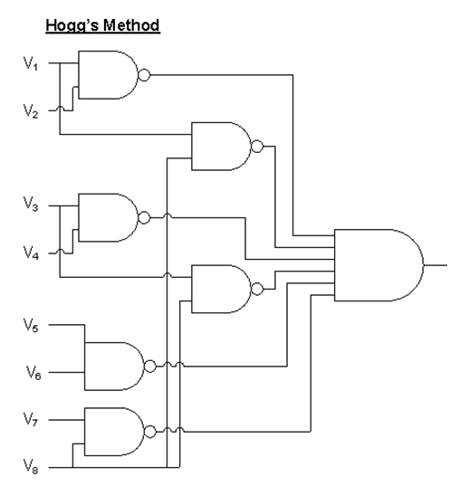
Maximum Clique – Hogg’s method
The oracle I created using Hogg’s method for this problem is very similar to the previous oracle. It creates two qubits per node: one representing the deactivated node, and the other representing an activated node
First, I create similar gates to Perkowski’s method to check that the given assignment actually is a clique
In addition, I have to create NAND gates between each node’s representative qubits to make sure that no qubit is simultaneously activated and deactivated.

Slide 61




Results – Costs of Oracles
Problems and Methods |  | Cost in Basic Gates | Cost in Qubits
Graph Coloring | Hogg’s | Best: Worst:
 | Perkowski’s | Best: Worst:
Maximum Clique | Hogg’s | Perkowski’s method + 42n | Perkowski’s + 2n
 | Perkowski’s | Best: Worst:
Satisfiability | Hogg’s | Best: Worst: 4v+2m*(2^{n+1}-3)+32(m+v)-96 4v+2m(2n+1-3)+2m+v+1-3 | v+m+2
 | Perkowski’s | Best: Worst: 2m*(2^{n+1}-3)+2t+32m-96 2m*(2n+1-3)+2t+2m+1-3 | 3v+m+2
SEND MORE MONEY | Hogg’s | Best: 93,138 Worst: 10¹⁶⁵ | 949
 | Perkowski’s | Best: 3952 Worst: 2.2*10¹² | 126

Slide 62
Results: Max Clique and Graph Coloring
Max Clique
 |  | N | 6 | 7 | 8 | 9 | 10 | 11 | 12 | 13 | 14 | 15 | 16 | 17 | 18 | 19 | 20
Hogg's best case |  | Pulses | 282 | 492 | 744 | 1038 | 1374 | 1752 | 2172 | 2634 | 3138 | 3684 | 4272 | 4902 | 5574 | 6288 | 7044
e=2n |  | Qubits | 23 | 30 | 38 | 47 | 57 | 68 | 80 | 93 | 107 | 122 | 138 | 155 | 173 | 192 | 212
Hogg's Worst case |  | Pulses | 1.E+03 | 3.E+04 | 2.E+06 | 3.E+08 | 7.E+10 | 4.E+13 | 4.E+16 | 7.E+19 | 3.E+23 | 2.E+27 | 4.E+31 | 1.E+36 | 9.E+40 | 1.E+46 | 3.E+51
Perkowski's Best Case |  | N | 6 | 7 | 8 | 9 | 10 | 11 | 12 | 13 | 14 | 15 | 16 | 17 | 18 | 19 | 20
e=2n |  | Pulses | 30 | 198 | 408 | 660 | 954 | 1290 | 1668 | 2088 | 2550 | 3054 | 3600 | 4188 | 4818 | 5490 | 6204
 |  | Qubits | 11 | 16 | 22 | 29 | 37 | 46 | 56 | 67 | 79 | 92 | 106 | 121 | 137 | 154 | 172
Perkowski's Worst Case |  | Pulses | 4.E+01 | 3.E+02 | 8.E+03 | 5.E+05 | 7.E+07 | 2.E+10 | 9.E+12 | 9.E+15 | 2.E+19 | 8.E+22 | 6.E+26 | 1.E+31 | 3.E+35 | 2.E+40 | 3.E+45
Graph Coloring
 |  | N | 6 | 7 | 8 | 9 | 10 | 11 | 12 | 13 | 14 | 15 | 16 | 17 | 18 | 19 | 20
Hogg's best case |  | Pulses | 6708 | 10194 | 14688 | 20316 | 27204 | 35478 | 45264 | 56688 | 69876 | 84954 | 102048 | 121284 | 142788 | 166686 | 193104
e=2n |  | Qubits | 200 | 296 | 418 | 569 | 752 | 970 | 1226 | 1523 | 1864 | 2252 | 2690 | 3181 | 3728 | 4334 | 5002
Hogg's Worst case (e=2n) |  | Pulses | 1.E+49 | 1.E+74 | 2.E+106 | 4.E+146 | 9.E+195 | 2.E+255 | Excel can not calculate any more
Hogg with e = 3n |  | Pulses | 8220 | 12252 | 17376 | 23718 | 31404 | 40560 | 51312 | 63786 | 78108 | 94404 | 112800 | 133422 | 156396 | 181848 | 209904
Complete Hogg |  | Pulses | 7464 | 12252 | 18720 | 27120 | 37704 | 50724 | 66432 | 85080 | 106920 | 132204 | 161184 | 194112 | 231240 | 272820 | 319104
Perkowski's Best Case |  | Pulses | 625 | 970 | 1344 | 1744 | 2168 | 2612 | 3075 | 3555 | 4052 | 4563 | 5088 | 5626 | 6176 | 6738 | 7311
e=2n |  | Qubits | 42 | 50 | 58 | 67 | 75 | 84 | 93 | 102 | 111 | 121 | 130 | 139 | 149 | 159 | 168
Perkowski's Worst Case |  | Pulses | 9.E+21 | 6.E+29 | 7.E+38 | 1.E+49 | 3.E+60 | 1.E+73 | 1.E+87 | 1.E+102 | 2.E+118 | 6.E+135 | 3.E+154 | 2.E+174 | 2.E+195 | 4.E+217 | 1.E+241
Perkowski with e = 3n |  | Pulses | 986 | 1503 | 2064 | 2664 | 3299 | 3966 | 4660 | 5381 | 6125 | 6892 | 7680 | 8487 | 9313 | 10155 | 11015
Complete Perkowski |  | Pulses | 355 | 703 | 1164 | 1744 | 2451 | 3289 | 4264 | 5381 | 6644 | 8057 | 9624 | 11348 | 13233 | 15281 | 17496

Slide 63
Results - SAT
t = mn/2
Perkowski's Method
n\m | 5 | 6 | 7 | 8 | 9 | 10 | 11 | 12 | 13 | 14 | 15 | 16 | 17 | 18 | 19 | 20
2 | 124 | 168 | 212 | 256 | 300 | 344 | 388 | 432 | 476 | 520 | 564 | 608 | 652 | 696 | 740 | 784
3 | 209 | 270 | 331 | 392 | 453 | 514 | 575 | 636 | 697 | 758 | 819 | 880 | 941 | 1002 | 1063 | 1124
4 | 374 | 468 | 562 | 656 | 750 | 844 | 938 | 1032 | 1126 | 1220 | 1314 | 1408 | 1502 | 1596 | 1690 | 1784
5 | 699 | 858 | 1017 | 1176 | 1335 | 1494 | 1653 | 1812 | 1971 | 2130 | 2289 | 2448 | 2607 | 2766 | 2925 | 3084
Hogg's Method (v = n)
2 | 186 | 228 | 270 | 312 | 354 | 396 | 438 | 480 | 522 | 564 | 606 | 648 | 690 | 732 | 774 | 816
3 | 302 | 360 | 418 | 476 | 534 | 592 | 650 | 708 | 766 | 824 | 882 | 940 | 998 | 1056 | 1114 | 1172
4 | 498 | 588 | 678 | 768 | 858 | 948 | 1038 | 1128 | 1218 | 1308 | 1398 | 1488 | 1578 | 1668 | 1758 | 1848
5 | 854 | 1008 | 1162 | 1316 | 1470 | 1624 | 1778 | 1932 | 2086 | 2240 | 2394 | 2548 | 2702 | 2856 | 3010 | 3164
t = mn/3
Perkowski's Method
n\m
2 | 120.6667 | 164 | 207.3333 | 250.6667 | 294 | 337.3333 | 380.6667 | 424 | 467.3333 | 510.6667 | 554 | 597.3333 | 640.6667 | 684 | 727.3333 | 770.6667
3 | 204 | 264 | 324 | 384 | 444 | 504 | 564 | 624 | 684 | 744 | 804 | 864 | 924 | 984 | 1044 | 1104
4 | 367.3333 | 460 | 552.6667 | 645.3333 | 738 | 830.6667 | 923.3333 | 1016 | 1108.667 | 1201.333 | 1294 | 1386.667 | 1479.333 | 1572 | 1664.667 | 1757.333
5 | 690.6667 | 848 | 1005.333 | 1162.667 | 1320 | 1477.333 | 1634.667 | 1792 | 1949.333 | 2106.667 | 2264 | 2421.333 | 2578.667 | 2736 | 2893.333 | 3050.667
Hogg's Method(v = n)
2 | 186 | 228 | 270 | 312 | 354 | 396 | 438 | 480 | 522 | 564 | 606 | 648 | 690 | 732 | 774 | 816
3 | 302 | 360 | 418 | 476 | 534 | 592 | 650 | 708 | 766 | 824 | 882 | 940 | 998 | 1056 | 1114 | 1172
4 | 498 | 588 | 678 | 768 | 858 | 948 | 1038 | 1128 | 1218 | 1308 | 1398 | 1488 | 1578 | 1668 | 1758 | 1848
5 | 854 | 1008 | 1162 | 1316 | 1470 | 1624 | 1778 | 1932 | 2086 | 2240 | 2394 | 2548 | 2702 | 2856 | 3010 | 3164
t = 2mn/3
Perkowski's Method
n\m
2 | 127.3333 | 172 | 216.6667 | 261.3333 | 306 | 350.6667 | 395.3333 | 440 | 484.6667 | 529.3333 | 574 | 618.6667 | 663.3333 | 708 | 752.6667 | 797.3333
3 | 214 | 276 | 338 | 400 | 462 | 524 | 586 | 648 | 710 | 772 | 834 | 896 | 958 | 1020 | 1082 | 1144
4 | 380.6667 | 476 | 571.3333 | 666.6667 | 762 | 857.3333 | 952.6667 | 1048 | 1143.333 | 1238.667 | 1334 | 1429.333 | 1524.667 | 1620 | 1715.333 | 1810.667
5 | 707.3333 | 868 | 1028.667 | 1189.333 | 1350 | 1510.667 | 1671.333 | 1832 | 1992.667 | 2153.333 | 2314 | 2474.667 | 2635.333 | 2796 | 2956.667 | 3117.333
Hogg's Method
n\m
2 | 186 | 228 | 270 | 312 | 354 | 396 | 438 | 480 | 522 | 564 | 606 | 648 | 690 | 732 | 774 | 816
3 | 302 | 360 | 418 | 476 | 534 | 592 | 650 | 708 | 766 | 824 | 882 | 940 | 998 | 1056 | 1114 | 1172
4 | 498 | 588 | 678 | 768 | 858 | 948 | 1038 | 1128 | 1218 | 1308 | 1398 | 1488 | 1578 | 1668 | 1758 | 1848
5 | 854 | 1008 | 1162 | 1316 | 1470 | 1624 | 1778 | 1932 | 2086 | 2240 | 2394 | 2548 | 2702 | 2856 | 3010 | 3164

Slide 64
Results – SAT Contd..
Worst Case: 3-SAT
Hogg
 | 651 | 1189 | 2239 | 4313 | 8435 | 16653 | 33063 | 65857 | 131419 | 262517 | 524687 | 1049001 | 2097603 | 4194781 | 8389111 | 16777745
Pk: (t=mn/3)
 | 201 | 293 | 449 | 733 | 1273 | 2325 | 4401 | 8525 | 16745 | 33157 | 65953 | 131517 | 262617 | 524789 | 1049105 | 2097709
Pk: (t=mn/2)
 | 206 | 299 | 456 | 741 | 1282 | 2335 | 4412 | 8537 | 16758 | 33171 | 65968 | 131533 | 262634 | 524807 | 1049124 | 2097729
Pk: (t=2mn/3)
 | 211 | 305 | 463 | 749 | 1291 | 2345 | 4423 | 8549 | 16771 | 33185 | 65983 | 131549 | 262651 | 524825 | 1049143 | 2097749
Qubits: 3-SAT
Hogg
 | 13 | 14 | 15 | 16 | 17 | 18 | 19 | 20 | 21 | 22 | 23 | 24 | 25 | 26 | 27 | 28
Perkowski
 | 10 | 11 | 12 | 13 | 14 | 15 | 16 | 17 | 18 | 19 | 20 | 21 | 22 | 23 | 24 | 25

Slide 65
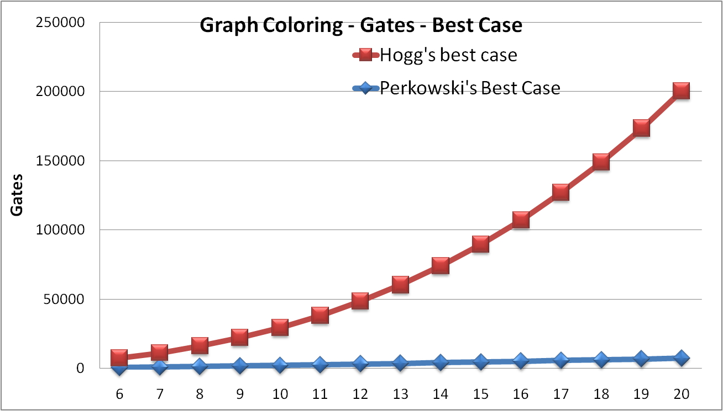
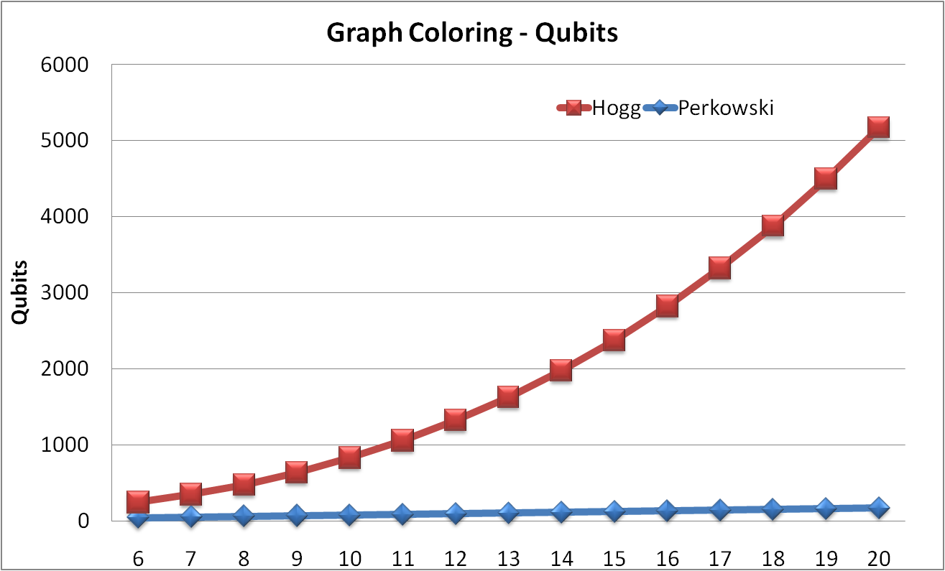
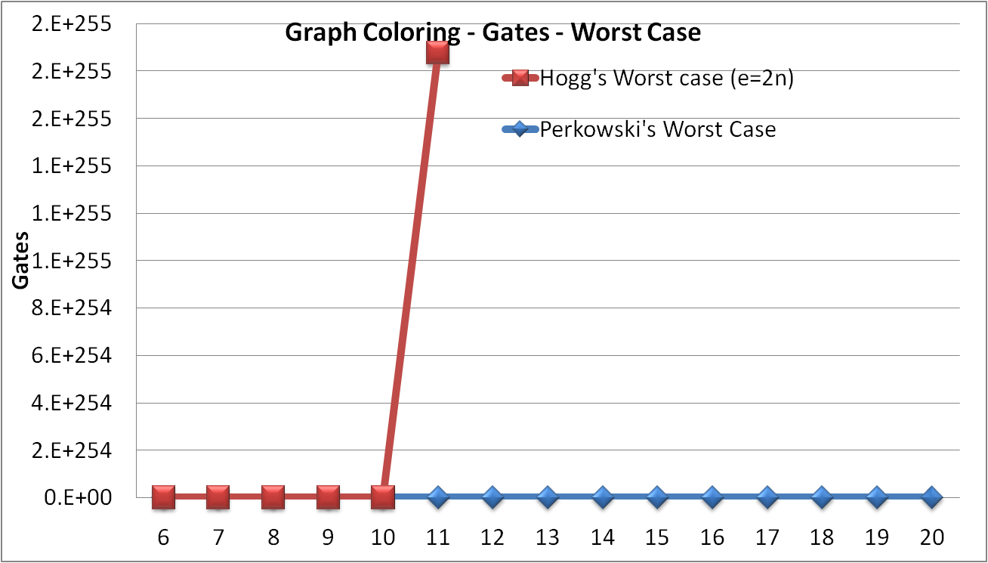
Results: Graph Coloring
Notes:
Discuss the results here.

Slide 66
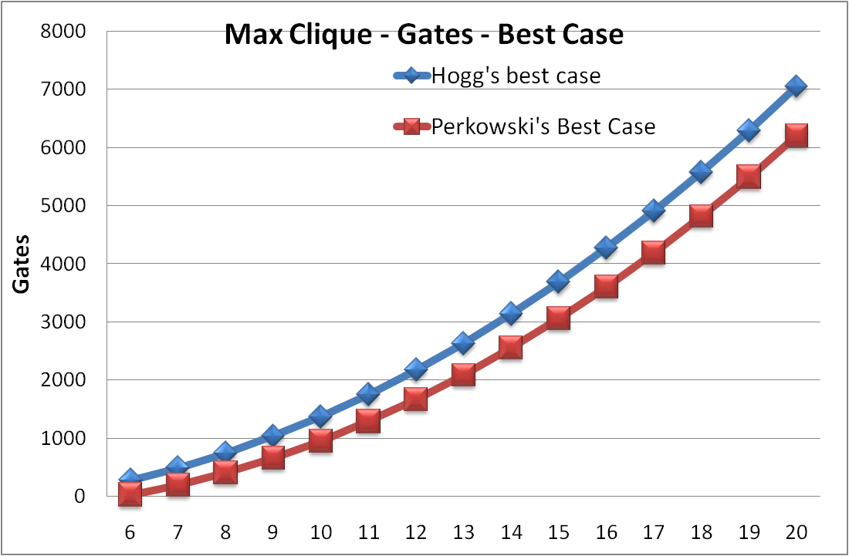
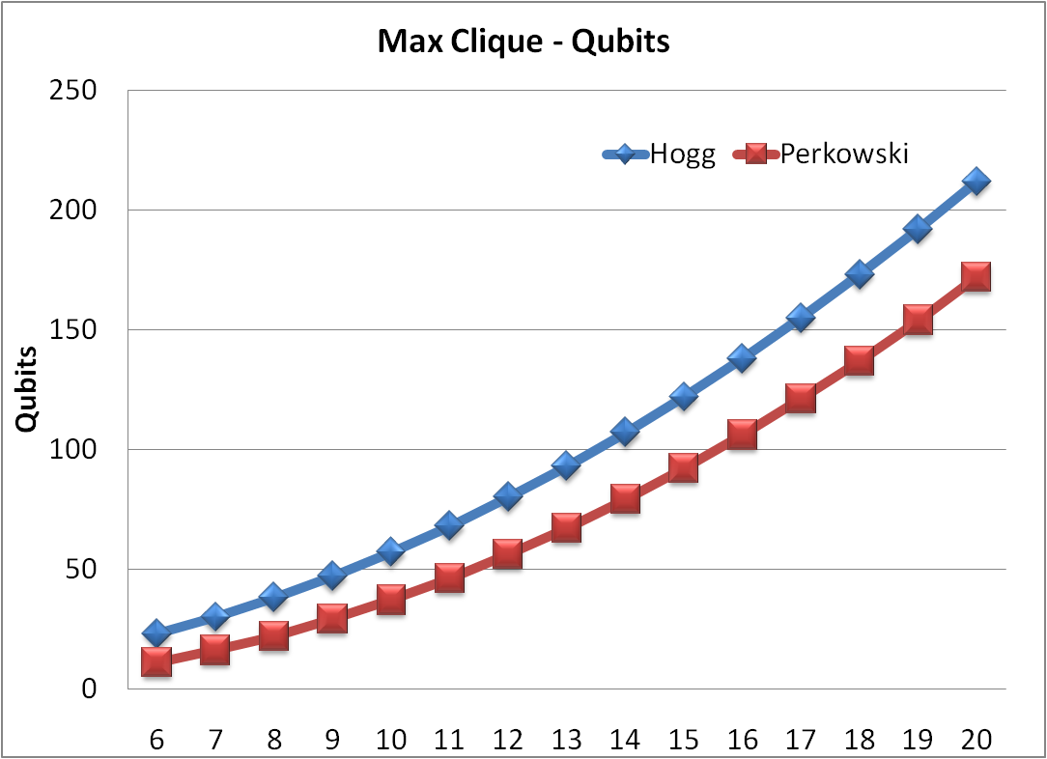
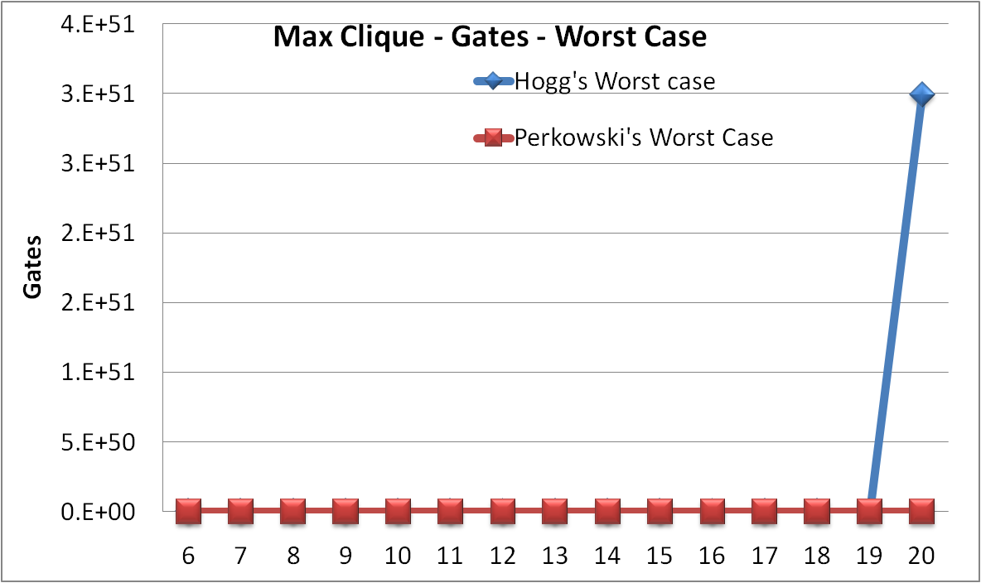
Results: Max Clique

Slide 67
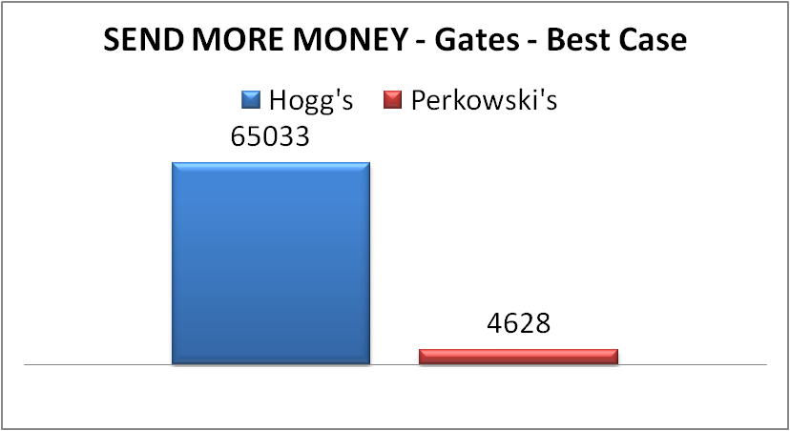
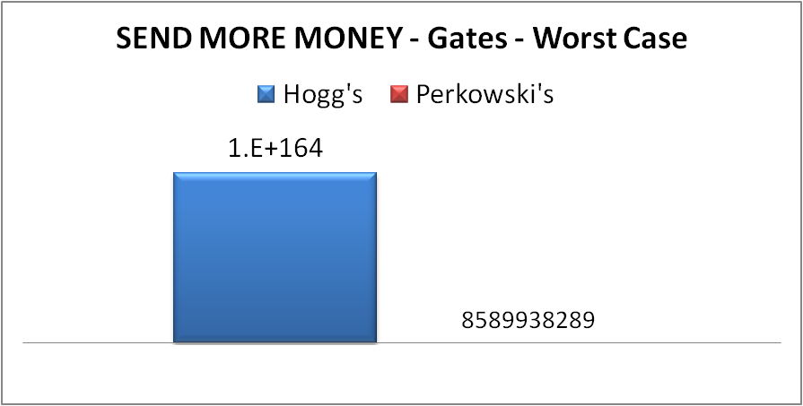
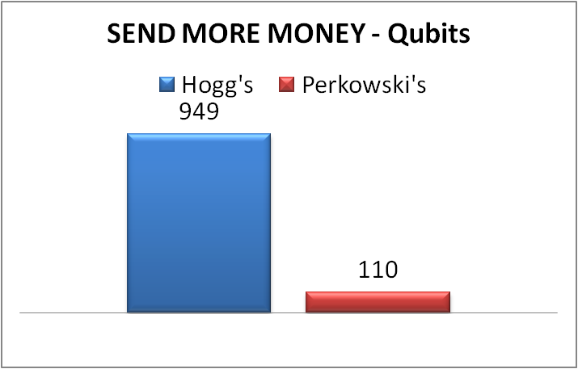
RESULTS: SEND MORE MONEY
SEND MORE MONEY
Hogg's |  | Best Case |  |  | Worst Case
 |  | Gates | 65033 |  | 1.E+164
 |  | Qbits | 949
 | Perkowski's | Best Case |  |  | Worst Case
 |  | Gates | 4628 |  | 2.2E12
 |  | Qbits | 110
Notes:
Change the Graphs!

Slide 68
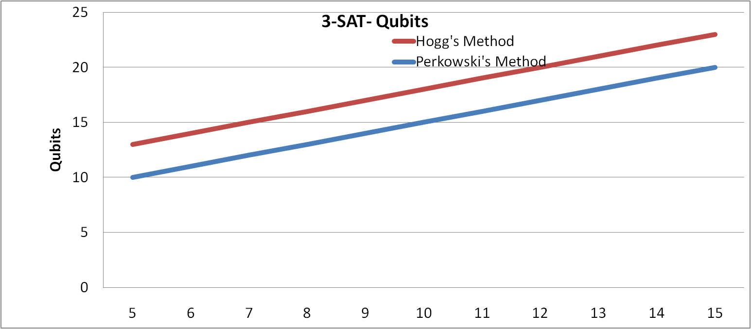
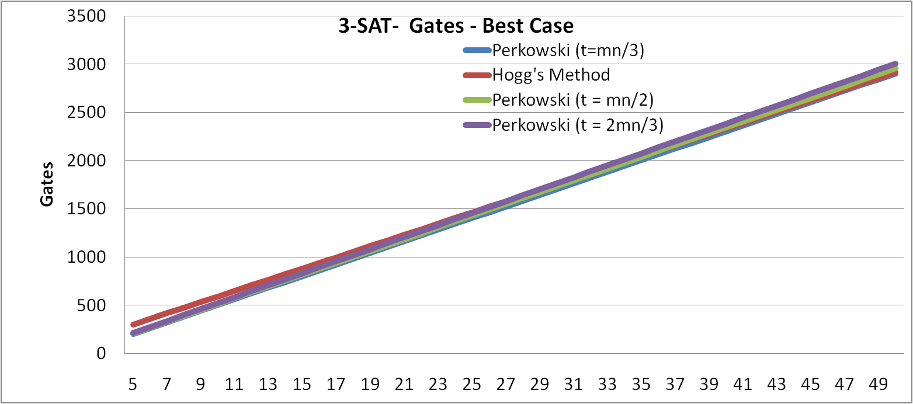
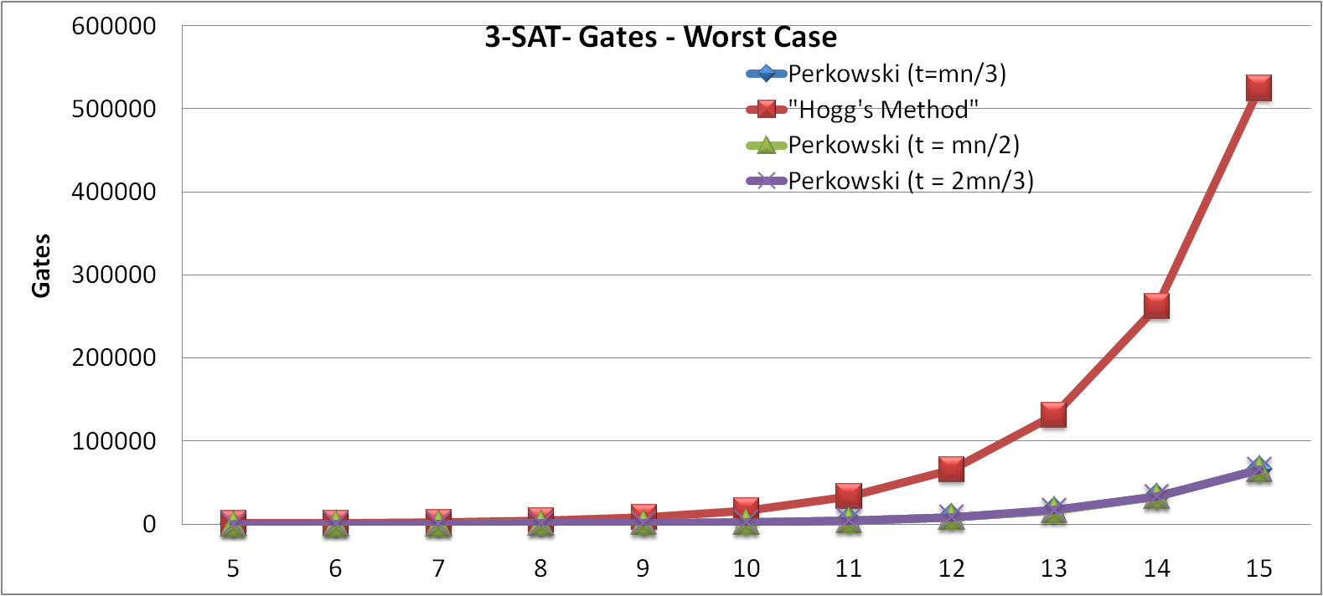
Results: SAT

Slide 69
Conclusion
I found that Perkowski’s method was much better than Hogg’s method when each variable can take on a large range of values
However, in cases where each variable could only take on a few values, like in Max Clique and SAT, they were closer together
In special cases of SAT, Hogg’s method was more efficient (in best case pulses only) than Perkowski’s method because Perkowski’s method requires more NOT gates
Notes:
Decrease the font size and create larger spaces; animations

Slide 70
Resources & Works Cited
  Cerf, N. J., Grover, L. K., & Williams, C. P. (1999, December 1). Nested Quantum Search and NP Hard Problems. Applicable Algebra in Engineering, Communication, and Computing, 10, 311-388
  Perry, R. T. (April 29,2006). Temple of Quantum Computing
  Hogg, T. (1996, March). Quantum Computing and Phase Transitions in Combinatorial Search. Journal of Artificial Intelligence, 4, 91-128
  Maslov, D., & Dueck, W. R. (2004, March 5). Improved Quantum Cost for n-Bit Toffoli Gates
  Lee, S., Lee, J., & Kim, T. (2003, July 7). Cost of Basic Gates in Quantum Computation. Department of Physics, Korea Advanced Institute of Science and Technology,
  Perkowski, M. A. (2009) Quantum Robotics
  Nielsen, M. A., & Chuang, I. L. (2000). Quantum Computing and Quantum Information. Cambridge, UK: Cambridge University Press
  Grover, L. K. (1997). A Fast Quantum Mechanical Algorithm for Database Search. 28th Annual Symposium on the Theory of Computing, 212 – 219
Notes:
Remove this whole slide.

Slide 71
Future Work
Perform simulations of Grover Algorithm to test whether or not my mathematical formulas are correct
Invent a new, and even more efficient oracle building method
Further investigate of Nested Quantum Search (recursive application of Grover Algorithm)
Investigate how the Shor Algorithm or the Bernstein – Vazirani Algorithm can be used for other problems
Notes:
Remove. (?) keep backup slides for anticipated questions; like more for Grover and future works.

Slide 72
Backup
PRINT ONLY FIRST 25 SLIDES, NOT THE BACKUP

Slide 73
Max Clique - Perkowski
Ensure that disconnected nodes are not activated
  This will require a NAND (toffoli) gate, because no two unconnected nodes can both be one.
  The total number of toffoli gates needed is the number of possible connections minus the number of actual connections.
  The total possible connections is n(n-1)/2. We denote the total number of actual connections with e. Thus we need a total of n(n-1)/2-e toffoli gates, i.e., 13(n(n-1)/2-e)pulses, and n(n-1)/2-e ancilla qubits.
Perform a global AND of the results
  Since we need to verify n(n-1)/2 –e outputs of toffoli gates, we will need an (n(n-1)/2-e)- bit toffoli gate at the end. This will cost 32(n(n-1)/2-e)-96 pulses and two qubits.
  In the worst case, it will cost pulses and 1 qubit.
Notes:
Explain earlier in pictures. Keep these in backup slides.

Slide 74
Max Clique - Hogg
Hogg’s method is almost exactly like Perkowski’s method, except that it creates two qubits per node- one of these represents the activated node, and the other represents the inactivated node.
If the “inactivated node” qubit of a certain node is zero, the node is activated. If it is one, the node is inactivated. The “activated node” qubit for a certain node is analogous to Perkowski’s qubits: it is one if the node is activated and zero if the node isn’t.
Thus, we can simply duplicate Perkowski’s method for this oracle using the “activated node” qubits instead of Perkowski’s qubits.
There is only one important difference, and that is that Hogg’s method needs to make sure a qubit isn’t both activated and inactivated.
This will cost n more NAND gates and n extra inputs into the final toffoli gate, or 13n+32n= 45n more pulses, and 2n extra qubits (n for each additional NAND gate and n for each additional starting qubit). Thus, for this problem, Hogg’s method is virtually obsolete

Slide 75
Satisfiability - Perkowski
For Perkowski’s method the oracle would be very simple: for each term of the equation you would have an OR gate for the n variables, and then a global AND for all the terms- just like in the formulation of the problem.
A large scale OR gate can be created in quantum technology by using a toffoli gate with all the inputs NOTed before and after the gate (to restore original values).
  Note that for the term a’, we would not have to include an extra NOT before the Toffoli, because we already are NOT-ing that input.
The cost of this circuit would be m n-bit toffoli gates, plus 2t NOT gates (t is the total of un NOT-ed terms), and then a final m-bit toffoli at the end. Since n is usually small, I will be using the 2^{m+1} estimate for OR gates. Thus the best case cost is m*(2^{n+1}-3)+2t+32m-96 pulses and v+m+2 qubits.
The worst case cost is m*(2^{n+1}-3)+2t+2^{m+1}-3 pulses

Slide 76
Satisfiability - Hogg
For Hogg’s method, the circuit will be similar to Perkowski’s method, except that no NOT gates would be needed.
Since we create a 1 and 0 (regular and NOT-ed) qubit for every variable, the un-NOT-ed variable can be represented by the 1 qubit, and the NOT-ed variable can be represented by the 0 qubit.
However, there will be 2v qubits instead of v (v is the total number of variables) qubits in Perkowski’s method.
Thus the cost is 10v+m*(2^{n+1}-3)+32(m+v)-96 pulses or 10v+m(2^{n+1}-3)+2^{m+v+1}-3 pulses and 3v+m+2 qubits.
The most efficient method in this case largely depends on t and v.

Slide 77
SEND MORE MONEY - Perkowski
I will make sure that no two letters are the same value, which will require inequality gates
    Since there are 9 possible values for the 8 letters, each letter will get four bits. There will be 32 qubits for the letters.
    Since there are 8 letters, there will have to by 8(8-1)/2 = 28 inequality gates.
    Since there are four bits for each letter, the inequality gates will cost four Feynman gates, four NOT gates, a four-bit toffoli (which, when costing no garbage bits, costs 61 pulses), and an ancilla bit.
    Thus the cost is 28(4*5+4*1+61)= 2380 pulses and 28 ancilla bits
I will test the four equations with quantum gates. This will require quantum adder gates, and it will require us to multiply carry gates by 10.
    In binary, 10 is 1010. With this in mind, c*1010 = c0c0, given that c is a one digit binary number (which, incidentally, all the carries are). Thus, all we will have to do is create four ancilla bits, and transfer our preferred “carry” value to two of them using a two Feynman gates. Thus multiplying a carry by 10 will cost 4 qubits and 10 pulses each.
    We will also have to use a network of quantum adder gates to perform each of our additions. Each network of adder gates, including the multipliers, costs 330 pulses and 12 qubits.
    Since this must be repeated for four equations, the overall cost will be 1320 pulses and 48 qubits. Four of these will be output qubits.
I will create a global AND at the end
  We will need to verify a total of 28+4 = 32 outputs. Thus, the global AND will cost 32(32)-96 = 928 pulses and 2 bits.
  Calculating the worst case cost, we have 2³²⁺¹-3 = 8.59x10⁹ pulses
The overall cost of the circuit is 4628 pulses and 110 qubits.
If we use the worst case estimate, we will have 8589938289 pulses.

Slide 78
SEND MORE MONEY - Hogg
Hogg’s method for this problem is very, very inefficient. Since Hogg’s variables can only take on values of one and zero, and not the value of the actual assignment that was made to the letter, one cannot use quantum adder gates. Instead, one has to come up with all possible solutions to the equations above by themselves, and then input these solutions into one large master circuit.
For example, the equation D+E = 10*c1+Y can be solved by the assignments (for D, E, Y, c1 respectively) 1,2,3,0; 1,3,4,0; 1,4,5,0; etc. In fact, there are 80 such sets for the first equation. Since there is an additional carry in the next terms, there are 160 such sets for the second and third equations. For the last equation, there is only one set of assignments that satisfies the equation, so there is only one set. For Hogg’s method we need the following:
  We need gates to make sure that one variable does not have two values, and that no two variables are given the same value
    This is very similar to what was done in graph coloring. It will take n(n-1)/2 NAND gates, where n is one of nine values. Thus, there are 9(8)/2 = 36 NAND gates. This procedure is repeated 8 times (one per letter) for a total of 288 toffoli gates, or 3744 pulses and 288 ancilla bits.
    To test that no two letters are assigned the same number, we need n(n-1)/2 NAND gates again, except that this time, we have n = 8, because there is one of each kind of assignment per letter. Since there this procedure is repeated 9 times (once per number), we have 9*8(7)/2 = 252 toffoli gates, or 3276 pulses and 252 ancilla bits.
  We also need gates to make sure that at least one of the possible conditions discussed above is met
    For the first equation of those discussed above, there are 80 possible conditions. Since there are four constraints in each of these possible solutions, we will need 80 4-control toffoli gates, one for each of the possible sets. This will cost 61*80 = 4880 pulses and 80 ancilla bits.
    For the next two sets of terms, we have 5 constraints and 160 possible solution sets. Thus, we will need 160 5-control toffoli gates, or 125 * 160 = 20,000 pulses and 160 ancilla bits. Because this is being repeated twice, we have 40,000 pulses and 320 ancilla bits total.
    Since there is only one possible solution to the third equation, we only need one 5-control toffoli gate, or 125 pulses and 1 ancilla bit.
    To make sure that at least one of the possible conditions are satisfied after the Toffoli gates, we need to use a large quantum OR gate. As discussed earlier, an quantum OR gate costs n+32n – 96 = 33n – 96 pulses and two qubits. Since we have to apply a quantum OR gate to 3 sets of inputs, we have 33(80) – 96 + 2( 33(160) – 96 ) = 2640 + 10368 = 13008 pulses and 6 qubits. Three of these are output qubits.
  A final AND gate. This will have 4+288+252 = 544 inputs. Thus it will cost 32(544) – 96 = 17312 pulses and 2 qubits.
Overall, we calculate 65033 pulses and 949 qubits for best case.
In the worst case, we will have 10¹⁶⁵ + 47718 pulses.

