Slide 1
Improved Complexity of Quantum Oracles for Ternary Grover Algorithm for Graph Coloring
Yushi Wang
Marek Perkowski
mperkows@cecs.pdx.edu
Department of Electrical and Computer Engineering,
Portland State University

Slide 2
Goals of our research
Mathematicians who create quantum algorithms (Grover, Shor, Phase Estimation, Many Body Dynamics, etc) do not pay attention to how the circuit is designed and to its complexity
They write: “let be given Unitary matrix U”
We want to create practical (gate level) quantum algorithms for practical problems , such as graph coloring or SAT
ISMVL 2011, 23-25 May 2011, Tuusula, Finland

Slide 3
Goals of our research
Compare binary versus MVL quantum algorithms
1) Yale Fan – 2007 Oslo
2) Yushi Wang – 2011 Tuusula
3) Vamsi Parasa – 2011 Tuusula
Compare one-hot and minimum length binary encodings
1) Sidharth Dhawan – 2011 Tuusula
Compare various multi-valued encodings.
Compare various non-minimum length binary encodings.
Compare various non-minimum length MVL encodings.
Do these comparisons on realistic quantum costs, on several practical examples
ISMVL 2011, 23-25 May 2011, Tuusula, Finland

Slide 4
Map and Graph Coloring Problem
Map coloring problem:
Given a map with disjoint regions, called countries, color the countries
No two countries may be of the same color
Minimal number of colors desired.
Graph coloring
In a map, replace all countries with nodes, and boundaries with lines
Resulting planar graph represents the map.
In general, graph is not planar, which means that the chromatic number can be as high as the number of nodes.
1
2
3
1
ISMVL 2011, 23-25 May 2011, Tuusula, Finland

Slide 5
Graph coloring problem
Represent colors as strings (binary or otherwise)
Each node_{i} is given a color, color (node_{i} )
Adjacent nodes are compared.
If color (node_{a}) = color (node_{b}), bad coloring
If color (node_{a}) ≠ color (node_{b}), for all adjacent nodes, good coloring
ISMVL 2011, 23-25 May 2011, Tuusula, Finland

Slide 6
The Graph Coloring Grover Algorithm has several applications in logic synthesis, scheduling, allocation, planning, robot motion, robot communication, resource allocation, conflict resolution, floor-planning, and many others.
It can serve as a “generic CSP solver” similar to a general SAT solver.

Slide 7
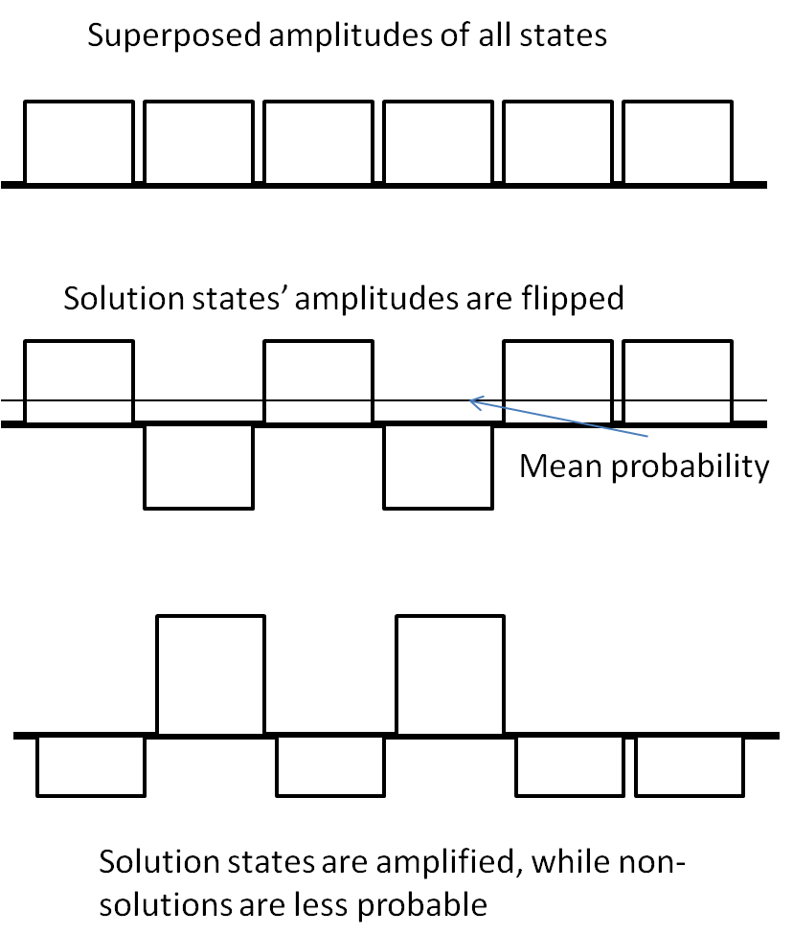
Quantum Unstructured Search (“Grover”)
Grover’s Algorithm uses superposition property of quantum information to perform an unstructured search more quickly
The initial input qubits are superposed to represent all possible solutions
The Oracle operation tags the phase of the solution states in this superposition
Another circuit then changes the phase information (which is hidden) into amplitude information (which we can detect). inversion-about-the-average operation HZH
Uses permutative Grover’s Oracle based on comparators for edges and a global AND gate.
This process is iterated √N times (as opposed to N iterations in classical logic) to maximally amplify the states.
H
ORACLE
H
H
…
…
…
…
H
H
H
H
Grover Loop (* √N)
Notes:
Explain Grover intuitively
Show an actual oracle being superposed into the “oracle” slot, and show repetition of Grover’s Algorithm
Explain more with animation; show repetition.
Talk about mirror circuits; show oracles with mirrors and same inputs/outputs.

Slide 8
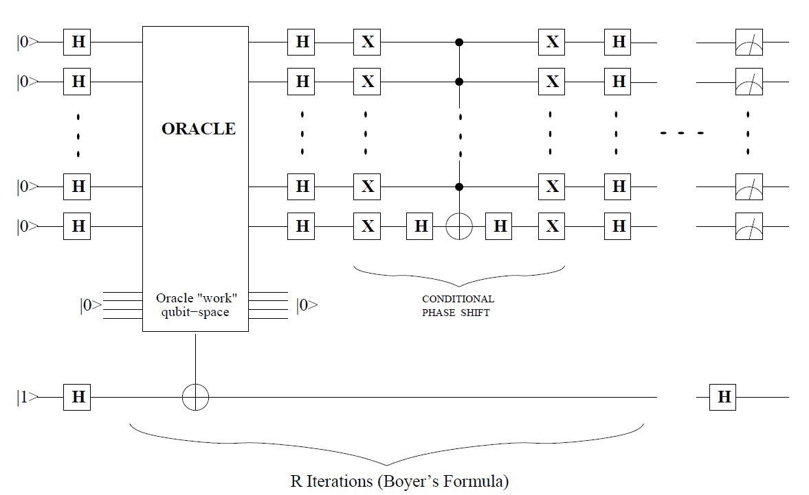
Circuit level representation of Grover
Iterate Grover Loop Square root of N times
Notes:
Replace this with an animation?

Slide 9
Concept of the coloring oracle
Since there are three nodes, each can take on up to three colors
Each node is represented with ||log2(3)|| = 2 qubits so that the total number of possible collective states per node is more than three.
Node 1
Node 2
Node 3
≠
≠
≠
For example, the states|00> and |01> represent different colors.
I have to make sure no two nodes that are connected are assigned the same color using bit-by-bit inequality gates.

Slide 10
Ternary Quantum Logic
Qutrits instead of qubits; superpositions are now of states
|0〉 , |1〉 , and |2〉
Chrestenson gate is used in place of Hadamard gate:
, where d1 =
Controlled-NOT binary gates replaced by single-qutrit reversible functions:
Controlled(+1), controlled( +2), controled(01),
Controlled(02), and controlled(12)
ISMVL 2011, 23-25 May 2011, Tuusula, Finland

Slide 11
9 colors, 4 qubits
9 colors, 2 qutrits
Worst case
9 nodes = 9*8/2=36 edges
36 * 4-qubit comparators PLUS final Toffoli gate with four inputs in AND
Versus
36 2-qutrit comparators PLUS final Toffoli gate with 2 inputs in AND
PLUS global Toffoli with 36 INPUTS, this gate can be internally built as binary or ternary, but realizes binary logic AND
0000
0001
0010
0011
0100
0101
0110
0111
1000
00
01
02
10
11
12
20
21
22

Slide 12
Ternary Grover’s
In 2007, Yale Fan proposed a design for a generalized multi-valued Grover’s Algorithm
For base n, a vector of quantum Fourier transforms (base n) is applied to the vector of |0〉 states. (Chrestenson Transform).
The HZH has been replaced by diffusion operator
CH Z CH
ISMVL 2011, 23-25 May 2011, Tuusula, Finland

Slide 13
Oracle overview: a general case
Evaluates a coloring of a map by comparing each pair of connected nodes.
Each comparison gives either 1 (good coloring of edge) or 0 (bad coloring)
This is inequality comparator. Output is 1 when colors are different.
If all of these comparisons are good, overall output is 1. If the two neighboring nodes have he same color, output = 0.
Can be reused

Slide 14
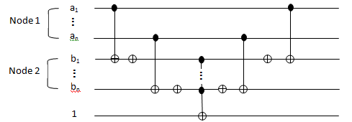
Binary Inequality Comparator circuit
Compare two strings of digits and operates on an ancilla bit.
If the two strings are exactly the same, output is flipped from 1 to 0.
If the two inputs are not exactly the same, output = 1.
After comparison, the operations are mirrored to return ancilla bit to 1

Slide 15
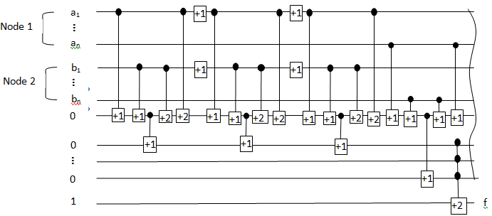
Ternary Quantum Inequality Comparator
Does the same thing, except in ternary
The curved line at the end of the circuit means mirror.
Can be reused

Slide 16
Costs of binary vs ternary quantum comparators
Ternary comparator costs more but we need less qudits
N
ISMVL 2011, 23-25 May 2011, Tuusula, Finland

Slide 17
Costs of binary Toffoli gate with many inputs
In [3], the cost of the binary n-bit Toffoli gate was found to be one of the following:
For a small number of input gates, such as from 2-5 inputs, the optimal construction of the Toffoli gate currently costs 2^{n} - 3 basic quantum operations.
For larger numbers, the cost grows linearly, at 32n – 96 gates, plus one garbage bit per input.
Thus, the complexity of the Toffoli gate overall grows linearly.

Slide 18
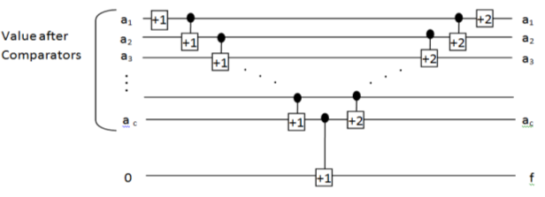
NEW -- Ternary Toffoli
As shown in previous diagram, a ternary version of the Toffoli gate (multi-controlled NOT gate)
Proposed multi-controlled NOT gate operates on one ancilla bit and any number of inputs, like the binary Toffoli
If all inputs equal 1, output is 1. Otherwise, output = 0

Slide 19
The reduced cost of the new Toffoli gate
Using the same standard cost of 2-qudit gates, the calculated cost of the multi-valued Toffoli gate is significantly lower.
Using the above diagram, one can construct a multi-valued extension using only 2n + 1 gates, which is also linear, but at 1/8 of the binary version’s cost.
A graphic comparison of the three is shown in next figure.

Slide 20
Costs of Toffoli gates
N
ISMVL 2011, 23-25 May 2011, Tuusula, Finland

Slide 21
Final cost comparison of binary and ternary comparators
Using the formulae for the cost of Toffoli in terms of two-qubit gates, the cost jumps significantly to 4(log₂N) + 32(log₂N) – 96 gates, assuming N ≥ 5.
For N < 5, the cost is 4(log₂N) + 2^{(log2N)} – 3 gates.
Now factoring the cost of Toffoli gates into the equation, the cost becomes much more favorable towards ternary logic, as shown in next Figure.

Slide 22
The final total costs: binary vs ternary
Using the diagrams of the mirrored comparators, we can see that the cost of the ternary comparator is
34(log₃N) two-qutrit gates,
4(log₃N) single-qutrit gates,
and one Toffoli gate with log₃N inputs.
The binary comparator costs 4(log₂N) two-qubit gates plus one log₂N-input Toffoli gate.

Slide 23
Costs of comparators. With Toffoli
N
ISMVL 2011, 23-25 May 2011, Tuusula, Finland

Slide 24
Simulation
Simulations have been carried out in MATLAB
Since MATLAB isn’t particularly good with large matrices, simulations have been limited to small cases.
a
b
c
ISMVL 2011, 23-25 May 2011, Tuusula, Finland

Slide 25
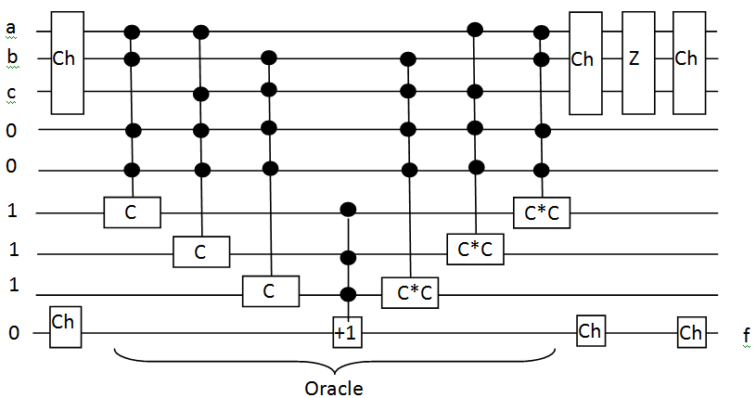
Simulation (cont’d)
Overall layout of the simulated circuit
ISMVL 2011, 23-25 May 2011, Tuusula, Finland

Slide 26
Simulation (cont’d)
MATLAB requires no wire crossovers, so the simulation used a slightly modified version of the ternary comparator circuit
Linear nearest neighbor model
ISMVL 2011, 23-25 May 2011, Tuusula, Finland

Slide 27
Grover Iterations
Grover Algorithm has been shown to require approximately √ M. iterations rounded up, where M is the number of “items in database”.
Since we have 3 nodes, each with 3 states, the total number of items is 3³, or 27.
Thus, our solution algorithm should have √ 27 = 6 iterations of the Grover operator.
With each successive application of the operator, the probabilities of the “good” states should increase in amplitude, whereas the “bad” states should decrease in amplitude until they reach ~0.

Slide 28
ISMVL 2011, 23-25 May 2011, Tuusula, Finland

Slide 29
ISMVL 2011, 23-25 May 2011, Tuusula, Finland

Slide 30
After 6 iterations

Slide 31
How many iterations?
After 2 Grover loops, the highest amplitude of the output was .655,
whereas after 6 Grover loops, the highest amplitude had increased to .87.

Slide 32
Conclusions 1
We synthesized a binary quantum algorithm for a graph coloring problem from binary gates
We synthesized a ternary quantum algorithm to a graph coloring problem from ternary gates
The ternary oracle can solve NP-complete problems, the same as binary
We compared the complexities of binary and ternary oracles for solving arbitrary size graph-coloring problems.
The ternary version of the oracle was shown to be able to perform the same functions as the binary functions equally well, giving the same outputs. (simulation)
The ternary oracle has a lower cost in wires and garbage bits because of its ability to store more information per qudit
The ternary oracle has smaller quantum cost.
ISMVL 2011, 23-25 May 2011, Tuusula, Finland

Slide 33
Conclusions 2
The number of gates required to build the ternary oracle is initially higher than that of the binary oracle for small graphs.
However, as the size and complexity of the graph grows, oracles in ternary-based logic have greater efficiency relative to binary oracles.
The multi-valued extensions of binary oracles can be created for comparators, arithmetic circuits and Toffoli gates.
Thus, any problem, even those requiring strictly binary outputs, can be solved with MV circuits.
The circuits that are binary input / binary output can be built more efficiently with ternary logic inside.
ISMVL 2011, 23-25 May 2011, Tuusula, Finland

Slide 34
Invention of a new binary Toffoli gate, ternary inside
The ternary Toffoli gate, invented in this paper, performs a similar function and will be used as a building block for ternary logic synthesis in the future.
Our new ternary Toffoli gate has 1/8 the cost of the binary Toffoli gate, as it scaled linearly with the number of inputs with slope two, whereas the binary gate required 16 more 2-qubit gates for each additional input.
Good for LNNM model

Slide 35
Conclusions 4
Ternary gates cause different rotations than binary gates on particles.
Therefore, the cost in NMR (Nuclear Magnetic Resonance) pulses of 2-qudit gates in binary and ternary are not the same.
Even 2-qubit binary gates require different numbers of pulses from each other, such as the Feynman gate, which requires 5 pulses, compared to the V and V⁺ gates, which require 3 pulses each.
Ternary gates, since they operate with 120° rotations, would have still different numbers of pulses, which may affect their efficiency relative to binary gates.
ISMVL 2011, 23-25 May 2011, Tuusula, Finland

Slide 36
Conclusions 5
For some future Constrained Satisfaction Problems for Grover, the oracle should have mixed (hybrid) qudits for reduction of quantum cost and processing speed.
Synthesis methods for hybrid quantum circuits and binary external/multiple-valued internal quantum circuits should be created
Ternary results will be even better for the Nearest Linear Nearest Neighbor Model, as the ternary comparators are more compact and ternary solution requires less SWAP gates to be added.
On the other hand, the ternary SWAP gates are
more expensive in terms of pulses.
ISMVL 2011, 23-25 May 2011, Tuusula, Finland

