Slide 1
Quantum Phase Estimation using Multivalued Logic
Vamsi Parasa
Marek Perkowski
Department of Electrical and Computer Engineering,
Portland State University
ISMVL 2011, 23-25 May 2011, Tuusula, Finland

Slide 2
Agenda
Importance of Quantum Phase Estimation (QPE)
QPE using binary logic
QPE using MVL
Performance Requirements
Salient features
Conclusion
ISMVL 2011, 23-25 May 2011, Tuusula, Finland

Slide 3
Abstract
We generalize the Quantum Phase Estimation algorithm to MVL logic.
We show the quantum circuits for QPE using qudits.
We derive the performance requirements of the QPE to achieve high probability of success.
We show how this leads to logarithmic decrease in the number of qudits and exponential decrease in error probability of the QPE algorithm as the value of the radix d increases.
ISMVL 2011, 23-25 May 2011, Tuusula, Finland

Slide 4
Introduction
QPE – one of the most important quantum subroutines, used in :
1) Shor’s Algorithm
2) Abrams and Lloyd Algorithm
(Simulating quantum systems)
Calculation of Molecular Ground State Energies
3) Quantum Counting (for Grover Search)
4) Fourier Transform on arbitrary Z_{p}
ISMVL 2011, 23-25 May 2011, Tuusula, Finland

Slide 5
Quantum phase estimation (QPE)
ISMVL 2011, 23-25 May 2011, Tuusula, Finland

Slide 6
QPE – Formal Definition
phase
ISMVL 2011, 23-25 May 2011, Tuusula, Finland

Slide 7
QPE Algorithm– Binary logic case
We first review the binary case:
Schematic for the QPE Algorithm
Measure phase in t qubits
Eigenvector of U

Slide 8
QPE : step 1 – Initialization, Binary logic case
ISMVL 2011, 23-25 May 2011, Tuusula, Finland

Slide 9
QPE : step 2 – Apply the operator U
Binary logic case

Slide 10
QPE : step 3 – Apply Inverse QFT
Binary logic case

Slide 11
QPE : step 4 - Measurement
Binary logic case
If the phase _{u} is an exact binary fraction, we measure the estimate of the phase _{u} with probability of 1.
If not, then we measure the estimate of the phase with a very high probability close to 1.
ISMVL 2011, 23-25 May 2011, Tuusula, Finland

Slide 12
Quantum circuit for u^{j}
Binary logic case
The circuit for QFT is well known and hence not discussed.

Slide 13
MV logic case
Now we have qudits not qubits
We have t qudits for phase
Now we have arbitrary Chrestenson instead Hadamard
Now we Inverse QFT on base d, not base 2

Slide 14
QFT and Chrestenson
MV logic case

Slide 15
MV logic case

Slide 16
MV logic case
ISMVL 2011, 23-25 May 2011, Tuusula, Finland

Slide 17
MV logic case
We apply inverse Quantum Fourier Transform
ISMVL 2011, 23-25 May, Tuusula, Finland

Slide 18
MV logic case
ISMVL 2011, 23-25 May, Tuusula, Finland

Slide 19
MV logic case
These are d-valued quantum multiplexers

Slide 20
D-valued quantum multiplexers
Case d=3
control
0
1
2
Target (date)

Slide 21
MV logic case
ISMVL 2011, 23-25 May, Tuusula, Finland

Slide 22
MV logic case
ISMVL 2011, 23-25 May, Tuusula, Finland

Slide 23
binary
ISMVL 2011, 23-25 May, Tuusula, Finland

Slide 24
MV logic case

Slide 25
MV logic case
ISMVL 2011, 23-25 May, Tuusula, Finland

Slide 26
MV logic case
ISMVL 2011, 23-25 May, Tuusula, Finland

Slide 27
MV logic case

Slide 28
ISMVL 2011, 23-25 May, Tuusula, Finland

Slide 29
ISMVL 2011, 23-25 May, Tuusula, Finland

Slide 30
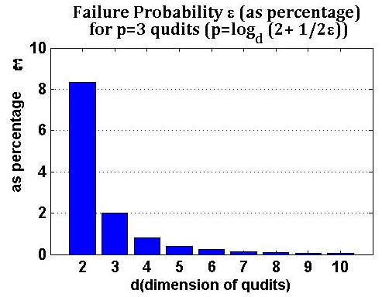
How MVL HELPS
Failure probability decreases exponentially with increase in radix d of the logic used

Slide 31
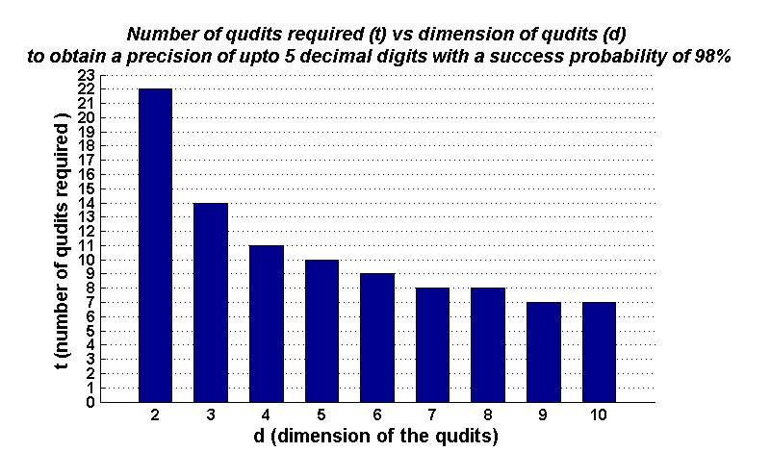
Less number of qudits for a given precision
These are the requirements for a real world problem of calculating molecular energies

Slide 32
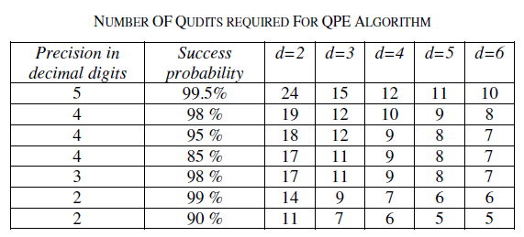
More RESULTS
ISMVL 2011, 23-25 May 2011, Tuusula, Finland
ISMVL 2011, 23-25 May, Tuusula, Finland

Slide 33
Conclusions
Quantum Phase Estimation has many applications in Quantum Computing
MVL is very helpful for Quantum Phase Estimation
Using MVL causes exponential decrease in the failure probability for a given precision of phase required.
Using MVL results in signification reduction in the number of qudits required as radix d increases
ISMVL 2011, 23-25 May 2011, Tuusula, Finland

Slide 34
Conclusions 2
The method creates high power unitary matrices U^{k} of the original Matrix U for which eigenvector |u> we want to find phase.
We cannot design these matrices as powers. This would be extremely wasteful
We have to calculate these matrices and decompose them to gates
New type of quantum logic synthesis problem: not permutative U, not arbitrary U, there are other problems like that, we found
This research problem has been not solved in literature even in case of binary unitary matrices U
ISMVL 2011, 23-25 May 2011, Tuusula, Finland

