Slide 1
New ECE 574 class about Embedded Systems
Projects for the new ECE 574 class
Marek Perkowski

Slide 2
Project based class
Graduate class - no prerequisities
C/C++ welcome, but not mandatory
Verilog/VHDL welcome, but not mandatory.
FPGA – Field Programmable Gate Arrays.
  Spectral transforms
  Robot Vision – tracking, face recognition.
GPU – Graphic Processing Unit
Constraint-Satisfaction programming for quantum computer – Orion.
Real world interface

Slide 3
Three new great platforms for projects
Graphic Processing Unit (GPU) based low cost supercomputers
Tetrix robotic kit with sensors, communication and actuators.
Quantum computer - First in the world, Orion from DWAVE, Vancouver, BC, Canada

Slide 4
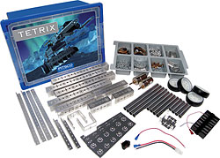
Tetrix Robot Kit from Pitsco
TETRIX™, a complete design system for students who are serious about robotics.
Used in commercial companies for robot and embedded systems prototyping.
TETRIX is also the official building system of the FIRST Tech Challenge.
Our robot team will participate for year 2008/2009.
You are welcome to join.
To learn more about this competition, visit www.usfirst.org.

Slide 5
TETRIX by PITSCO
Developed for use in high schools
TETRIX is a revolutionary new metal building system
designed by Pitsco, Inc.
sold by LEGO® Education.
A unique LEGO connector joins the metal with LEGO elements
use the LEGO NXT Intelligent Brick as the controller.

Slide 6
Tetrix Robot Kit
Featuring heavy-duty aluminum elements for construction of robotic components
Flexible and broad robot design base
All improved: hardware, interface, mechanics and software.
Build a basic square chassis robot base with a remote control
Incorporate other electronics (not included) into design – hundreds of components.
Highly specific autonomous robot.
Designed by Carnegie Mellon University Robotics Department

Slide 7
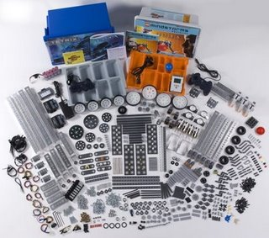
Tetrix Robot Kit
The TETRIX Base Set has 600 parts, including the following:
Brackets and mounts
Structural channel and plates
Structural tubing and hubs
Servos, motors, and accessories
Wheels, gears, and drive train
Hardware and hex keys
Battery holder and connectors
Number of Elements: 600

Slide 8
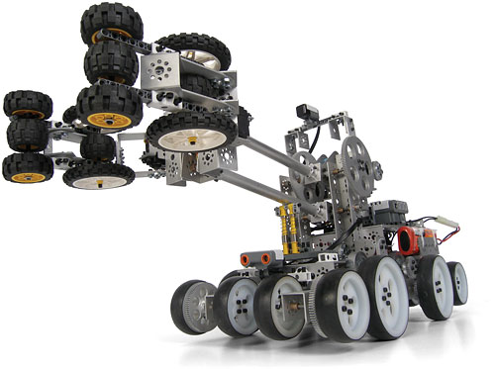
Very high quality, stability, mechanically firm designs.
No comparison in quality with Lego, Vex, Mechano or any other previous robotic kit system.
Also includes a user guide that covers building the basic robot body, wiring and using a remote control, designing gear assemblies, building arm mechanisms and end effectors, and more.

Slide 9
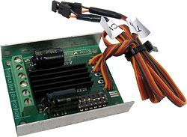
Motors
TETRIX™ DC Motor Speed Controller
HS-475HB Standard Servo w/ Carbonite Gears -- 4
152 RPM 12V DC Gearbox Drive Motor with 6mm D Shaft -- 4

Slide 10
Three Systems in one
Lego NXT motors
Servos with controllers
12-volt DC motors with controllers
With the motor controllers that allow the NXT to control the non-LEGO motors, you can have many more than three motors;
by stringing motor controllers together, you can have almost as many motors as you want, provided you have enough batteries.
And in January 2009, robot builders can use the unique TETRIX hole pattern to attach
  the LEGO® MINDSTORMS® NXT Intelligent Brick,
  sensors,
  and any other LEGO® Technic element
  to the TETRIX system via a custom connector.

Slide 11
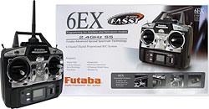
R/C Controller
Control of TETRIX™ robot with this six-channel remote control.
Featuring interference-free performance and a 2.4 GHz system.
Servo reversing on all six channels.
Unlike the commercial version of this controller, it includes
  a receiver,
  transmitter with charger,
  on/off switch, and battery holder.

Slide 12
Mechanical Design
structural pieces to be connected at many angles, not just 90º and 180º.
the metal gears
tough and flexible.
heavy-duty aluminum
strong drive motors and servos

Slide 13
Lego NXT is part of Tetrix
LEGO MINDSTORMS Education NXT Base Set
LEGO Touch Sensor (in addition to NXT Base Set sensors)
LEGO Light Sensor (in addition to NXT Base Set sensor)
HiTechnic NXT Compass Sensor
8-Cell AA Battery Holder
12v NiMh 3000 mah Rechargeable Battery
Battery Charger
On/Off Battery Harness
DC gearhead motor shaft encoders
FTC Bluetooth Dongle
Logitech Gaming Controller
HiTechnic DC Motor Controller for TETRIX
HiTechnic Servo Controller for TETRIX
HiTechnic Touch Sensor Multiplexer
More sensors than standard Lego NXT

Slide 14
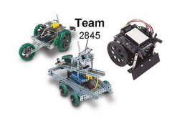
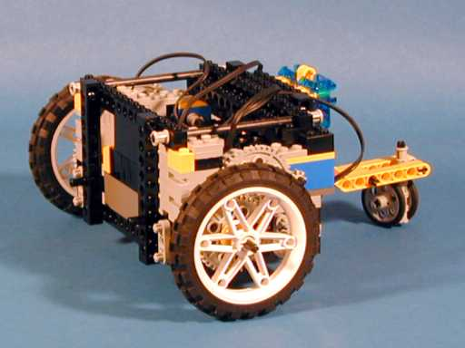
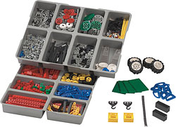
Our Available Resources
LEGO TOOLKITS

Slide 15
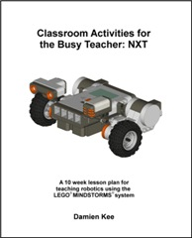
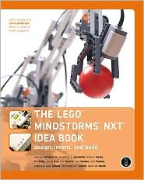
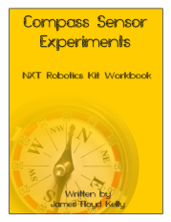
Many books and webpages available for NXT system

Slide 16
Software
LEGO MINDSTORMS Education NXT Software
LabVIEW for FTC
RobotC
If you were not a Lego Kid do not worry.
We will learn about NXT and TETRIX in next lectures.

Slide 17
Our concept of quantum robot
based on reducing all problems to constraint satisfaction solved on a quantum computer

Slide 18
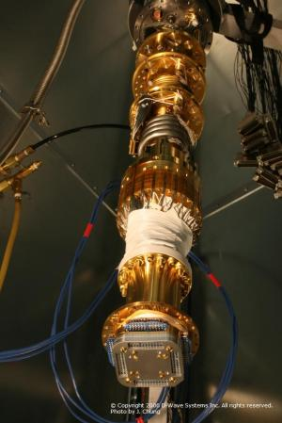
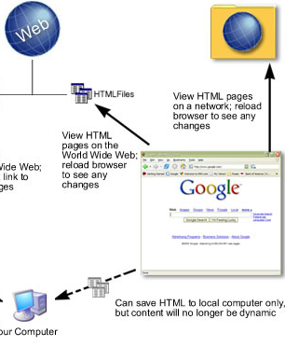
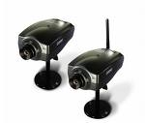



The whole proposed PSU Quantum Robot system
Orion Quantum Adiabatic Computer in Vancouver BC, Canada
Orion interface
PC
Personal computer
Bluetooth connection
GPU supercomputer

Slide 19
QUBOT-1 – the world’s first quantum robot

Slide 20
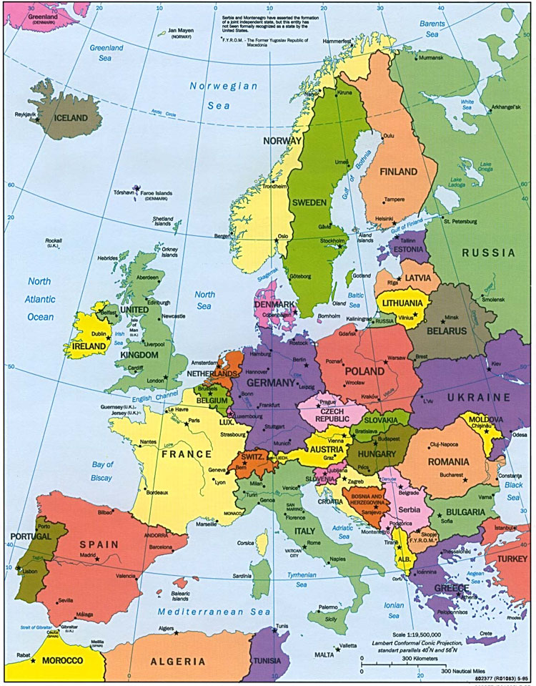
Oracle for Quantum Map of Europe Coloring
Germany
France
Switzerland
Spain
Spain
France
Germany
Quaternary qudits
Switzerland
Multiple-Valued Quantum Circuits
≠
≠
≠
≠
Good coloring

Slide 21
Constraint Satisfaction Problem is to satisfy the constraints and minimize the energy
Germany
France
Switzerland
Spain
Spain
France
Germany
Constraints to be satisfied
Switzerland
≠
≠
≠
≠
Good coloring
Energy to be minimized
Count number of ones
Adiabatic Quantum Computer

Slide 22
Constraints Satisfaction Problems
S E N D
+ M O R E
M O N E Y
Cryptographic Problems
Graph coloring

Slide 23
Constraint Satisfaction for Robotics
Insufficient speed of robot image processing and pattern recognition.
  This can be solved by special processors, DSP processors, FPGA architectures and parallel computing.
Prolog allows to write CSP programs very quickly.
An interesting approach is to formulate many problems using the same general model.
This model may be predicate calculus, Satisfiability, Artificial Neural Nets or Constraints Satisfaction Model.
  Constraints to be satisfied (complex formulas in general)
  Energies to be minimized (complex formulas)

Slide 24
SAT as a constraint satisfaction problem
(a + b’ + c) * (b + d’) … = 1
Highly parallel system of updating nodes
c
=1
=0
=1
a
b
d
=1
(a + b’ + c)
(b + d’)
Yes , do nothing to nodes
No , update nodes

Slide 25
SAT as a constraint satisfaction problem
(a + b’ + c) * (b + d’) … = 1
Constraints:
(a + b’ + c) = 1
(b + d’) = 1
…..
Orion programming is just writing equations for constraints and equations for energy
Energy optimization:
(a + b’ + c) = f1
(b + d’) = f2
….
Min ( f1’ + f2’ + …..)

Slide 26
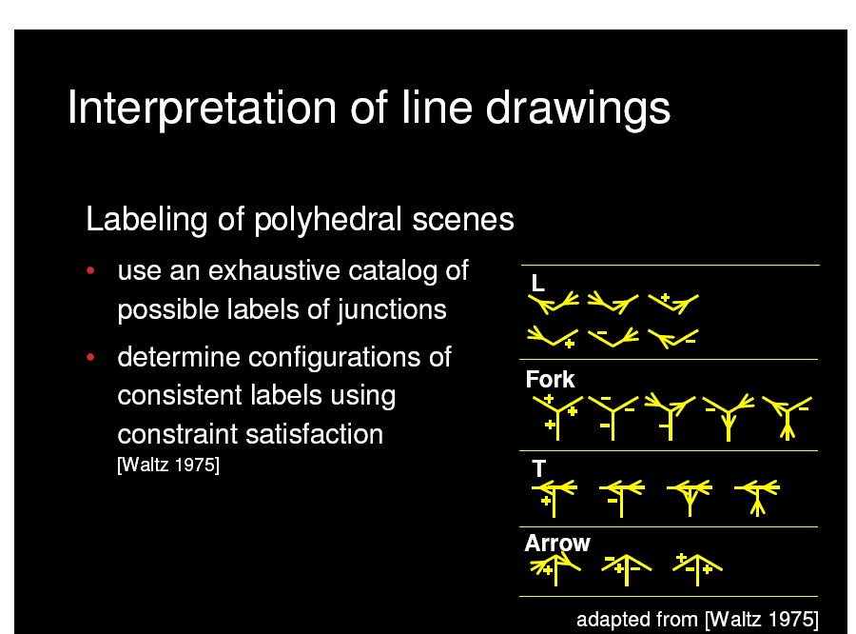
Constraint Satisfaction Image Analysis by Waltz
Huffman and Clowes created an approach to polyhedral scene analysis, scenes with opaque, trihedral solids, next improved significantly by Waltz
Popularized the concept of constraints satisfaction and its use in problem solving, especially image interpretation.
Objects in this approach had always three plane surfaces intersecting in every vertex.
Notes:
Thus there are 18 possible trihedral vertices in this problem out of 64 possible.
There are only 3 types of edges between these blocks possible:
(1) obscuring edge is a boundary between objects or objects and background. Boundary lines are found using outlines with no outside vertices,
(2) concave edges are edges between two object’s faces forming an acute angle when seen from outside,
(3) convex edges are those between two faces of an object forming an obtuse angle as seen from outside.

Slide 27
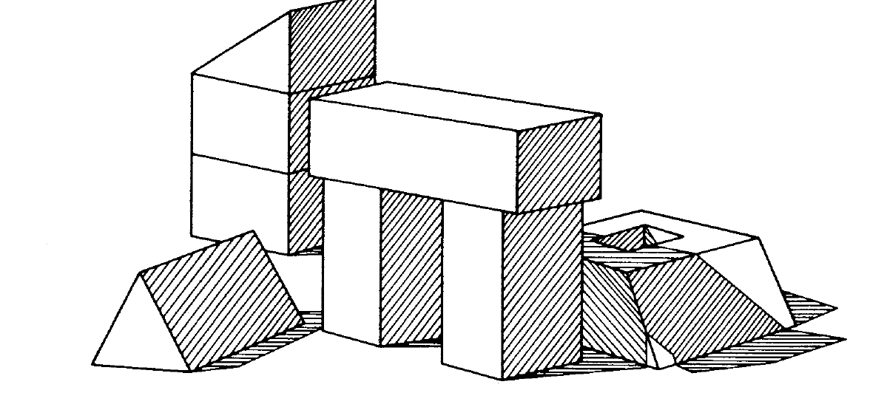
Constraint Satisfaction Image Analysis by Waltz
There are only four ways to label a line in this blocks world model.
The line can be convex, concave, a boundary line facing up and a boundary line facing down (left, or right).
The direction of the boundary line depends on the side of the line corresponding to the face of the causing it object.
Waltz created a famous algorithm which for this world model which always finds the unique correct labeling if a figure is correct.
Notes:
Moreover, the algorithm handled also shadows and cracks in blocks. Mackworth and Sugihara extended this work to arbitrary polyhedra and Malik to smooth curved objects.
This becomes a well-known approach to image recognition based on constraint satisfaction and a prototype of many similar approaches to vision and planning problems in robotics.

Slide 28
AC-3: State 2
Queue:
(2,3)(3,2)(3,4)(4,3)(4,1)(1,4) (1,3)(3,1)
Removing (2,3).
L3 on 2 inconsistent with 3, so it is removed.
Of arcs (k,2), (1,2) is not on queue, so it is added.

Slide 29
Constraint satisfaction model in robotics
Used in main areas of robotics:
  vision,
  knowledge acquisition,
  knowledge usage.
In particular the following:
  planning, scheduling, allocation, motion planning, gesture planning, assembly planning, graph problems including graph coloring, graph matching, floor-plan design, temporal reasoning, spatial and temporal planning, assignment and mapping problems, resource allocation in AI, combined planning and scheduling, arc and path consistency, general matching problems, belief maintenance, experiment planning, satisfiability and Boolean/mixed equation solving, machine design and manufacturing, diagnostic reasoning, qualitative and symbolic reasoning, decision support, computational linguistics, hardware design and verification, configuration, real-time systems, and robot planning, implementation of non-conflicting sensor systems, man-robot and robot-robot communication systems and protocols, contingency-tolerant motion control, multi-robot motion planning, multi-robot task planning and scheduling, coordination of a group of robots, and many others

Slide 30
Examples of CSP in robotics
Scene recognition
Motion generation in presence of constraints
  internal (low power, don’t hit itself)
  external (shape of racing track, wolf-man-cabbage-goat)
Gesture under emotions
Communication in a swarm of robots (graph coloring)
Robot guard (set covering)

Slide 31
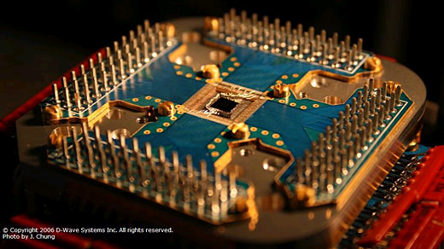
New Approach to Quantum Robotics
Robot
Obstacle
Avoidance
Problem
Robot Reasoning
Problem
Robot
Communication
Problem
Robot Vision
Problem
Constraint Satisfaction Problem
Adiabatic Quantum Computer
Classical quantum computing

Slide 32

Adiabatic Quantum Computing to solve Constraint Satisfaction Problems efficiently

Slide 33
Adiabatic Quantum Computing to solve Constraint Satisfaction Problem efficiently.
Will February 13th 2007 be remembered in annals of computing.?
DWAVE company demonstrated their Orion quantum computing system in Computer History Museum in Mountain View, California.
The first time in history a commercial quantum computer was presented.
The Orion system is a hardware accelerator designed to solve in principle a particular NP-complete problem called the two-dimensional Ising model in a magnetic field (for instance quadratic programming).
It is built around a 28-qubit superconducting adiabatic quantum computer (AQC) processor.

Slide 34
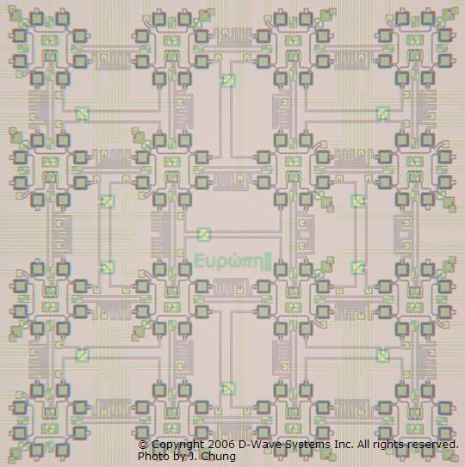
Orion computer from DWAVE
Conventional front end
The solution of an NP-complete problem:
1. Pattern matching applied to searching databases of molecules.
2. Planning/scheduling application for assigning people to seats subject to constraints.
3. Sudoku
7
1
5
3
2
8
9
2
8
2
3
9
8
3
7
4
5
7
6
4
6
5
4
6
2

Slide 35
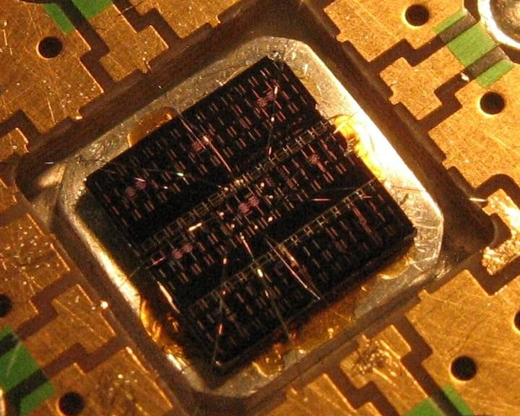
Orion Is the Constraint Satisfaction Solver
The company promises to provide free access by Internet to one of their systems to those researchers who want to develop their own applications.
Does it have quadratic speed-up?

Slide 36
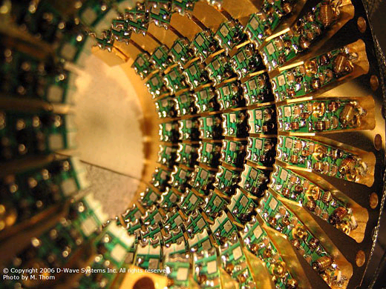
Orion computer from DWAVE
The plans are that by the end of year 2008 the Orion systems will be scaled to more than 1000 qubits.
Company plans to build in 2009 processors specifically designed for quantum simulation, which represents a big commercial opportunity.
These problems include: protein folding, drug design and many other in chemistry, biology and material science.
Thus the company claims to dominate enormous markets of NP-complete problems and quantum simulation.

Slide 37
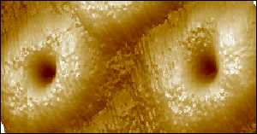
We plan to concentrate on robotic applications of the Constraint Satisfaction Model.
Adiabatic Quantum Computing was proved equivalent to standard QC circuit model.
Each of the developed by us methods can be transformed to an adiabatic quantum program and run on Orion.
We developed logic minimization methods to reduce the graph that is created in AQC to program problems such as Maximum Clique or SAT.
This programming is like on “assembly level” but with time more efficient methods will be developed in our group.
  This is also similar to programming current Field-Programmable Gate Arrays.

Slide 38
Future work on Adiabatic Quantum Controller for a robot
In the second research/development direction the interface to Orion system will be learned
How to formulate front-end formulations for various robotic problems as constraint-satisfaction problems for this system?

Slide 39
New Research Direction
New approach to quantum robotics based on reduction to Constraint Satisfaction Model
Well-known problems
New problems
Notes:
Some ideas of quantum computing can be used to build sophisticated robot controllers.
Intelligent biped robots will be an excellent medium to teach emotional robotics, robot theatre, gait and movement generation, dialog and many other computational intelligence areas that have been not researched yet because of high costs of biped robots.

Slide 40
Interface to ORION COMPUTER Application Programming Interface API
This is an Alpha release of Orion Web Services designed to introduce users to our APIs and to solicit user feedback on the usability and functionality of the system.
Orion web services allow you to formulate a wide range of problems that are amenable to quantum acceleration.
Note that D-Wave’s quantum processors will not be made available in this release.
Several specialized software solvers targeted at this same set of problems are included in this release so you will be able to formulate and solve problems using Orion software.
We are providing early access to our interfaces to help you learn how to use our APIs and develop applications which leverage our solvers.
When the quantum processors become available your application will be able to call them by using the same APIs and program calls.

Slide 41
D-WAVE’S QUANTUM SOLUTION
The D-Wave quantum computer (DQC) promises better, faster solutions to your computationally difficult problems.
DQC works like a co-processor that enhances the ability of your application and conventional computer to solve these complex problems.
At the heart of DQC is a microprocessor that contains quantum bits (qubits).
It uses adiabatic quantum computing to perform computations in parallel rather than serially like conventional processors.
DQC is especially well suited to
  solving discrete-optimization problems and
  complex search problems.
The software’s flexibility lets you exploit this ability for many kinds of applications in a variety of markets.
Its broad platform lets you easily integrate existing database, optimization, scheduling and decision-making applications with DQC.
You can also use the DQC platform and our software development kit (SDK) to develop new applications for exploiting quantum computation.

Slide 42
Harnessing the Power of the D-Wave Quantum Computer
The DQC hardware is wonderfully powerful and complex.
DQC’s sophisticated software harnesses that power and hides the complexity.
In addition, DQC will support several familiar formats for exchanging problem descriptions and solutions with user applications based on industry standards.
To benefit from the power of the D-Wave quantum computer, you will simply need to make minor changes to your application so that it sends the problem description to the DQC rather than to the module that currently solves the problem.
For example, if you have a database application, just change the code in the business logic layer so that it calls the DQC solver via its web server.

Slide 43
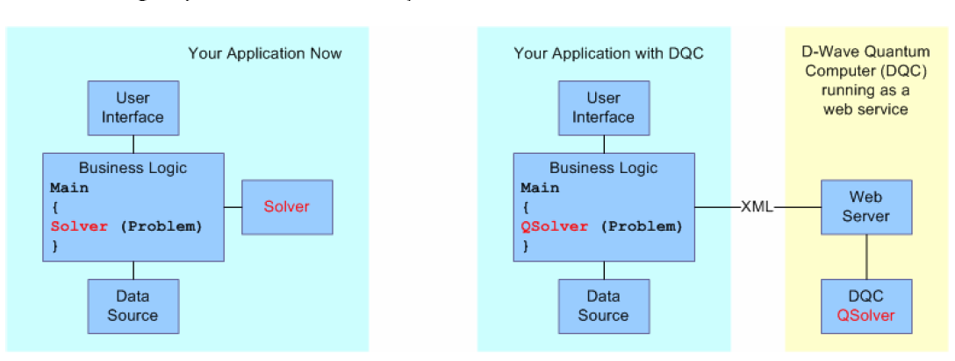
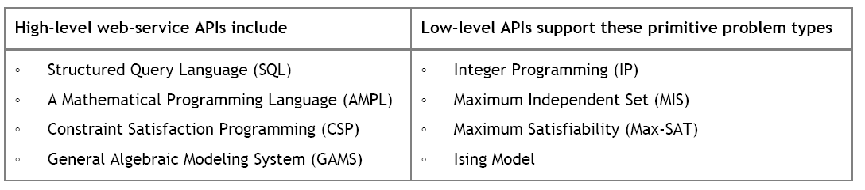
API software to access the power of DQC

Slide 44
Choose the API that’s Right for You
You don’t need to learn a new programming language to integrate the D-Wave quantum computer with your application.
The DQC software platform will provide standard web-service APIs that support several modeling, optimization and domain-specific languages.
These include SQL, AMPL and GAMS.
These languages have the advantage of being declarative, expressive and familiar to a wide community of users.

Slide 45
APIs for each of its software layers.
Furthermore, the DQC software platform offers APIs for each of its software layers.
Consequently, applications that need only basic control of DQC can interact with the system through one of the standard web-service APIs.
Alternatively, applications that need to control DQC more precisely can access it through a low-level problem-solving API.
The flexibility of the DQC software’s layered architecture will even let you run its top layers locally and access the bottom layers remotely.

Slide 46
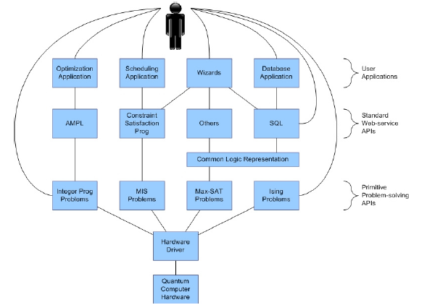
Users can access DQC
  through their applications and wizards
  Directly through web service API
  Primitive Problem Solving APIs

Slide 47
System Deployment
D-Wave will package its quantum computer hardware in industry-standard racks so that they will be field deployable.
Because DQC is extremely energy-efficient, it offers massive reductions in power and cooling costs over other high-performance computing options.
DQC hardware can be installed at user sites or, alternatively, accessed remotely as a service provided by you or D-Wave.

Slide 48
Partnership Opportunities with D-Wave
D-Wave currently has DQC hardware and software available that lets you build pilot applications leveraging quantum-computing technology.
We are rapidly scaling the size of the quantum solver.
D-Wave is now accepting a limited number of development partners who can help us drive additional requirements for applications that would benefit from the ability to solve computationally difficult problems efficiently.
We encourage those who wish to benefit from accelerated discrete-optimization and search capabilities to contact D-Wave Systems Inc. at busdev@dwavesys.com.

Slide 49
SAT Solvers = Formal hardware verifications
Verifying whether a logic circuit performs to specifications is an important part of the circuit design process.
Here are some benchmark SAT problems generated during formal hardware verification on real circuits and links to the methods used to generate them
All of the benchmarks at this site should be solvable using Orion web services’ portfolio of SAT solvers.
An idea for an application is to build a code base for compiling a circuit design to SAT and then feeding the SAT problem to Orion via web services.
  Applications could even access the entire software platform through XML-based web services.

Slide 50
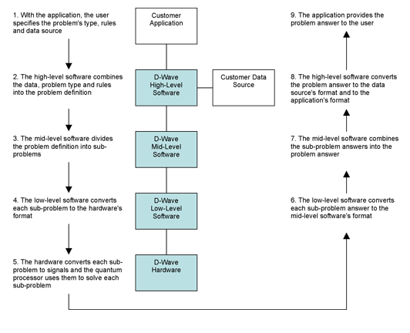
How D-Wave’s Software Works
The following diagram shows how D Wave’s software processes a problem from the application.

Slide 51
Examples of problems that can be efficiently solved with Orion

Slide 52
Conditional robot response based on camera input
This one is really cool.
At a high level the way it works is as follows.
You have a camera trained on a human. The data taken by the camera is processed so as to detect features, which are generalized patterns of behavior.
For example, a feature detector could be configured to detect the presence of anger in the human, for example by learning-based methods.
In addition, there is a robot, which is connected to the data processing system connected to the camera.
This robot has effectors which control its actions.
In this application, the effector controls are functions of the processed input from the camera, where the rules connecting the two are user-determined.

Slide 53
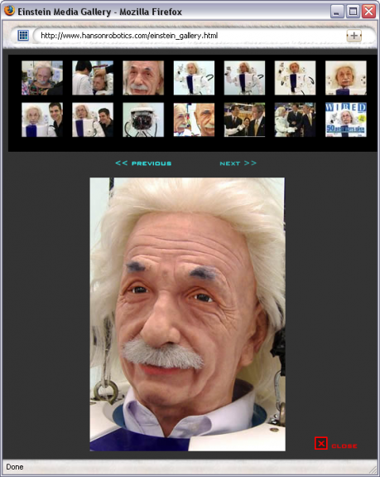
This generic situation, where the robot’s behavior is conditioned upon the input from the feature detectors connected to the camera, maps to a constraint satisfaction problem as described here.
The way this would work is that the human / camera / robot system would generate optimization and satisfiability problems, to determine how the robot’s effectors should fire, and these problems can be remotely solved using Orion.
For example, you could acquire a Hansen Robotics Einstein, sit it him on your desk, train a camera on your face, use an anger feature detector that causes the Einstein robot to laugh harder the angrier you get.

Slide 54
Building error correcting codes
Sending, storing and processing operations generate errors.
One example of this is if I attempt to send you 64 bits of information over the internet, maybe only 63 of them arrive.
Neither you nor I know which was deleted.
A code to fix such a problem is called a single-deletion-correcting code. There are many other types of errors that occur, and modern encoding schemes need to correct all of them.
One family of encoding schemes can be found by solving for the Maximum Independent Set of a graph.
Several challenge graphs whose Maximum Independent Sets provide error correction schemes, are posted on DWAVE webpage. Go there and find them. And Much More.
An application to generate error correction codes could comprise building these graphs based on desired error correction properties, and then solving for the Maximum Independent Set of these graphs using the Orion web services API.

Slide 55
Image recognition
Image recognition with an adiabatic quantum computer I.
Mapping to quadratic unconstrained binary optimization
Abstract:
Many artificial intelligence (AI) problems naturally map to NP-hard optimization problems.
This has the interesting consequence that enabling human-level capability in machines often requires systems that can handle formally intractable problems.
This issue can sometimes (but possibly not always) be resolved by building special-purpose heuristic algorithms, tailored to the problem in question.
Because of the continued difficulties in automating certain tasks that are natural for humans, there remains a strong motivation for AI researchers to investigate and apply new algorithms and techniques to hard AI problems.

Slide 56
Image recognition
Recently a novel class of relevant algorithms that require quantum mechanical hardware have been proposed.
These algorithms, referred to as quantum adiabatic algorithms, represent a new approach to designing both complete and heuristic solvers for NP-hard optimization problems.
In this work we describe how to formulate image recognition, which is a canonical NP-hard AI problem, as a Quadratic Unconstrained Binary Optimization (QUBO) problem.
The QUBO format corresponds to the input format required for D-Wave superconducting adiabatic quantum computing (AQC) processors.

Slide 57
Determining the behavior of a swarm of Lego Mindstorms robots
The Lego Mindstorms product has an API that allows developers to program behavior of inexpensive robots.
An idea for a class of applications would be to condition the collective behavior of a group of such robots on the solution of quadratic binary programs or SAT problems.
The inputs in this case would be sensor data coming from the robots’ built-in sensors.
Orion could be used to solve sensor fusion problems, or a myriad of other possibilities arising in swarm intelligence.
This would be a very interesting and inexpensive project.
The idea of being able to build a swarm of robots whose behavior is subject to a server-side quantum computer accessed over the internet is exceptionally cool.

Slide 58
Other Available Resources - FPGA
ALTERA BOARD
  Altera Stratix Nios Development Board
  Altera UP2 Development Board

Slide 59

Why FPGA?
Handles dense logic and memory elements, offering very high logic capacity
Easy to revise the logic design
Lower cost and shorter development cycle
Complete integrated design environment (IDE)
Easy to learn and use

Slide 60
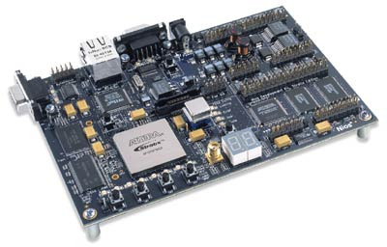
Altera Stratix Nios Development Board
Stratix EP1S10F780C6
  10,570 Logic Elements
  920 Kb on-chip memory
Provide hardware platform for developing embedded system
  Comes pre-programmed with a 32-bit Nios processor reference design

Slide 61
Altera Stratix Nios Development Board
8 MB of flash Memory,1MB of static RAM, 16MB of SDRAM
On-board Ethernet MAC/PHY device
Compact Flash connector header
Two RS-232 DB9 serial ports
50MHz oscillator and zero-skew clock distribution circuitry
Four push-button switches
Dual 7-segment LED display

Slide 62
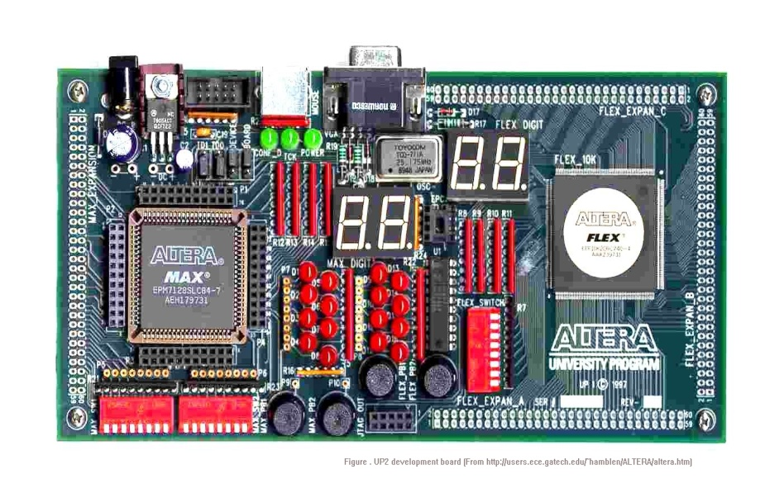
Altera UP2 Development Board
EPF10K70RC240-4 device
EPM7128SLC-7 device
One RS-232 serial port
Four push-button switches
Dual 7-segment LED display
25.175MHz oscillator

Slide 63
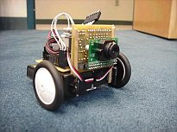
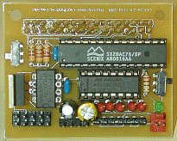
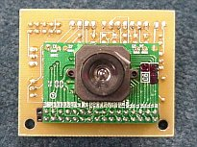
Available Resources
CMU CAM
  track the position and size of a colorful or bright object
  measure the RGB or YUV statistics of an image region
  automatically acquire and track the first object it sees
  physically track using a directly connected servo
  dump a complete image over the serial port
  dump a bitmap showing the shape of the tracked object

Slide 64
Problems to Exams (1)
What kind of robot you would like to build using Tetrix system or Lego NXT system?
What is so great about Tetrix?
What is our concept of a Quantum Robot?
Give examples of Constraint Satisfaction problems that are not from this class.
Constraint versus cost versus energy minimization in Constraint Satisfaction
Based on Google, find and describe one constraint satisfaction problem in detail.
What is the idea of API.
Give examples of API, find more on them in Internet and Wikipedia. Learn how to use Google Scholar and similar resources, such as Videos, PPT on WWW, images, etc.

Slide 65
Problems to Exams (2)
Give examples of problems that can be reduced to SAT
Give examples of problems that can be reduced to maximum clique
Give examples of problems that can be reduced to Petrick Function
Give examples of problems that can be reduced to graph coloring.

