Slide 1
IMAGE PROCESSING
USING FPGA
Sumitha Ajith
Saicharan Bandarupalli
Mahesh Borgaonkar

Slide 2
Project Phases
In Simulation Stage
Development of an Algorithm for Blob Detection
  What is blob detection
  Sequential Connected Component Algorithm
  Our optimized Implementation
  Simulation results
Main Part
Hardware implementation
  VGA display using Block RAM as Video Memory
  VGA display using SRAM as Video Memory

Slide 3
BLOB DETECTION

Slide 4
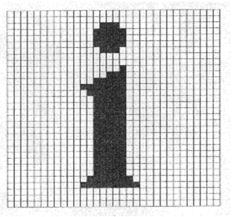
What is Blob Detection?
Identify connected Pixels [Blob]
Identify blob by color
Measure Blob Parameters
  Area
  Centroid

Slide 5
Considerations
Challenges
Algorithms typically sequential with multiple stages
  Makes Real-Time Image Processing Hard
Large Storage Demands
  Source.
  Processed Image.
  Intermediate Images.
Memory Access Latency and Contention
Algorithm Focus
Minimize Storage Requirements
Minimize Number of Passes (Stages) for Processing
Processing Block
Image source
Display Module
On Board SRAM Chips
Memory Heavily Strained
Optimize to reduce Scheduling Issues

Slide 6
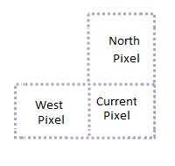
Labeling
Uses Sequential Connected Component Algorithm
Psuedo-code

Slide 7
Labeling - Example
0 | 0 | 0 | 0 | 0 | 0 | 0 | 0
0 | 1 | 1 | 1 | 0 | 1 | 1 | 0
0 | 0 | 1 | 1 | 0 | 0 | 1 | 0
0 | 0 | 0 | 1 | 0 | 0 | 1 | 0
0 | 0 | 1 | 1 | 0 | 0 | 1 | 0
0 | 0 | 1 | 1 | 0 | 0 | 1 | 0
0 | 1 | 1 | 1 | 1 | 1 | 1 | 0
0 | 0 | 0 | 0 | 0 | 0 | 0 | 0
0 | 0 | 0 | 0 | 0 | 0 | 0 | 0
0 | 1 | 1 | 1 | 0 | 2 | 2 | 0
0 | 0 | 1 | 1 | 0 | 0 | 2 | 0
0 | 0 | 0 | 1 | 0 | 0 | 2 | 0
0 | 0 | 3 | 1 | 0 | 0 | 2 | 0
0 | 0 | 3 | 1 | 0 | 0 | 2 | 0
0 | 4 | 3 | 1 | 1 | 1 | 1 | 0
0 | 0 | 0 | 0 | 0 | 0 | 0 | 0
Source Image
Intermediate Labeled Image
0 | 0 | 0 | 0 | 0 | 0 | 0 | 0
0 | 1 | 1 | 1 | 0 | 1 | 1 | 0
0 | 0 | 1 | 1 | 0 | 0 | 1 | 0
0 | 0 | 0 | 1 | 0 | 0 | 1 | 0
0 | 0 | 1 | 1 | 0 | 0 | 1 | 0
0 | 0 | 1 | 1 | 0 | 0 | 1 | 0
0 | 1 | 1 | 1 | 1 | 1 | 1 | 0
0 | 0 | 0 | 0 | 0 | 0 | 0 | 0
BLOB Detected!

Slide 8
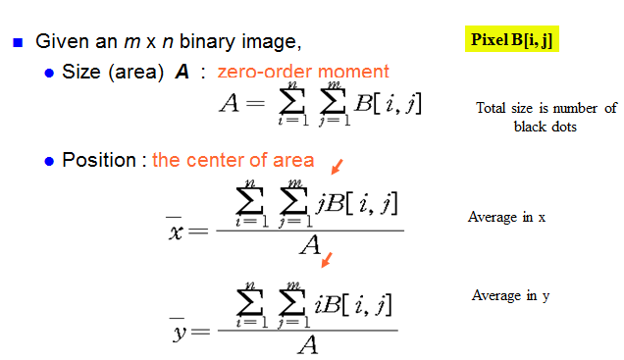
Blob Parameters
Calculations:

Slide 9
Optimized Labeling
Implementation:
  Usage of LINE FIFO to get North Labels
  Blob Parameter Table Design and Update Logic
    Facilitates Single Pass Blob Parameter Calculation
Image source
Pixel by pixel
Label the Pixel
Update Blob Parameter Table
SRAM
Blob detection Module

Slide 10
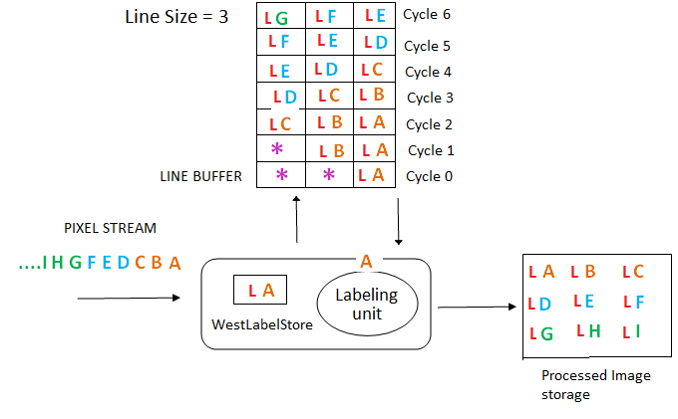
Line FIFO Operation

Slide 11
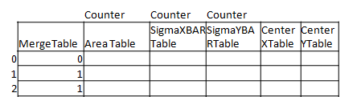
Blob Table Update
MergeTable[MergeLabel] = Merge Table[PresentLabel]
Running Counters : Area , XBar, Ybar
  Incremented during each hit to a valid pixel
Check if you merged two labels. If so increment only one counter.
Index By Blob Label
Merge Label
Update Table
Threshold
LABEL
Update Counters
Memory
Image source
Process Complete
Centroid Calculator
Table look up
DIVIDER
Table Update

Slide 12
Results
Blob detection done on the way from Image source to Memory.
Modelsim Simulation Results

Slide 13
FPGA Implementation

Slide 14
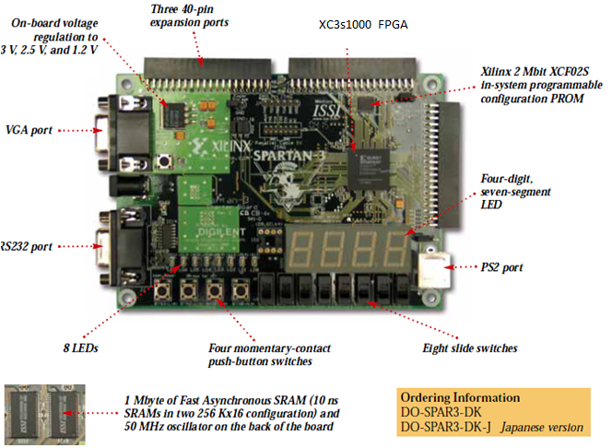
Hardware and Software used
Synthesis
Xilinx ISE
Downloading bit File
  Impact
Spartan 3 FPGA Board [costs $ 140]

Slide 15
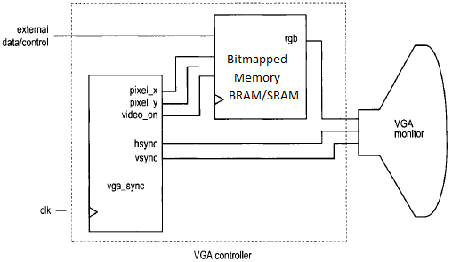
Part 1:
VGA display Interface with Block RAM as Video Memory
Part 2:
VGA display Interface with SRAM as Video Memory

Slide 16
Part 1 :
Synch Signals Generator & Block Memory
VGA module generate the five active signals : hsync, vsync & three video signals Red, Green and Blue
Block RAM is special memory module embedded in FPGA device separated from regular logic cells.
Xilinx Core Gen Feature is used to generate blockRAM.
Each block RAM consist of a 16k by 1 to 512 by 32.
A 24 bit sample picture is taken and converted into a 3 bit format which can be initialized in Block RAM
Xilinx BlockRAM can be initialized with the .coe file.

Slide 17
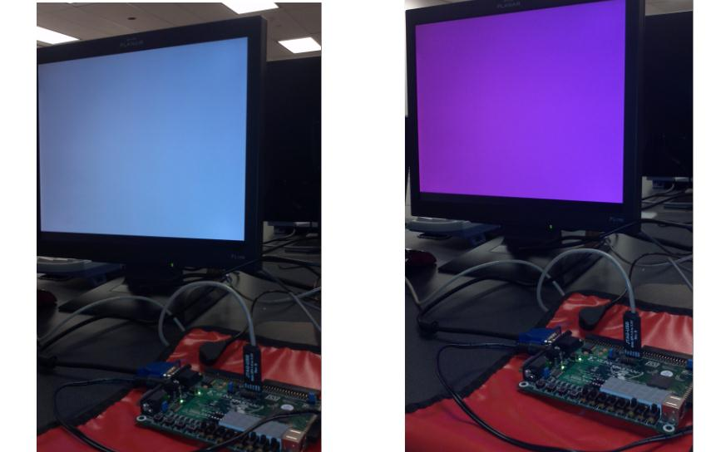
Test Results : Sync Signal Generator
VGA Synch Signal generator Test Results: Screen bitmapped to unique color input read from Switches

Slide 18
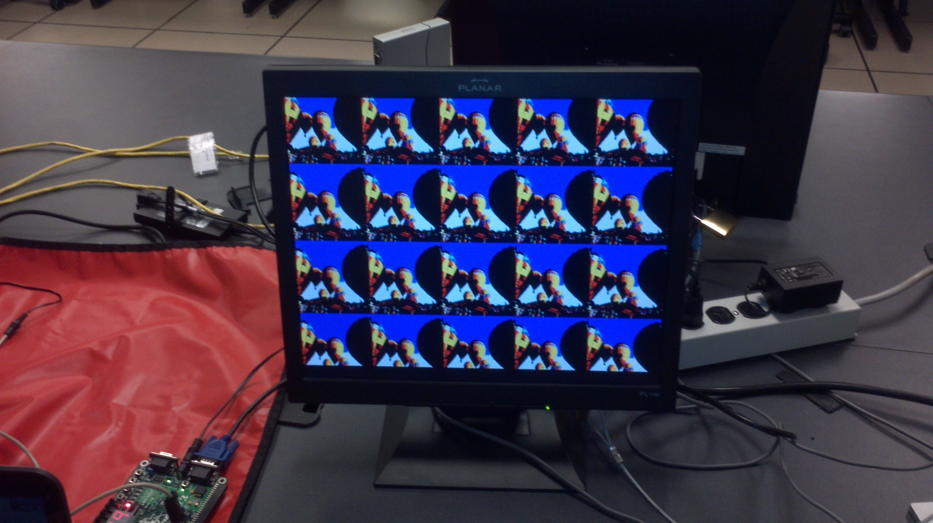
3bit VGA – S3Board

Slide 19
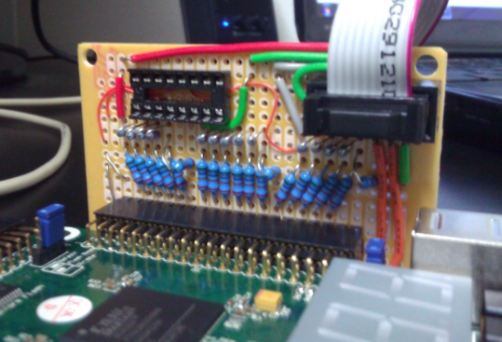
Enhancing VGA Display

Slide 20
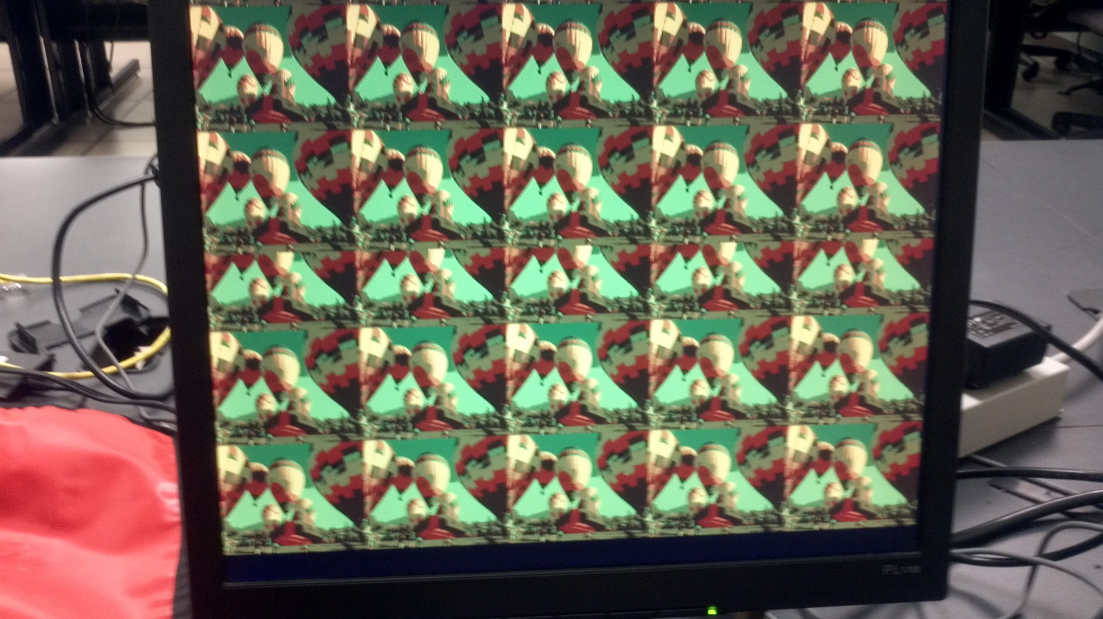
Experimental results

Slide 21
Display using SRAM as Video Memory
Notes:
Mahesh Part Starts from here:

Slide 22
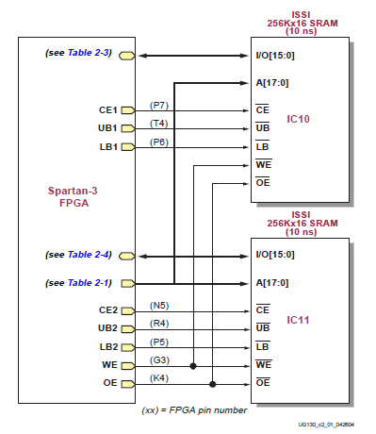
S3 FPGA Memory
S3 board has a megabyte of fast asynchronous SRAM, surface mounted.
It has two 256K*16 SRAM devices.
Both devices shares common write-enable, output-enable and address signals.
But each has a separate chip select.

Slide 23
Role of Memory Controller
The S3 board has two 256k-by 16 synchronous SRAM devices, which total 1MB.
A memory controller has been constructed for these devices.
The timing characteristics of each RAM device are different, controller is applicable to only one particular device.
Memory controller is used as interface, between main system and SRAM.
The performance of memory controller is measured by number of memory access that can be completed I given time.

Slide 24
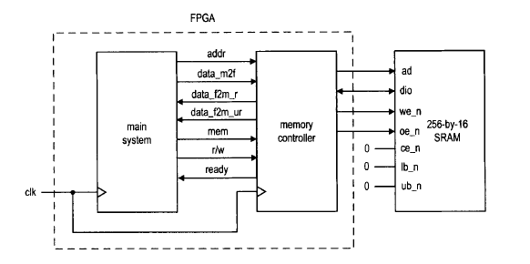
When the main system wants to access memory, it places address and data on the bus and activates the command.
At raising edge of clock, all signals are sampled by memory controller and desired operation is performed.

Slide 25
SRAM Read and Write Timing
Read cycle
  The we_n, write enable should be deactivated.
  Place the address on address bus and activate the oe_n signal.
  Wait for address access time (taa), as data from SRAM becomes available.
  Retrieve the data and deactivate the oe_n signal.

Slide 26
Write cycle
  Place the address on the bus and data on dio bus and activate the we_n signal.
  Wait for we_n pulse width and then deactivate we_n signal. The data is latched to SRAM at raising edge.
  Remove the data from bus.

Slide 27
Additional Considerations
Should be fast enough to feed the VGA controller whose pixel rate is 25MHz
Board clock is only 50MHz
SRAM has access latency of only 10ns.
Possible to come up with a FSM whose Read and write cycles are small but with a fast clock.

Slide 28
Digital Clock Manager from Xilinx
Use Xilinx DCM feature to increase clock frequency.
Board Clock 50MHz
Output : 200 MHZ

Slide 29
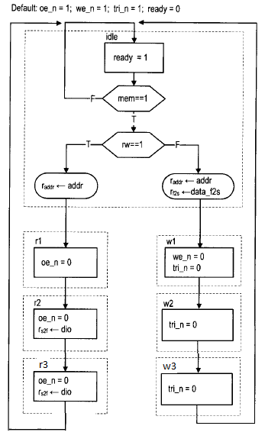
Memory Controller FSM : @200MHZ
The FSM consist of Idle stat
Read and write.
Back to Back read operations will take 20 ns to complete.
Same timing constraints for write.
Each block i.e. Idle, read 1, read 2, read 3 requires 5 ns, so the total time is 20ns.

Slide 30
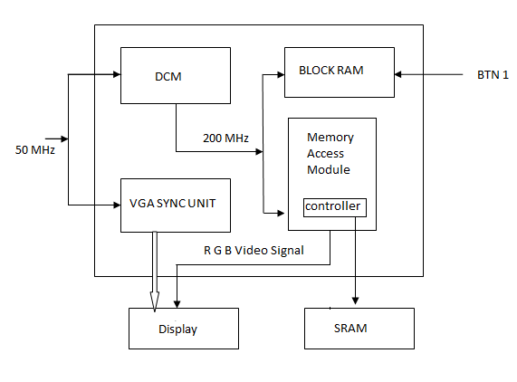
Complete Display System Design

Slide 31
Sequence of Events
Image is initialized in the Block RAM
Wait for user input : BTN Press.
On BTN press – Image is transferred from BRAM to SRAM
Simultaneously Image gets displayed on the screen
FSM is designed to sequence theses events

Slide 32
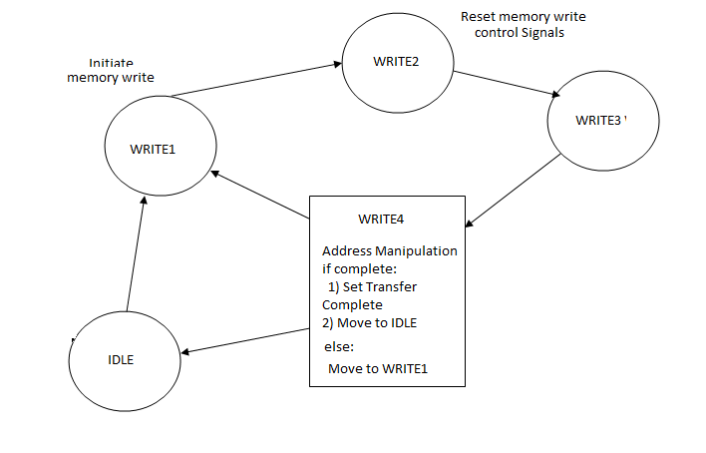
Transferring Image from BRAM to SRAM
Runs @ 200MHz
Button Press

Slide 33
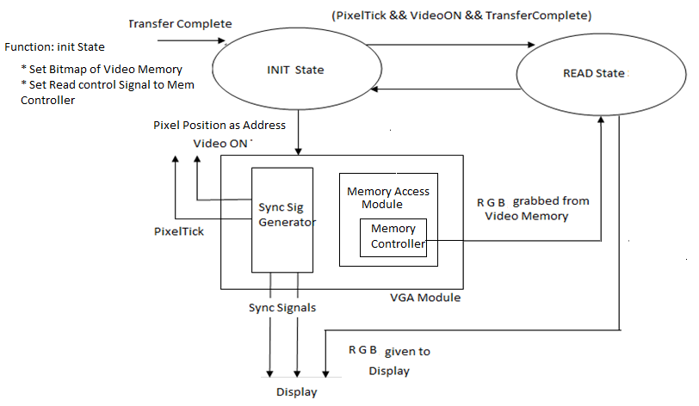
Display from SRAM

Slide 34
Demo
VGA DISPLAY FROM SRAM

Slide 35
Future Work
Camera Interfacing:
Synthesize Blob Detection Algorithm
Design a Memory Scheduler to synchronize events
Implement Object Tracking

Slide 36
Conclusion
Learning Experience
Synthesizable Verilog Programming for FPGA
    Use Xilinx inbuilt features such as DCM, Block RAM
    Building a SRAM Memory controller
    How multiple FSMs work together.
    Concept of VGA displays.
Image Processing Fundamentals Review

Slide 37
Thank You

